Slide 1


Facts on link analysis that all should know
But noone really published
András Benczúr
Computer and Automation Research Institute
Hungarian Academy of Sciences
(MTA SZTAKI)
Supported by EC FET Open project NADINE
Notes:
1

Slide 2
Questions – an overview
Why is the PageRank eigengap the same as the damping factor?
In what sense does PageRank express centrality?
What are the second, third orthogonal hub and authority rankings in HITS?
Why does HITS prefer dense subgraphs and what is its consequence in the spectrum?
And consequence in spectral graph partitioning?
Why is spectral partitioning considered hard in social networks?
Connect “Spectral and path-based tribes”
© Sebastiano

Slide 3
Plan
Answer these questions in 30 minutes
Show surprisingly simple mathematics
Give probably new insights
Toolkit for very efficient algorithms
Wonder why noone really published these …

Slide 4
Hyperlink analysis: Goals
Ranking, PageRank
… well that is obvious?
Features for network classification
Propagation, Markov Random Fields
Centrality
… PageRank why central?
Similarity of graph nodes

Slide 5

PageRank as Quality
A quality page is pointed to by several quality pages
  “hyperlink structure contains an enormous amount of latent human annotation that can be extremely valuable for automatically inferring notions of authority.” (Chakrabarti et. al. ’99)
  NB: not all links are useful, quality, …
  The Good, the Bad and the Ugly

Slide 6
PageRank as Quality
A quality page is pointed to by several quality pages
PR^{(k+1)} = PR^{(k)} M
PR^{(k+1)} = PR^{(k)} ( (1 - ε) M + ε · U )
= PR⁽¹⁾ ( (1 - ε) M + ε · U )^{k}
U could represent jump to any fixed (personalized) distribution
Brin, Page 98

Slide 7
Teleportation – less obvious reasons
Assume PageRank is δ > 0
fraction δ of time spent here
k „manipulative” nodes
δ
Walk will stuck here for
time proportional to δ 2^{k}
Exponential gain of the manipulator
Reference??

Slide 8
PageRank as a Big Data problem
Estimated 10+ billions of Web pages worldwide
PageRank (as floats)
  fits into 40GB storage
Personalization just to single pages:
  10 billions of PageRank scores for each page
  Storage exceeds several Exabytes!
NB single-page personalization is enough:

Slide 9
For certain things are just too big?
For light to reach the other side of the Galaxy … takes rather longer: five hundred thousand years.
The record for hitch hiking this distance is just under five years, but you don't get to see much on the way.
D Adams, The Hitchhiker's Guide to the Galaxy. 1979

Slide 10
Equivalence with short walks
Jeh, Widom ’03, Fogaras ’03
  Random walk starts from distribution (or page) u
  Follows random outlink with probability 1-ε, stops with ε
  PPR(u,v)=Pr{ the walk from u stops at page v }
PR⁽¹⁾ ( (1 - ε) M + ε · U )^{k} =
u Σ_{i = 0} ε(1 - ε)^{i} M^{i} + PR⁽¹⁾ (1 - ε) ^{k} M^{k}
k-1
paths of length i
Terminate with probability ε
Continue with probability (1 - ε)

Slide 11
Stop!
Appreciate the simplicity
Few lines completely elementary proof
Convergence follows w/o any theory
Convergence speed follows (eigengap)
Meaning: centrality through short walks
Solves algorithmics (to come)

Slide 12
Story on the Fogaras results
A WWW 2003 reject, containing the proof + reverse PR (CheiRank?)
The paper should be re-written so as to situate itself with respect to this literature. Good starting points for looking at related work would be
M.E. Frisse. Searching for information in a hypertext medical handbook. Communications of the ACM 31(7), 1988.
J. Boyan and D. Freitag and T. Joachims. A Machine Learning Architecture for Optimizing Web Search Engines. AAAI Workshop on Internet Based Information Systems, 1996.
Massimo Marchiori. The Quest for Correct Information on the Web: Hyper Search Engines. Proc. 7th International World Wide Web Conference, 1998
The paper of Boyan et al. has a "reverse PageRank" algorithm that is very close to what is present in this paper.
Also, a paper by Katz from the social networks literature L. Katz. A new status index derived from sociometric analysis. Psychometrika 18(1953). initiates a line of work concerned with counting paths under an exponential damping factor, as in Section 2.1.

Slide 13
Monte Carlo Personalized PageRank
Markov Chain Monte Carlo algorithm
Pre-computation
  From u simulate N independent random walks
  Database of fingerprints: ending vertices of the walks from all vertices
Query
  PPR(u,v) := # ( walks u→v ) / N
  N ≈ 1000 approximates top 100 well
Fingerprinting techniques
Fogaras-Racz: Towards Scaling Fully Personalized PageRank

Slide 14
Semi-Supervised Learning
Idea: Objects in a network are similar to neighbors
  Web: links between similar content; neighbors of spam are likely spam
  Telco: contacts of churned more likely to churn
  Friendship, trust
Implementations:
  Stacked graphical learning [Cohen, Kou 2007]
  Propagation [Zhou et al, NIPS 2003]

Slide 15
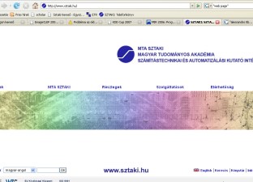
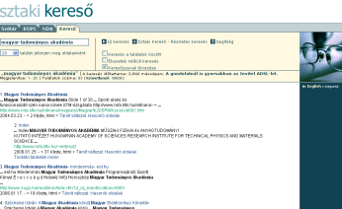
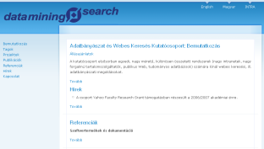
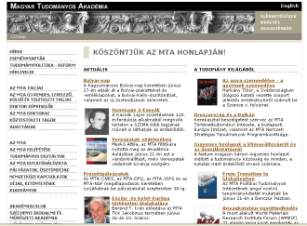
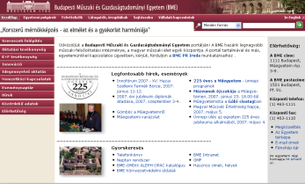
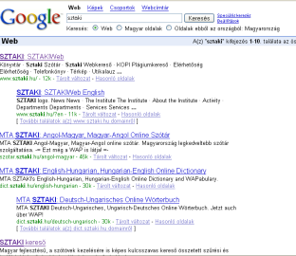
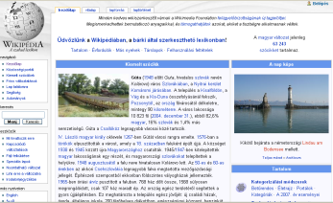

Random link with probability 1- ε
v
u

Slide 16
Personalized teleport with prob ε
v

Slide 17
SimRank: similarity in graphs
“Two pages are similar if pointed to by similar pages” [Jeh–Widom KDD 2002]:
N(v₂)
N(v₁)
Algorithmics:
path pair meeting time
u₁
u₂
Fogaras-Racz: Scaling link-based similarity search

Slide 18
Other uses
Google BadRank
TrustRank: personalized on quality seed [Gyongyi,Garcia-Molina 2005]
SpamRank: statistics of short incoming walks [B,Csalogany,Sarlos,Uher 2005]
Truncated PageRank versions, neighborhood features, ratios, host level statistics [Castillo et al, 2006]

Slide 19
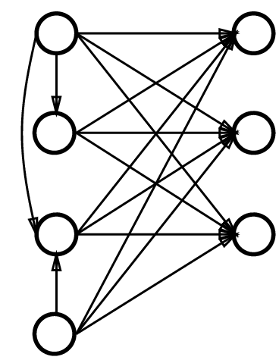
Hyperlink Induced Topic Search
www.lawa-project.eu
http://www.quantware.ups-tlse.fr/FETNADINE/
https://www.stratosphere.eu/
Authority
(content)
Hub (link collection)
Kleinberg 2008

Slide 20
HITS, SVD and matrices
a^{(k+1)} = h^{(k)} A
h^{(k+1)} = a^{(k+1)} A^{T}
a^{(k+1)} = a⁽¹⁾ (A^{T} A)^{k}
h^{(k+1)} = h⁽¹⁾ (A A^{T})^{k}
( )
k
w₁² 0 … 0
0 w₂² 0 … 0
…
0 … 0 w_{n}²
= a⁽¹⁾ U U^{T}
( )
k
w₁² 0 … 0
0 w₂² 0 … 0
…
0 … 0 w_{n}²
= h⁽¹⁾ V V^{T}

Slide 21
HITS and path concentration
Paths of length exactly 2 between i and j
Or maybe also less than 2 if A_{ii}>0
A^{k} = |{paths of length k between endpts}|
(AA^{T}) = |{alternating back-and-forth routes}|
(AA^{T})^{k} = |{alternating back-n-forth k times}|

Slide 22
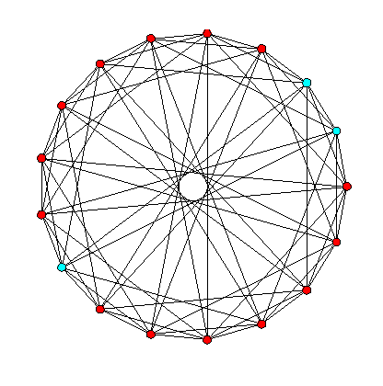
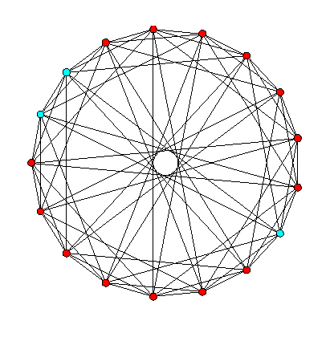
Guess 1st and 2nd singular directions!
HITS is instable, reverting the connecting edge completely changes the scores
Two singular values are very close

Slide 23
SVD and Ellipsoids
{y=Ax : ||x|| = 1}
ellipsoid with axes u_{i} of length w_{i}
Nodes projected based on neighbor vector
*
*
Second principal component
*
*
First principal component
*
*
*
*
*
*
*
*
*
Original axes
*
*
*
*
*
*
*
*
*
*
*
Data points

Slide 24
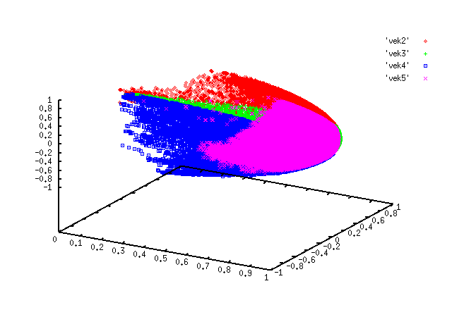
Projection of graph nodes by A
First three singular components of a social network
Clusters by K-Means
{x_{i}^{T}A : x_{i} are base vectors of nodes}
Two nodes are near if their A_{i.} vectors are close
Disappointing result if you partition a path (parts alternate)

Slide 25
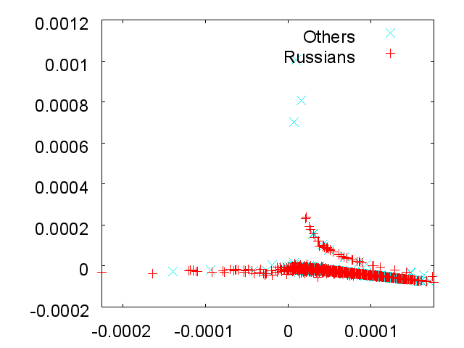
Hardness of spectral partitioning
Two typical singular directions
(well … Laplacian, normalization …)
LiveJournal blogger friendship network
Characteristic “Russian” user group
Goal to split this group and separate non-Russians (Ukraine, Estonia, …)

Slide 26
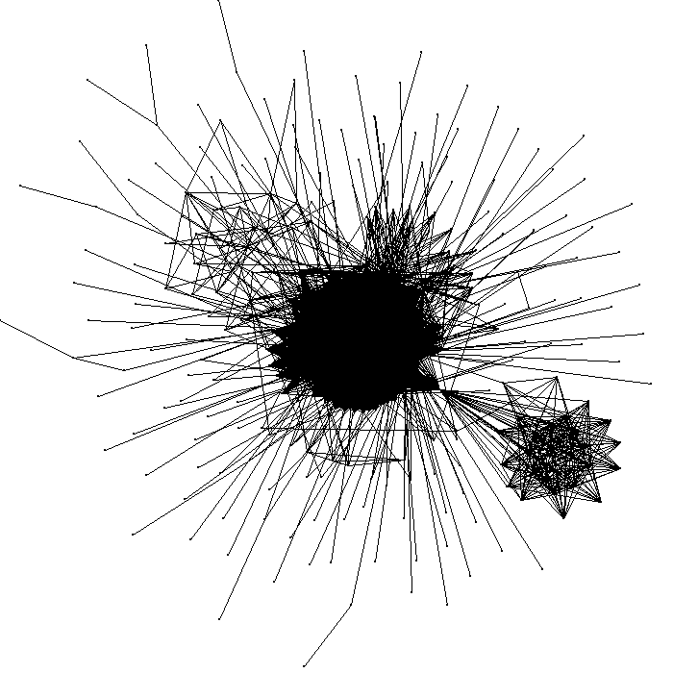
Hardness of spectral partitioning
Two typical singular directions
Most of the first many directions grab medium size dense parts

Slide 27
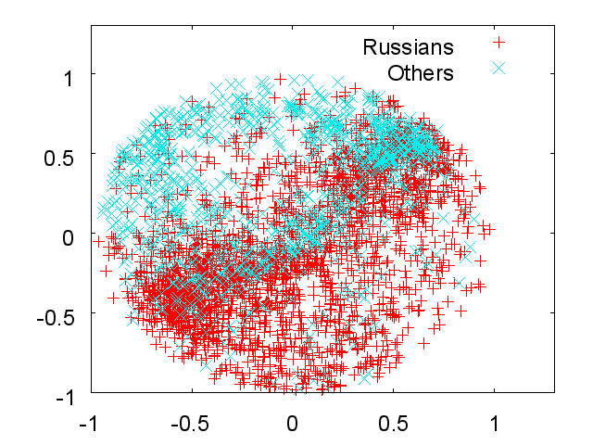
Hardness of spectral partitioning
Two typical singular directions
Computationally costly improvement : semidefinite relaxation [Lang 2005]

Slide 28
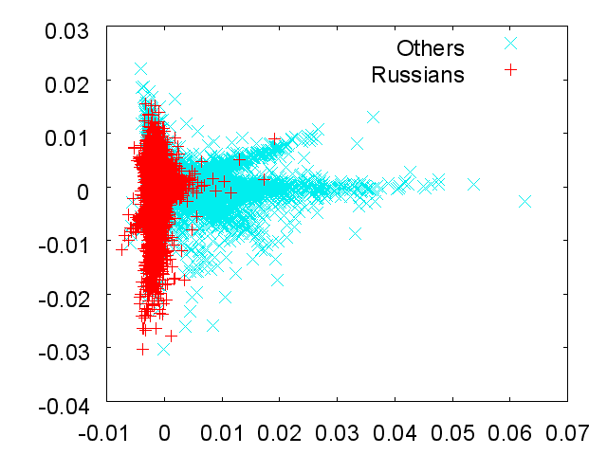
Hardness of spectral partitioning
After removal of dense cores
[Kurucz, B, AoIS 2010]

Slide 29
Summary: nice mathematical facts
PageRank teleportation for numerical stability
PageRank convergence mathematically very simple by short path equivalence
Short path equivalence explains centrality and yields Big Data approximation algorithms
HITS is just first singular directions
HITS concentrates at dense subgraphs
Spectral graph partitioning fails due to these dense subgraphs

Slide 30


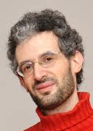

















Questions?
András Benczúr
Head,
Informatics Laboratory
and
“Big Data” lab
http://datamining.sztaki.hu/
MTA SZTAKI benczur@sztaki.hu

