Slide 1
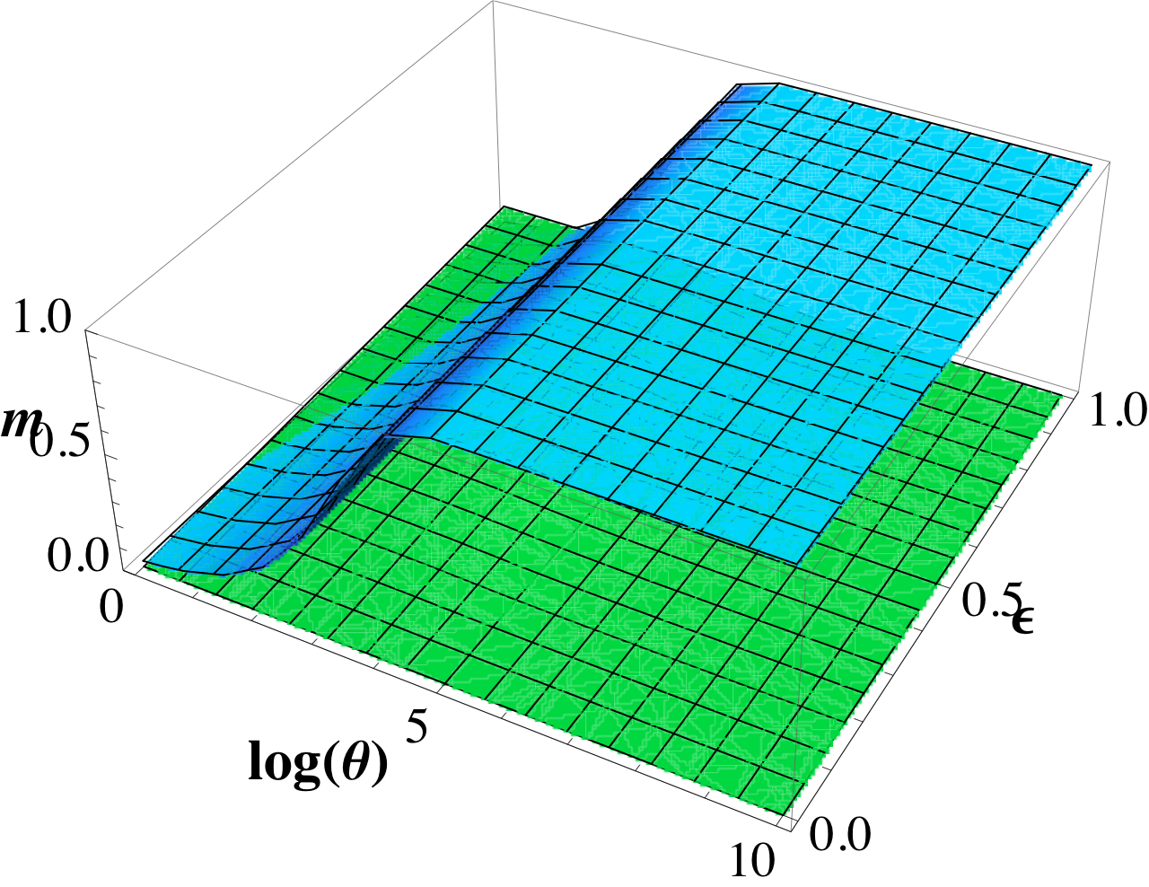
Spectral properties of complex networks and classical/quantum phase transitions
ETC Trento Workshop
Spectral properties of complex networks
Trento 23-29 July, 2012
Ginestra Bianconi
Department of Physics, Northeastern University, Boston

Slide 2
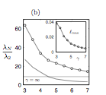
Complex topologies affect the behavior of critical phenomena
Scale-free degree distribution
change the critical behavior of the
Ising model, Percolation,
epidemic spreading on annealed networks
Spectral properties
change the synchronization properties,
epidemic spreading on quenched networks
γ
Nishikawa et al.PRL 2003

Slide 3
Outline of the talk
Generalization of the Ginsburg criterion for spatial complex networks (classical Ising model)
Random Transverse Ising model on annealed and quenched networks
The Bose-Hubbard model on annealed and quenched networks

Slide 4
How do critical phenomena on complex networks change if we include spatial interactions?

Slide 5
Annealed uncorrelated complex networks
In annealed uncorrelated complex networks, we assign to each node an expected degree θ
Each link is present with probability p_{ij}
The degree k_{i} a node i is a Poisson variable with mean θ_{i}
Boguna, Pastor-Satorras PRE 2003

Slide 6
Ising model in annealed complex networks
The Ising model on annealed complex networks has Hamiltonian given by
The critical temperature is given by
The magnetization is non-homogeneous
G. Bianconi 2002,S.N. Dorogovtsev et al. 2002,
Leone et al. 2002, Goltsev et al. 2003,Lee et al. 2009

Slide 7
Critical exponents of the Ising model on complex topologies
 | M | δC(T<T_{c}) | χ
γ>5 | |T_{c}-T|^{1/2} | Jump at T_{c} | |T_{c}-T|⁻¹
γ=5 | |T-T_{c}|^{1/2}/(|ln|T_{c}T||)^{1/2} | 1/ln|T_{c}-T| | |T_{c}-T|⁻¹
3<γ<5 | |T_{c}-T|^{1/(γ−1)} | |T_{c}-T|^{(5−γ)/(γ−3)} | |T_{c}-T|⁻¹
γ=3 | e^{-2T/<θ>} | T²e^{-4T/<θ>} | T⁻¹
2<γ<3 | T^{−1/(3−γ)} | T^{−(γ−1)/(3−γ)} | T⁻¹
Goltsev et al. 2003
But the critical fluctuations still remain mean-field !

Slide 8
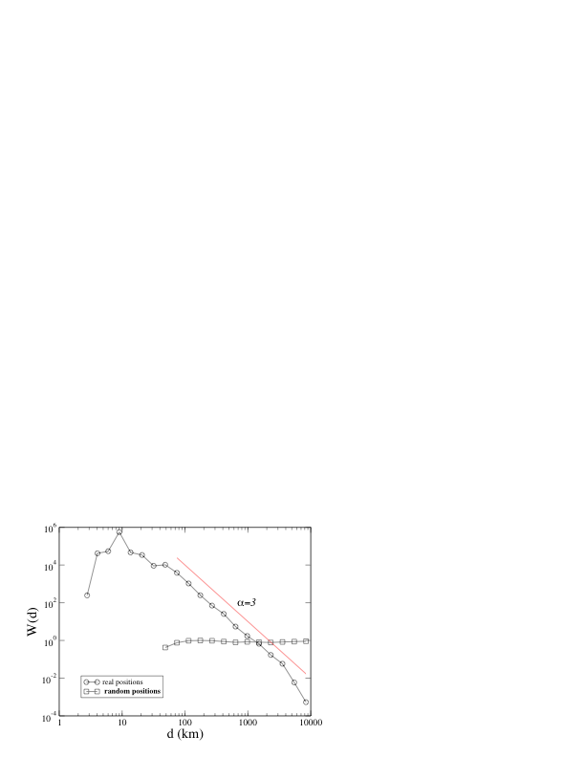
Ensembles of spatial complex networks
The maximally entropic network with
spatial structure has link probability
given by
J(d)
The function J(d) can be measured in real spatial networks
Airport Network
Bianconi et al. PNAS 2009

Slide 9
Annealead Ising model in spatial complex networks
The linking probability of spatial complex networks is chosen to be
The Ising model on spatial annealed complex networks has Hamiltonian given by
We want to study the critical fluctuations in this model as a function of the typical range of the interactions

Slide 10
Stability of the mean-field approximation
The partition function is given by
The magnetization in the mean field approximation is given by
The susceptibility is then evaluated by stationary phase approximation

Slide 11
Stationary phase approximation
The free energy is given in the stationary phase approximation by
The inverse susceptibility matrix is given by

Slide 12
Results of the stationary phase approximation
We project the results into the base of eigenvalues λ and eigenvectors u^{λ} of the matrix p_{ij}.
The critical temperature T_{c} is given by
where Λ is the maximal eigenvalue of the matrix p_{ij} and
The inverse susceptibility is given by

Slide 13
Critical fluctuations
We assume that the spectrum is given by
Δ is the spectral gap and λ_{c} the spectral edge.
Anomalous critical fluctuations sets in only if the gap vanish in the thermodynamic limit, and δ_{S}<1
For regular lattice δ_{S} =(d-2)/2 δ_{S}<1 only if d<4
The effective dimension of complex networks is d_{eff} =2δ_{S} +2
ρ(λ)
λ_{c}
Λ
λ

Slide 14
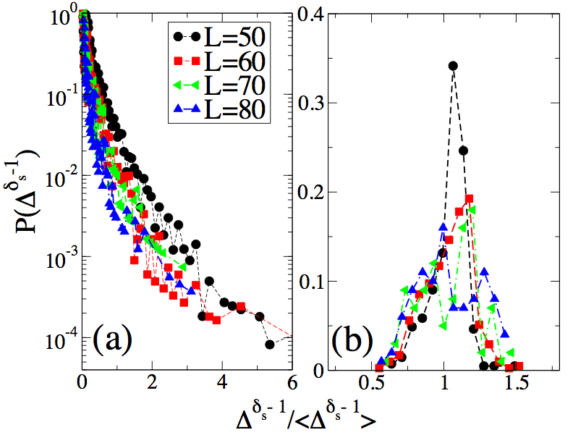
Distribution of the spectral gap Δ
For networks with
the spectral gap Δ is non-self-averaging but its distribution is stable.
γ_{SF}=4,d₀=1 γ_{SF}=6 d₀=1

Slide 15
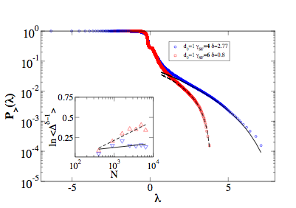
Criteria for onset anomalous critical fluctuations
In order to predict anomalous critical fluctuations we introduce the quantity
If
and anomalous
fluctuations sets in.
S. Bradde F. Caccioli L. Dall’Asta G. Bianconi PRL 2010

Slide 16
Random Transverse Ising model
This Hamiltonian mimics the
Superconductor-Insulator phase transition in a granular superconductor
(L. B. Ioffe, M. Mezard PRL 2010,
M. V. Feigel’man, L. B. Ioffe, and M. Mézard PRE 2010)
To mimic the randomness of the onsite noise
we draw ε_{i} from a ρ(ε) distribution.
The superconducting phase transition would correspond
with the phase with spontaneous magnetization
in the z direction.

Slide 17
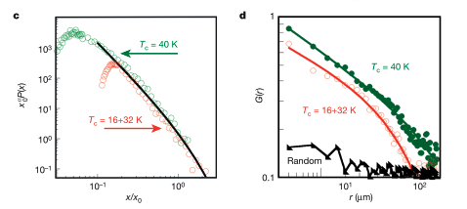
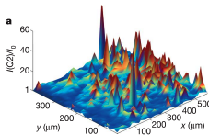
Scale-free structural organization of oxygen interstitials in La₂CuO_{4+ y}
16K
T_{c}=16K
Fratini et al. Nature 2010

Slide 18
RTIM on an Annealed complex network
In the annealed network
model we can substitute
in the Hamiltonian
The order parameter is
The magnetization depends on the expected degree θ
G. Bianconi, PRE 2012

Slide 19
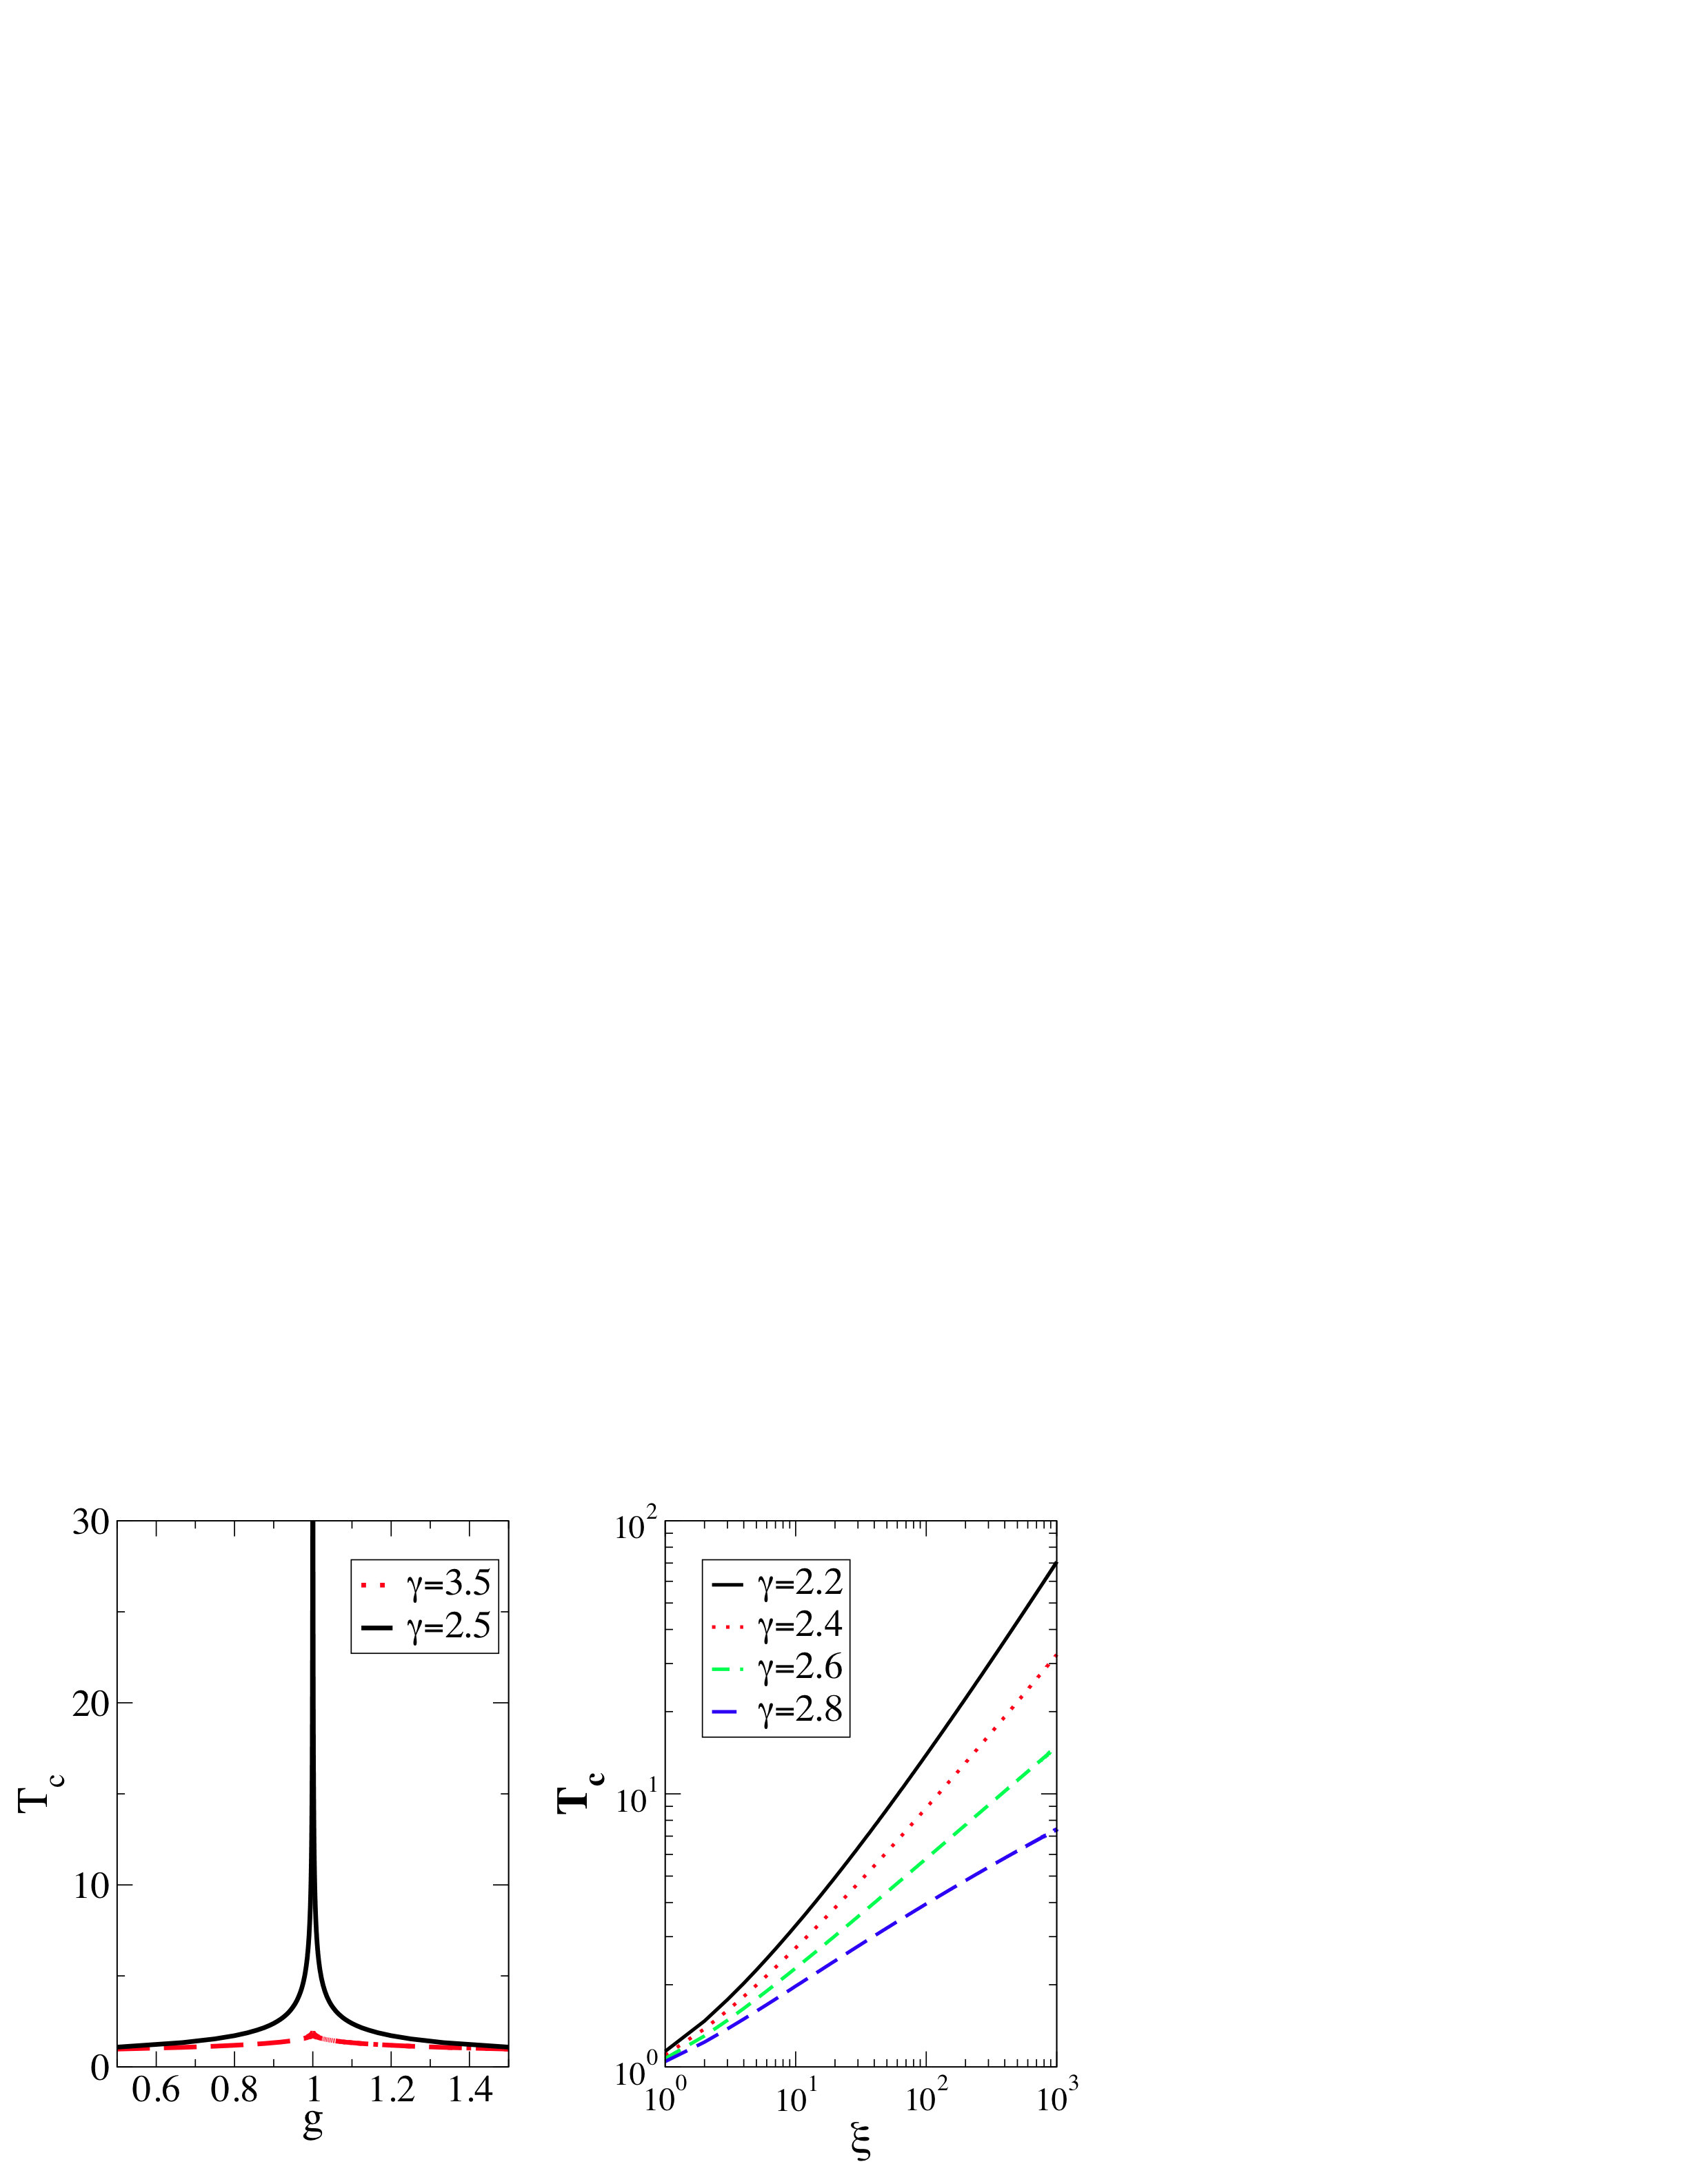
The critical temperature
Equation for T_{c}
Complex network topology
Scaling of T_{c}
G. Bianconi, PRE 2012

Slide 20
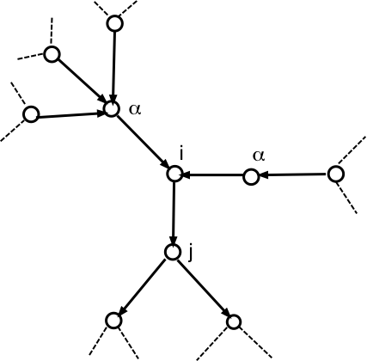
Solution of the RTIM on quenched network

Slide 21
On the critical line if we apply an infinitesimal field at the periphery of the network, the cavity field at a given site is given by

Slide 22
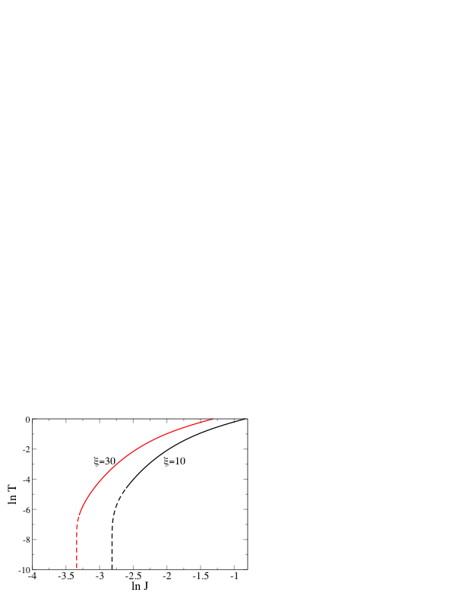
Dependence of the phase diagram from the cutoff of the degree distribution
For a random scale-free network
In general there is a phase transition at zero temperature.
Nevertheless
for λ<3 the critical coupling J_{c}(T=0) decreases as the cutoff ξ increases.
The system at low temperature
is in a Griffith Phase described by a replica-symmetry broken
Phase in the mapping to the random polymer problem

Slide 23
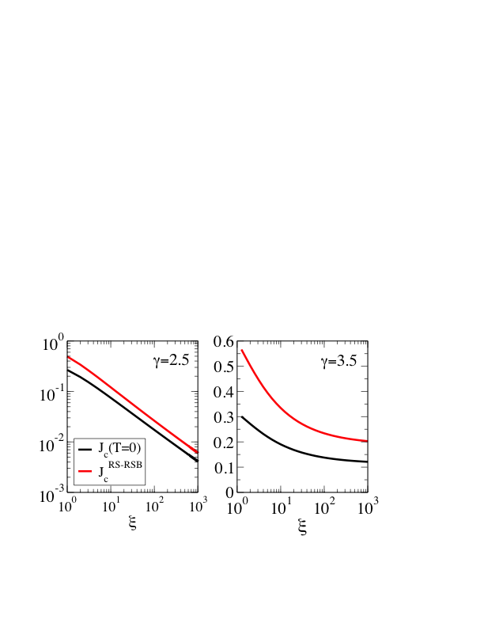
The replica-symmetry broken phase decreases in size with increasing values of the cutoff for power-law exponent γ less or equal to 3
G. Bianconi JSTAT 2012

Slide 24
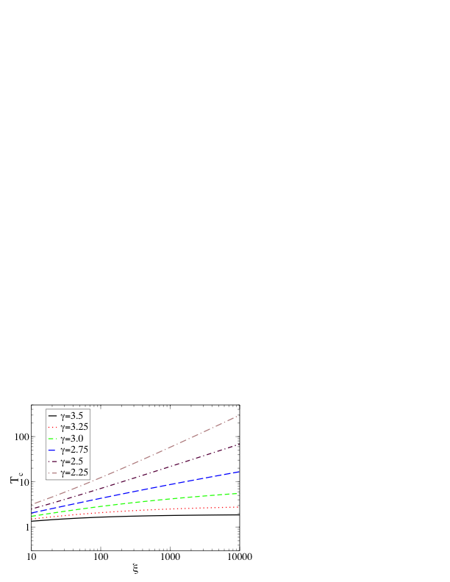
Enhancement of Tc with the increasing value of the exponential cutoff
The critical temperature for λ less or equal to 3
Increases with increasing exponential cutoff
of the degree distribution

Slide 25
Bose-Hubbard model on complex networks
U on site repulsion of the Bosons,
μ chemical potential
t coefficient of hopping
τ_{ij} adjacency matrix of the network

Slide 26
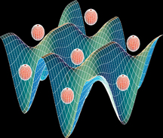
Optical lattices
Optical lattice are nowadays use to localize cold atoms
That can hop between sites by quantum tunelling.
These optical lattices have been use to test the behavior of quantum models such as the Bose-Hubbard model which was first realized with cold atoms by Greiner et al. in 2002.
The possible realization of more complex network topologies to localize cold atoms remains an open problem. Here we want to show the consequences on the phase diagram of quantum phase transition defined on complex networks.

Slide 27
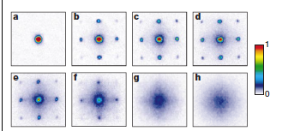
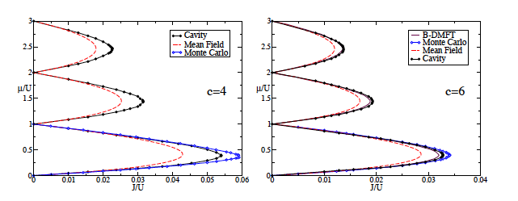
Bose-Hubbard model: a challenge
Experimental evidence
Absorption images of multiple matter wave interface pattern as a function of the depth of the potential of the optical lattice
Greiner,Mandel,Esslinger, Hansh, Bloch Nature 2002
Theoretical approaches
The solution of the Bose-Hubbard
model even on a Bethe lattice
Represent a challenge, available techniques are mean-field, dynamical mean-field model, quantum cavity model
Semerjian, Tarzia, Zamponi PRE 2009

Slide 28
Mean field approximation with on annealed network

Slide 29
Mean-field Hamiltonian and order parameter on a annealed network
Order parameter of the
phase transition

Slide 30
Perturbative solution of the effective single site Hamiltonian

Slide 31
Mean-field solution of the B-H model on annealed complex network
The critical line is determined by the line in which the
mass term goes to zero m (t_{c},U,μ)=0
There is no Mott-Insulator phase as long as the second
Moment of the expected degree distribution diverges

Slide 32
Mean-field solution on quenched network
Critical lines and phase diagram

Slide 33
Maximal Eigenvalue of the adjacency matrix on networks
Random networks
Apollonian networks

Slide 34
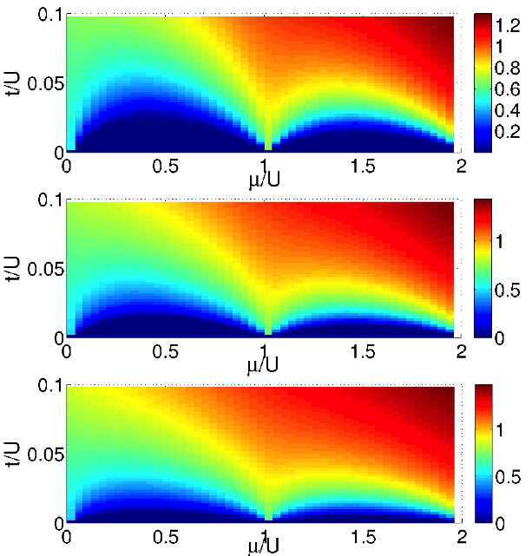
Mean-field phase diagram of random scale-free network
λ=2.2
N=100
N=1,000
N=10,000
Halu, Ferretti, Vezzani, Bianconi EPL 2012

Slide 35
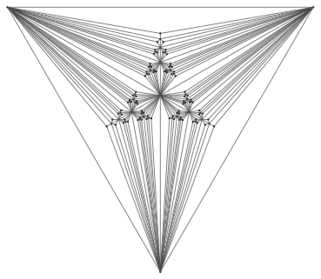
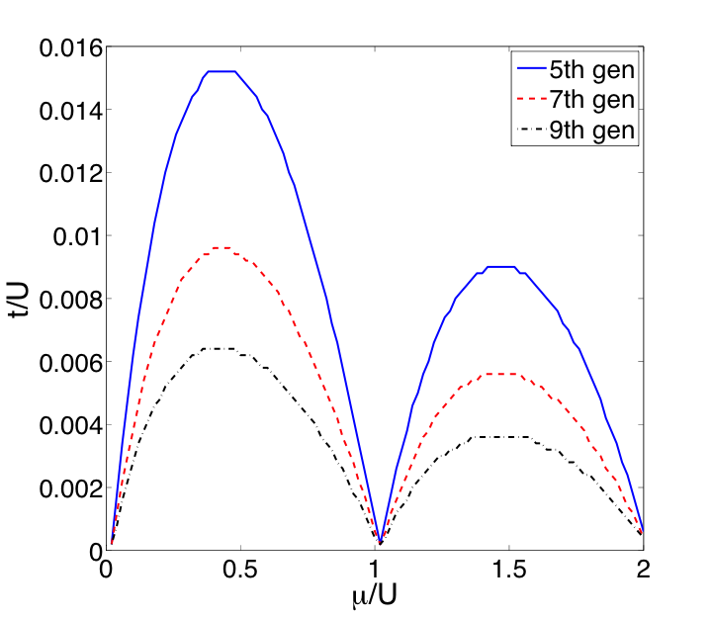
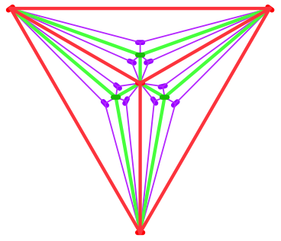
Bose-Hubbard model on Apollonian network
The effective Mott-Insulator phase decreases
with network size and disappear in the
thermodynamic limit

Slide 36
References
S. Bradde, F. Caccioli, L. Dall’Asta and G. Bianconi
Critical fluctuations in spatial networks
Phys. Rev. Lett. 104, 218701 (2010).
A. Halu, L. Ferretti, A. Vezzani G. Bianconi
Phase diagram of the Bose-Hubbard Model on Complex Networks
EPL 99 1 18001 (2012)
G. Bianconi Supercondutor-Insulator Transition on Annealed Complex Networks Phys. Rev. E 85, 061113 (2012).
G. Bianconi Enhancement of Tc in the Superconductor-Insulator Phase Transition on Scale-Free Networks JSTAT 2012 (in press) arXiv:1204.6282

Slide 37
Conclusions
Critical phase transitions when defined on complex networks display new phase diagrams
The spectral properties and the degree distribution play a crucial role in determining the phase diagram of critical phenomena in networks
We can generalize the Ginsburg criterion to complex networks
The Random Transverse Ising Model (RTIM) on scale-free networks with exponential cutoff has a critical temperature that depends on the cutoff if the power-law exponent γ<3.
The Bose-Hubbard model on quenched network has a phase diagram that depend on the spectral properties of the network
This open new perspective in studying the interplay between spectral properties and classical/ quantum phase transition in networks

Slide 38
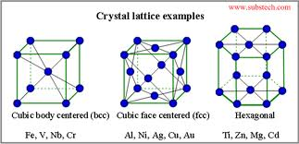
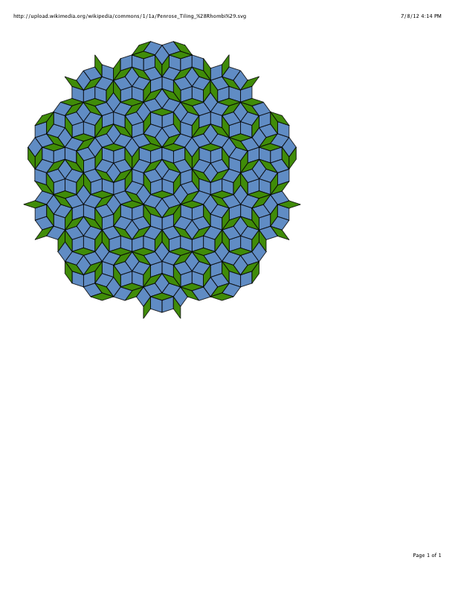
Lattices and quasicrystal
A lattice is a regular pattern of points and links repeating periodically in finite dimensions

Slide 40
Scale-free networks
with
with
with

Slide 41
Conclusions
Critical phase transitions when defined on complex networks display new phase diagrams
The Random Transverse Ising Model (RTIM) on scale-free networks with exponential cutoff has a critical temperature that depends on the cutoff if the power-law exponent λ<3.
We have characterized the Bose-Hubbard model on annealed and quenched networks by the mean-field model
This open new perspective in studying other quantum phase transitions such as rotor models, quantum spin-glass models on complex networks
Experimental implementation of potentials describing complex networks could open new scenario for the realization of cold atoms multi-body states with new phase diagrams

