Slide 1

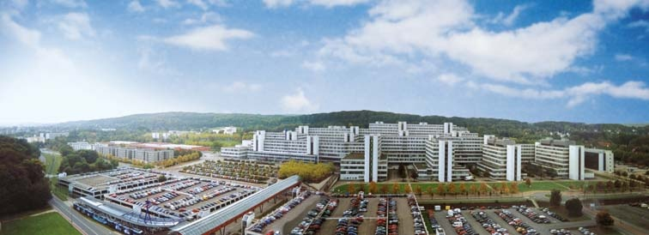
Mathematical Analysis of Complex Networks and Databases
Philippe Blanchard
Dima Volchenkov

Slide 2


What is a network/database?
A network is any method of sharing information between systems consisting of many individual units, a measurable pattern of relationships among entities in a social, ecological, linguistic, musical, financial, etc. space
We suggest that these relationships can be expressed by large but finite matrices (often: with positive entries, symmetric)

Slide 3
Discovering the important nodes and quantifying differences between them in a graph is not easy, since the graph does not possess a metric space structure.
No metric space
structure!

Slide 4

Συμμετρεῖν - to measure together
G→A (adjacency matrix of the graph)
Symmetry w.r.t. permutations (rearrangments) of objects

Slide 5

Συμμετρεῖν - to measure together
G→A (adjacency matrix of the graph)
↓
Π: [Π,A]=0, Automorphisms
A permutation matrix
Symmetry w.r.t. permutations (rearrangments) of objects

Slide 6

Συμμετρεῖν - to measure together
G→A (adjacency matrix of the graph)
↓
Π: [Π,A]=0, Π =1, only trivial
automorphisms

Slide 7
Συμμετρεῖν - to measure together
G→A (adjacency matrix of the graph)
↓
Π: [Π,A]=0, Π =1, only trivial
automorphisms
A permutation matrix is a stochastic matrix.
We can extend the notion of automorphisms on the class of stochastic matrices.
↓
T: [T, A]=0, Fractional automorphisms,
or stochastic automorphisms

Slide 8
Συμμετρεῖν - to measure together
G→A (adjacency matrix of the graph)
↓
Π: [Π,A]=0, Π =1, only trivial
automorphisms
A permutation matrix is a stochastic matrix.
We can extend the notion of automorphisms on the class of stochastic matrices.
↓
T: [T, A]=0, Fractional automorphisms,
or stochastic automorphisms

Slide 9
Συμμετρεῖν - to measure together
G→A (adjacency matrix of the graph)
↓
Π: [Π,A]=0, Π =1, only trivial
automorphisms
A permutation matrix is a stochastic matrix.
We can extend the notion of automorphisms on the class of stochastic matrices.
↓
T: [T, A]=0, Fractional automorphisms,
or stochastic automorphisms
Π
Π
Π
Π
We may remember the Birkhoff-von Neumann theorem asserting that every doubly stochastic matrix can be written as a convex combination of permutation matrices:
Compact graphs (trees, cycles)
Π
Π
Π

Slide 10
Συμμετρεῖν - to measure together
G→A (adjacency matrix of the graph)
↓
T: [T, A]=0 , Fractional automorphisms
Infinitely many fractional automorphisms:
Each T can be considered as a transition matrix of a Markov chain, a random walk defined on the graph/database.

Slide 11
Plan of the talk
Data/Graph probabilistic geometric manifolds;
Riemannian probabilistic geometry. The relations between the curvature of probabilistic geometric manifold and an intelligibility of the network/database;
The data dynamical model; data stability;

Slide 12
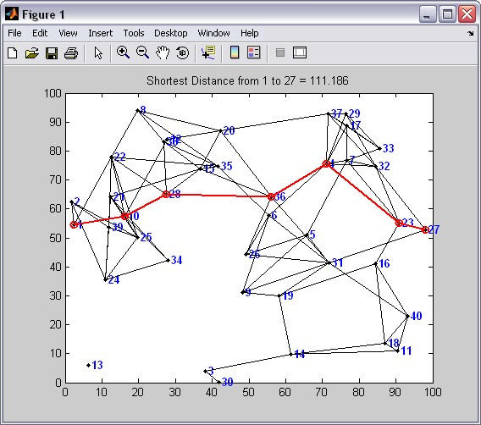
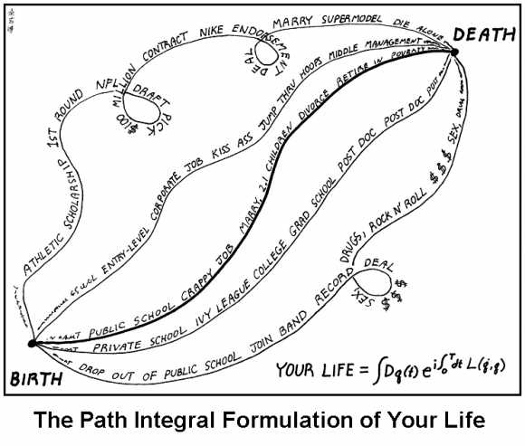
Distance related to fractional automorphisms
Fractional automorphisms establish an equivalence relation between the states (nodes) i ∼ j if an only if (T^{n})_{ij} > 0 for some n ≥ 0 and (T^{m})_{ij} > 0 for some m ≥ 0, and have all their states in one (communicating) equivalence class.
In classical graph theory:
Random Walks/ fractional automorphisms assign some probability to every possible path:
The shortest-path distance, insensitive to the structure of the graph:
The distance = “a Feynman path integral”
sensitive to the global structure of the graph.
The length of a walk

Slide 13
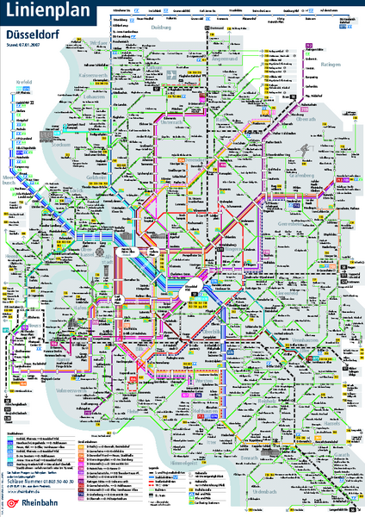
Random walks (fractional automorphisms) on the graph/database
β is the “laziness parameter”.
“Nearest neighbor random walks”
~ processes invariant w.r.t time-dilations
j
i
ℓ

Slide 14
Random walks (fractional automorphisms) on the graph/database
β is the “laziness parameter”.
“Nearest neighbor random walks”
~ processes invariant w.r.t time-dilations, time units
j
i
“Scale- dependent random walks”
ℓ

Slide 15
Random walks (fractional automorphisms) on the graph/database
β is the “laziness parameter”.
“Nearest neighbor random walks”
~ processes invariant w.r.t time-dilations, time units
j
i
“Scale- dependent random walks”
ℓ
All paths are equi-probable.
“Scale- invariant random walks (of maximal path-entropy)”

Slide 16
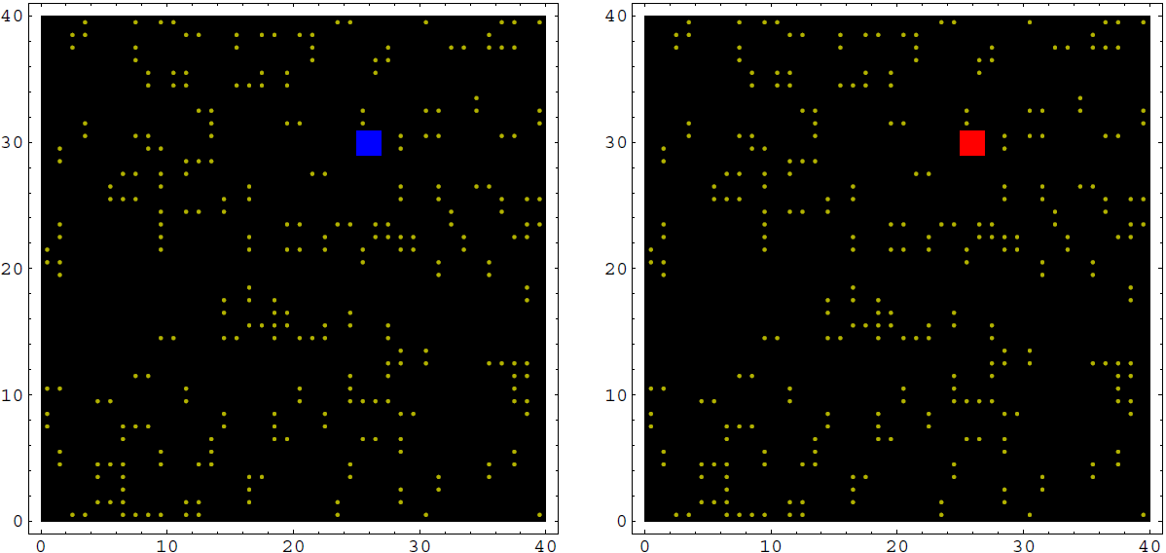

Slide 17
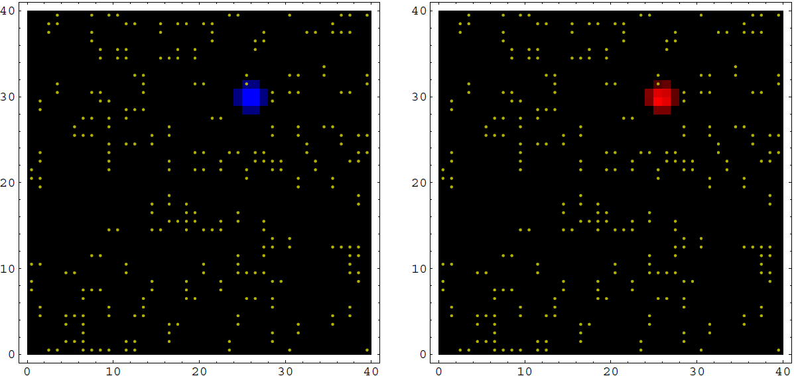

Slide 18
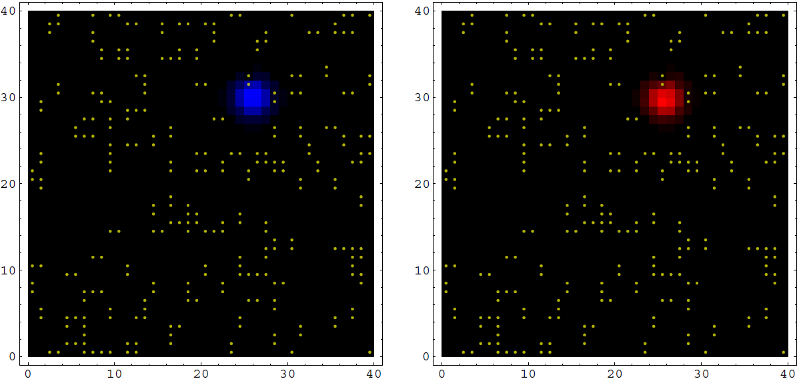

Slide 19
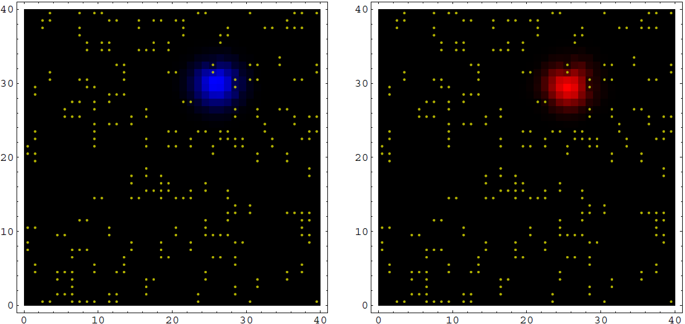

Slide 20
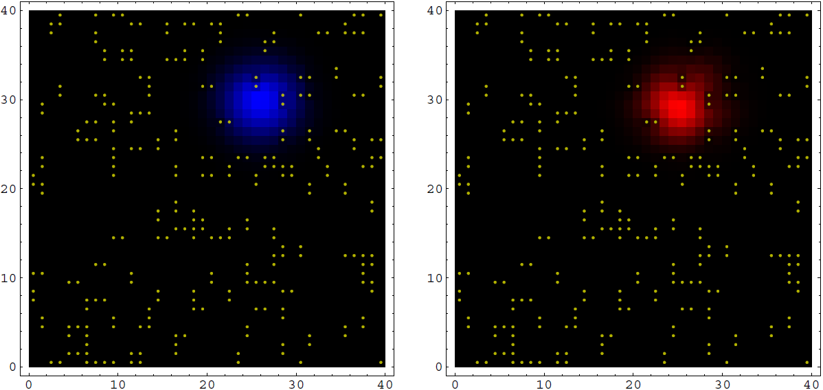

Slide 21
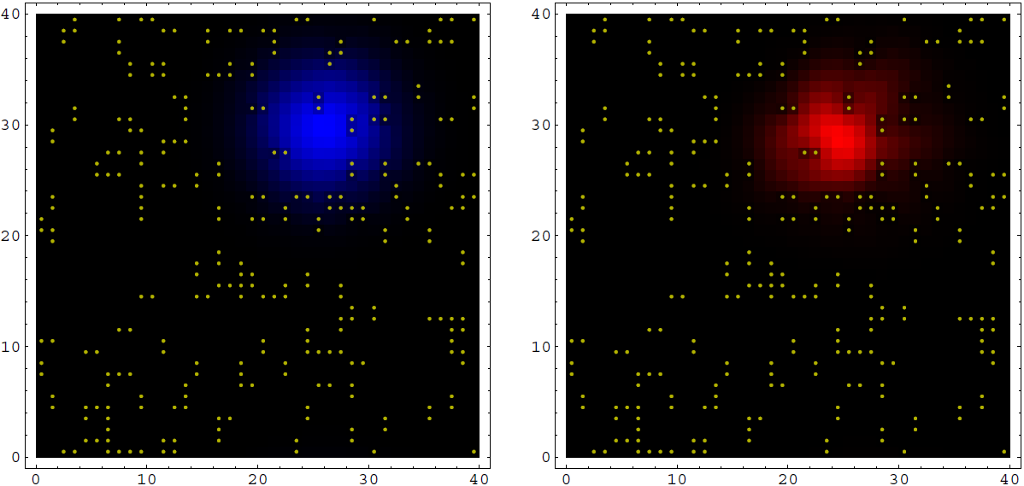

Slide 22
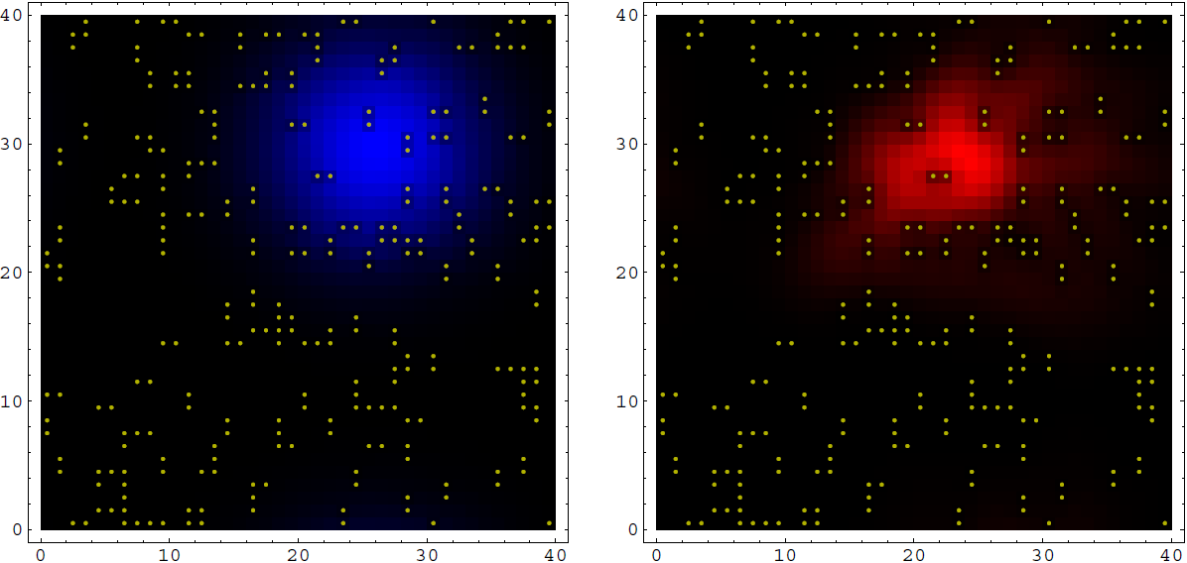

Slide 23
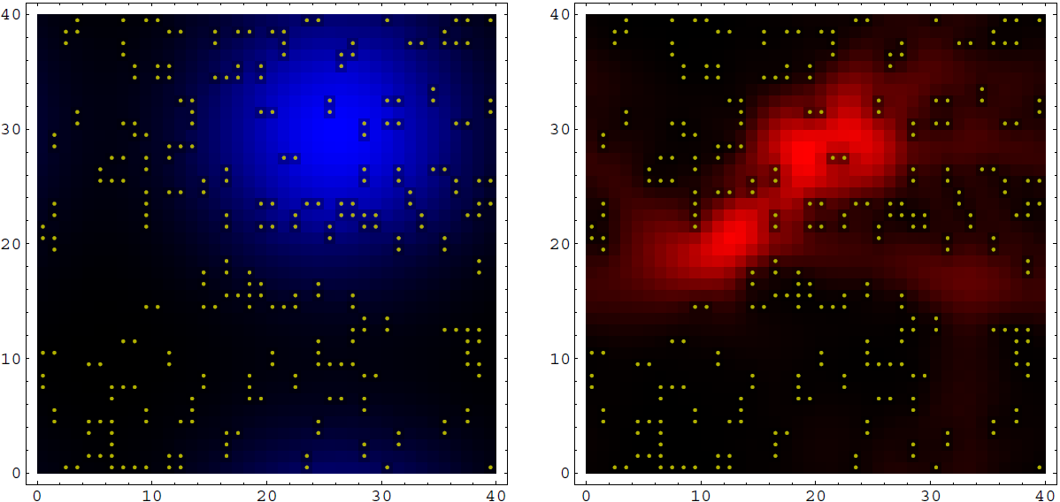

Slide 24
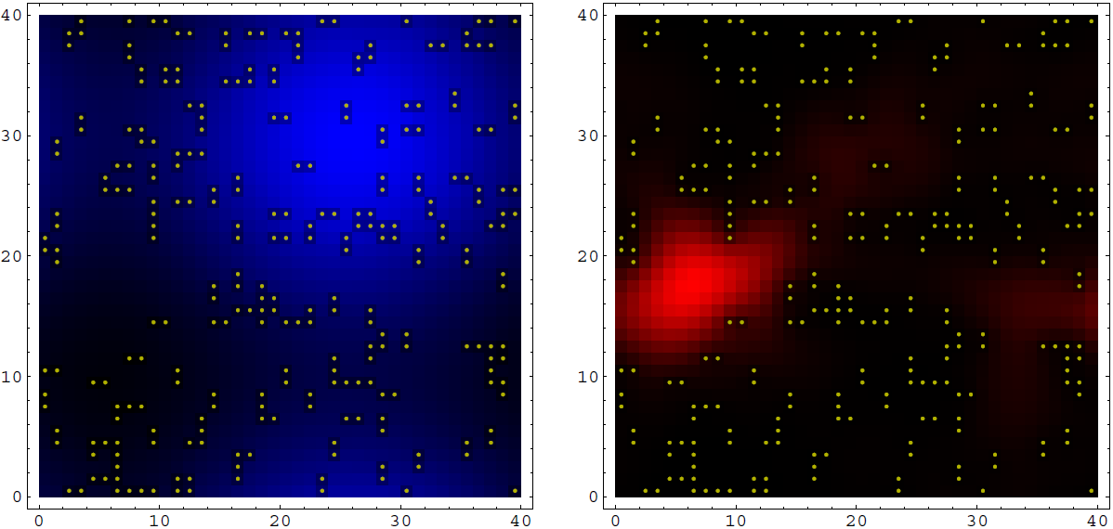

Slide 25
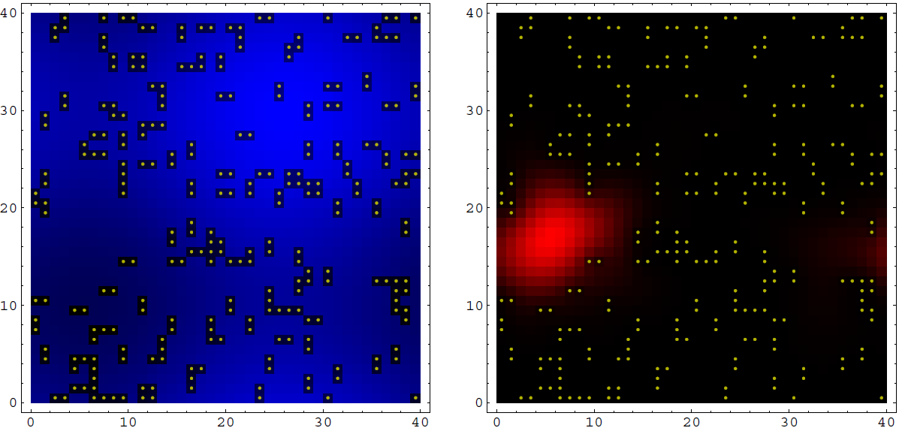

Slide 26
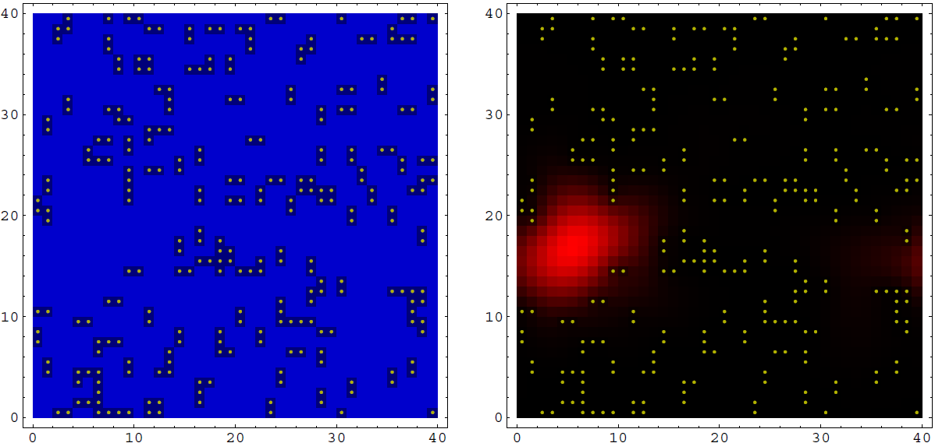

Slide 27
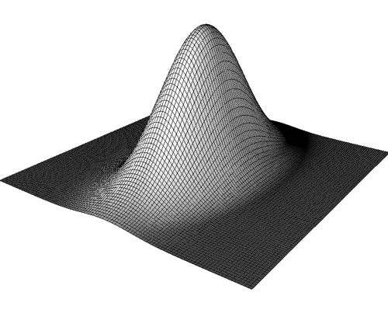
From symmetry to geometry
G→A → Π: [Π,A]=0, Automorphisms
↓
T: [T, A]=0 → , Green function
↓
(a generalized inverse)
Green functions serve roughly an analogous role in partial differential equations as do Fourier series in the solution of ordinary differential equations.
Green functions in general are distributions, not necessarily proper functions.
We can define a scalar product:
x
x'
Geometry

Slide 28

From symmetry to geometry
Green functions:
The problem is that
As being a member of a multiplicative group under the ordinary matrix multiplication, the Laplace operator
possesses a group inverse (a special case of Drazin inverse) with respect to this group, L♯, which satisfies the conditions:
[L, L♯] = [L ♯, A] =0

Slide 29
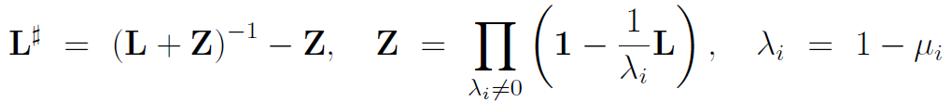
From symmetry to geometry
Green functions:
The problem is that
The most elegant way is by considering the eigenprojection of the matrix
L corresponding to the eigenvalue λ₁ = 1−μ₁ = 0
where the product in the idempotent matrix Z is taken over all nonzero eigenvalues of L.

Slide 30



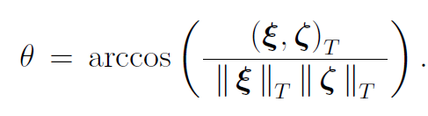
Probabilistic Euclidean metric structure
The inner product between any two vectors
The dot product is a symmetric real valued scalar function that allows us to define the (squared) norm of a vector

Slide 31


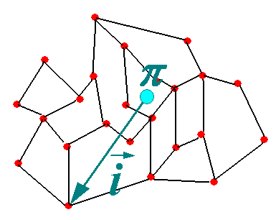
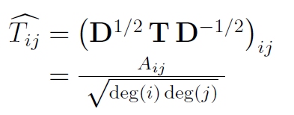

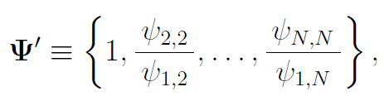
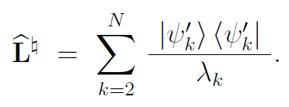
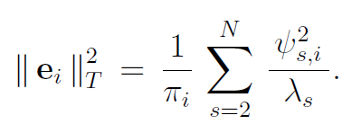
Spectral representations of the probabilistic Euclidean metric structure
The kernel of the generalized inverse operator
The spectral representation of the (mean) first passage time to the node i ∈ V , the expected number of steps required to reach the node i ∈ V for the first time starting from a node randomly chosen among all nodes of the graph accordingly to the stationary distribution π.

Slide 32
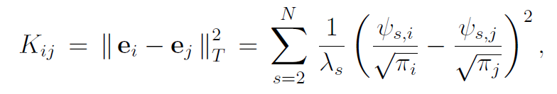
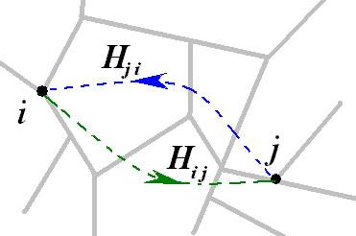

Spectral representations of the probabilistic Euclidean metric structure
The commute time, the expected number of steps required for a random walker starting at i ∈ V to visit j ∈ V and then to return back to i,
The first-hitting time is the expected number of steps a random walker starting from the node i needs to reach j for the first time
The matrix of first-hitting times is not symmetric, H_{ij} ≠ H_{ji}, even for a regular graph.

Slide 33



Electric resistance / Power grid networks
An electrical network is considered as an interconnection of resistors.
can be described by the Kirchhoff circuit law,
a
b

Slide 34

Electric resistance / Power grid networks
An electrical network is considered as an interconnection of resistors.
can be described by the Kirchhoff circuit law,
a
b
Given an electric current from a to b of amount 1 A, the effective resistance of a network is the potential difference between a and b,

Slide 35
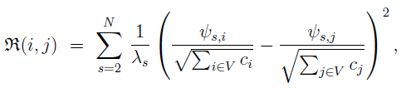


Electric resistance / Power grid networks
The effective resistance allows for the spectral representation:
b
The relation between the commute time of RW and the effective resistance:
a
The (mean) first passage time to a node is nothing else but its electric potential in the resistance network.

Slide 36
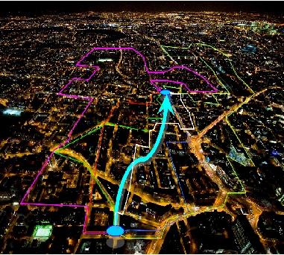
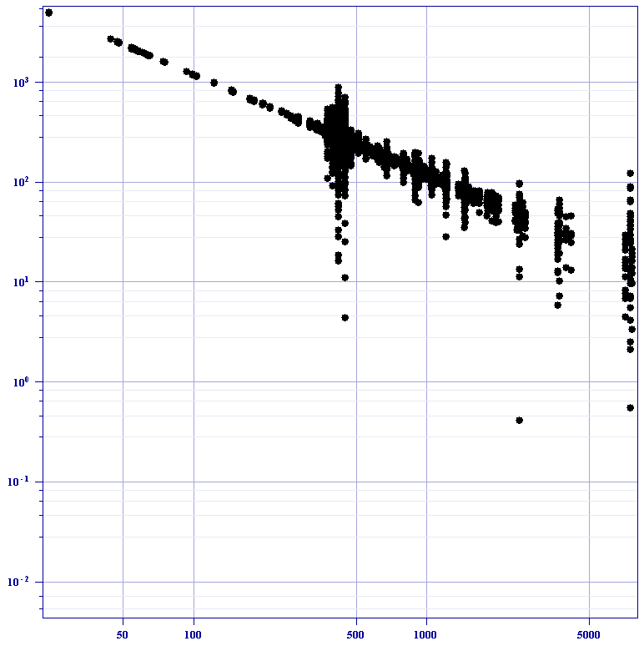
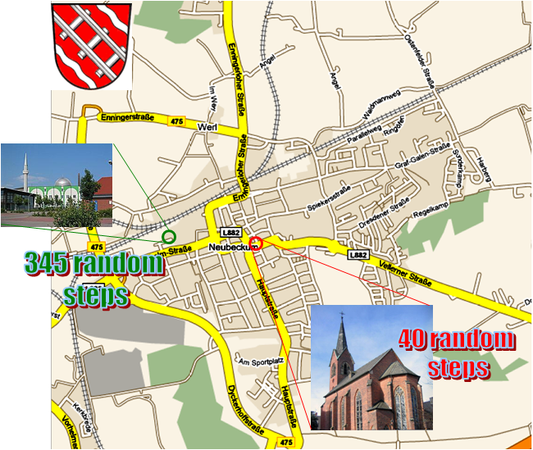

The (mean) first-passage time in cities
Cities are the biggest editors of our life: built environments constrain our visual space and determine our ability to move thorough by structuring movement space.
Some places in urban environments are easily accessible, others are not;
well accessible places are more favorable to public,
while isolated places are either abandoned, or misused.
In a long time perspective, inequality in accessibility results in disparity of land prices:
the more isolated a place is, the less its price would be.
In a lapse of time, structural isolation would cause social isolation, as a host society occupies the structural focus of urban environments, while the guest society would typically reside in outskirts, where the land price is relatively cheap.

Slide 37

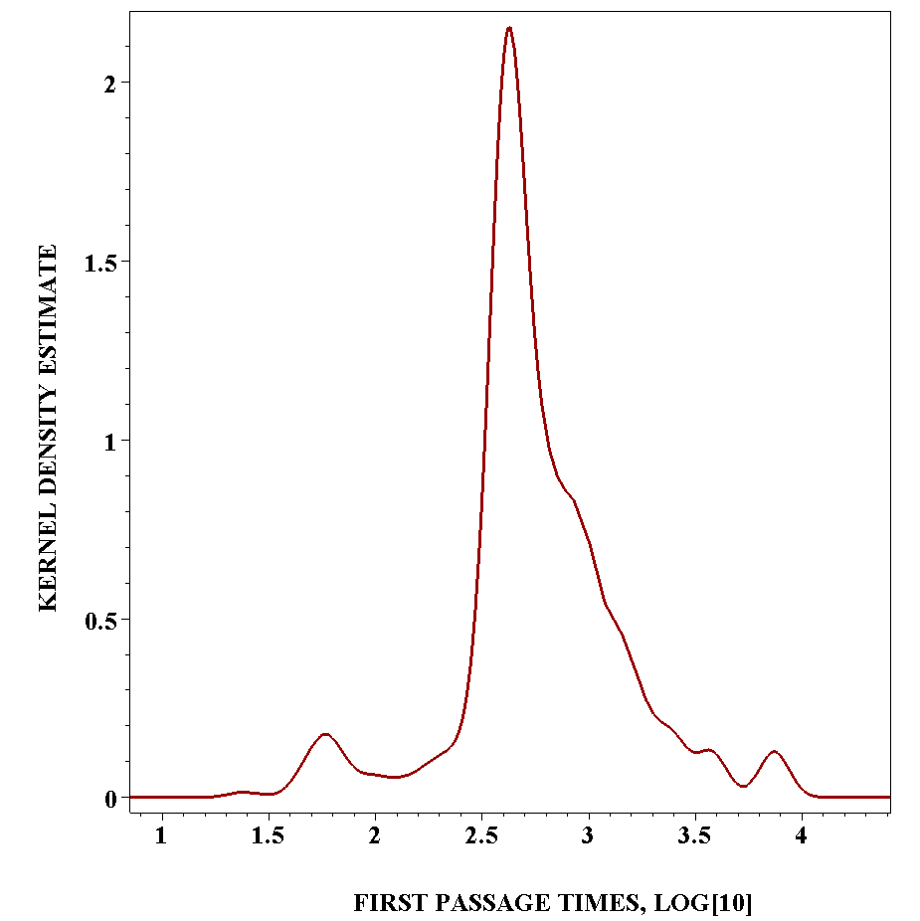



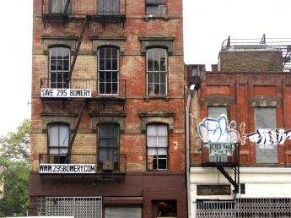

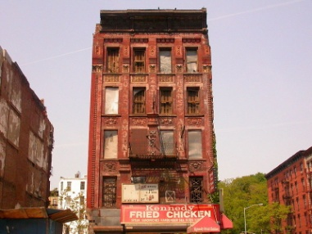
Around The City of Big Apple
SoHo
East Village
Times Square
Federal Hall
Bowery
CORE
East Harlem
Public
Decay
SLUM

Slide 38

Who makes the most money in Manhattan?
$300.000
$100.000
$60.000
$40.000
$20.000
The data on the mean household income per year provided by

Slide 39
Prison Expenditures in Manhattan districts per year (2003)
1.3 bell
1 bell
$50,000,000-
$2,500,000
0.4 bell
$2,500,000-
$250,000
$250,000-
$100,000
The data taken from the

Slide 40
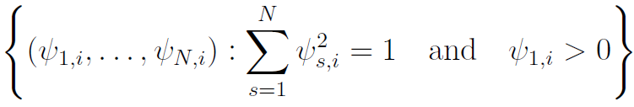
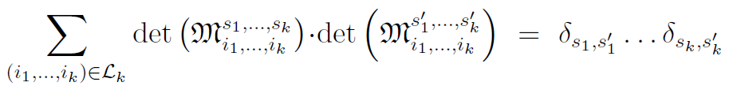

The determinants of minors of the k^{th} order of Ψ define an orthonormal basis in the

Slide 41


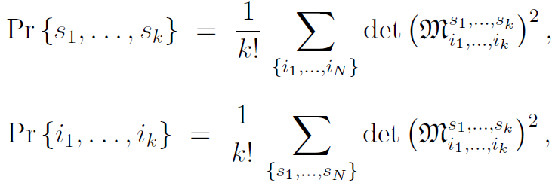
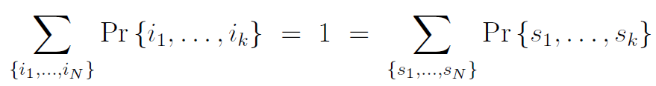
The squares of these determinants define the probability distributions over the ordered sets of k indexes:
satisfying the natural normalization condition,

Slide 42

The squares of these determinants define the probability distributions over the ordered sets of k indexes:
satisfying the natural normalization condition,
The simplest example of such a probability distribution is the stationary distribution of random walks over the graph nodes.

Slide 43
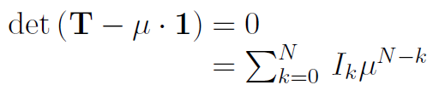
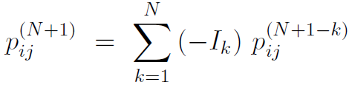
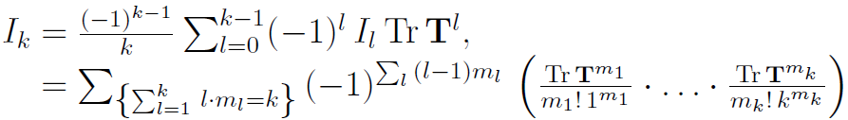
The recurrence probabilities as principal invariants
The Cayley – Hamilton theorem in linear algebra asserts that any N × N matrix is a solution of its associated characteristic polynomial.
where the roots μ are the eigenvalues of T, and {I_{k}}^{N}_{k=1} are its principal invariants, with I₀ = 1.
As the powers of T determines the probabilities of transitions, we obtain the following expression for the probability of transition from i to j in t = N + 1 steps as the sign alternating sum of the conditional probabilities:
where p_{ij}^{(N+1-k)} are the probabilities to reach j from i faster than in N + 1 steps,
and |I_{k}| are the k-steps recurrence probabilities quantifying the chance to return in k steps.
|I₁| = Tr T is the probability that a random walker stays at a node in one time step,
|I_{N}| = |det T| expresses the probability that the random walks revisit an initial node in N steps.

Slide 44

Probabilistic Riemannian geometry
Small changes to data in a database/weights of nodes would rise small changes to the probabilistic geometric representation of database/graph. We can think of them as of the smooth manifolds with a Riemannian metric.
We can determine a node/entry dependent basis of vector fields on the probabilistic manifold:
x
u_{i}
u_{j}
T_{x}M∈ R^{N-1}
π
… and then define the metric tensor at each node/entry (of the database) by
Standard calculus of differential geometry…

Slide 45
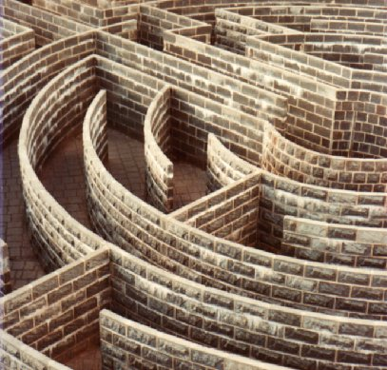
Probabilistic hypersurfaces of negative curvature
Traps: (Mean) First Passage Time > Recurrence Time
Mazes and labyrinths
It might be difficult to reach a place, but we return to the place quite often
provided we reached that.
“Confusing environments”

Slide 46
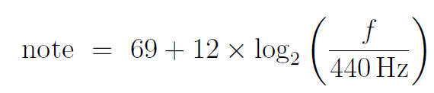
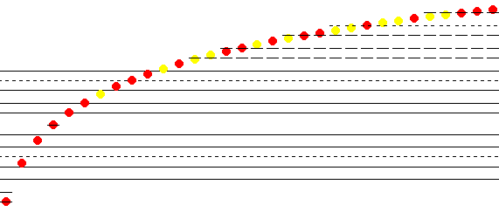
Probabilistic hypersurfaces of positive curvature
Landmarks: (Mean) First Passage Time < Recurrence Time
An example:
Music = the cyclic group over the discrete space of notes:
Z/12Z
Motivated by the logarithmic pitch perception in humans, music theorists represent pitches using a numerical scale based on the logarithm of fundamental frequency.
Landmarks establishes a wayguiding structure that facilitates understanding of the environment.
The resulting linear pitch space in which octaves have size 12, semitones have size 1, and the number 69 is assigned to the note "A4".
“Intelligible environments”

Slide 47
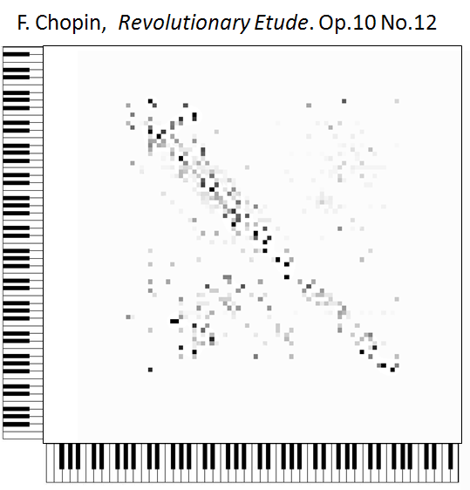
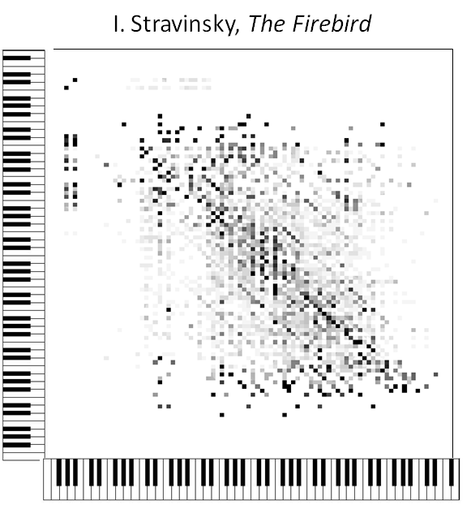
A discrete model of music (MIDI) as a simple
Markov chain
In a musical dice game, a piece is generated by patching notes X_{t} taking values from the set of pitches that sound good together into a temporal sequence.

Slide 48
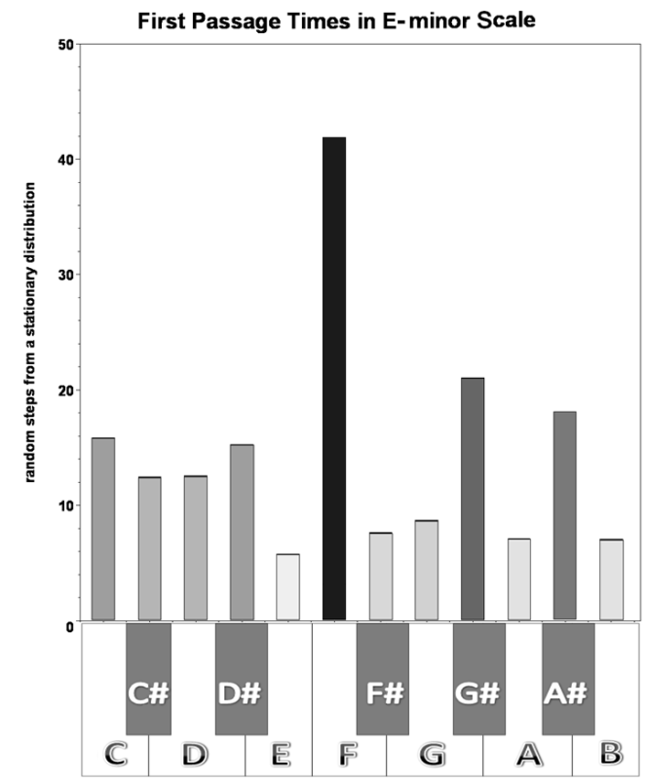
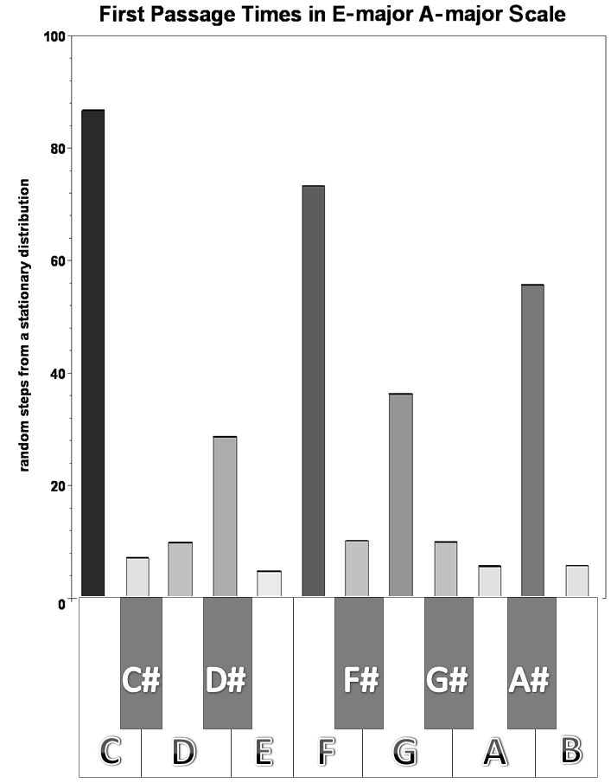
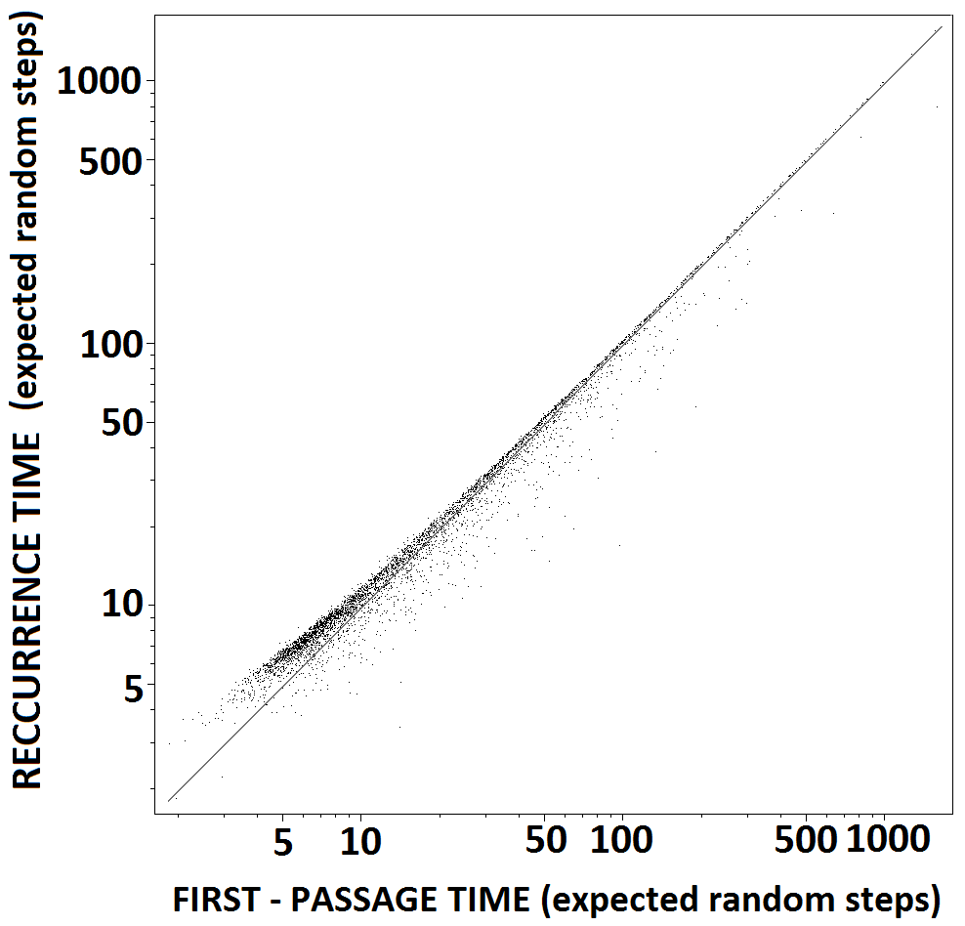
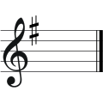
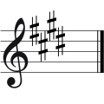
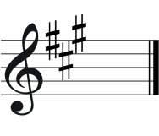

First passage times to notes resolve tonality
In music theory, the hierarchical pitch relationships are introduced based on a tonic key, a pitch which is the lowest degree of a scale and that all other notes in a musical composition gravitate toward. A successful tonal piece of music gives a listener a feeling that a particular (tonic) chord is the most stable and final.
Tonality structure
of music
The basic pitches for the E minor scale are "E", "F", "G", "A", "B", "C", and "D".
The E major scale is based on "E", "F", "G", "A", "B", "C", and "D".
The A major scale consists of "A", "B", "C", "D", "E", "F", and "G".
The recurrence time vs. the first passage time over 804 compositions of 29 Western composers.
Namely, every pitch in a musical piece is characterized with respect to the entire structure of the Markov chain by its level of accessibility estimated by the first passage time to it that is the expected length of the shortest path of a random walk toward the pitch from any other pitch randomly chosen over the musical score. The values of first passage times to notes are strictly ordered in accordance to their role in the tone scale of the musical composition.

