Slide 1

  MW-modulated Photoluminescence
  Imaging of 2DEG magnetoplasmons
  B.M. Ashkinadze
Physics Department, Technion-Israel Institute
of Technology, Haifa 32000, Israel

Slide 2

OUTLINE
Photoluminescence of MDQW and HJs containing a 2DEG
- different physical mechanisms
2D-electron cyclotron (magnetoplasma) resonance
- microwave absorption by a 2DEG
Mw-modulated Photoluminescence and Optically detected CR-resonance :
- hot 2DEG, phonon wind and “heating” of holes
2D-plasmon imaging
- spatially-distributed mw-field affecting the 2DEG

Slide 3
GaAs/AlGaAs modulation-doped heterostructures
GaAs E_{g}=1.519 eV
Al_{x}Ga_{1-x}As E_{g}=1.8 eV
(x=0.18-0.33)
Samples were grown by L. N. Pfeiffer and V. Umansky
Laser Light: hν =1.56 - 2.0 eV
α ⁻¹ > 10⁻⁴ cm ~ L
L <(1 -1.5) x10⁻⁴ cm
Very low excitation:
P_{Laser} < 50 μW ( I_{L}~ 30 mW/cm²)
δn ~ δp (<10⁷cm⁻²) << n_{2D}
d
GaAs layer width
Si δ- doping.
Intrinsic Photoluminescence:
spectrum - J(E_{m})
intensity - J
under mw irradiation
2D-electrons
(L~100-200Ǻ)
n _{2D} = (0.2-3)x10¹¹ cm⁻²
~ (1- 25)x10⁶ cm²/ Vs (at T_{L}< 2 K)
Heterojunction, HJ [ d > 500 Ǻ]
Quantum well (MDQW) [d~100-500 Ǻ]

Slide 4
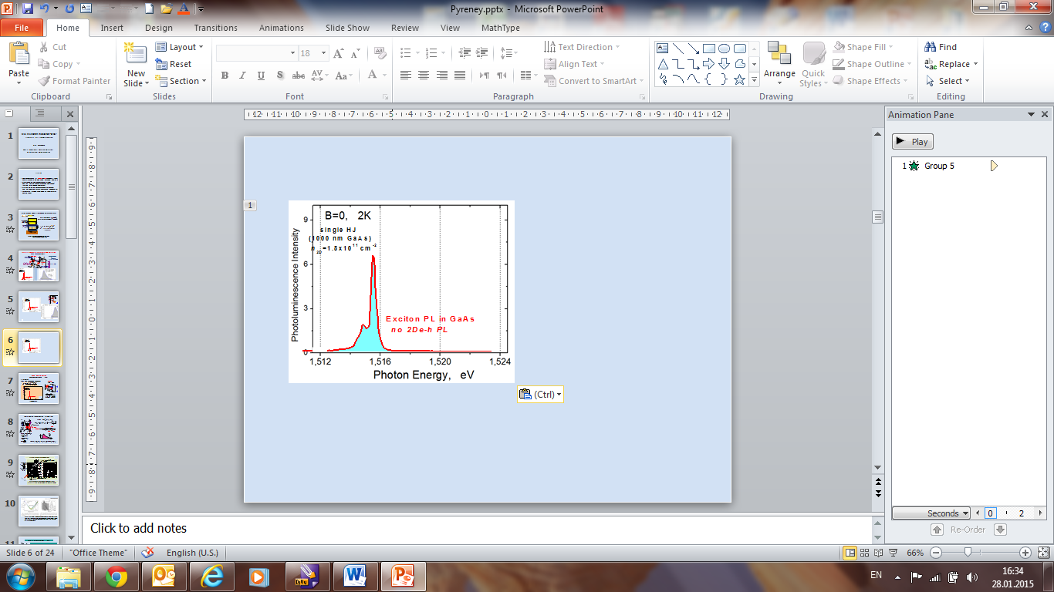
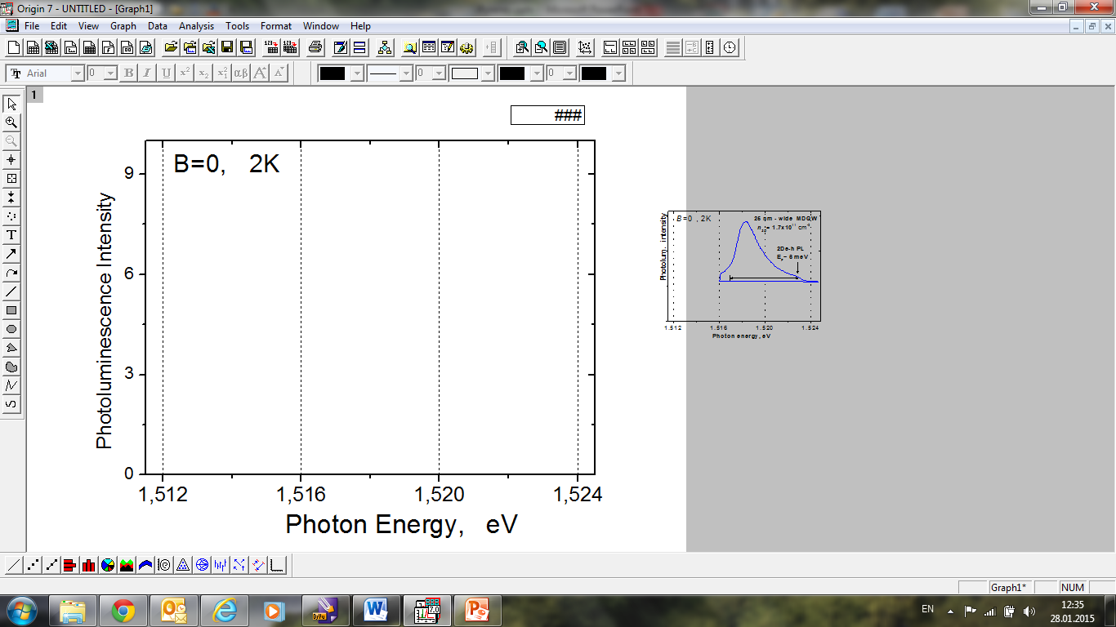
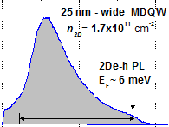
Photoluminescence in high quality heterostrustures
QW 25nm
GaAs
Al_{0.33}Ga_{0.67}As
Al_{0.33}Ga_{0.67}As
2DEG
Si⁺
E_{F}
Exciton PL
in a single HJ
2De-hole PL
light illumination
E _{gap}~1.8 eV
HJ built-in E
Drift of the photoexcited holes away
from the interface into the flat band
region

Slide 5
PL spectrum of the 2De-h radiative recombination
ε_{e}
E_{F} T_{e}
δn ~ δp <<n_{2D}
at τ_{ε} << τ _{R}
T_{h} =T_{L}
at τ _{R} << τ_{ε}
“T_{h}” >T_{L}
f_{e}
τ_{R}
τ _{ε}
E_{F}
f_{h} ? “T_{h}”
ε_{h}
E
E_{g}
Direct optical transitions:

Slide 6
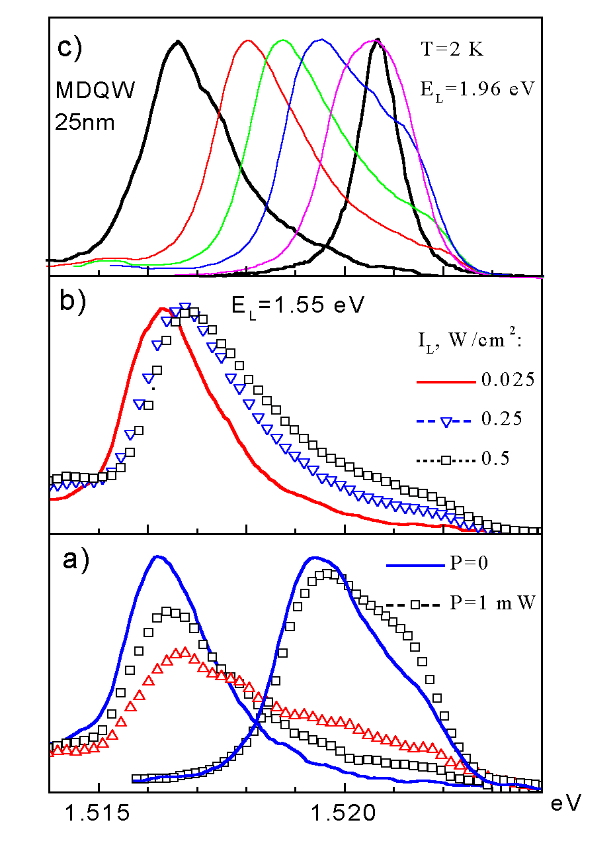
2DEG PL in quantum wells B=0
E_{L} =1.96 eV> E_{g} (AlGaAs)
2DEG
optical depletion:
n_{2De} decreases
2De-h PL
MDQW-width and n_{2d} variations
< E_{g} (AlGaAs)
Effect of mw-radiation on
the 2De-hole PL spectrum

Slide 7
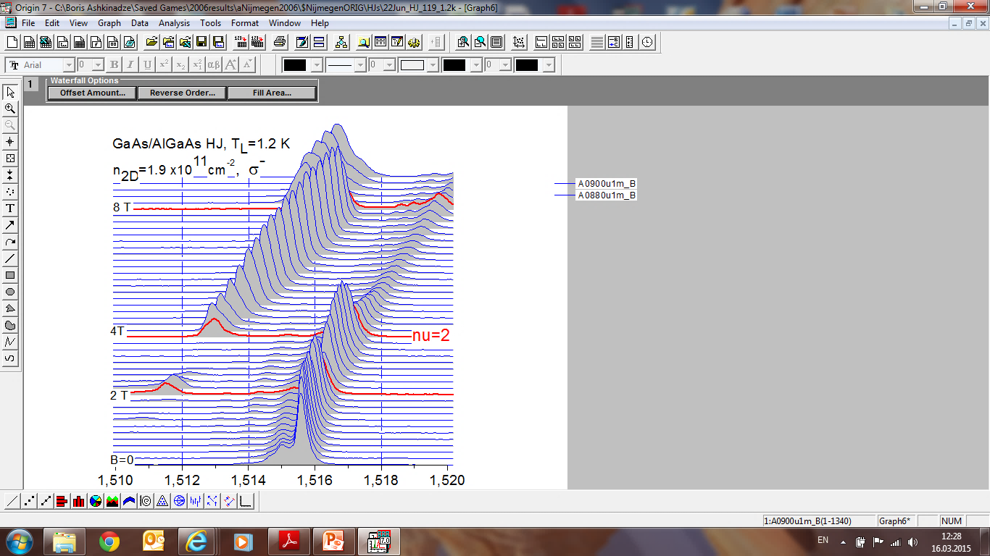
PL in MD QW & HJ: spectral evolution under magnetic field
(+optical depletion)
filling factor:
MDQW, 20 nm
n_{2D}= 10¹¹ cm⁻²
single HJ
T=2 K
ν ∼2
2De-hole PL
Exciton
Photon energy
Exciton to 2De-h PL changeover at ν ~ 2 (4)

Slide 8
Experiment
mw absorption
p-i-n
modulator
cw
MW
DETECTOR
CIRCULATOR
LOCK-IN
ATTENUATOR
Gunn-Diode
P_{mw}
P_{mw}- P ^{abs}_{mw}
PL & Mw-modulated PL
E
B (0-1T)
SPECTRO-
METER
PM
T= 2-300 K
λ/4
Chopper
Laser light (1.56 & 1.96 eV)
f =33-37 GHz, λ∼ 8mm, TE₁₀ mode

Slide 9
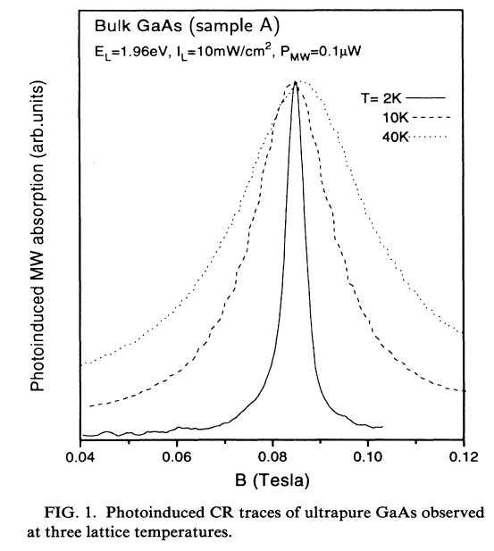
Electron Cyclotron Resonance - mw absorption
2DEG: high n_{2D} - a magnetoplasma shift
T_{L} =20K
Mw-absorption
bulk photoexcited GaAs
low n_{e} ~ 10¹² cm⁻³
DMPR
(dimensional magne-
toplasma resonance)
T_{L} =2K
μ=2.4x10⁶ cm²/Vs
P_{mw} > 0.1 mW
T_{e}~6K, T_{L} =2K
MOCVD-grown
P_{mw}~1 μW
m* = 0.066 m_{e}
τ_{m} ~110 ps
μ∼2x10⁶
Drude CR-line shape
negligible mw reflection
(“radiative broadening”)
At increased P_{mw}
the CR-line broadens
n_{2D} =1 x 10¹¹cm²
mesa 0.7 mm, HJ
+ HeNe laser light
n_{2D}⁰=2.6 x 10¹¹cm²

Slide 10
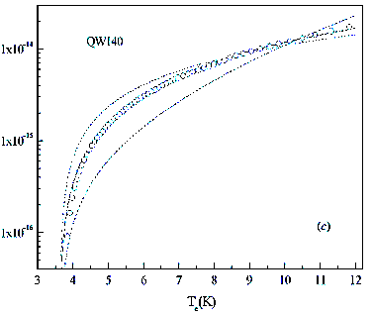

2DEG under increased microwave radiation
Electron temperature, T_{e} increases
Power loss per electron versus T_{e}
P_{abs} (at CR) : #1x1 mm, n_{2D} = 10¹¹cm⁻² , N_{e}= 10⁹ el
P_{abs} = ~ 10% P_{in} ~10⁻⁵ W (at P_{in} =0.1 mW )
P_{abs} / N_{e} ~ 10⁻¹⁴ W / el T^{R}_{e} ~5-10 K
M. E. Daniels, B. K. Ridley, S.S.Electronics.32, 1207 (1989).
N.Balkan et.al., Semicond. Sci. Technol.17(2002) 18–29
(dc-current exp.)
The mw-heated 2DEG emits phonons
10⁻¹⁵ W/el , T_{e} ~ 5 K
10⁻¹⁴ W/el , T_{e} ~ 10 K
Low-energy ballistically propagated acoustic phonons (free path > sample size)

Slide 11
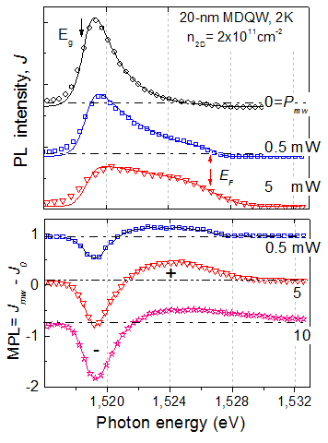
Microwave-induced PL change
mw
Primary effect is a
2D-electron mw-heating
Spectra at B=0
2DEG
B
T_{e}, “T_{h}”
2 , 2.5 K
3, 4.5 K
8, 18 K
B_{c}
“T_{h}“ > T_{e} ?!
T_{e} and “T_{h}” reaches
maximuma at e-CR
2D-electron heating leads to energy redistribution of photoexcited holes!
via nonequilibrium phonons emitted by warm 2DEG (2De and holes are spatially separated!)

Slide 12
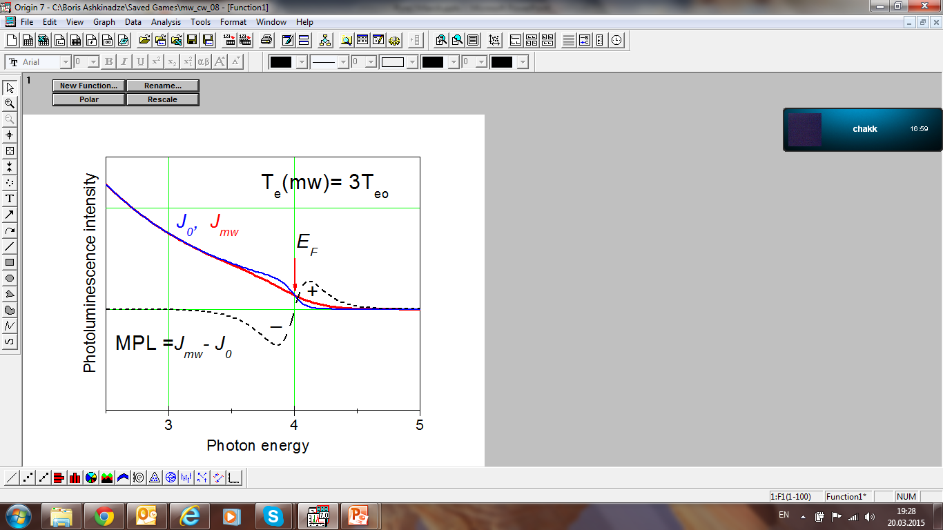
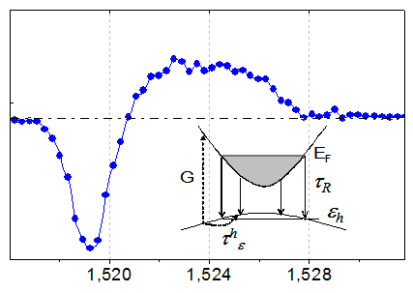
The hole-energy distribution is governed by
the competition of two processes:
hole recombination with the 2DEG and
hole-energy relaxation due to inelastic
scattering by acoustic phonons.
Direct effect of the increased T_{e}
no effect
light excitation
E_{L}
expected
NA phonons
observed
A net hole energy relaxation rate decreases
due to “hole heating” mediated by NA phonons
(An indirect 2DEG-hole interaction)
To clarify the physical mechanisms
that govern the mw-induced effects:
Transient dynamics
T_{e} relaxation time < 10⁻⁹ s
N_{ph} ~ 10 ⁻⁷ - 10⁻⁸ s

Slide 13
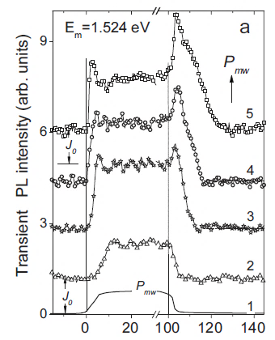
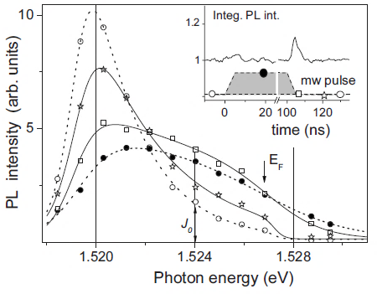

Transient dynamics of mw-modulated PL (under short mw-pulses)
PL intensity relaxes much longer than the leading and trailing mw-pulse edges (~3-5 ns)!
The transient PL intensity
(E_{m} =1.524 eV, B=0.085 T, P_{mw} =0.1 - 1 mW)
Time-resolved (2 ns gate) PL spectra
The PL spectrum has not recovered
after 15 ns delay time
Overshoots and a long decay time
after the mw pulse terminates
Hole-energy relaxation time ~ Nonequilibrium acoustic phonon lifetime ~10 ns

Slide 14
Interaction of free excitons with 2DEG in a single HJ
2DEG mw-heating causes a remarkable change in the exciton PL (for HJ)
exciton diffusion (drift)
2DEG
E_{F}
E₀
Light
FE
z=0
hole drift in E_{HJ}
z=d
Excitons dissociate into 2De and 3D-hole
near the 2DEG (rate S₂).
2De-hole PL
PL changeover: a steep S₂ increase at filling factor ν < 2
The exciton-2DEG dynamics is affected by NA phonon flux :
The excitons are repelled from hot 2DEG {n_{ex}(d) decreases}

Slide 15
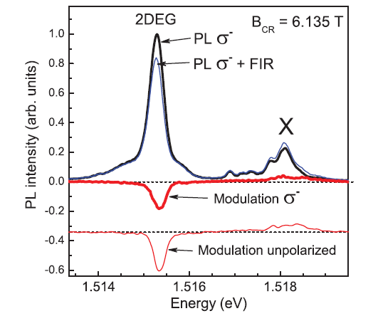
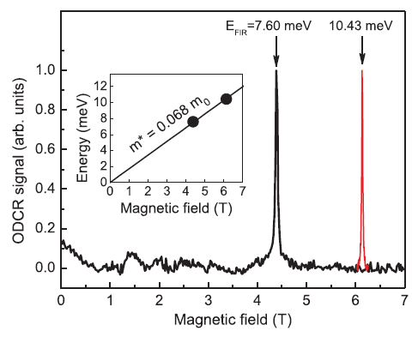
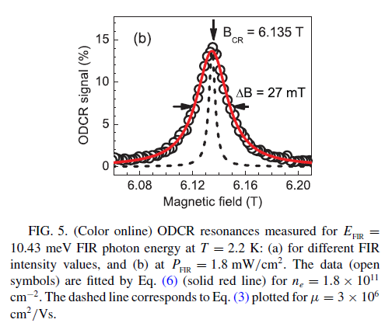
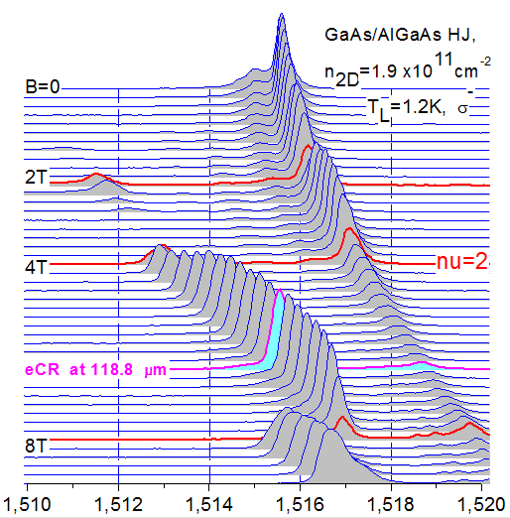
Optically detected FIR 2D-e cyclotron resonance in a single HJ
ODR mechanism:
No 2DEG-PL spectral shift:
Negligible FIR-induced
n_{2D}-change on the lowest LL
S₂ n_{ex} decreases
(resulting in the decreased p)
LL1
P_{FIR} ~2 mW/cm⁻²
10.43 meV
LL0
FIR-heated 2DEG emits
a phonon flux (wind) exerting
a force on the exciton.
The excitons “are repelled”
from the 2DEG
(L. Keldysh, 1976)
Line shape for
ODR = FIR CR absorption
Radiative broadening (λ<<a)
--- Drude line for μ=3x10⁶ cm²/Vs

Slide 16
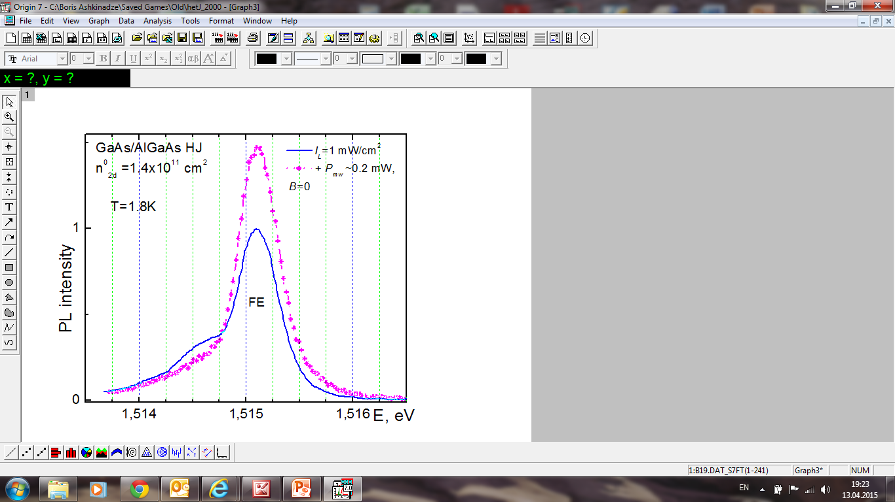
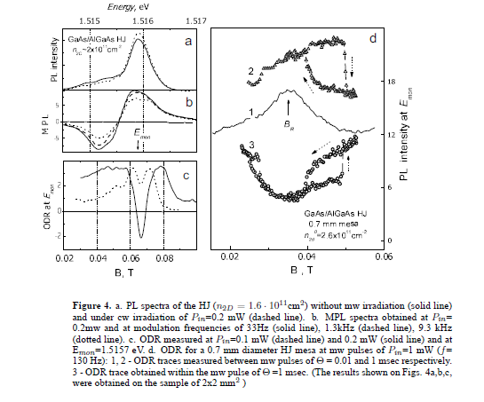
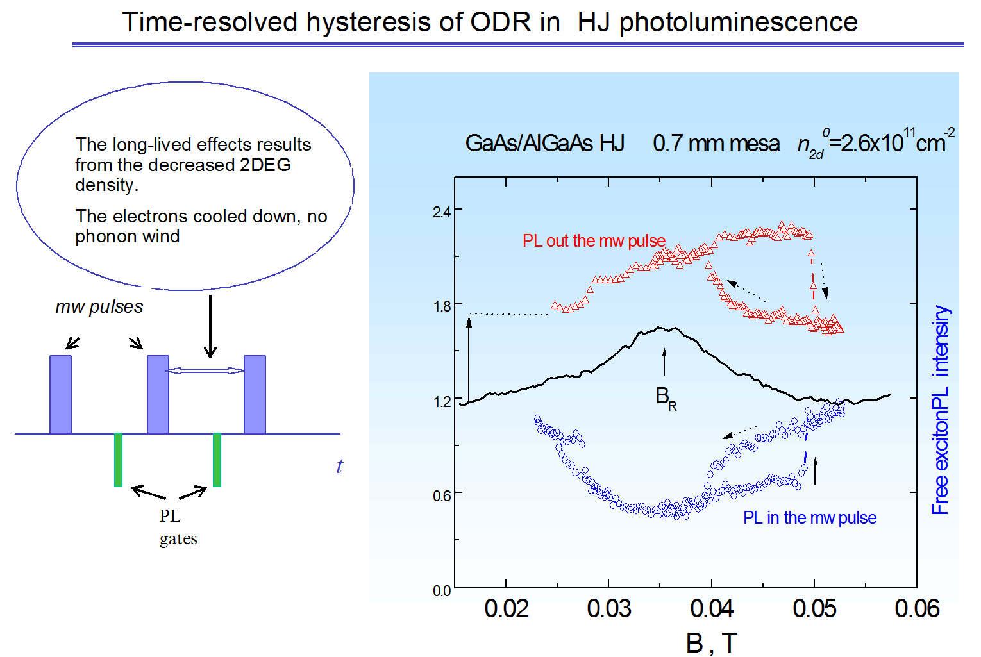
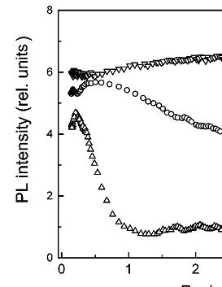


2D-e DMPR (mw- CR) detected by the exciton PL in a single HJ
Remarkable mw-ODR line shape
Hysteresis at P_{mw} > 1 mW
n_{2D}=2.6x 10¹¹cm⁻² (0.7mm mesa)
Exciton PL intensity , J_{ex}
P _{mw2} >
B=0
P _{mw1}
J_{ex} (E_{m}=1.515 eV)
J_{ex}(P_{mw}=0)
J_{ex} vs P_{mw}
B, T
Free excitons respond
to mw-heating of the 2DEG !
B, T
J_{ex} at 1.515 eV
lowest I_{L}
The electrons cooled down,
no phonon wind
P_{mw}
Absorption of the NA-phonons by the excitons results in:
1. repelling the excitons from
the 2DEG (J_{ex} increases )
2. exciton heating (E. Ivchenko et.,al. Solid State, Physics 30, 1161, 1988)
mw-pulses: 10⁻⁵ s
10⁻⁴s
J_{ex} increases (x1.5-2)
and then decreases
J_{2De-h} decreases
FE spectrum broadens
3 PL gate positions
The long-lived FE PL hysteresis
- decreased n_{2D}

Slide 17
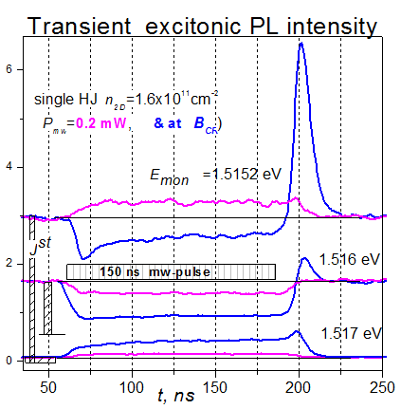
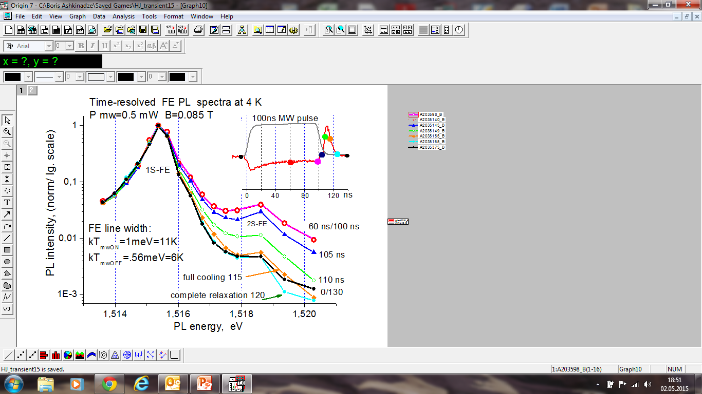
Dynamics of mw-induced exciton PL modulation (single HJ)
FE exciton heating under 2DEG mw-heating:
Absorption of non-equillibrium phonons
GaAs/AlGaAs HJ, n_{2D}=1.4x10¹¹cm⁻²
Mw-induced PL modulation lasts ~20 ns
The strongest mw- modulation - at high PL energies

Slide 18
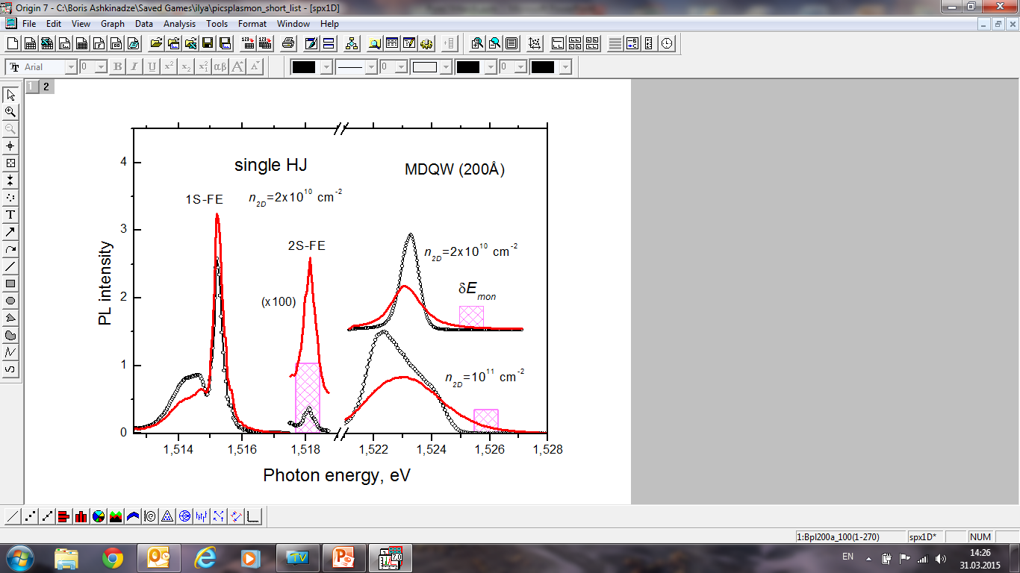
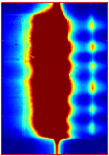
Spatially resolved mw-modulated PL
as a probe of the local microwave field acting the 2DEG
Spatially integrated PL
(0.1mm² excitation spot)
Spatially resolved PL
(1mm² excitation spot)
y
+E_{mw}
7.2 mm
mw
L
4mm
2DEG
d
E_{y}
B
x
y
Δ y ≈ 10 μm
ΔE_{photon} ≈ 0.1 meV
Photon energy
CCD image
E_{loc}(y)
(for HJ PL)
y
PL intensity at δE_{mon} : J_{mon} = f( T_{e} ) = f (|E_{loc}|² )
J_{mon} (y) ~ |E_{loc}(y)|²
Local electron temperature: “hot” and “cold” spots
Spatial n_{2DEG} and T_{e} –distribution (in-2DEG plane)
Imaging mw-induced PL spectroscopy
GAs+2DEG
Notes:
18

Slide 19
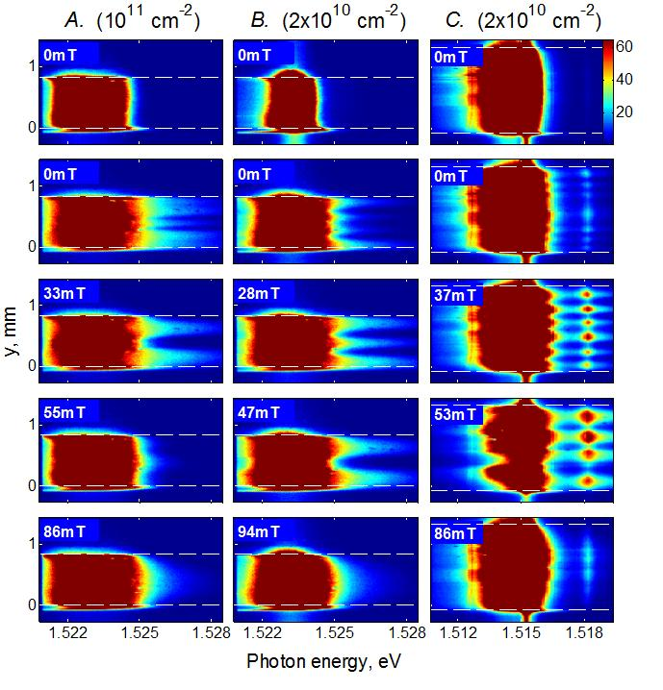
PL patterns induced by MW
MDQW 20nm
Single HJ
n_{2D}=
10¹¹cm⁻²
2x10¹⁰ cm⁻²
2x10¹⁰cm⁻²
Local electric field mapping
no MW
B=0
Spatial PL inhomogenity is due to
Excitation of confined magnetoplasmons
B=0
PL int. J
Inc(ident
q=2π/λ_{mp} = j (π/d)
Standing wave resonances: (λ_{mp} /2) j =d
j=1
Ε_{mw} (y)
d
j=3
j=2
Ballistically -propagated phonons

Slide 20
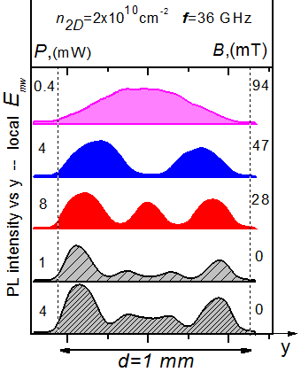
Local mw-field reconstruction:
I_{PL}
B, n_{2D} and f dependencies fit qualitatively
to magnetoplasmon dispersion relation:
from the high-energy
PL intensity
J_{PL}(y) ∝ T_{e} ∝ |E_{mp}|²
Patterns depend on n_{2D} and B
The direct observation of magnetoplasmon
modes excited by mw in a laterally confined 2DEG
Patterns are independent
of mw power !
The mw-field affecting the 2DEG is spatially inhomogeneous

Slide 21
Conclusions
2De-hole (or excitonic) photoluminescence is a sensitive probe of the
microwave induced effects in the heterostructures containing a 2DEG
Non-equilibrium acoustic phonon flux emitted by the warm 2DEG plays
an important role in the mw-induced phenomena. These phonons leading to a hole (exciton) “heating”, are the underlying agent of the PL spectral changes, in particular, of the optically detected 2D-e CR-resonance.
In the HJ, the excitonic and 2De-h photoluminescence are in dynamical equilibrium. Such an equilibrium can be controlled by the phonon wind from the warm 2DEG
Spatially resolved photoluminescence maps the spatial non-uniformity of the internal microwave field (as well as the 2DEG density) and is used to image magnetoplasmons excited by a microwave radiation.
Thank you for attention
Many thanks for collaboration: Ilya Baskin, E. Cohen, E. Linder, G. Bartsch, D. Yakovlev

Slide 22
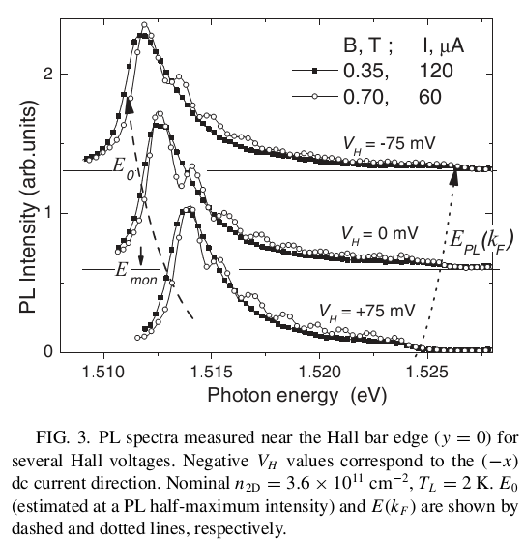
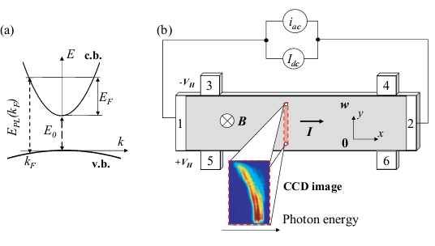
Direct optical transitions due to recombination of low-density photoholes in the valence band (v.b.) and 2D electrons in the conduction band (c.b.).
(b) A schematic description of the Hall bar and the spatially resolved photoluminescence experiment

Slide 23
B.M. Ashkinadze, E. Linder, V. Umansky
Dimensional magnetoplasma resonance detected by free-exciton
photoluminescence in modulation-doped GaAs/AlxGa1-xAs heterojunctions
Phys. Rev. B 62, 10310, 2000
B.M. Ashkinadze, V. Voznyy, E. Linder, E. Cohen, L.N.Pfeiffer
Photoluminescence hysteresis of the optically detected cyclotron-like resonance of a 2DEG
Phys. Rev. B 64, 161306, 2001
B.M. Ashkinadze, V. Voznyy, E. Cohen, A. Ron, V. Umansky
Condensation of bulk excitons on a magnetized 2DEG in modulation-doped heterojunctions
Phys. Rev. B 65, 073311, 2002
B.M. Ashkinadze, E. Linder, E. Cohen, V. Rudenkov, P. Christianen, L.N.Pfeiffer
Exciton to two-dimensional electron-hole photoluminescence transitions driven by the quantum Hall effect .
Phys. Rev. B 72, 075332, 2005
B.M. Ashkinadze, E. Linder, E. Cohen, L.N.Pfeiffer
Microwave-modulated photoluminescence of a two-dimensional electron gas
Phys. Rev. B 74, 245310, 2006
I. Baskin, B.M. Ashkinadze, E. Cohen, L.N.Pfeiffer
Microwave-induced photoluminescence modulation and optically detected resonances due to a 2DEG in a heterostructure
Phys. Rev. B 78, 195318, 2008
I. Baskin, B.M. Ashkinadze, E. Cohen, L.N.Pfeiffer
Imaging magnetoplasmons excited in a two-dimensional electron gas
Phys. Rev. B 84, 041305, 2011
G. Bartsch, C. Zens, B.M. Ashkinadze, D.R. Yakovlev, M. Bayer
Optically detected far-infrared cyclotron resonance of two-dimensional electrons in a single GaAs/(Al,Ga) As heterojunction
Phys. Rev. B 87, 085316, 2013
I. Baskin, B.M. Ashkinadze, E. Cohen, L.N.Pfeiffer
Luminescence flashes induced by microwave radiation in undoped GaAs QWs Phys. Rev. B 79, 195325, 2009

Slide 24
Exciton – 2DEG PL transition (model )
Approaching to the 2DEG, excitons dissociate into 2De and 3D-hole with a rate S₂ that depends on B
at ν >2 - low S₂ _ No 2DEG-hole PL
D=100cm²sec
τ_{ex}=10⁻⁹sec
S₁=10³ cm/sec
at ν < 2 - high S₂ – PL changeover
Distant interaction of hot 2DEG with excitons : Non-equilibrium phonons affect the exciton-2DEG dynamics and S₂ reduces
V₁ – potential well for exciton
V₂ = V_{kin} + V _{2De-3h}
Phys. Rev. B 72, 075332, 2005

Slide 25
2DEG under increased microwave radiation (c)
2DEG density varies under high mw-power
As P_{mw} increases - DMPCR shifts to higher B:
2DEG density decreases with T_{e} (mw-power)
E_{F}
(nonlinear coefficient β)
Nonlinear Dimensional Magnetoplasma
Resonance (DMPCR)
Classical nonlinear
oscillator
B. Ashkinadze, V. Yudson, PRL83, 812, 1999

Slide 26
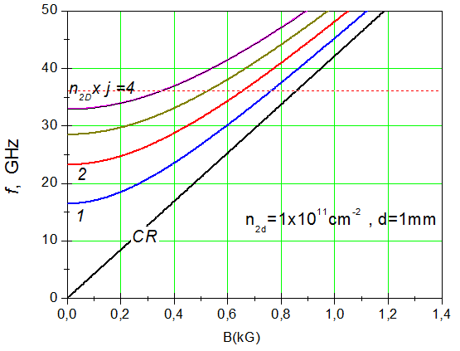
Magnetoplasmon dispersion
Longitudinal modes
L
E_{mw}
q_{x}
d
q_{y}
sample
At d <<L, q_{x}~ π/L << q_{y} ~ π/W

Slide 27
Direct optical transitions due to recombination of low-density photoholes in the valence band (v.b.) and 2D electrons in the conduction band (c.b.).
(b) A schematic description of the Hall bar and the spatially resolved photoluminescence experiment

