Slide 1
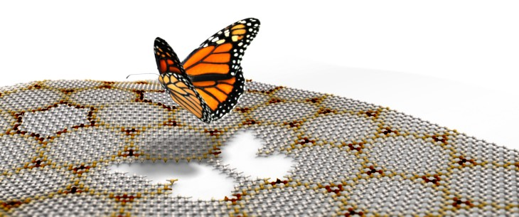
Hofstadter’s Butterfly in the strongly interacting regime
Cory R. Dean
Columbia University

Slide 2
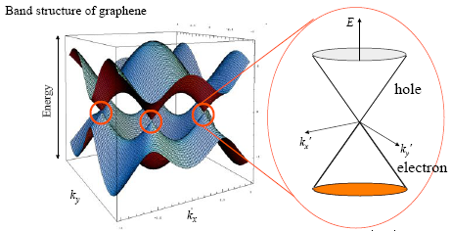
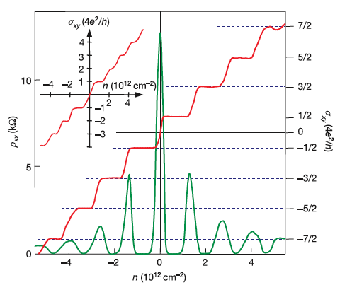
Graphene on BN
linear dispersion:
Novoselov, Geim, Science (2005), Nature (2005); Zhang, Kim, Nature (2005)

Slide 3
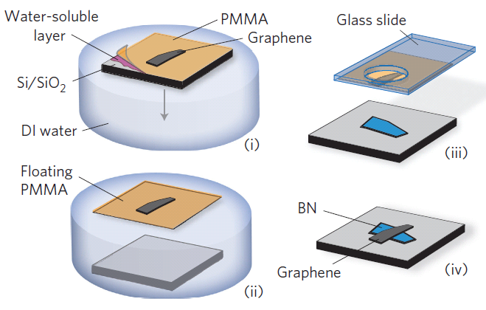
Graphene on BN
linear dispersion:
Novoselov, Geim, Science (2005), Nature (2005); Zhang, Kim, Nature (2005)
Dean, et al Nature Nano. (2010)

Slide 4
Graphene on BN
linear dispersion:
Novoselov, Geim, Science (2005), Nature (2005); Zhang, Kim, Nature (2005)
Mobility
Dean, et al Nature Nano. (2010)

Slide 5
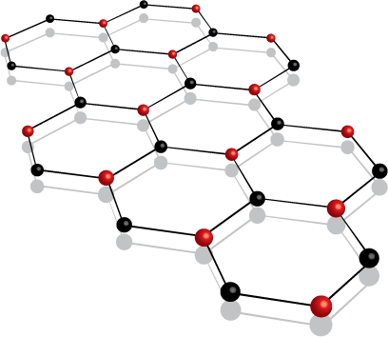
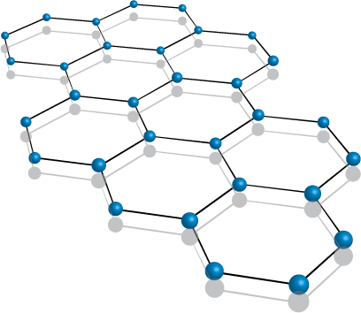
Graphene versus h-BN
Graphene
(a_{o} = 2.46 A)
h-BN
(a_{o} = 2.50 A)

Slide 6
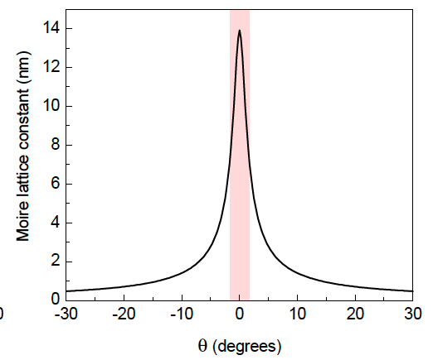
Moire Pattern
a = 15 nm

Slide 7
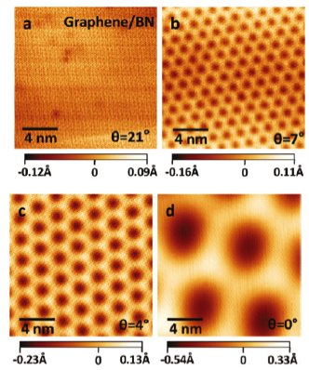
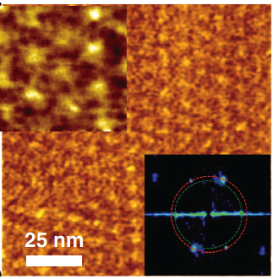
BL graphene on h-BN
STM measurement confirms Moiré pattern
1 μm
Xue et al, Nature Mater (2011);
Decker et al Nano Lett (2011);
Yankowitz et al, Nat. Phys. (2012)

Slide 8
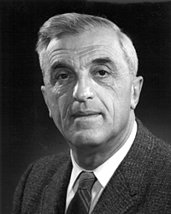
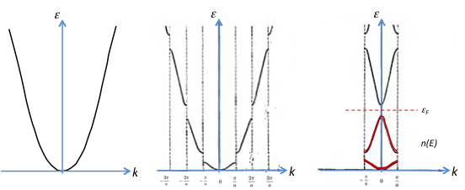
BL graphene on h-BN
Periodic Potential
STM measurement confirms Moiré pattern
Bloch Waves:
Length scale: lattice paramater, a
Xue et al, Nature Mater (2011);
Decker et al Nano Lett (2011);
Yankowitz et al, Nat. Phys. (2012)

Slide 9
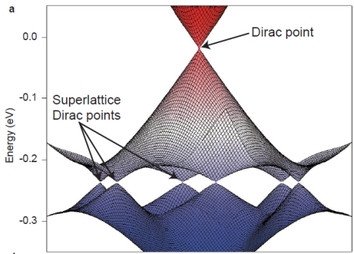
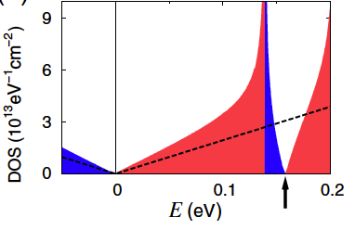
BL graphene on h-BN
Periodic Potential
Bloch Waves:
Length scale: lattice paramater, a
Park et al, PRL (2008); Nat. Phys. (2008)

Slide 10
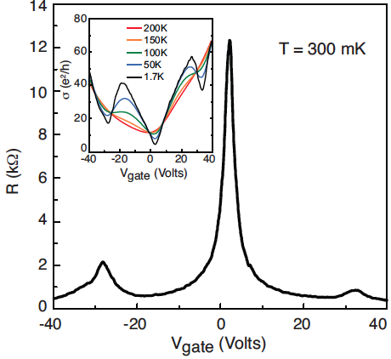
BL graphene on h-BN
1 μm

Slide 11
BL graphene on h-BN
1 μm
~ 30 V
~ 30 V
Moiré λ_{AFM} = 15.5+/-1 nm
Moiré λ_{Transport} = 14.6 nm

Slide 12
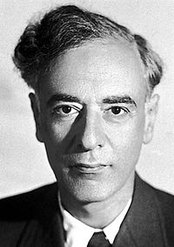
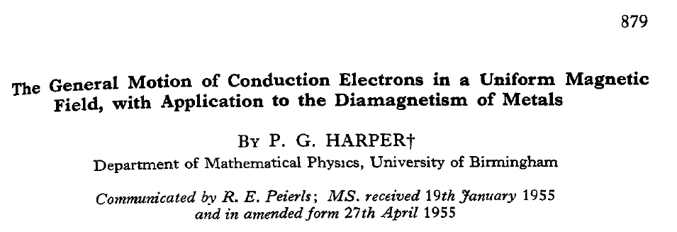
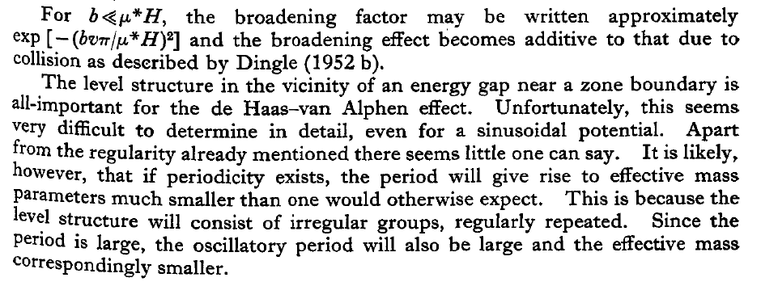
Elecrons subjected to classical forces
Periodic Potential
Magnetic Field
Proc. Phys. Soc. Lond. A 68 879 (1955)
Felix Bloch
Lev Landau
Landau levels:
Bloch Waves:
, N=0,1,2,3...
Length scale: lattice paramater, a
Length scale: magnetic length, l_{B}

Slide 13
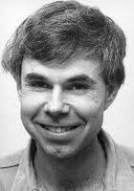
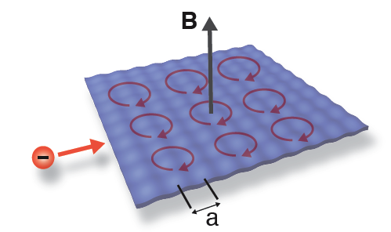
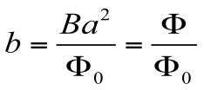
Quantum Hall effect in a periodic potential
“superlattice”
Douglas
Hofstadter
Harper’s equation for 2D square lattice

Slide 14
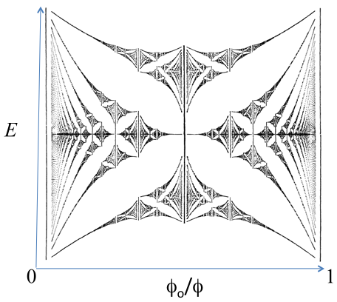
Quantum Hall effect in a periodic potential
“superlattice”
Douglas
Hofstadter
Harper’s equation for 2D square lattice
“Hofstadter Butterfly”
When b=p/q, where p, q are coprimes, the LL splits into p sub-bands that are q-fold degenerate
-Hofstadter, PRB (1976)

Slide 15
Quantum Hall effect in a periodic potential
“superlattice”
Douglas
Hofstadter
Harper’s equation for 2D square lattice
“Hofstadter Butterfly”
When b=p/q, where p, q are coprimes, the LL splits into p sub-bands that are q-fold degenerate
Landau energy bands develop fractal structure when magnetic length is of order the periodic unit cell
-Hofstadter, PRB (1976)

Slide 16
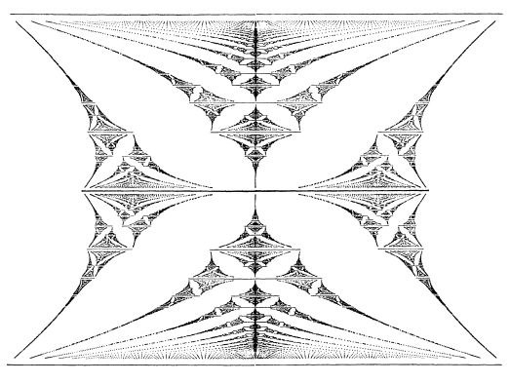
Hofstadter’s Butterfly to Wannier Diagram
Hofstadter’s Energy Spectrum
1
ε /W
0
1
magnetic flux
per unit cell

Slide 17
Hofstadter’s Butterfly to Wannier Diagram
Hofstadter’s Energy Spectrum
1
ε /W
0
1/5
1/4
1/3
1/2
1
magnetic flux
per unit cell

Slide 18
Hofstadter’s Butterfly to Wannier Diagram
Hofstadter’s Energy Spectrum
Wannier Phys. Stat. Sol. (1978)
1
1
ε /W
0
1/5
1/4
1/3
1/2
0
1
1/4
1/3
1/2
1
t : slope
s : intercept
Diophantine
equation:
magnetic flux
per unit cell
Electron density
per unit cell

Slide 19
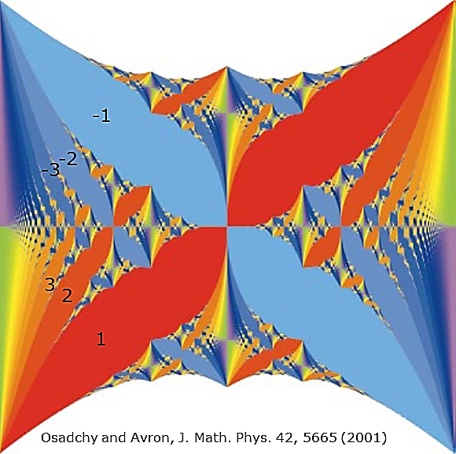
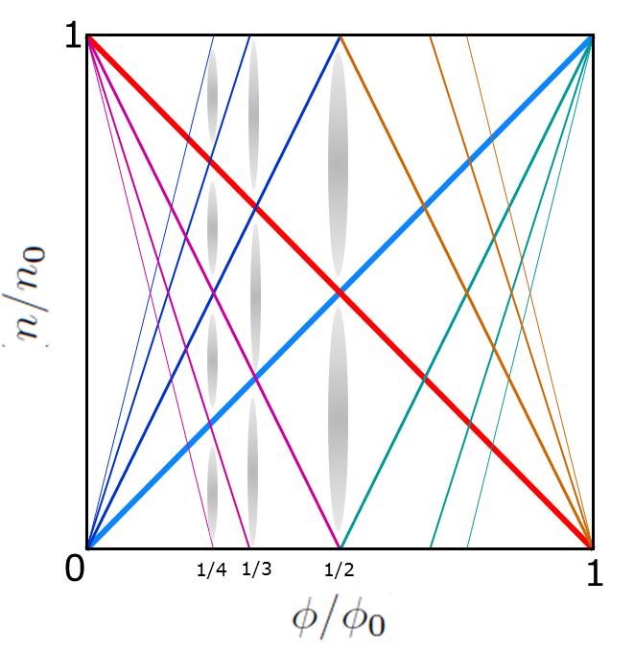
Quantum Hall effect in a periodic potential
(also Streda J. Phys. C. (1982)
Spectral gaps satisfy a Diophantine equation
Band filling factor
Quantum Hall conductance

Slide 20
Quantum Hall effect in a periodic potential
Physical observables:
non-monotonic variation in Rxy but with quantization to integer units of e²/h
corresponding minima in Rxx, but not necessarily at integer filling fractions
(also Streda J. Phys. C. (1982)
Spectral gaps satisfy a Diophantine equation
Band filling factor
Quantum Hall conductance

Slide 21
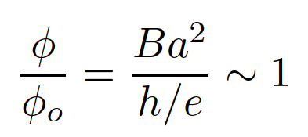
Experimental challenges
1
Technical challenge:
ε /W
0
1
a = 1nm

Slide 22
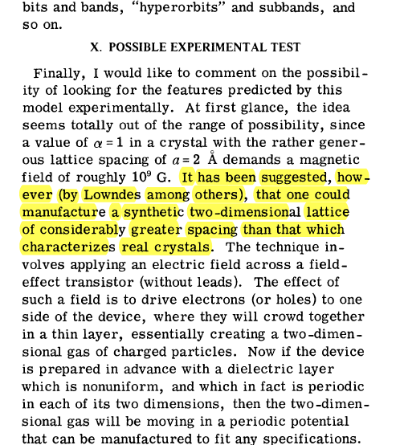
Experimental challenges
1
Technical challenge:
ε /W
0
1
a = 1nm

Slide 23
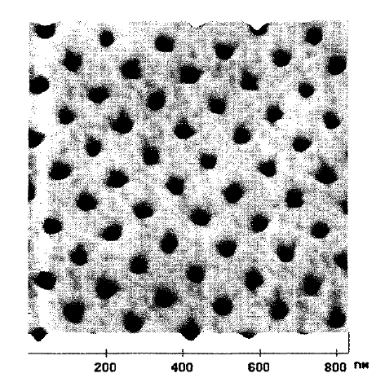
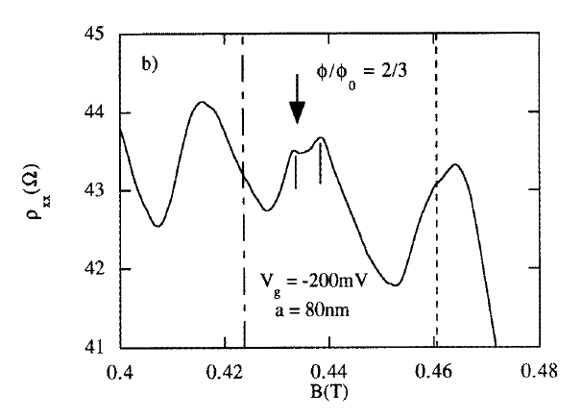
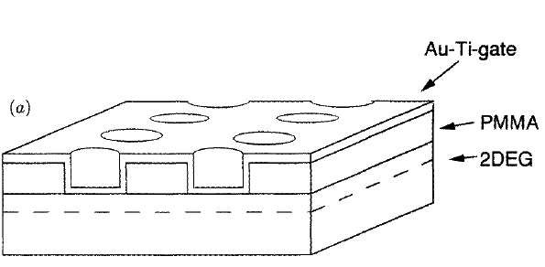
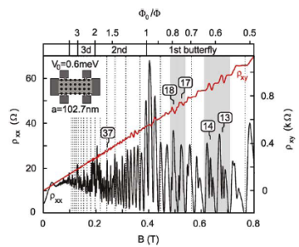
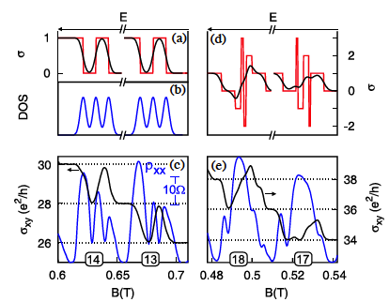
Looking for Hofstadter
a = 100nm
-Schlosser et al, Semicond. Sci. Technol. (1996)
Unit cell limited to ~100 nm
limited field and density
range accessible
Do not observe ‘fully quantized’
mingaps in fractal spectrum
require low disorder!
Albrecht et al, PRL. (2001); Geisler et al, Physica E (2004)

Slide 24
Looking for Hofstadter
a = 100nm
-Schlosser et al, Semicond. Sci. Technol. (1996)
Unit cell limited to ~100 nm
limited field and density
range accessible
Do not observe ‘fully quantized’
mingaps in fractal spectrum
require low disorder!
Albrecht et al, PRL. (2001); Geisler et al, Physica E (2004)

Slide 25
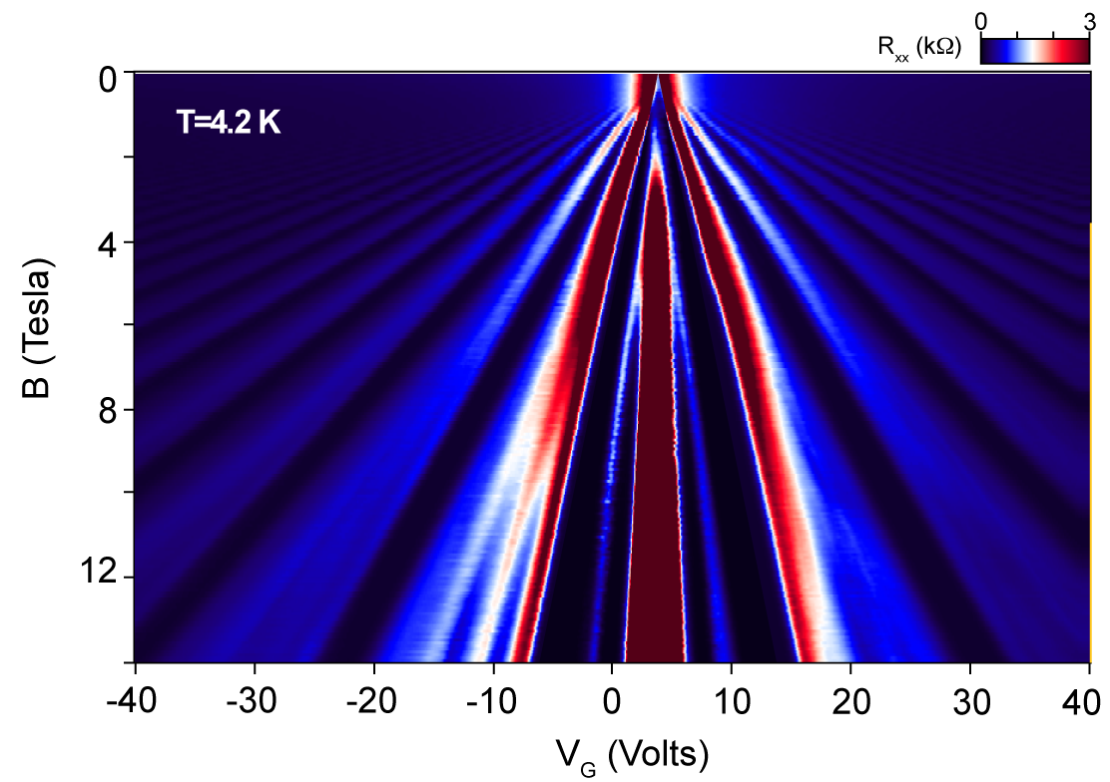
Conventional QHE in graphene
12
8
4
-10
+1
9
8
7
5
4
3
T=1.5K
0
-1
0
-2
+10
+6
+2
-6
Young, et al Nature Phys. (2012)

Slide 26
BL graphene with moire pattern
-4
+2
+4
-8
+8
-12
+12
Dean et al, Nature (2012)

Slide 27
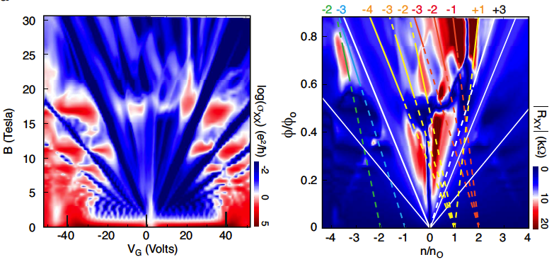
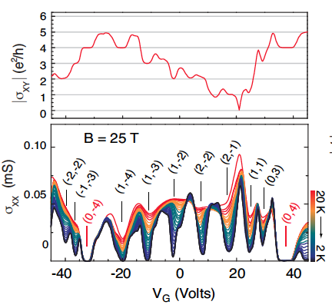
Agreement with the Diophantine equation
Dean et al, Nature (2012)

Slide 28
Agreement with the Diophantine equation
Wannier diagram:
1
0
-1
0
1
Diophantine equation:
slope
offset
Dean et al, Nature (2012)

Slide 29
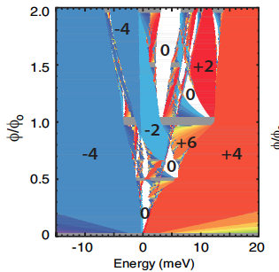
Comparison with theory
Dean et al, Nature (2012)

Slide 30
Symmetry Breaking
fully degenerate: S=0,4,8…
Sublattice lifted: S=0,2,4,6….
Dean et al, Nature (2012)

Slide 31
Symmetry Breaking
strong electron hole asymmetry
Valley symmetry breaking
Selected minigaps emerge
Qualitative agreement with theory for BL graphene on BN
fully degenerate: S=0,4,8…
Sublattice lifted: S=0,2,4,6….
Dean et al, Nature (2012)

Slide 32
Symmetry Breaking
Role of interactions??
strong electron hole asymmetry
Valley symmetry breaking
Selected minigaps emerge
Qualitative agreement with theory for BL graphene on BN
Dean et al, Nature (2012)

Slide 33
What about nesting prediction?

Slide 34
What about nesting prediction?

Slide 35
What about nesting prediction?
0.6
φ/φ_{o}
1/2
0.5
0.4
n/n_{o}

Slide 36
What about nesting prediction?
0.6
φ/φ_{o}
1/2
0.5
0.4
n/n_{o}
0.35
φ/φ_{o}
1/3
0.25
n/n_{o}

Slide 37
What about nesting prediction?
0
-6
-4
-2
2
4
0.6
-8
6
φ/φ_{o}
1/2
0.5
0.4
n/n_{o}
2
-10
-4
0.35
-7
φ/φ_{o}
1/3
8
0.25
n/n_{o}

Slide 38
What about nesting prediction?
0
-6
-4
-2
2
4
0.6
-8
6
φ/φ_{o}
1/2
0.5
0.4
n/n_{o}
2
-10
-4
0.35
-7
φ/φ_{o}
1/3
8
0.25
n/n_{o}

Slide 39
What about nesting prediction?
0
-6
-4
-2
2
4
0.6
-8
6
2/3
φ/φ_{o}
1/2
0.5
1/2
1/3
0.4
n/n_{o}
2
-10
-4
0.35
-7
φ/φ_{o}
1/3
8
0.25
n/n_{o}

Slide 40
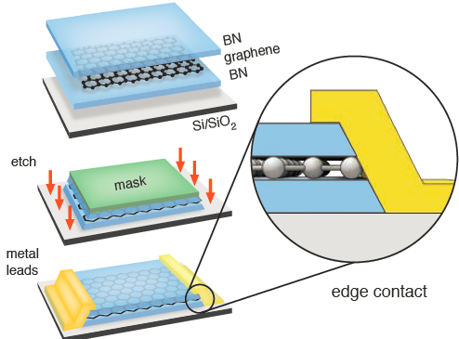
Monolayer graphene on BN
Wang et al, Science (2013)

Slide 41
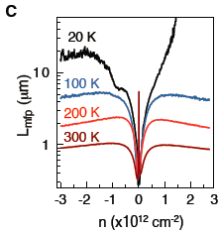
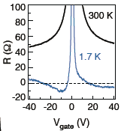
Monolayer graphene on BN
Wang et al, Science (2013)

Slide 42
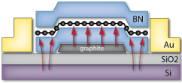
Monolayer graphene on BN
Lei et al, Science (2013)

Slide 43
Thermally induced alignment
10 μm
10 μm

Slide 44
Emergence of a gap at CNP
Hunt, et al Science (2014); Gorbachev, et al, Science (2014);Woods, et al, Nature Phys (2014); Chen, et al, Nature Comm (2014); Amet, et al, Nature Comm (2015)

Slide 45
Butterfly in high mobility device

Slide 46
Butterfly in high mobility device

Slide 47
Butterfly in high mobility device

Slide 48
Detailed look at high field features
ф/ф_{o}
R_{XX} (Ω)
n/n_{o}

Slide 49
Monolayer graphene on BN
FQHE can exist in a patterned 2DEG with Hofstadter mini-gaps
When FQHE and mini-gap states intersect, state with the larger gap emerges
Kol, A. & Read, PRB (1993).
Pfannkuche, D. & Macdonald (1997)
Ghazaryan, Chakraborty, & Pietilainen, arXiv (2014).

Slide 50
Detailed look at high field features
ф/ф_{o}
R_{XX} (Ω)
n/n_{o}

Slide 51
Detailed look at high field features
ф/ф_{o}
R_{XX} (Ω)
n/n_{o}

Slide 52
Detailed look at high field features
ф/ф_{o}
R_{XX} (Ω)
n/n_{o}

Slide 53
Detailed look at high field features
gaps and mini gaps allowed by Diophantine equation
conventional fractional quantum Hall effect
anomalous

Slide 54
Detailed look at high field features

Slide 55
Detailed look at high field features
-1/3
1/3
1/2
Observation of
fractional Bloch index
σ_{XY} plateau = 1 e²/h
Slope (“t”) = 1.009 +/- 0.007
n/no intercept (“s”) = 0.3 +/- 0.01

Slide 56
Detailed look at high field features

Slide 57
Detailed look at high field features
MacDonald and Murray, PRL (1985)
Kol, A. & Read, PRB (1993).
Pfannkuche, D. & Macdonald (1997)
Ghazaryan, Chakraborty, & Pietilainen, arXiv (2014).
Chen et al PRB (2014)
Generalized Laughlin-like state?
Spontaneous quantum Hall ferromagnetism?
Charge density wave?

Slide 58
Observations
Direct evidence of mini-gap structure following Wannier description
in density-flux space
Observation of two quantum numbers associated with each gap in
the QHE spectrum
Evidence of recursion within the diagram
Evidence of fractional Bloch index
Open questions
role of electron-electron interactions/origin of symmetry breaking
relationship between observed gap hierarchy and superlattice
symmetry
nature of the FBQHE ground state??

Slide 59
Acknowledgements
Collaboration
James Hone, Ken Shepard, Philip Kim,
Masa Ishigami, M. Koshino, P. Moon
L. Wang, Y. Gao, P. Maher, F. Ghahari, C. Forsythe, Y. Gao, J. Katoch
Z. Han, B. Wen
Theoretical discussions
A. MacDonald, T. Chakraborty, M. Koshino, I. Aleiner, V. Fal’ko, A. Young
NIMS Japan (h-BN crystals)
Takashi Taniguchi, Kenji Watanabe

Slide 60
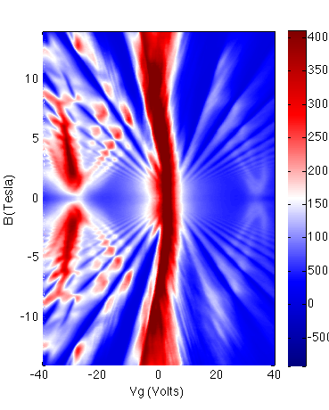
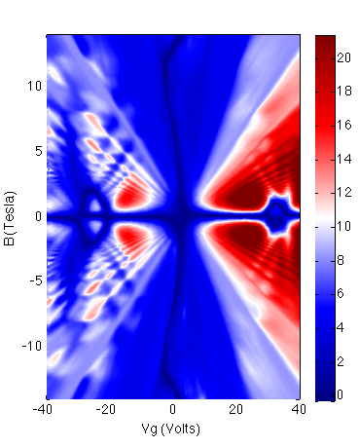
Electron hole asymmetry

