Slide 1
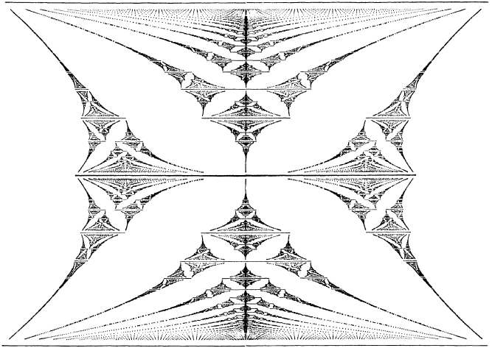
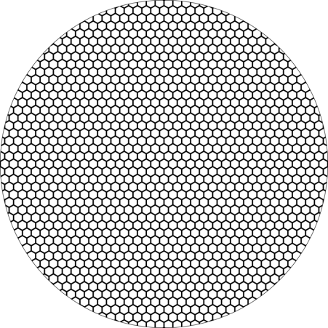
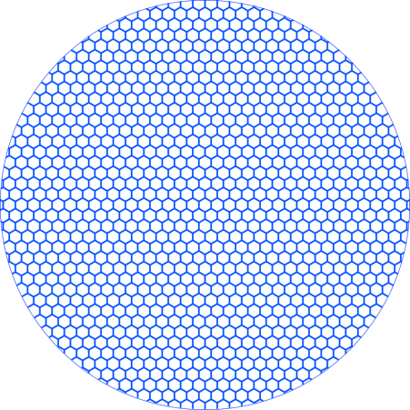
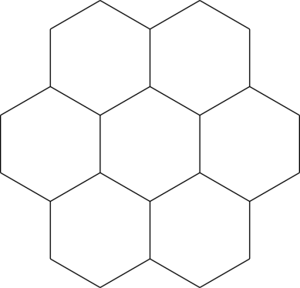



θ
λ
Graphene Superlattices
Leonid Ponomarenko
QT2DS, Luchon (France), 26/05/15

Slide 2



Collaboration and Support
Fabrication (Manchester):
Roman Gorbachev, Greg Auton, Andrey Kretinin, Freddie Withers
Transport measurements and AFM (Manchester):
Artem Mishchenko, Geliang Yu, Colin Woods, Roshan Krishna Kumar
High magnetic fields (Grenoble, CNRS)
Marek Potemski, Benjamin Piot
Theory (Lancaster):
Vladimir Falko, John Wallbank, Martin Mucha-Kruczynski
The project lead by Andre Geim and Kostya Novoselov

Slide 3
Outline
Graphene: quick introduction
Graphene heterostructures
Graphene Superlattices
Hofstadter butterfly in transport & quantum capacitance
Commensurate-incommensurate transition
Valley Hall Effect

Slide 4
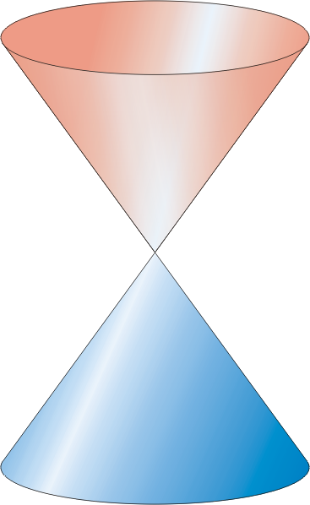
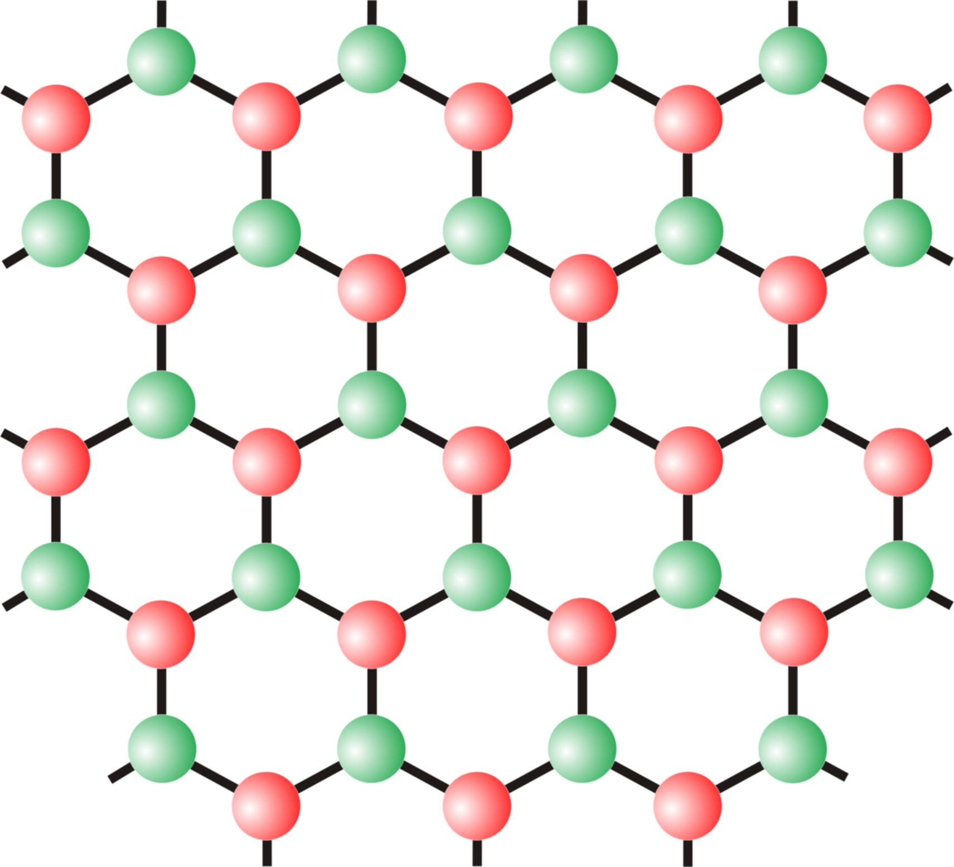
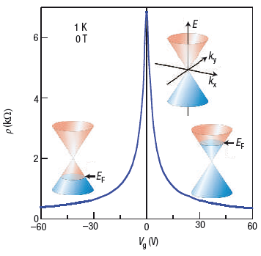
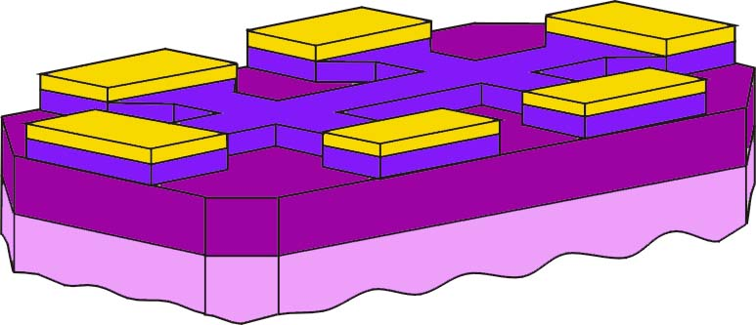
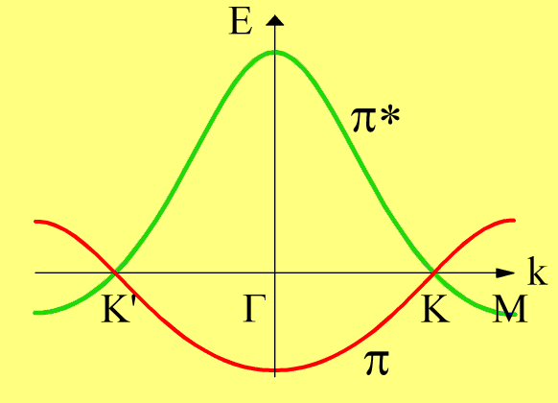
Band Structure and Field Effect
P. Wallace, Phys. Rev. 71, 622 (1947)
Hexagonal lattice, A-B sublattice symmetry (= inversion symmetry)
SiO₂
Si
graphene
Geim & Novoselov, Science 2004
Mechanical exfoliation (“Sticky tape” method)

Slide 5
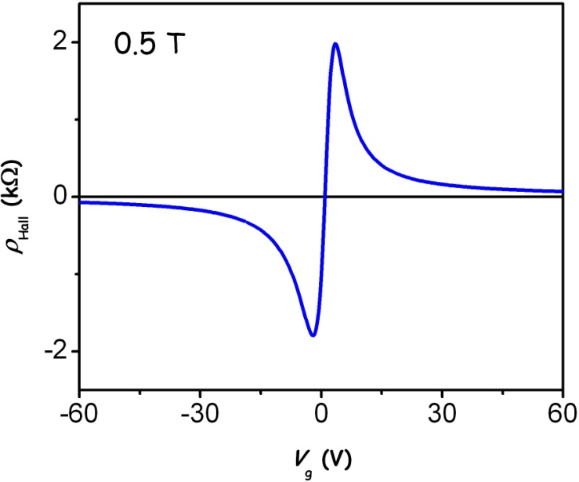
Band Structure and Field Effect
B – magnetic field n – carrier density
µ - mobility
10 000 cm²/Vs (on SiO2)
1 000 000 cm²/Vs (suspended, 4 K)
SiO₂
Si
graphene
Geim & Novoselov, Science 2004
Mechanical exfoliation (“Sticky tape” method)

Slide 6
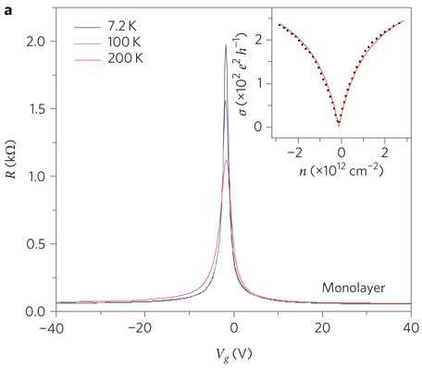
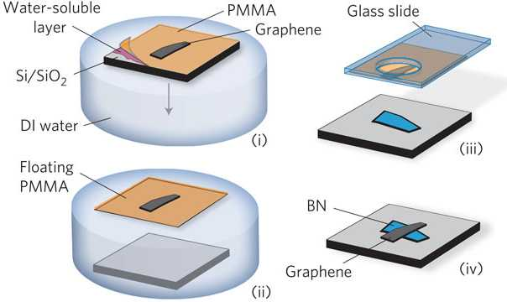
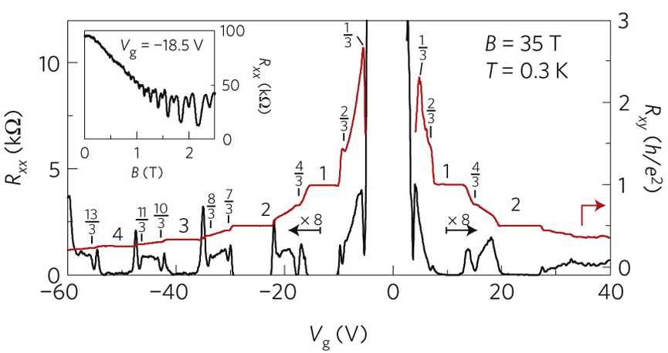
Graphene Heterostructures
Boron nitride substrates for high-quality graphene electronics
C. R. Dean et al. Nature Nano 5, 722 (2010)
One order improvement in mobility.
Fractional Quantum Hall Effect
Dean et al., Nature Phys. (2011)

Slide 7
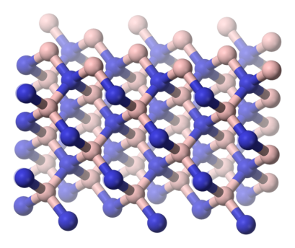
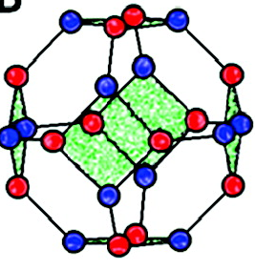
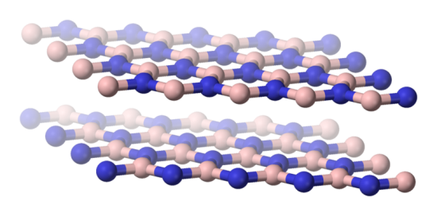
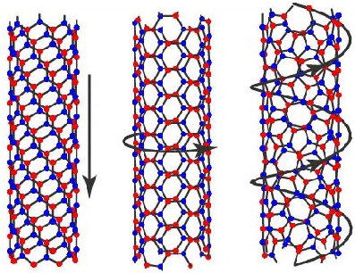
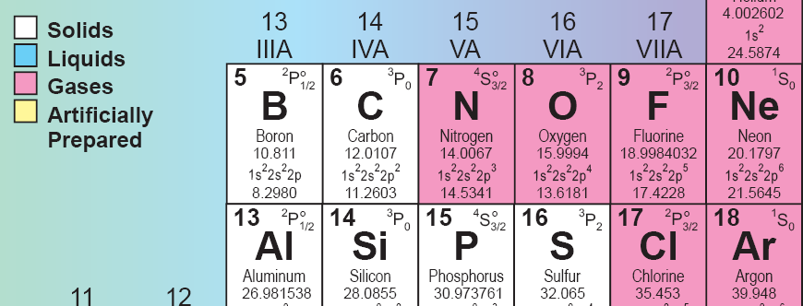
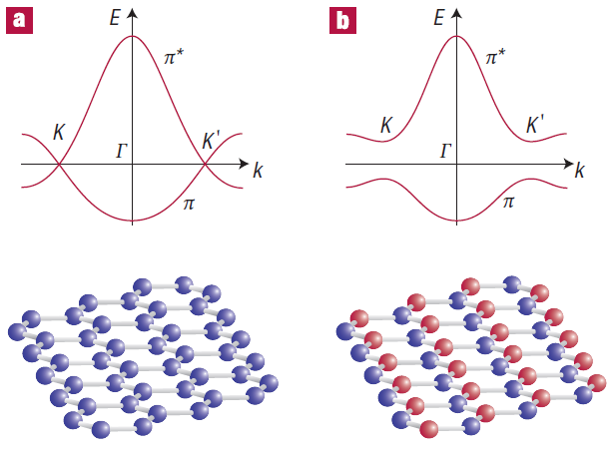
Different forms of Boron Nitride
Hexagonal – “white graphite”
Cubic – almost as hard as diamond
Fullerene-like molecule B₁₂N₁₂
BN nanotubes
Graphene
Boron Nitride
BN: insulator with gap 5.8 eV
K. Watanabe et al, Nature Materials 2004.
a = 2.462 A, c = 6.708 A
a = 2.504 A, c = 6.661 A

Slide 8
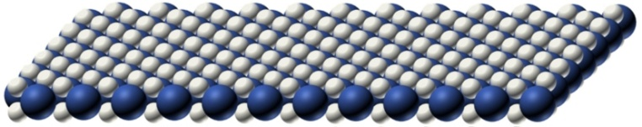
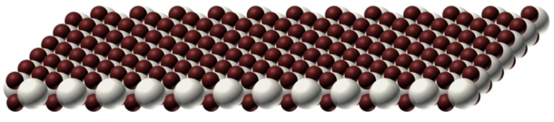
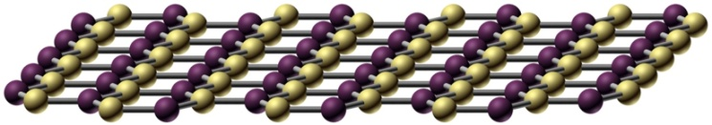
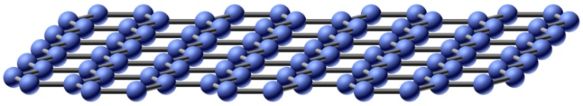
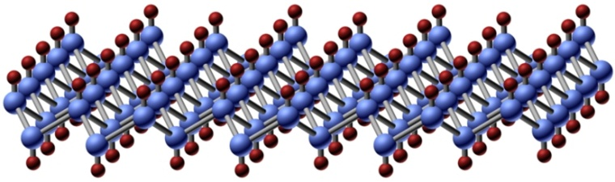
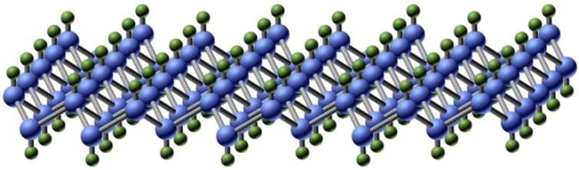
Multi-Layer Structures
MoS₂
NbSe₂
Boron-Nitride
Graphene
Van der Waals heterostructures. Geim & Grigorieva, NATURE (2013)
GraFane
Graphane

Slide 9
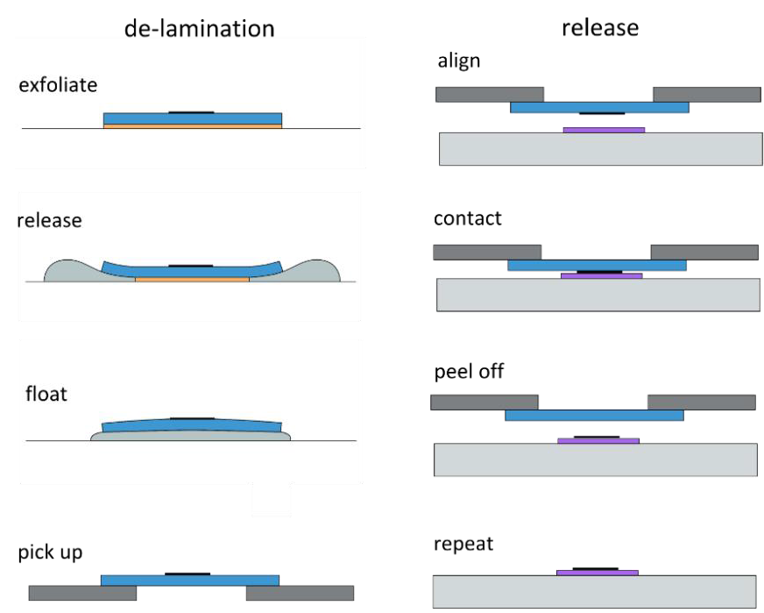
Dry-peel transfer

Slide 10
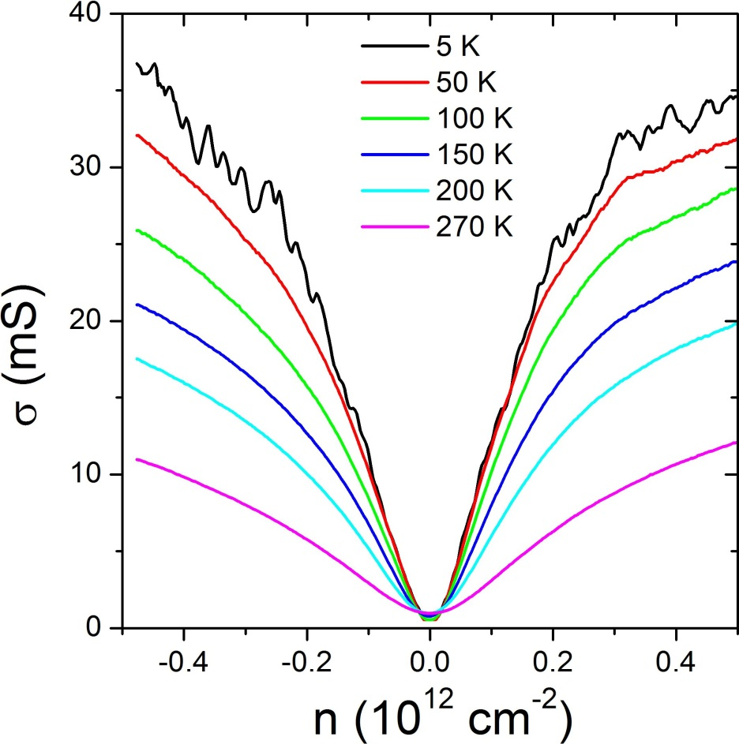
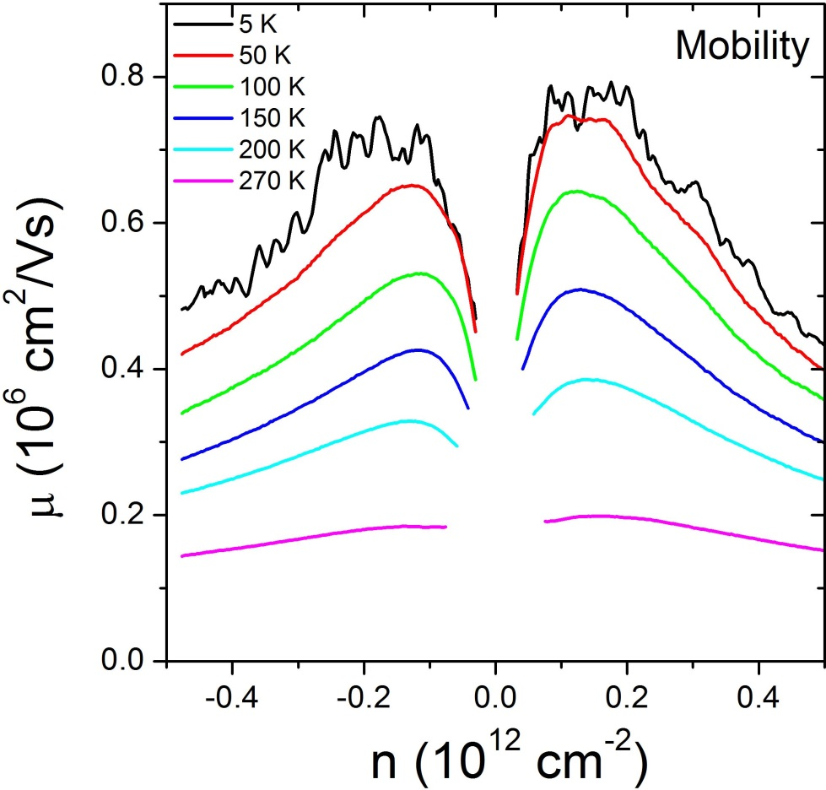
Mobility and Mean Free Path

Slide 11
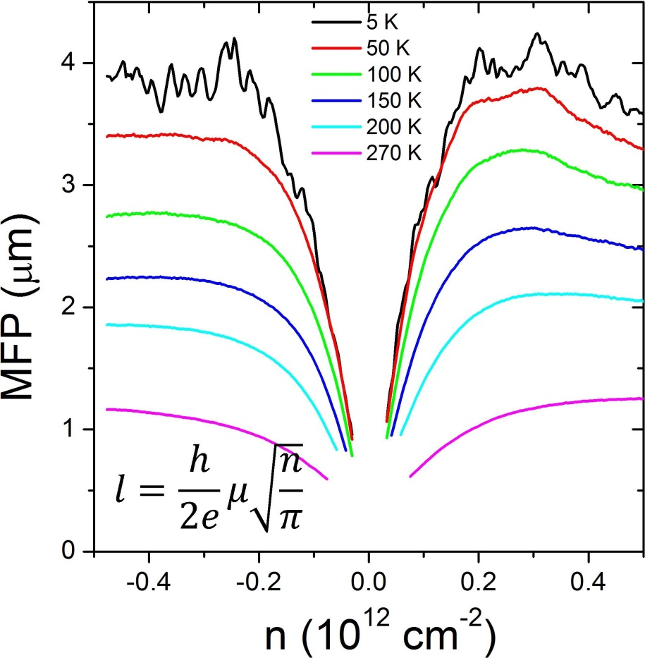
Mobility and Mean Free Path
The width of the Hall bar is 2 μm
At low temperatures the MFP is limited by the size of the device

Slide 12
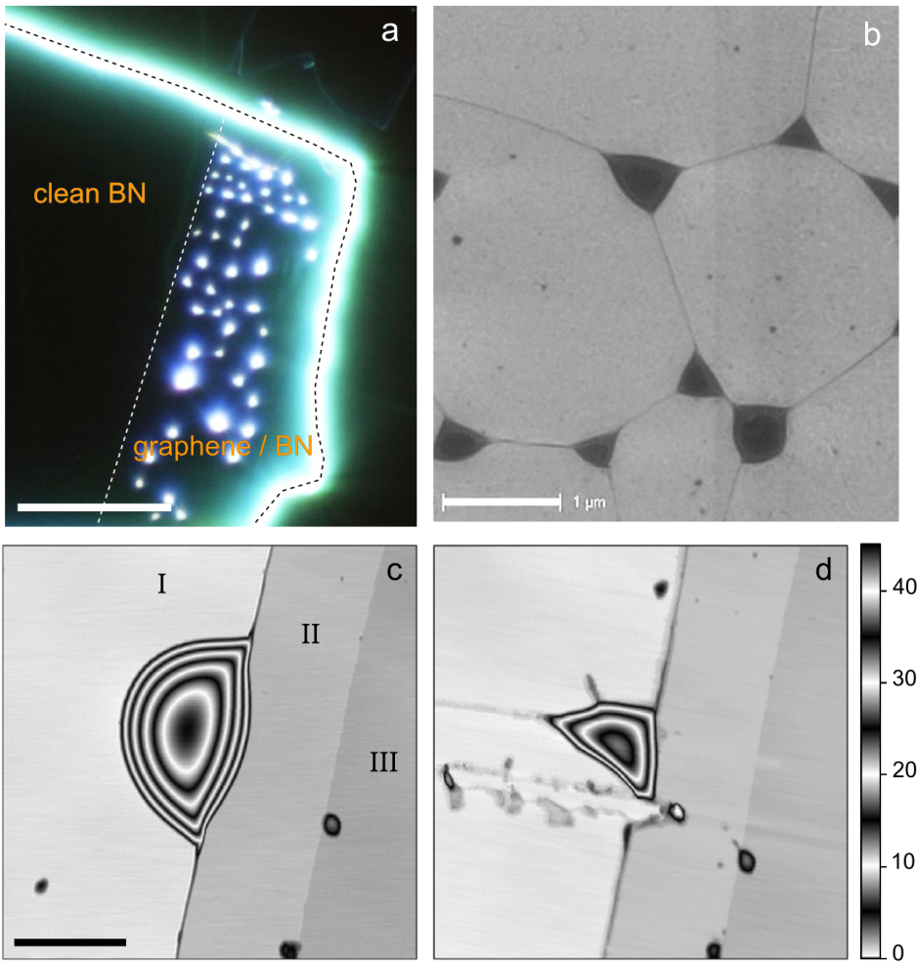
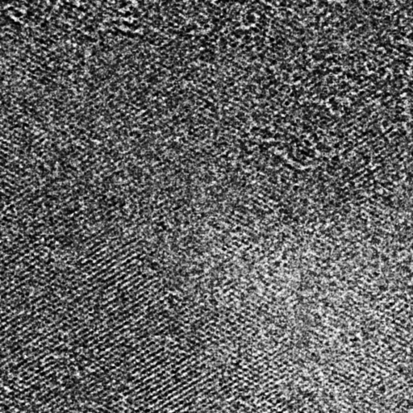
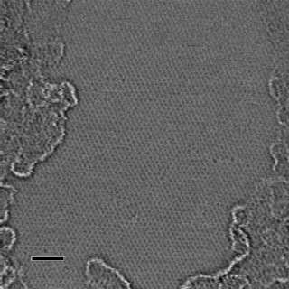
Bubbles
everything covered
with contamination
optics
SEM
TEM
20 μm
2 nm
AFM
AFM
occasional
10 nm scale
patches
0.5 μm
2 nm
so much contamination → BUBBLES

Slide 13
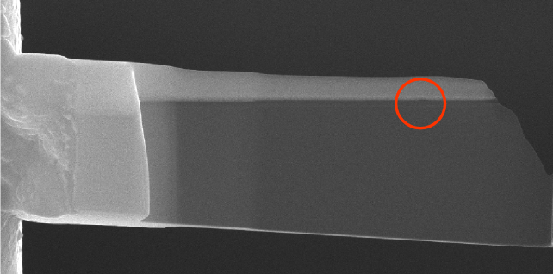
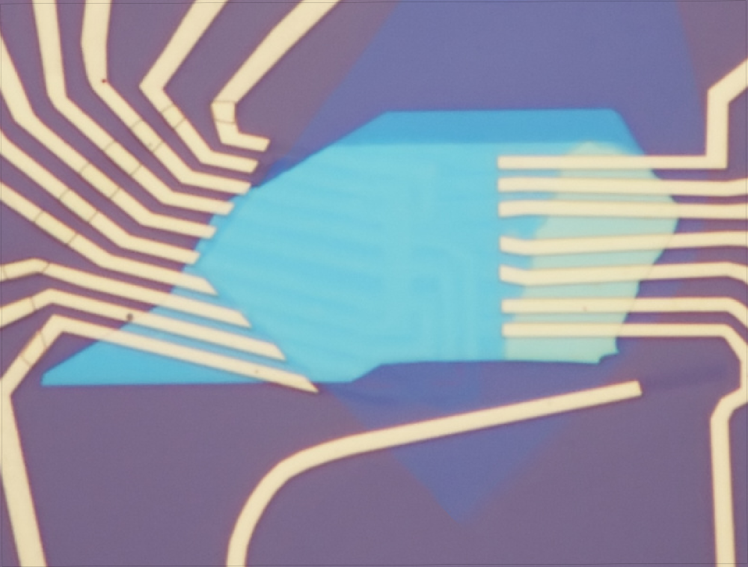
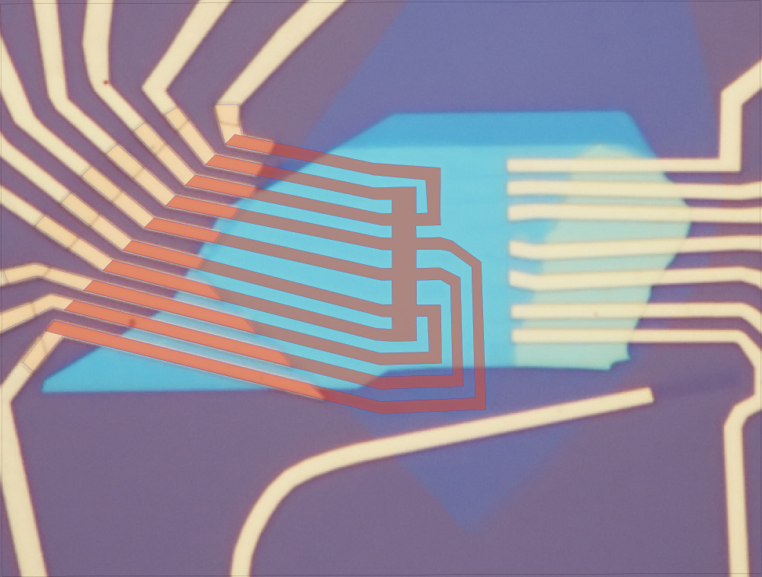
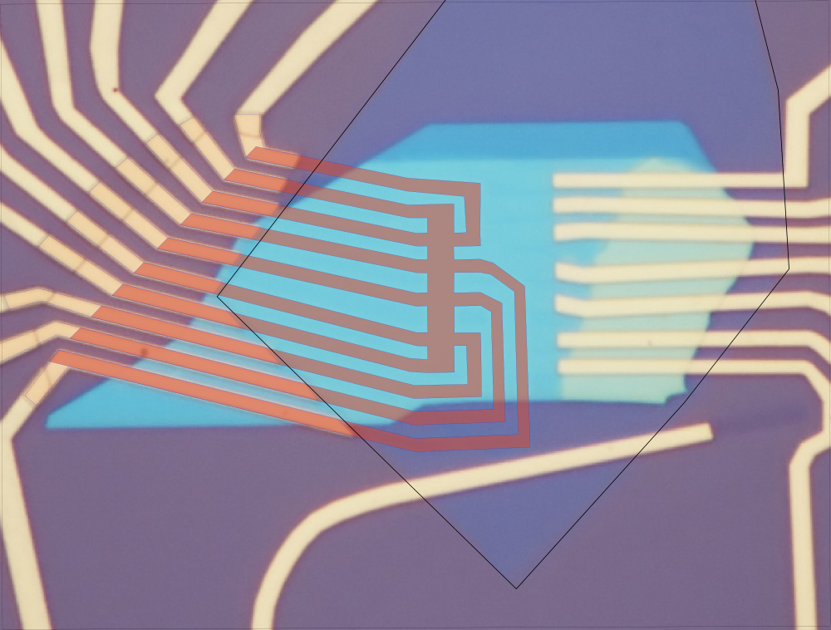
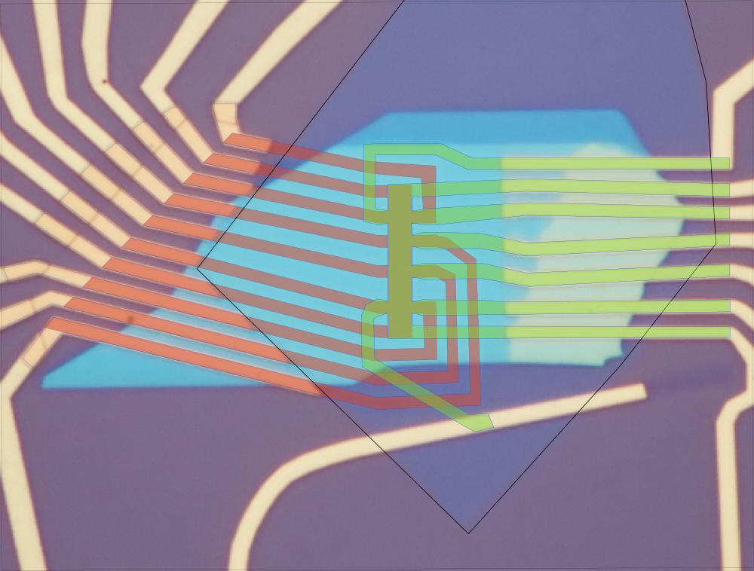
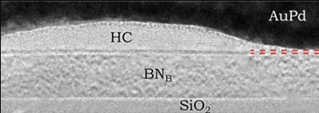
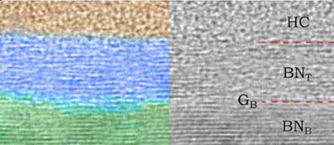
graphene-hBN interface in TEM
SEM
10 μm
NO CONTAMINATION LAYER
at the interface
between graphene & hBN
chemical
analysis
TEM
Focused ion beam (FIB) milling + STEM
Slices 20-70 nm thick
Manchester, Nature Materials 2012

Slide 14
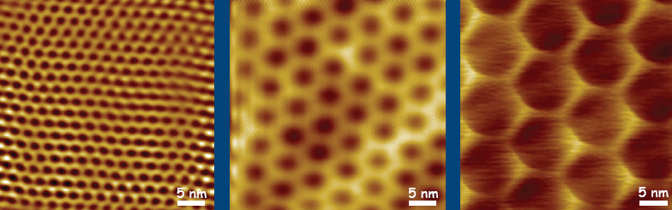
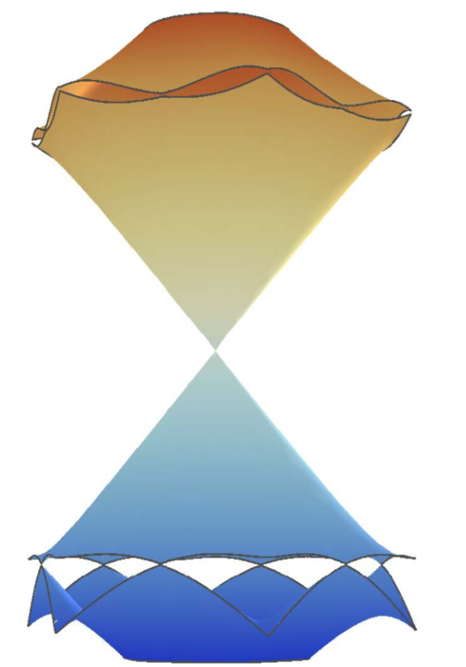
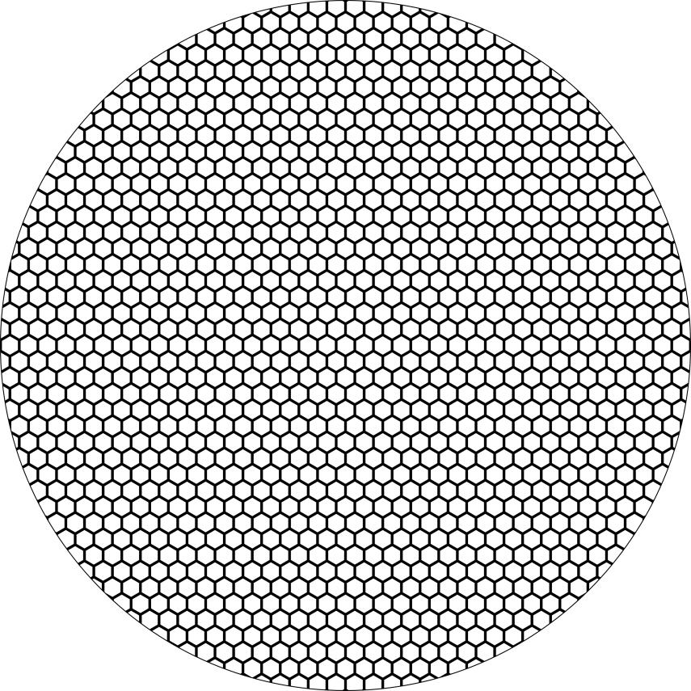
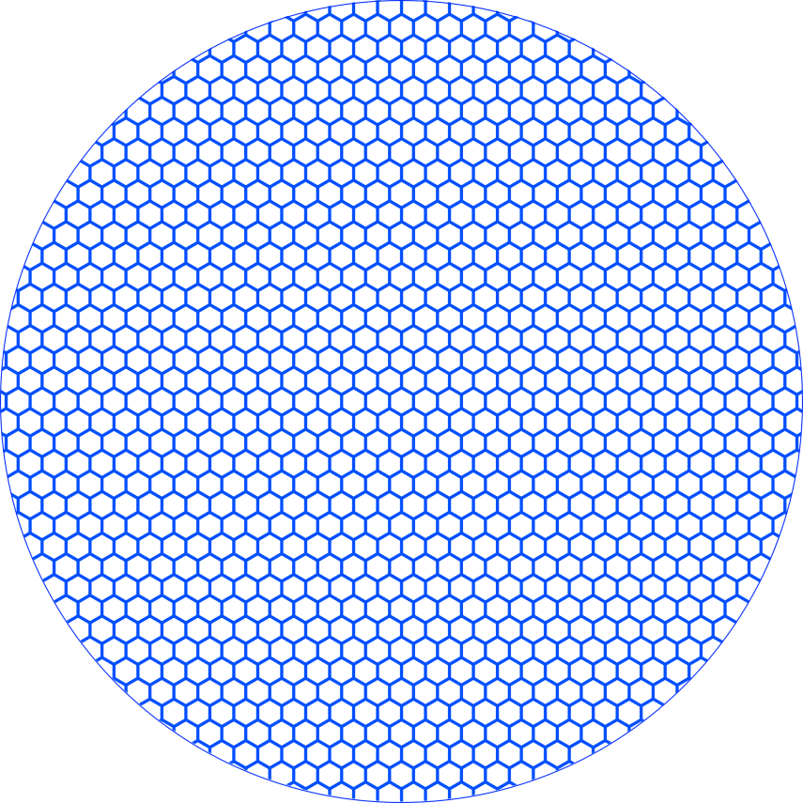
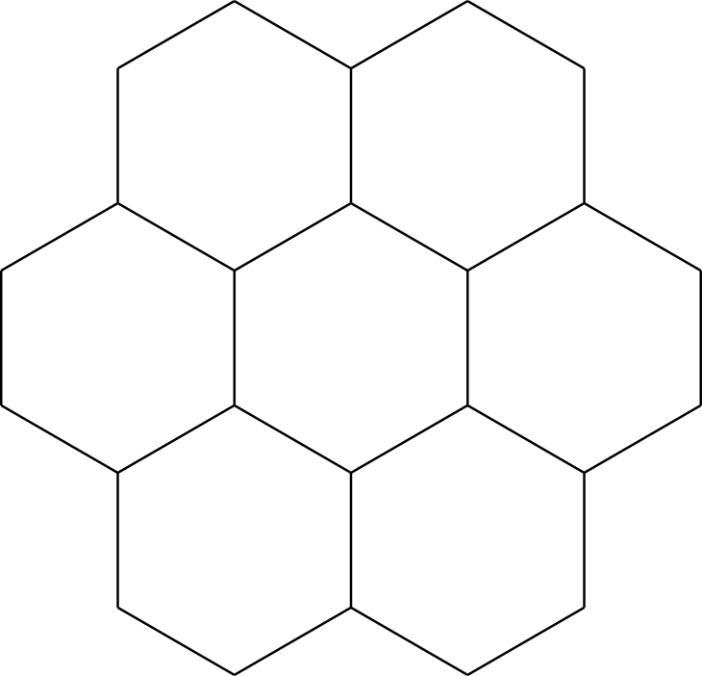


moiré patterns: graphene on hBN
periodicity =2.4 nm
6.0 nm
11.5 nm
Yankowitz et al, Nature Phys 2012
Xue et al, Nature Mat 2011; Decker et al, Nanolett 2011
STM
θ
1.8% lattice mismatch
$$E_{s}$$
THEORY:
Steve Louie‘s group
Nature Phys 2008, PRL 2008
Francois Peeters’ group
PRB 2010-2012
Burset et al, PRB 2011
Ortix et al, PRB 2012
Kindermann et al, PRB 2012
Fal’ko et al, PRB 2013
and SOME MORE
λ
$${−E}_{s}$$

Slide 15
moiré patterns: graphene on hBN
periodicity =2.4 nm
6.0 nm
11.5 nm
Yankowitz et al, Nature Phys 2012
θ
New Dirac points
generated
at the edges of
the superlattice
Brillouin zone
$$E_{s}$$
λ
for short periods,
gaps lie at
too high energies
$${−E}_{s}$$

Slide 16
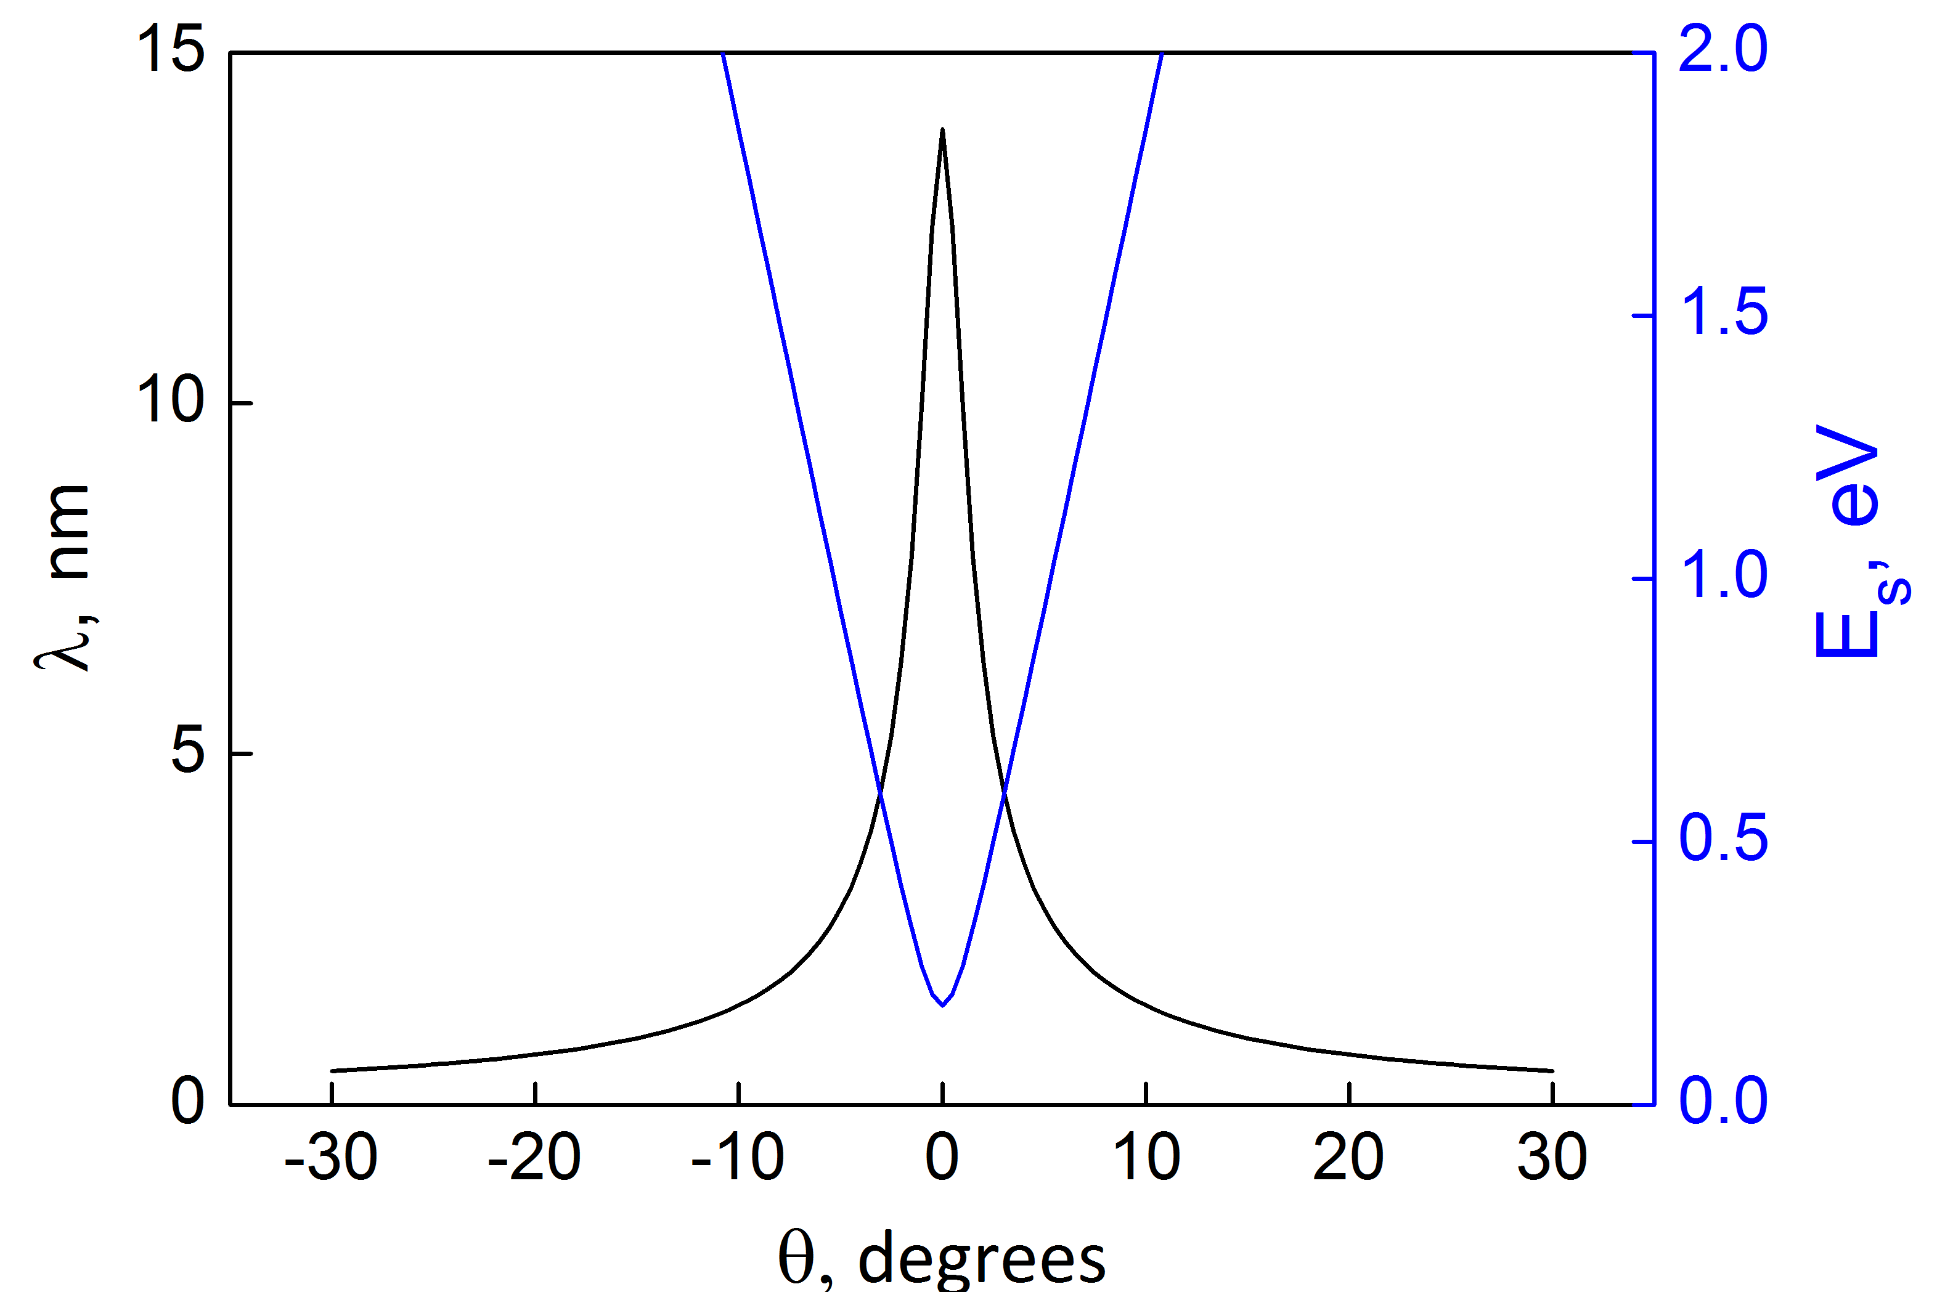
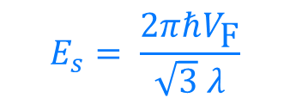
can we probe in transport?
periodicity =2.4 nm
6.0 nm
11.5 nm
need moiré
like this
Yankowitz et al, Nature Phys 2012
$$E_{s}= \frac{2πℏV_{\text{F}}}{\sqrt{3} λ}$$
$$E_{s}$$
for short periods,
gaps lie at
too high energies
“invisible”
for transport
measurements
<2 degrees
accessible by
the field effect
$${−E}_{s}$$

Slide 17
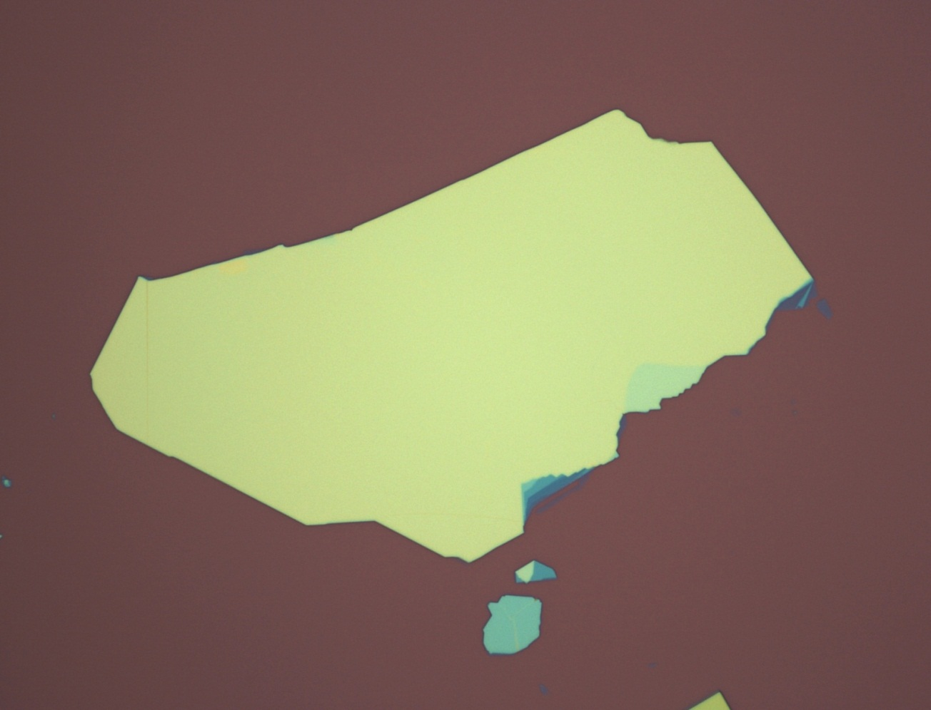
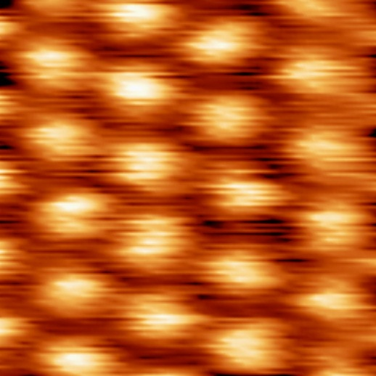
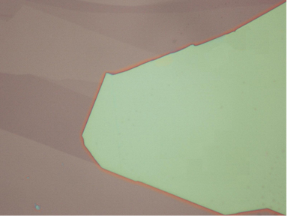
specially aligned graphene devices
ambient CAFM:
moiré in graphene on BN
with ∼12 nm period

Slide 18
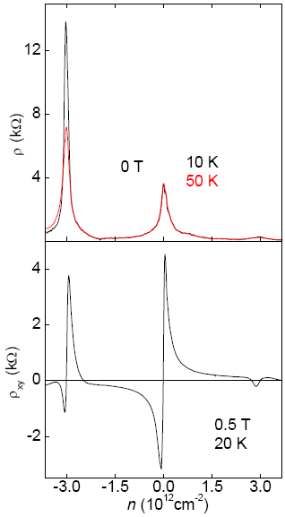

secondary Dirac points
specially aligned graphene devices
new neutrality points @0.2-0.35 eV
electron-like orbits for
strong hole doping and vice versa
n~3x10¹² cm⁻², λ = 13 nm, (A = 150 nm²)
4 electrons/u.c.
second generation
Dirac fermions
Ponomarenko et al. Nature (2013)

Slide 19


what happen in magnetic field?
Two competing lengthscales: a : lattice periodicity
l_{B} : magnetic length
ε
Duglas F. Hofstadter, Phys. Rev. B 14, 2239 (1976)
flux quanta per unit cell
Energy levels develop fractal structure when magnetic length is of the order of the lattice period
0
φ/φ₀
1
graphene:
graphene/BN superlattice:
λ ≈ 14 nm A ≈ 170 nm²
B ≈ 24 T (φ/φ₀ = 1)
a ≈ 0.25 nm ⇒ B ≈ 10⁴ T

Slide 20



Tracing gaps in B and n
ε
n/n₀
0
φ/φ₀
1
0
φ/φ₀
1
Hofstadter’s energy spectrum
Wannier diagram
Phys. Status Solidi 88, 757 (1978)
gaps are constrained to linear trajectories in the B-n diagram:
ℤ
n/n₀ – normalised density (n₀ = 4/A, where A is the area of supercell)

Slide 21



Magnetotransport measurements
Some of the features of Hofstadter’s energy spectrum are seen in magnetotransport
“Landau levels” fanning from the secondary DP
$$E_{LL}(12 T)>Δ_{vH}$$
Ponomarenko et al. Nature (2013)

Slide 22



Magnetotransport measurements
Some of the features of Hofstadter’s energy spectrum are seen in magnetotransport
Enhanced conductivity, periodic in 1/B
$$B_{q}=\frac{1}{q}\frac{φ_{0}}{A}, q∈ ℕ$$
$$σ_{xx}=\frac{ρ_{xx}}{{ρ_{xx}}_{}^{2}+{ρ_{xy}}_{}^{2}}$$
Ponomarenko et al. Nature (2013)

Slide 23









Capacitance Measurements
Simple and reliable technique for studying details of the band structure
$$V$$
$$d$$
$$C_{g}=\frac{εε_{0}}{d}, V=Ed=\frac{en}{C_{g}}$$
“geometrical” capacitance
$$V$$
$$V=Ed+\frac{1}{e}μ(n)$$
$$V∝n$$
$$C_{q}=e^{2}\frac{dn}{dμ}$$
$$\frac{1}{C}=\frac{1}{C_{g}}+\frac{1}{C_{q}}$$
density of states
L.A.Ponomarenko et al,
PRL 105 136801 (2010)

Slide 24
Signatures of Hofstadter’s butterfly
Capacitance measurements: density of states can be probed directly
Dark colours correspond to low DOS
Black – Landau fan (4x degenerate)
Blue – Landau fan (degeneracy lifted, QHFM)
Green – “Landau levels” from secondary DPs
Red – gaps in Hofstadter spectrum
G.L.Yu et al. Nature Physics 10, 525 (2014)

Slide 25

Commensurate-incommensurate transition in graphene on hBN
λ = 8nm
λ = 14nm
Resistance
Young’s modulus
Woods et al., Nature Phys., 10, 2014, 451.

Slide 26
Two types of G/hBN superlattices
Incommensurate:
Not aligned
No global gap
Commensurate:
Global A/B asymmetry
Global gap
Ponomarenko et al., Nature, 497, 2013, 594.
Woods et al., Nature Phys., 10, 2014, 451.

Slide 27





Massive Dirac Fermions in
van der Waals Heterostructure
A gap opens at the Dirac point in aligned structures,
$$∆ \sim 38 meV$$
Hunt et al., Science., 340, 1427 (2013)
Chen et al., Nature Comm. 5, 4461 (2014)

Slide 28



Berry Curvature
(some key properties)
The Berry curvature is an intrinsic property of the bend structure: if $|\left.u\left(k\right)\right\rangle$ is the eigenstate of the Hamiltonian $\hat{H}$, then the Berry curvature (density) $Ω\left(k\right)$ is:
$$Ω\left(k\right)=∇_{k}×A\left(k\right), where A\left(k\right)=i\left\langle u(k) | ∇_{k} | u(k)\right\rangle$$
$Ω\left(k\right)=0$ for the system with both inversion and time reversal symmetries
$Ω\left(k\right)$ is the local quantity (in k-space)
Anomalous velocity
$Ω\left(k\right)$ is observable (gauge invariant)
$Ω\left(k\right)$ affects electron dynamics, for example, group velocity
$$v\left(k\right)=\frac{1}{ℏ}\frac{∂ε(k)}{∂k}+\frac{e}{ℏ}E×Ω \left(k\right) (B=0)$$
Relation to the Berry phase $γ$ along a closed path C:
$γ=\int_{S}{Ω\left(k\right)}dk$, where S is the surface enclosed by C
Magnetic flux

Slide 29





Berry curvature in gapped graphene
Different A and B sublattices = Broken inversion symmetry
$$Ω\left(k\right)=±\frac{v_{F}Δ}{2{\left[ε\left(k\right)\right]}^{3}}$$
$Ω\left(k\right)$ hot spots at K and K’
$$Ω\left(−\vec{k}\right)≠Ω\left(\vec{k}\right)$$
Xiao D., Yao W., Niu Q.,
PRL, 99, 2007, 236809.
B = 0,
$$Ω\left(\vec{k}\right)=−Ω\left(−\vec{k}\right)$$
Time reversal symmetry requires

Slide 30


Berry curvature in gapped graphene:
nonlocal measurements
Valley Hall effect: voltage applied across the device gives rise to counter-propagating streams of carriers in two valleys. A reverse process creates the electric field in remote regions.
Berry curvature hot
spots
B = 0T, T = 20K
Gorbachev et al., Science, 346, 2014, 448.

Slide 31



Nonlocal measurements:
carrier density dependence
$$ρ_{xx}$$
$${ρ }_{xx}^{3}$$
Gorbachev et al., Science, 346, 2014, 448.
B = 0T, T = 20K

Slide 32
Nonlocal measurements:
length dependence
anomalous contribution to ρ_{xx} observed in the bend geometry
10 devices,
20 K
L =
7 μm
ξ ≈ 1 μm
Nonlocal signal decays exponentially with increasing L
Gorbachev et al., Science, 346, 2014, 448.
B = 0T, T = 20K

Slide 33








Conclusions
Graphene superlattice is an excellent example of “band structure engineering” and creating artificial structures with on demand properties (simply by controlling the orientation of graphene with respect to the properly chosen substrate)
Hofstadter butterfly has been finally observed (almost 40 years after its prediction)
Valley Hall effect observed in gapped graphene in zero field
Thank you!

