Slide 1
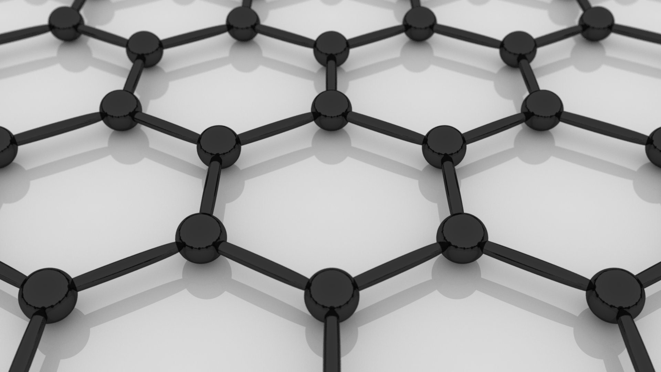

CVD graphene for quantum metrology
R. Ribeiro-Palau
Laboratoire National de Métrologie et d’Essais
(French National Metrology and Testing Laboratory)

Slide 2
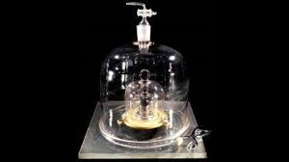
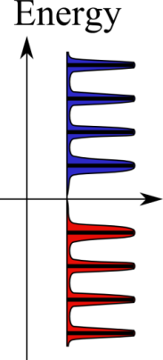
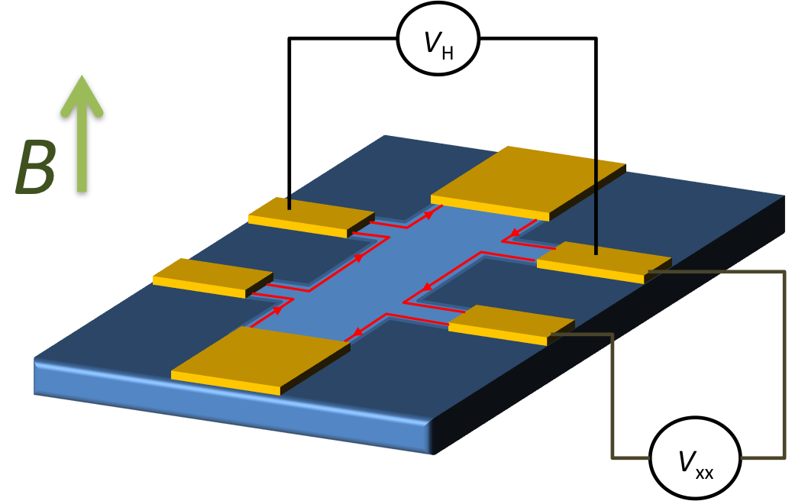
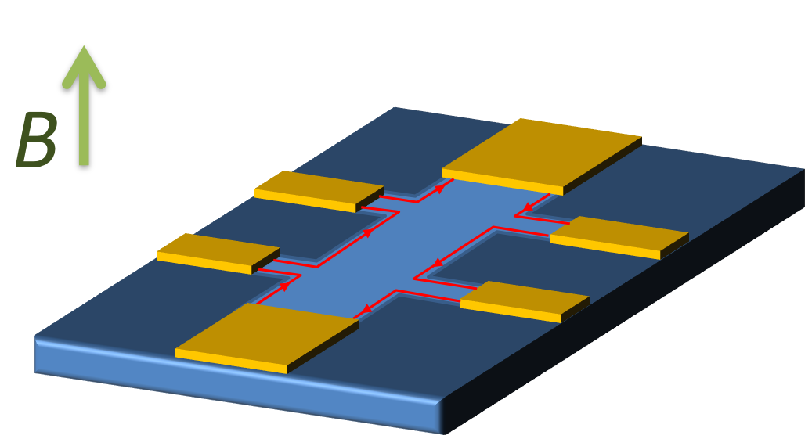
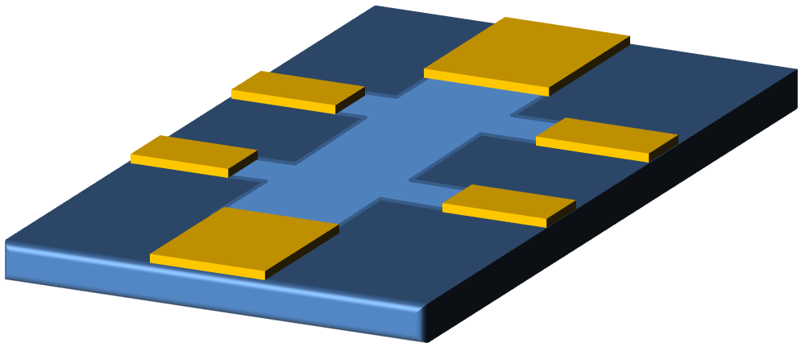
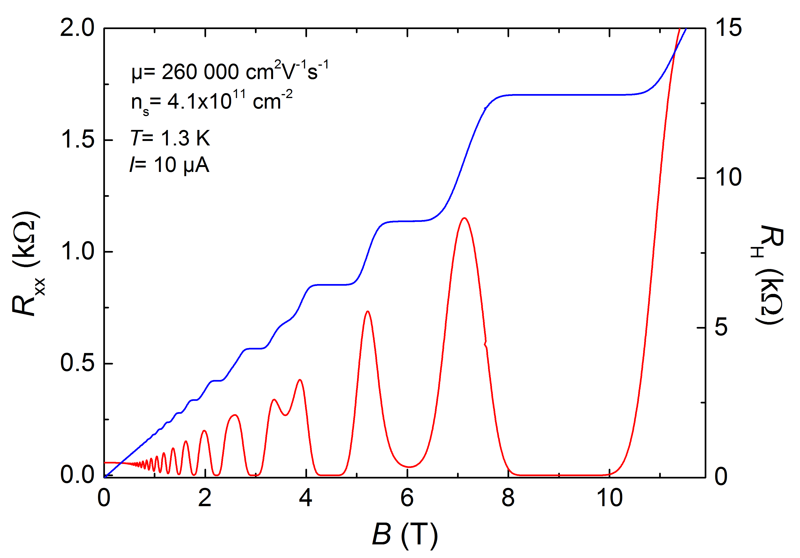
Electrical resistance standard
kilogram standard
Quantum Hall resistance in GaAs/AlGaAs has been the practical electrical resistance standard of the SI since 1990
Applying a magnetic field
R_{H}=R_{K}/2=h/2e²
Typical accuracy of ΔR_{H}/R_{H}≈10⁻⁹
in GaAs/AlGaAs devices
- 400 μm wide Hall bar
- I ≤40 μA
- B ≥ 9 T
- T ≤ 1.3 K
Practical?

Slide 3
Outline
Why to use graphene as an electrical resistance standard?
Is graphene truly better than GaAs/AlGaAs?
Our approach: CVD on SiC
Highly accurate experiments: B, T, I space

Slide 4
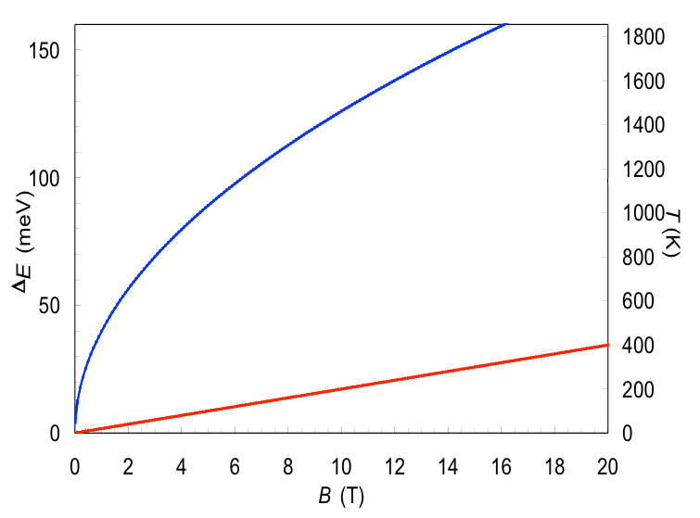
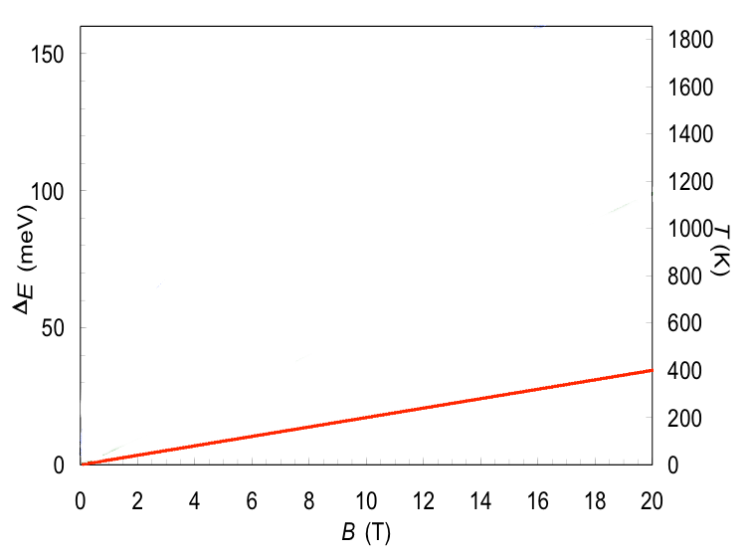
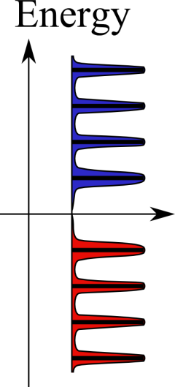
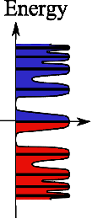
Graphene as an electrical resistance standard
First Landau levels spacing
To minimize thermal activation between Landau levels
Monolayer graphene
ΔE >> k_{B}T
More precisely, to obtain 1 part in 10⁹ precision:
ΔE/k_{B}T > 100
@ 2 K
GaAs
Graphene advantages:
New generation of electrical resistance standards:
- Higher temperature (T>4 K)
Helium free cryostats
- Lower magnetic field (B<5 T)
Transportable coils
- High operation current (I >100 µA)
Commercial resistance bridge

Slide 5
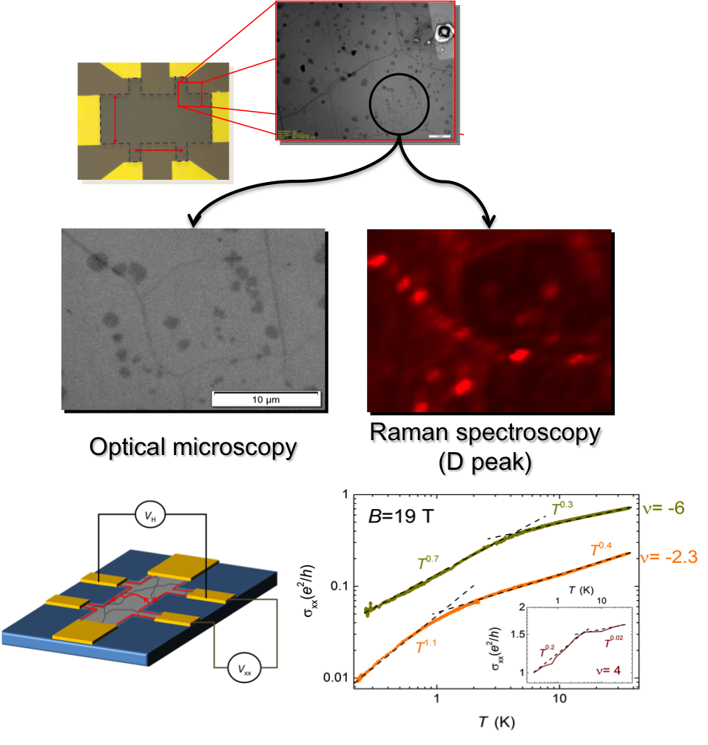
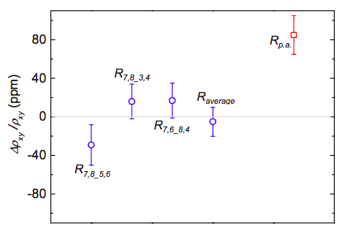
Graphene QHRS timeline
2005
Observation of the QHE in graphene
K. Novoselov et al., Nature (2005)
Y. Zhang et al., Nature (2005)
 | Large size (10000 μm²) | High mobility (>5000 cm²V⁻¹s⁻¹) | Low carrier density (<2x10¹¹ cm⁻²) | Reproducible result
Mechanical exfoliation | ✗ | ✓ | ✓ | ✗
SiC sublimation | ✓ | ✓ | ✗ | ✗
CVD | ✓ | ✓ | ? | ?
ΔR_{H}/R_{H}=15x10⁻⁶
B= 14 T
T= 300 mK
2009
First accurate measurements
A. J. M. Giesbers et al., APL (2009)
2010
Highly accurate measurements
ΔR_{H}/R_{H}=9x10⁻¹¹
B= 14 T
T= 300 mK
2011
A. Tzalenchuk et al., Nature Nano (2010)
T. J. B. M. Janssen et al., New J. of Phys. and Metrologia (2011)
2013
Anomalous dissipation mechanism in CVD graphene
Lafont F., Ribeiro-Palau R. et al., PRB (2014)
Not yet competitive with GaAs-based quantum resistance standards
2014
… ?
2015

Slide 6
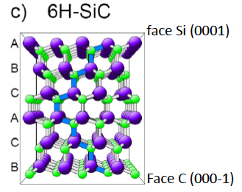


Chemical vapor deposition on SiC
Horizontal hot-wall CVD reactor designed for SiC epitaxy
Precursor
C₃H₈
T = 1550 °C
Carrier gas:
Hydrogen/Argon
(23 % H)
P = 800 mbar
Semi-insulating 0.16° off-axis 6H-SiC substrate
C
Graphene
SiC
More details in: A. Michon et al., APL (2010)

Slide 7
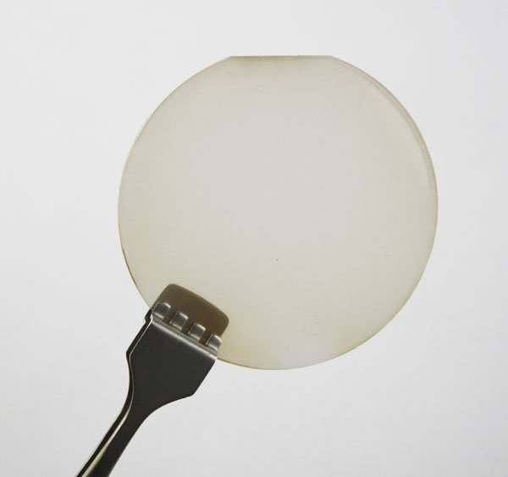
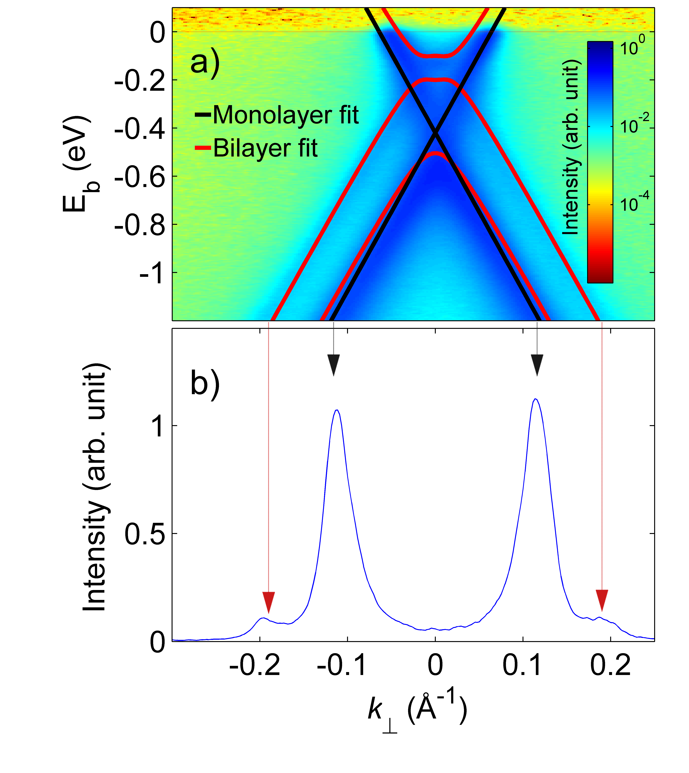
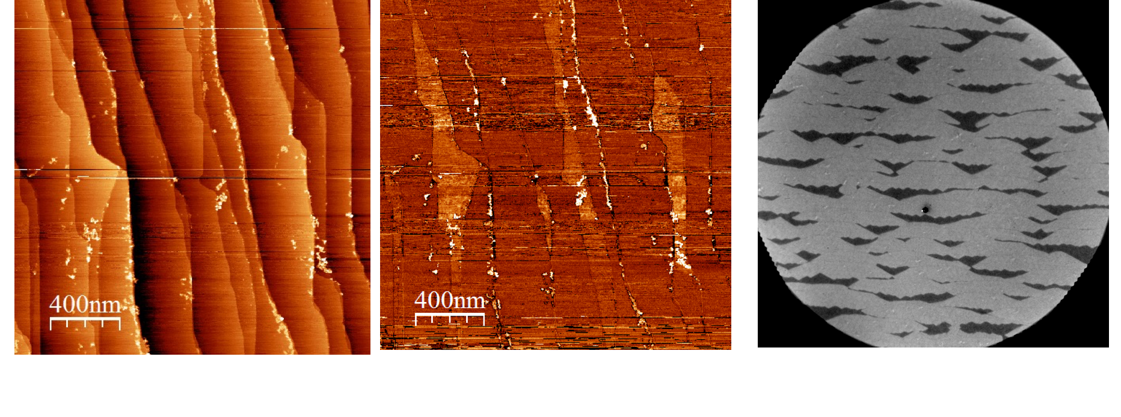
Chemical vapor deposition on SiC
ARPES
MLG n_{s}≈1x10¹³ cm⁻²
BLG n_{s}≈3x10¹² cm⁻²
Low energy electron microscopy
More details in:
Jabakhanji et al. PRB (2014)
Atomic Force Microscopy

Slide 8
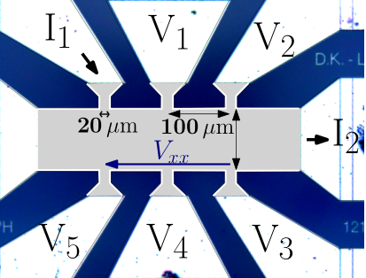
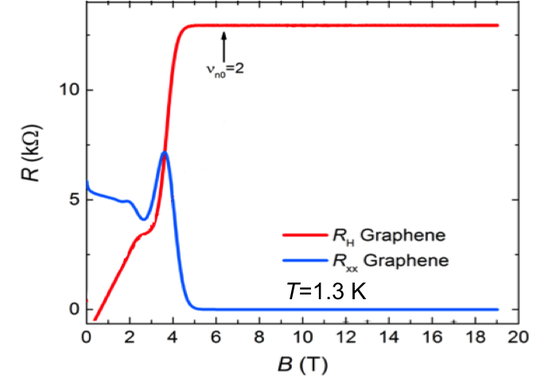
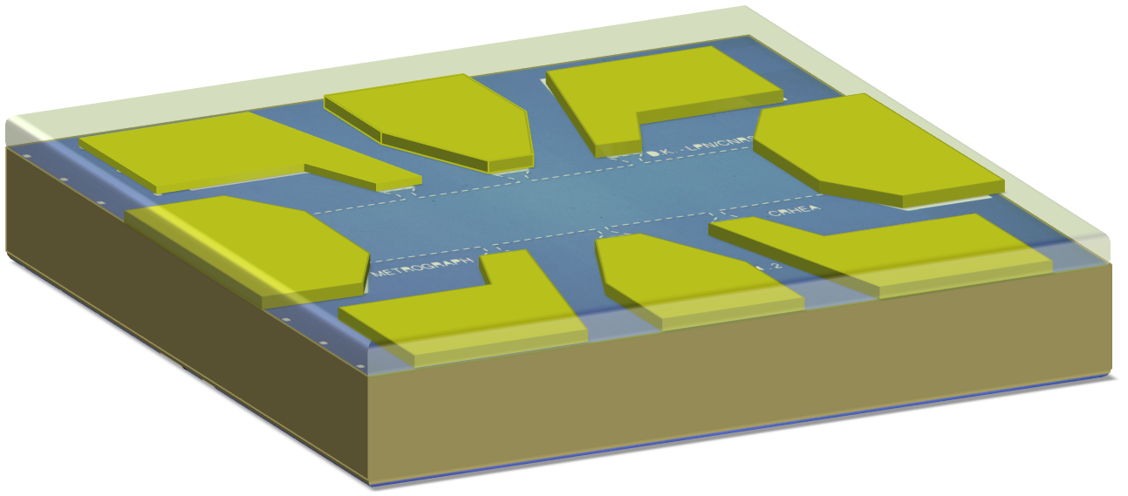

Chemical vapor deposition on SiC
Hall bar of 420 μm x 100 μm
ARPES
Low contact resistance (< 1 Ω)
essential in accurate measurements
Chemical gate
500°C annealing + P(MMA-MAA)/ZEP520A
(no illumination)
MLG n_{s}≈1x10¹³ cm⁻²
n_{s}=3.2x10¹¹ cm⁻²
µ=3800 cm²V⁻¹s⁻¹
BLG n_{s}≈3x10¹² cm⁻²
Lara-Avila S. et al., Adv. Mat. (2011)

Slide 9
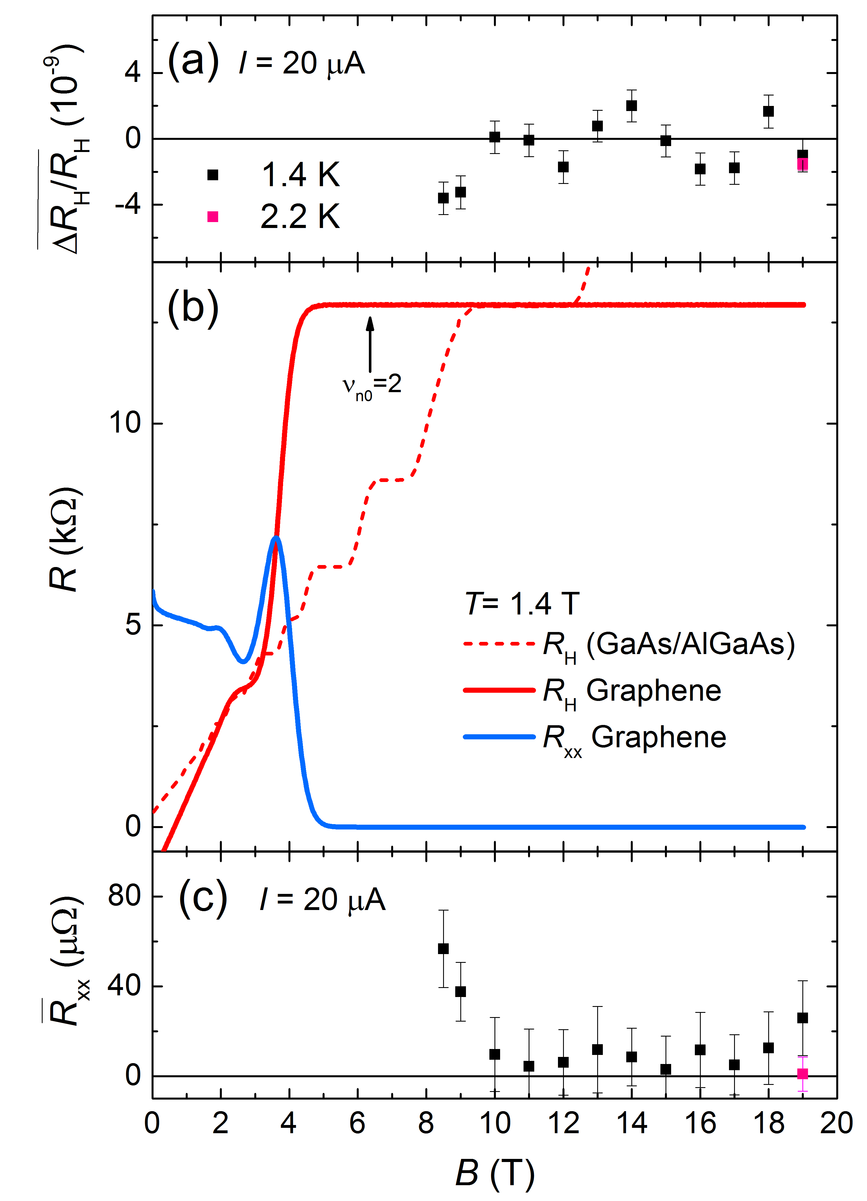

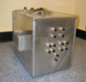
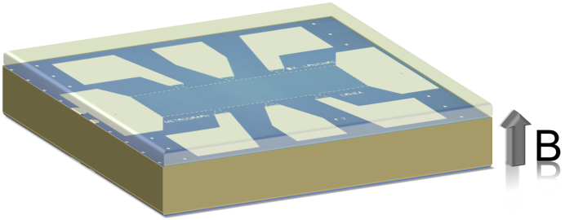
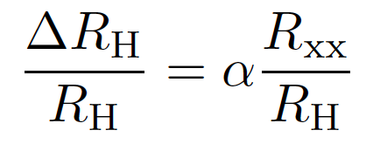
Resistance quantization
n_{s}=3.2x10¹¹ cm⁻²
1s.d.
Accurate Hall resistance measurements
Indirect comparisons of R_{H-G} with the resistance of a GaAs-QHRS (LEP514) via an intermediate room-temperature 100 Ω resistor, using a cryogenic current comparator bridge.
r_{GaAs}
r_{Graph}
GaAs/AlGaAs
100 Ω
wire resistor
Graphene
T=1.3 K
Longitudinal resistance or quantization parameter
Coupling factor:
-0.67
R_{xx}≤ 20 μΩ
To preserve 1x10⁻⁹ accuracy
F. Lafont, R. Ribeiro-Palau et al., Nature Comms. (2015)

Slide 10
Resistance quantization
n_{s}=3.2x10¹¹ cm⁻²
1s.d.
Accurate Hall resistance measurements
10⁻⁹ accuracy under the same conditions as GaAs QHRS
10⁻⁹ accuracy over a magnetic field range of 9 T
(in GaAs/AlGaAs samples <2 T)
T=1.3 K
Quantization regime does not correspond to ν=2 (calculated from n_{s})
Longitudinal resistance or quantization parameter
Coupling factor:
-0.67
R_{xx}≤ 20 μΩ
To preserve 1x10⁻⁹ accuracy
F. Lafont, R. Ribeiro-Palau et al., Nature Comms. (2015)

Slide 11
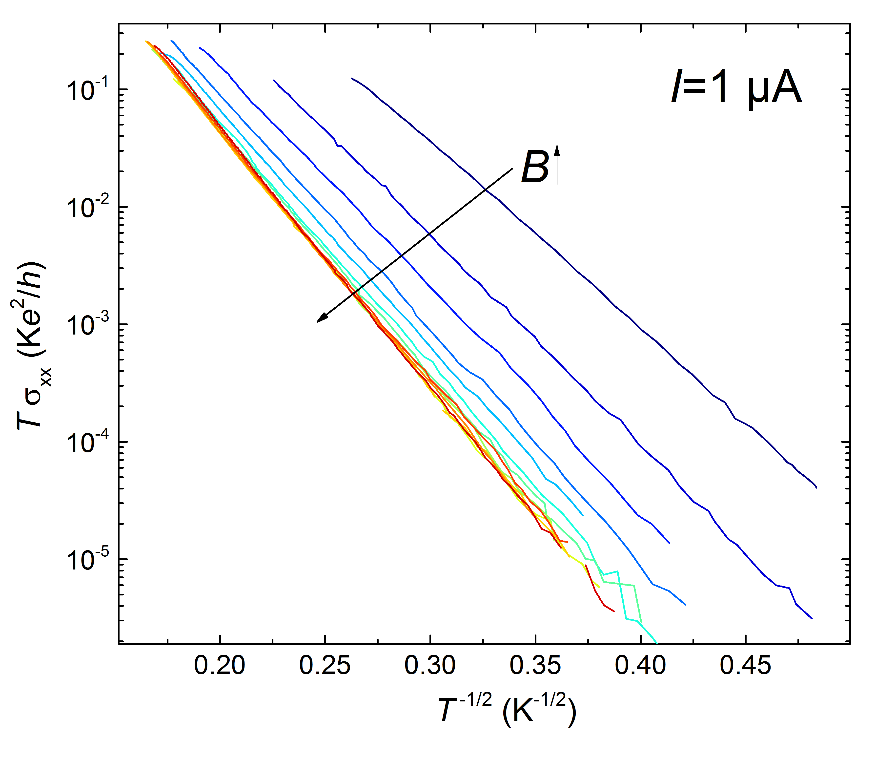
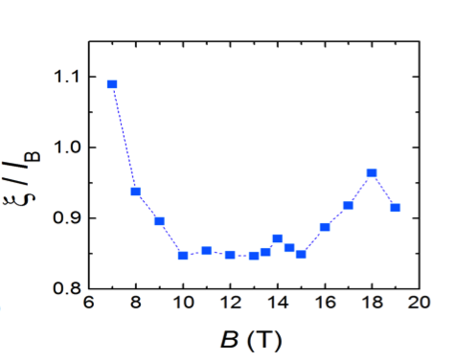
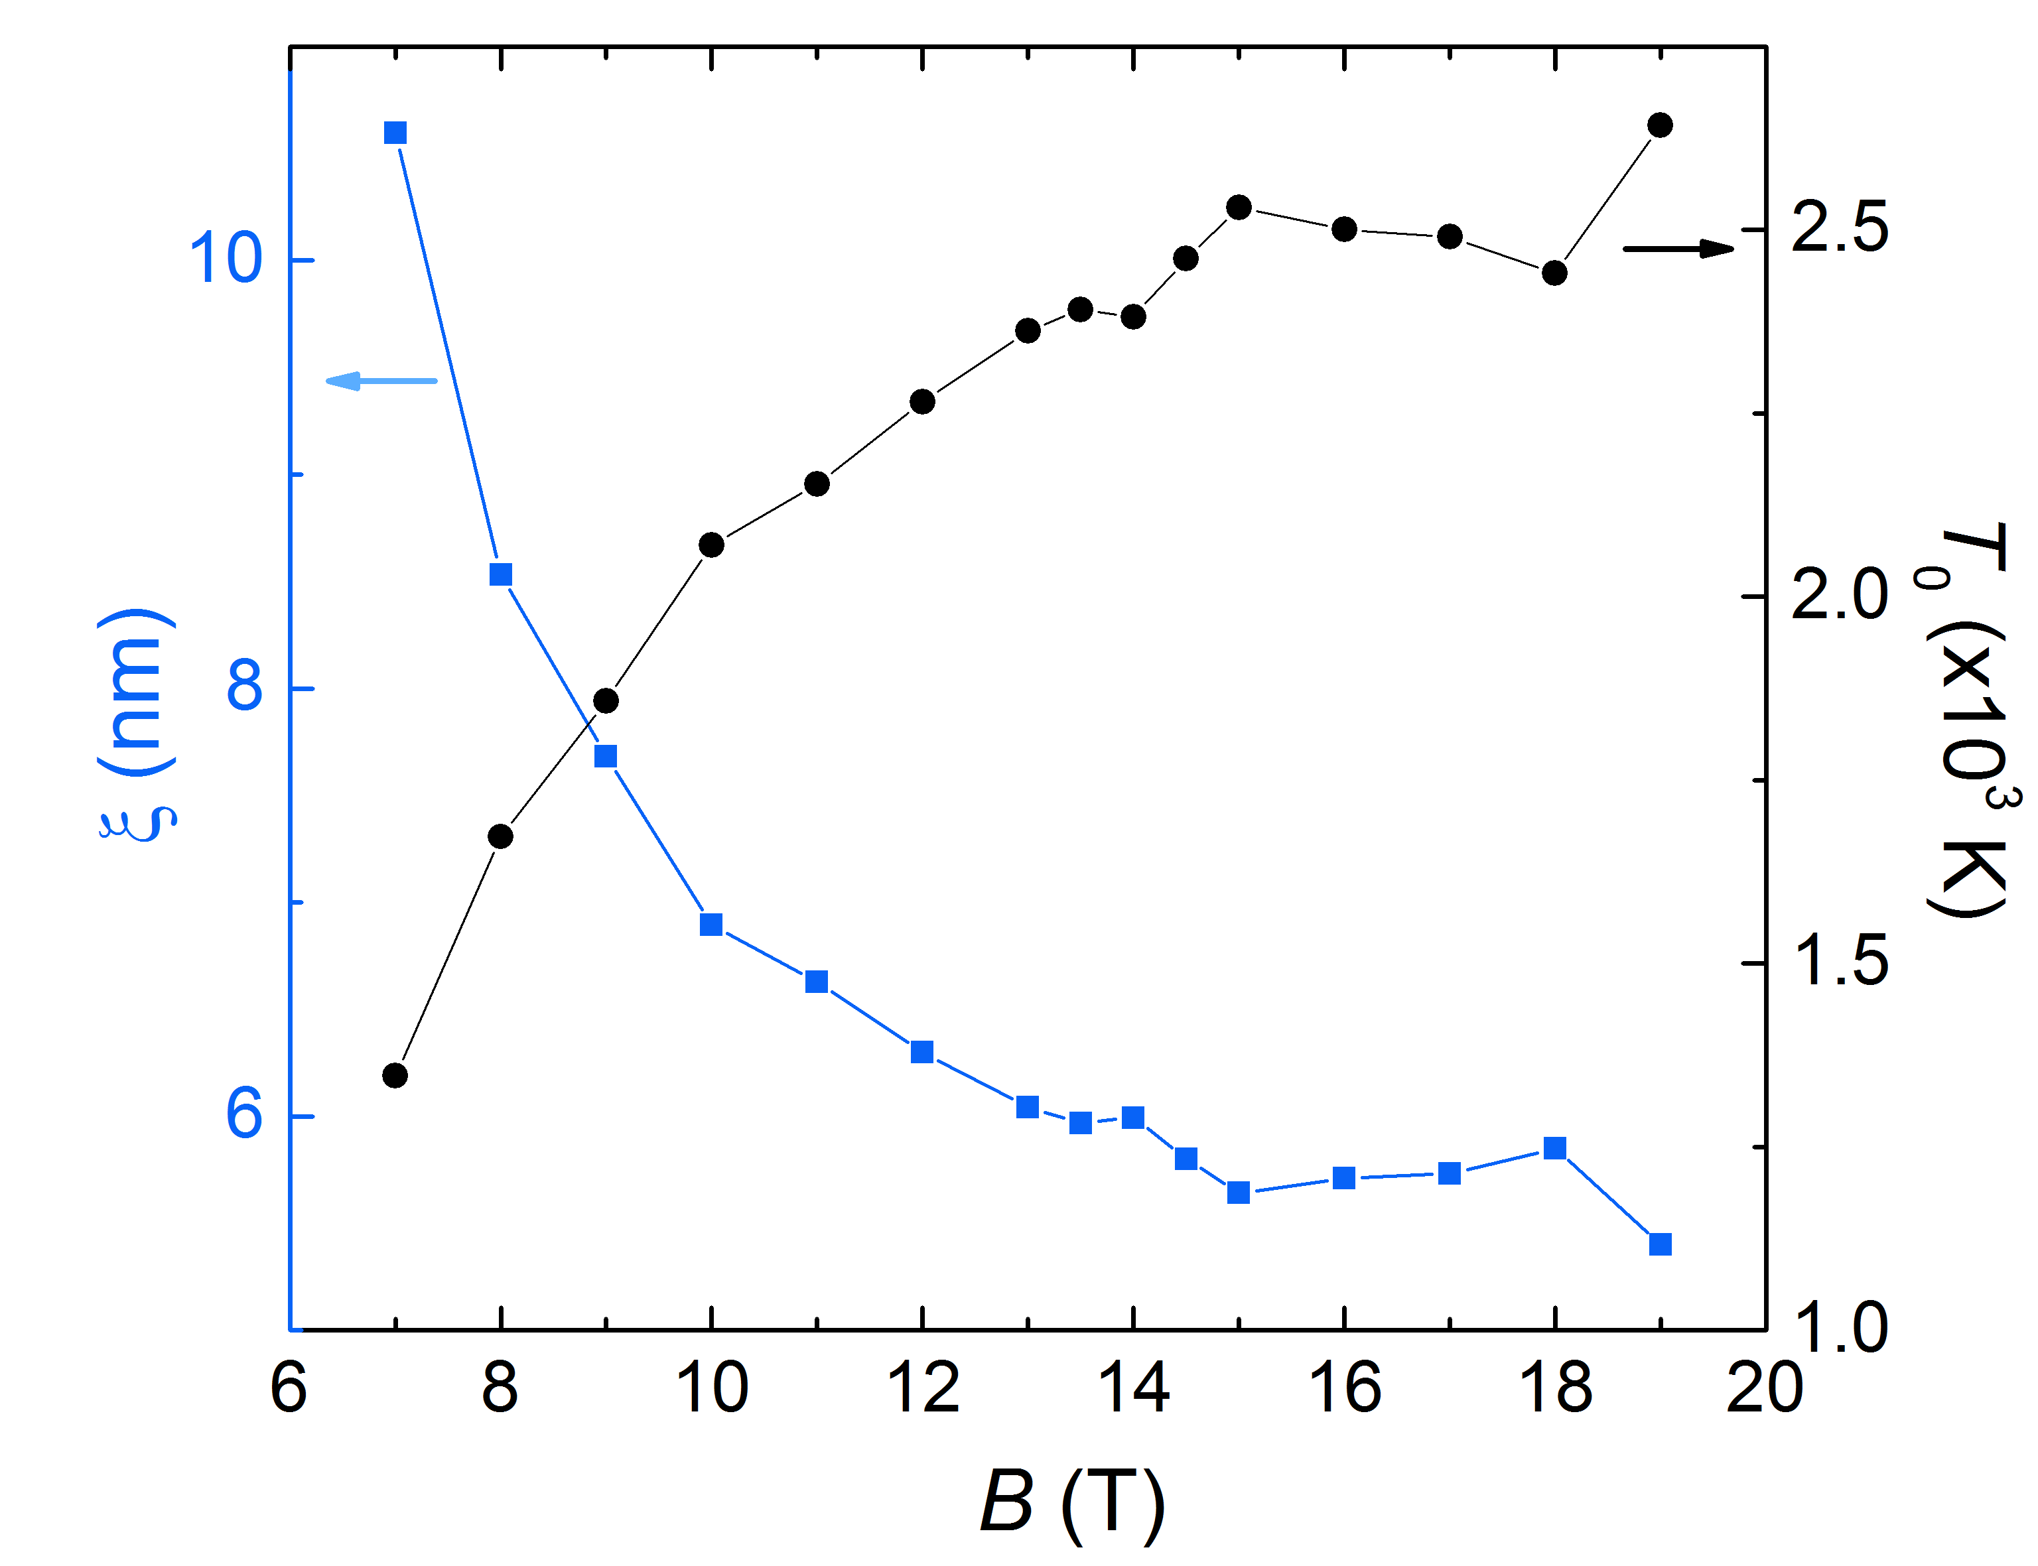
Resistance quantization
n_{s}=3.2x10¹¹ cm⁻²
Variable Range Hopping mechanism
40 K
(7 T- 19 T)
4 K
Possible linear increase of the density with magnetic field

Slide 12
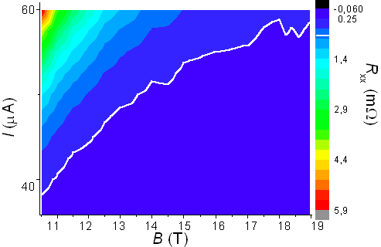
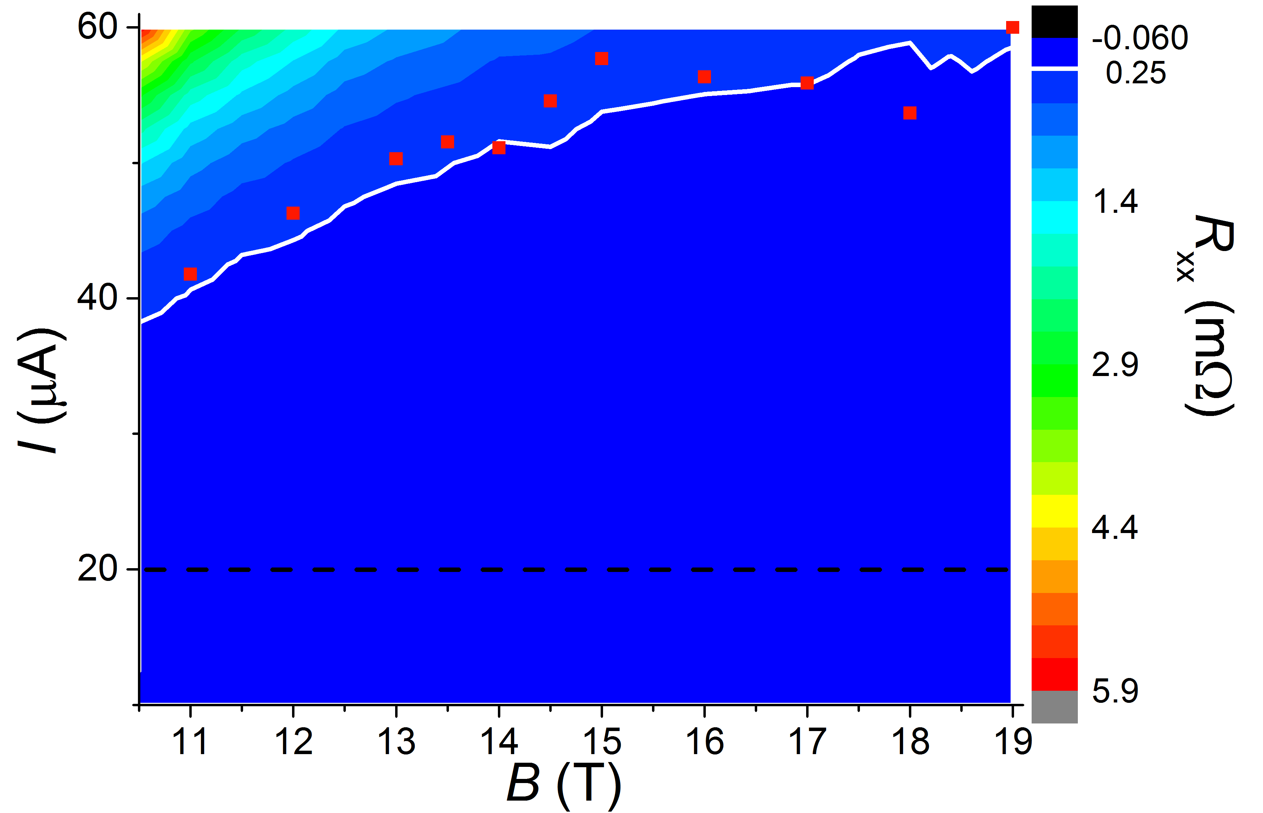
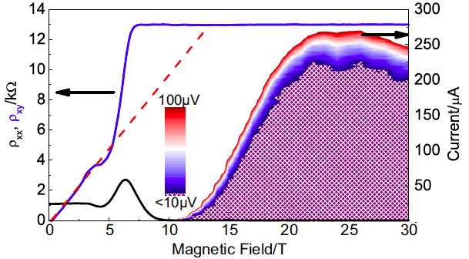
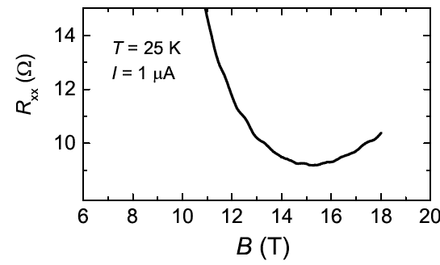
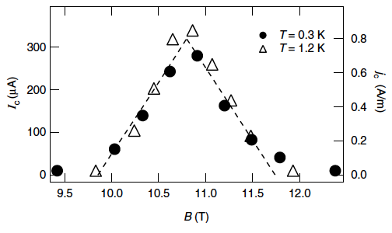
Breakdown current
n_{s}=3.2x10¹¹ cm⁻²
Graphene from sublimation of SiC
ξ ²
n_{s}~6.5x10¹¹ cm⁻²
Alexander-Webber et al. PRL (2013)
Breakdown current in GaAs/AlGaAs
Maximum of current is found at ν integer
Jeckelmann et al. IEEE Trans. Instrum. Meas. (2001)

Slide 13
Chemical vapor deposition on SiC
Horizontal hot-wall CVD reactor designed for SiC epitaxy
Precursor
C₃H₈
T = 1550 °C
Carrier gas:
Hydrogen/Argon
(44 % H)
P = 800 mbar
Semi-insulating 0.16° off-axis 6H-SiC substrate
C
Graphene
SiC
More details in: A. Michon et al., APL (2010)

Slide 14
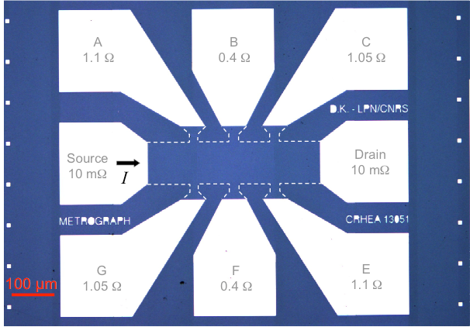
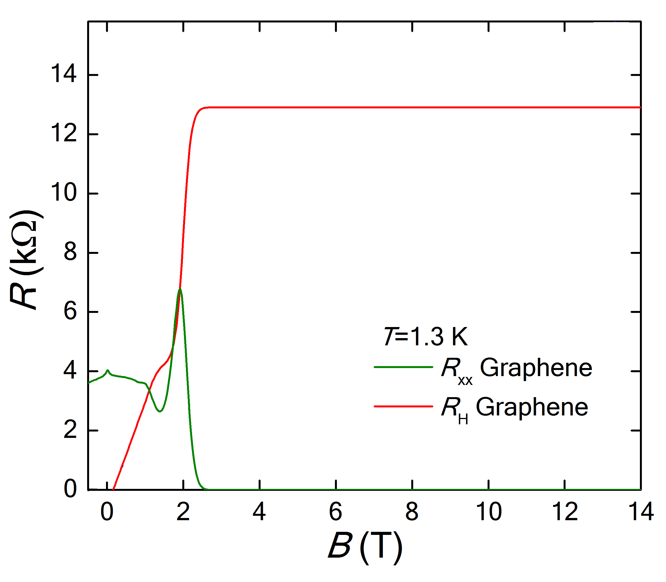
Chemical vapor deposition on SiC
Hall bar of 420 μm x 100 μm
Chemical gate
500°C annealing + P(MMA-MAA)/ZEP520A
(no illumination)
n_{s}≈1.8×10¹¹ cm⁻²
μ≈9 400 cm²V⁻¹s⁻¹
Lara-Avila S. et al., Adv. Mat. (2011)

Slide 15
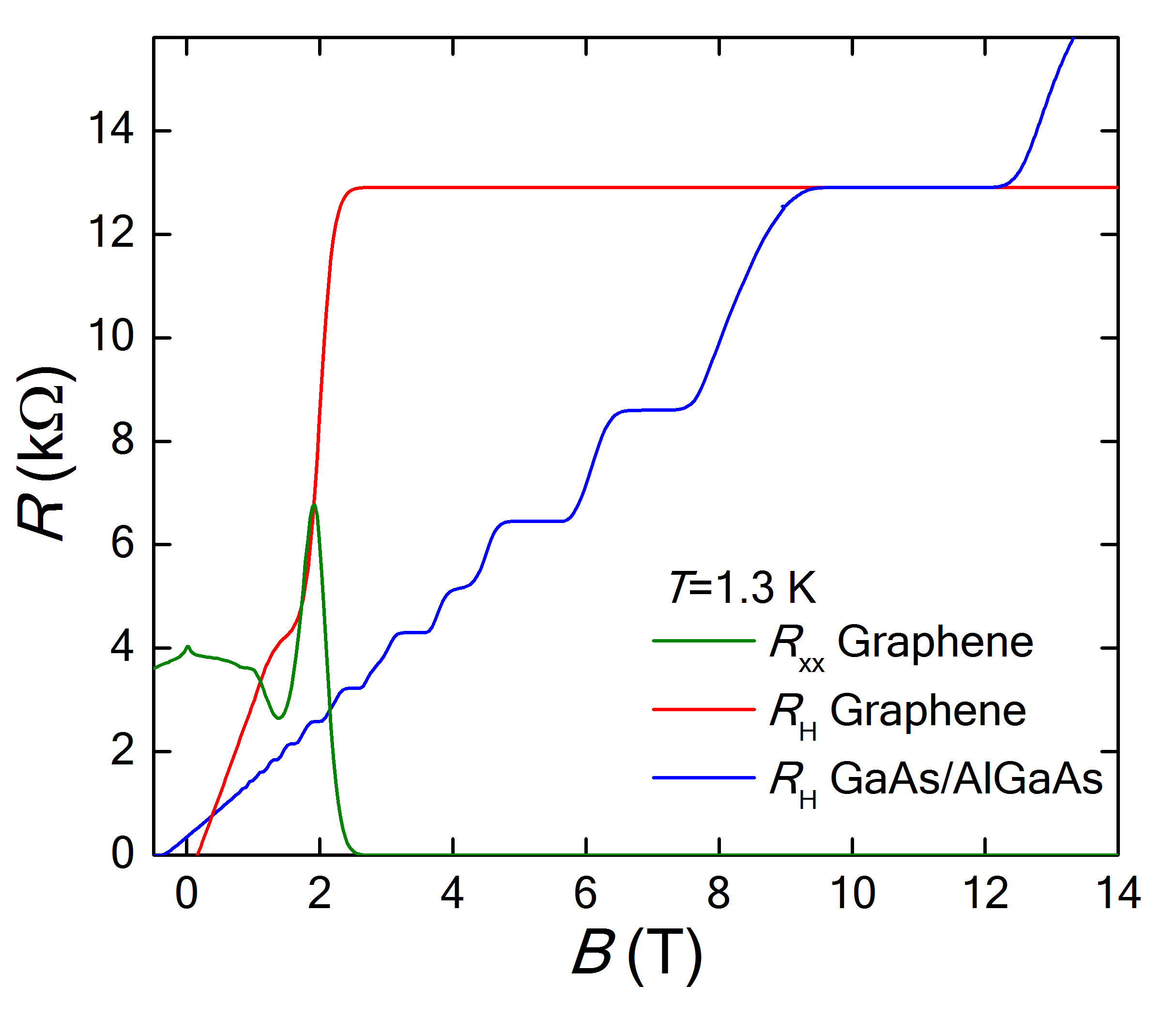
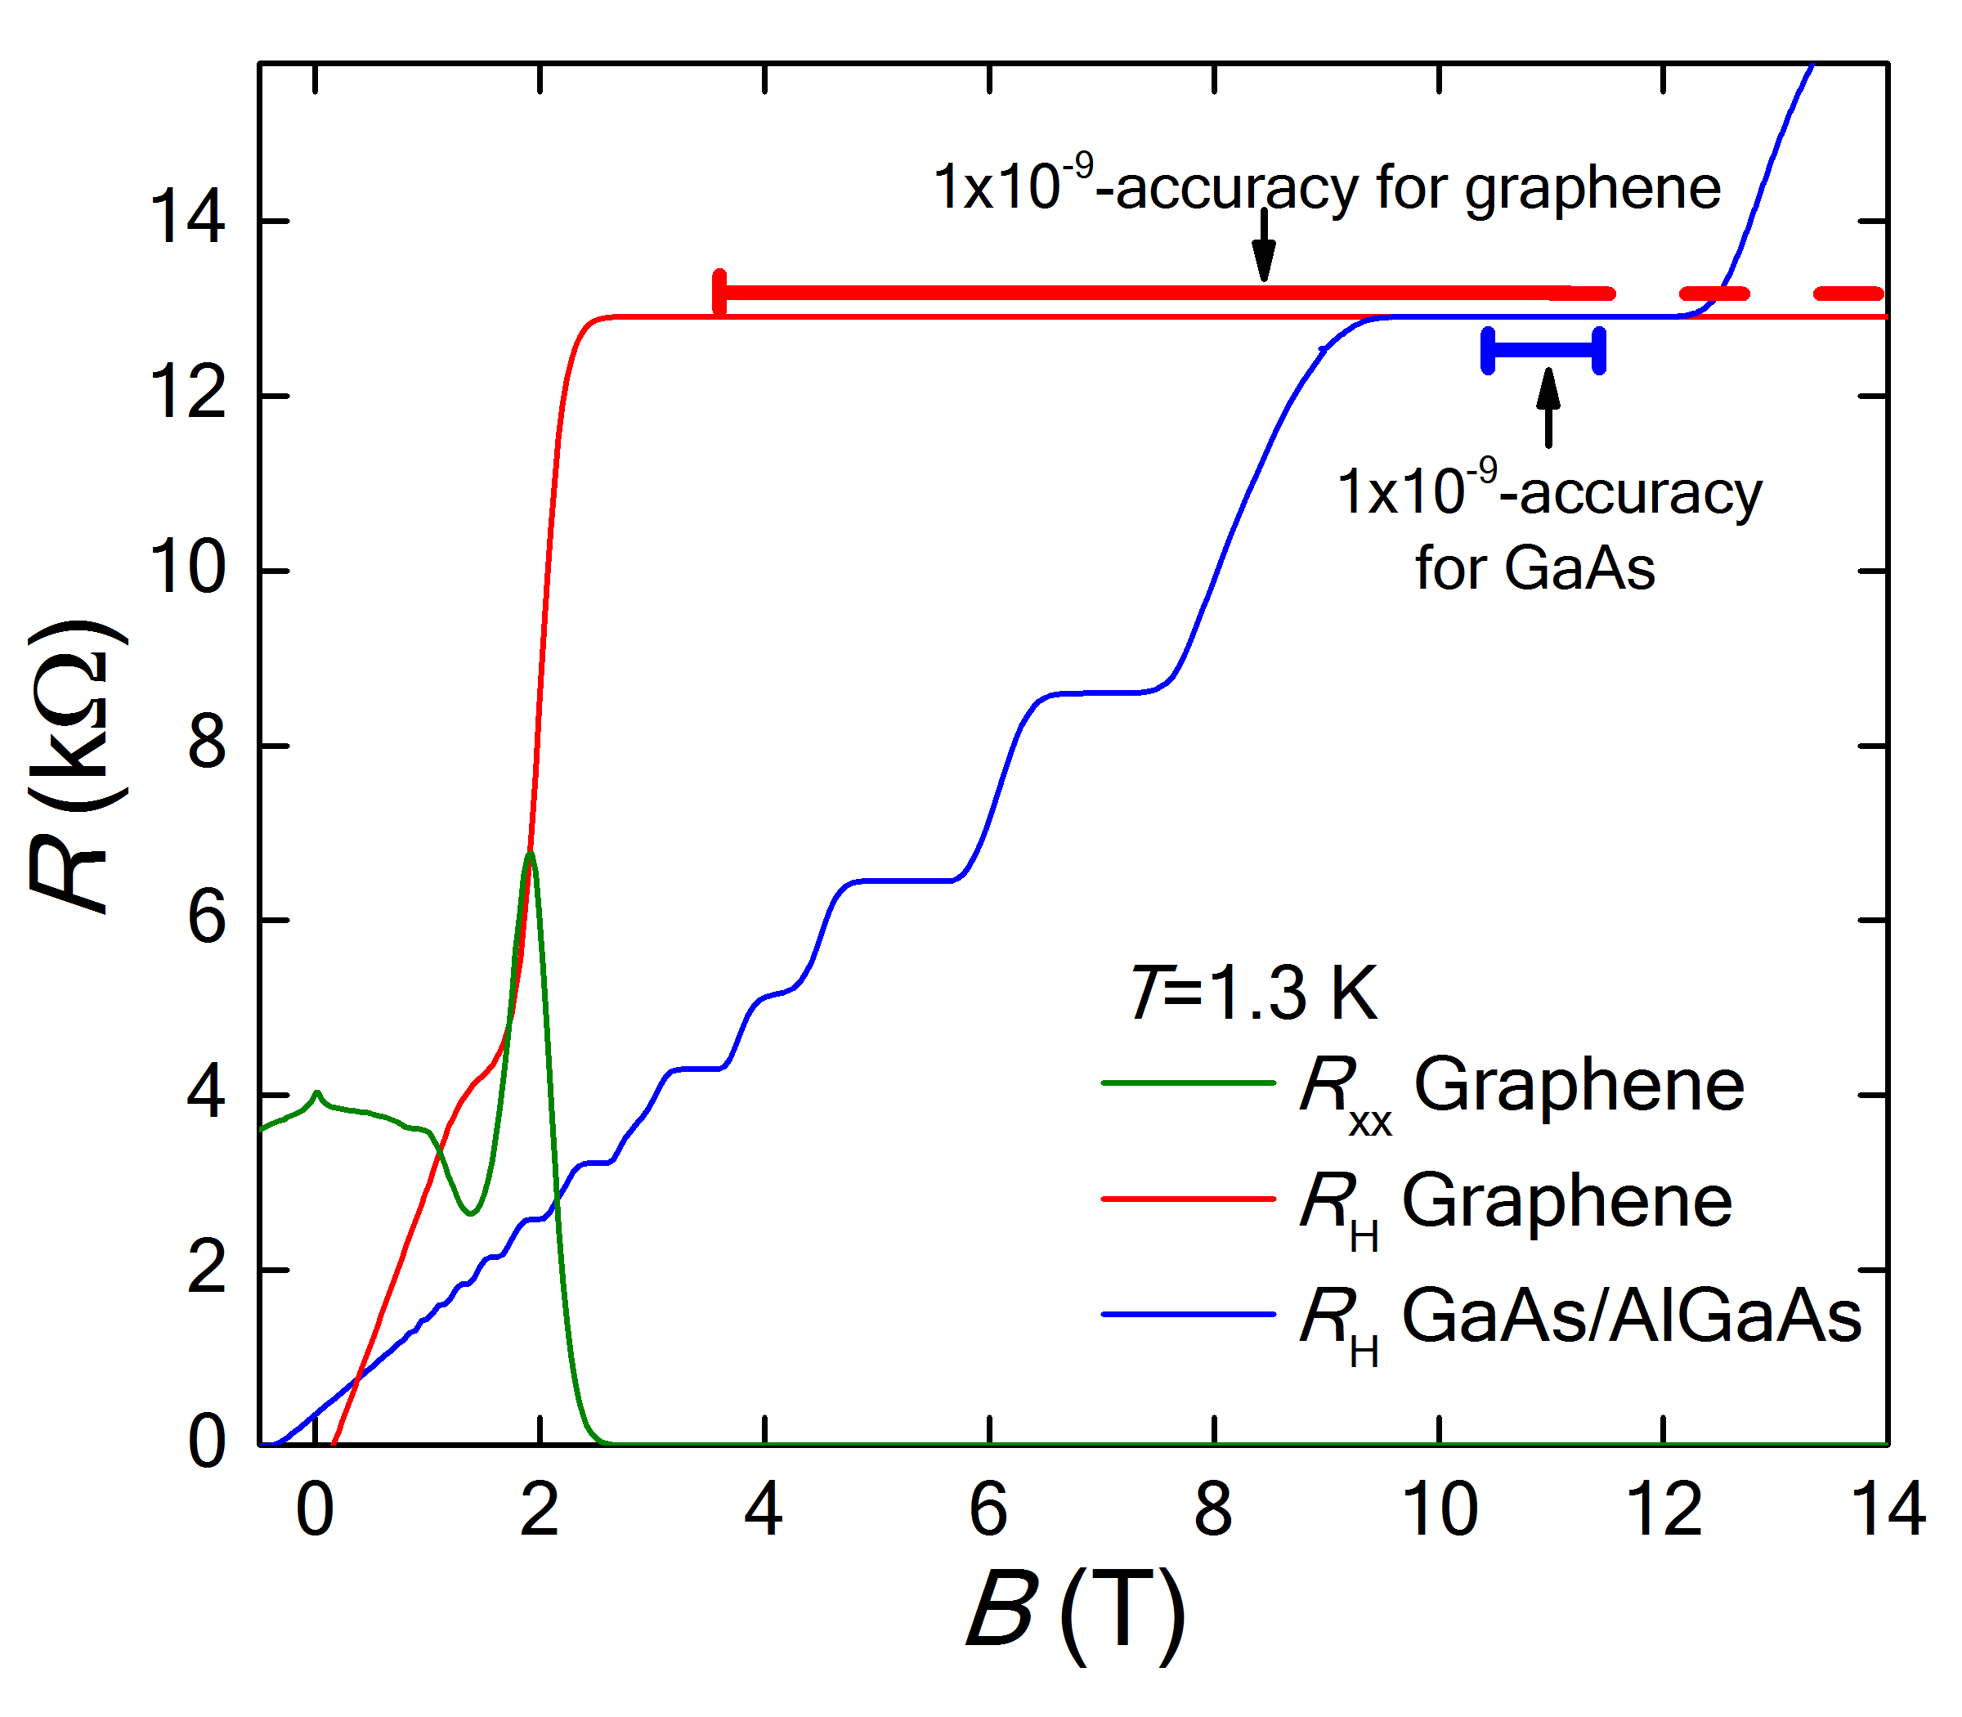
Quantum Hall effect in CVD graphene on SiC
Graphene has a ν=2 plateau, at least, 6 times larger than GaAs/AlGaAs

Slide 16
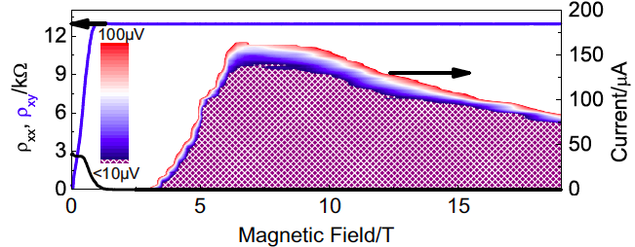
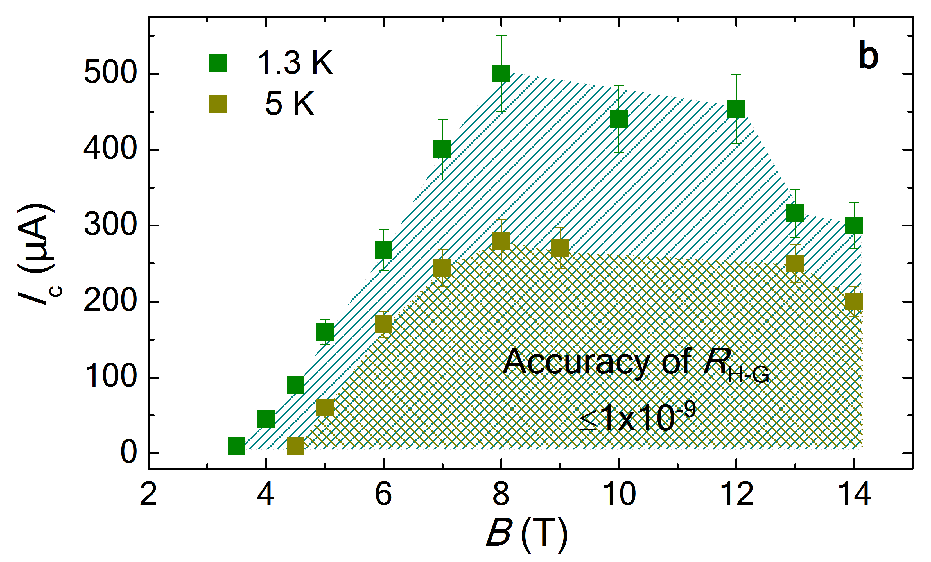
Breakdown current
n_{s}=1.8x10¹¹ cm⁻²
Breakdown current in GaAs/AlGaAs
Graphene from sublimation of SiC
n_{s}~1x10¹¹ cm⁻²
Jeckelmann et al. IEEE Trans. Instrum. Meas. (2001)
Alexander-Webber et al. PRL (2013)
Critical current increase linearly with the magnetic field

Slide 17
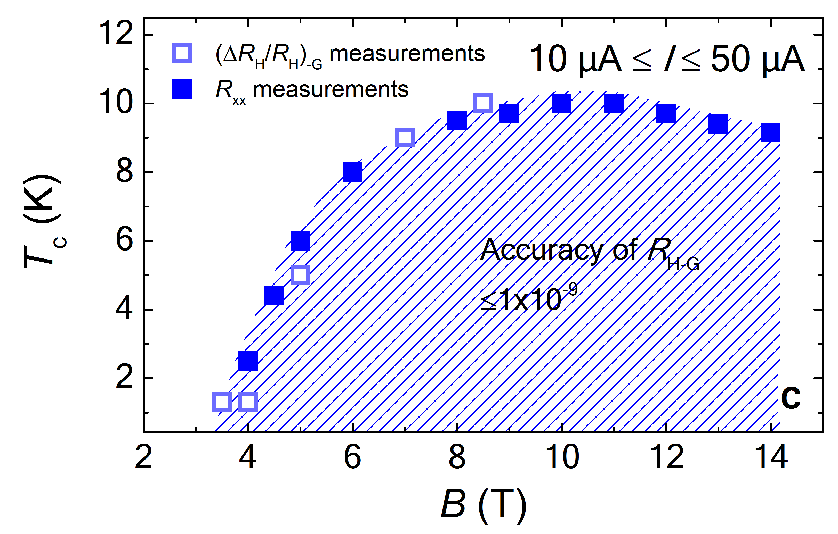
Temperature effects
n_{s}=1.8x10¹¹ cm⁻²
Quantization range
Highest breakdown current
Highest temperature

Slide 18
Graphene vs GaAs/AlGaAs

Slide 19
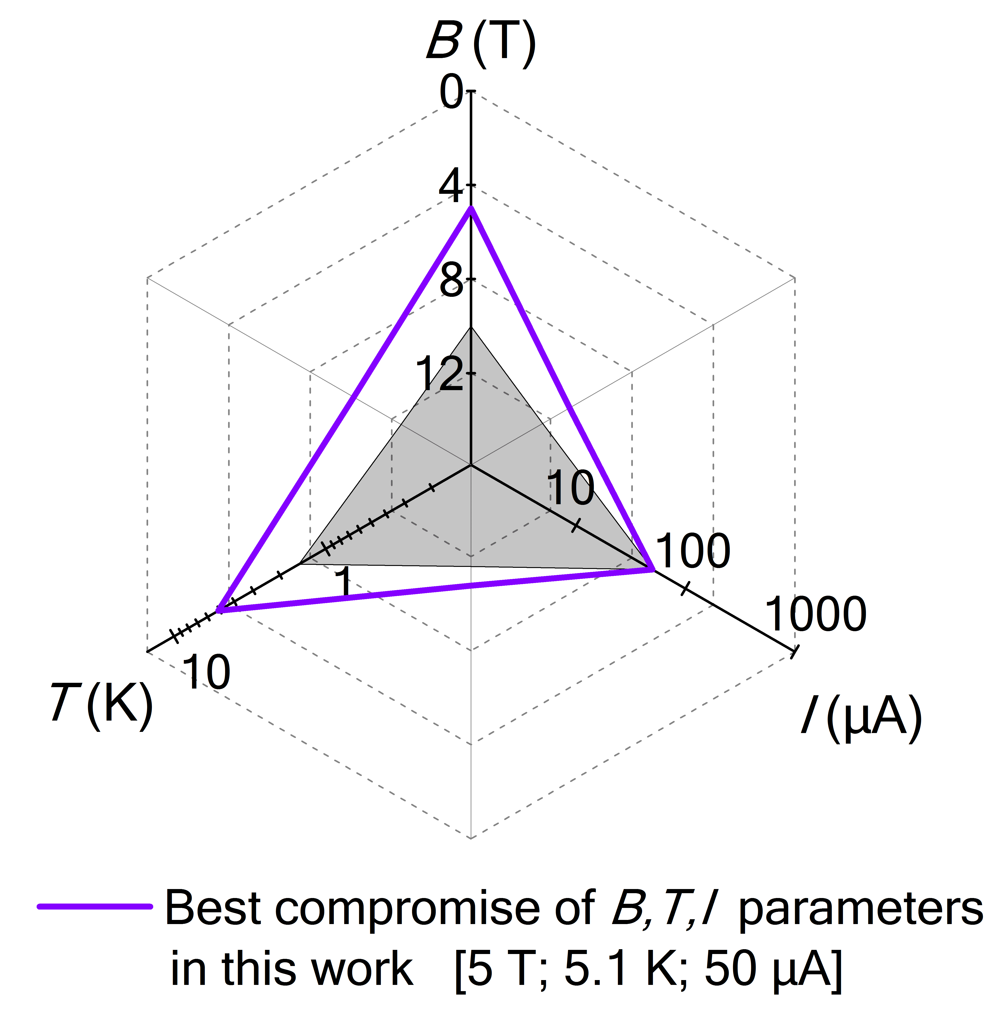
Conclusions
Graphene will replace GaAs/AlGaAs from the national metrology institutes
It will be highly involved in the dissemination of practical standards towards the industry.
It will help in the redefinition of the kilogram.
What is the origin of the shift of ν=2 ?

Slide 20
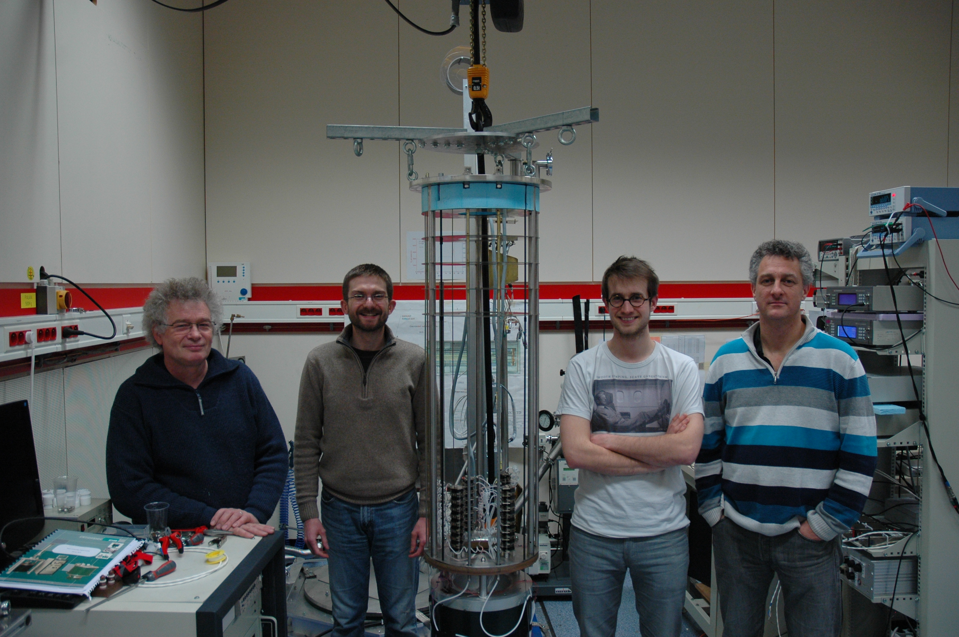
Quantum Metrology group - LNE
W. Poirier
F. Schopfer
J. Brun-Picard
F. Lafont
D. Leprat
Thanks for your attention
In collaboration with:
A. Michon (CRHEA-Valbonne, France)
D. Kazazis (LPN-Orsay, France)
B. Jouault (L2C- Montpellier, France)

Slide 21
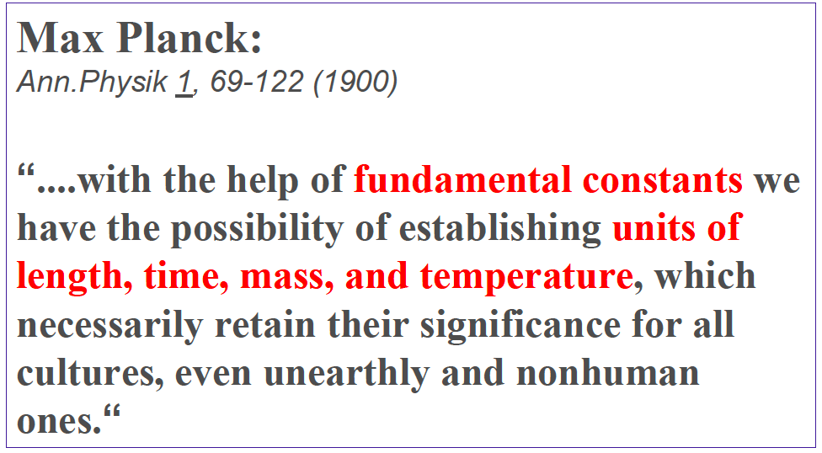
“It will be ironic if massless Dirac fermions were involved in a new definition of the Kilogram”
Mass appeal,
Editorial Nature Nanotech (2010).

