Slide 1

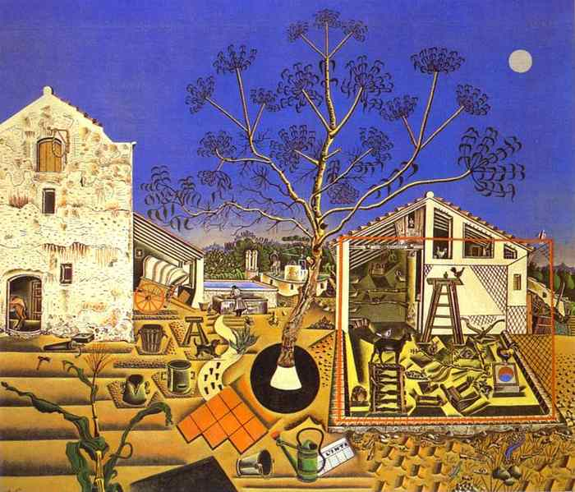
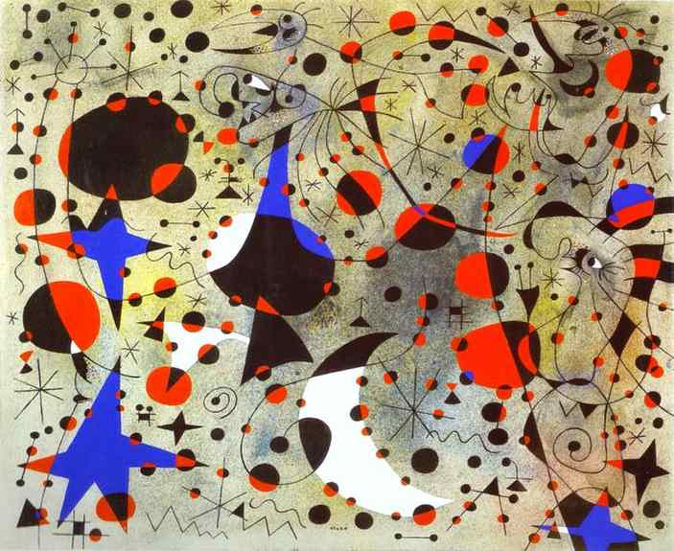

Electron effective mass in an ultra-high mobility GaAs/AlGaAs quantum well from MIRO and EPR experiment on DPPH
Sergei Studenikin, Geof Aers, and Andy Sachrajda
National Research Council of Canada, Ottawa, Canada
Q. Shi, and M. A. Zudov
School of Physics and Astronomy, University of Minnesota, Minneapolis, Minnesota, USA
L. N. Pfeiffer, and K. W. West
Department of Electrical Engineering, Princeton University, Princeton, New Jersey, USA
Notes:
Electron effective mass in an ultra-high mobility GaAs/AlGaAs quantum well
from MIRO and EPR experiment on DPPH
MIROs as a presize tool to study electron effective mass
Joan Miró (1893-1983) - famous Spanish artist

Slide 2
Three first MIRO/ZRS papers: number of scitations per year

Slide 3
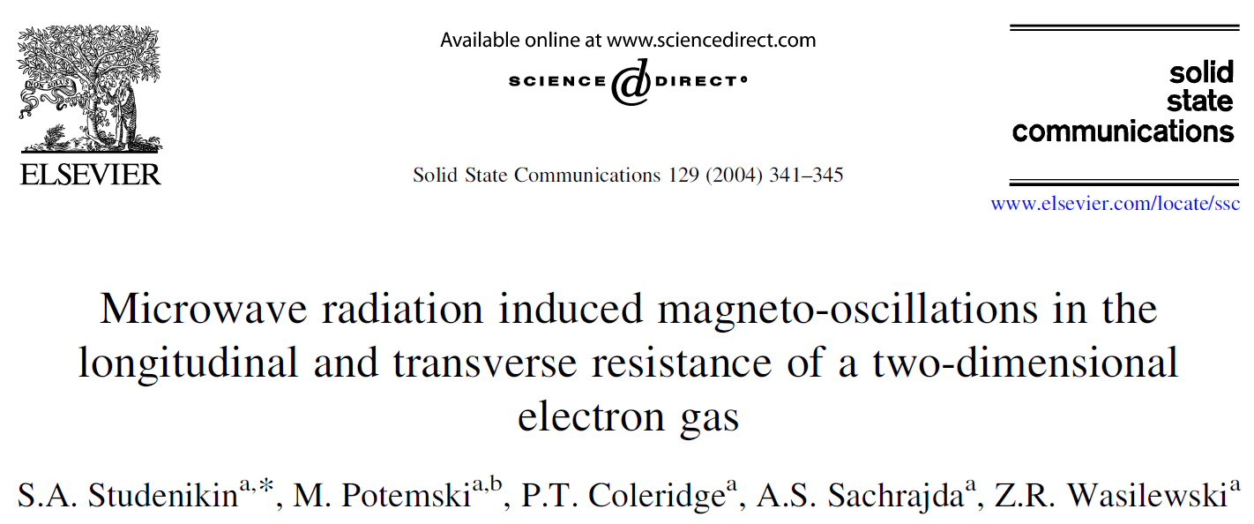
First time use of “MIRO”
Joan Miró (1893-1983)

Slide 4


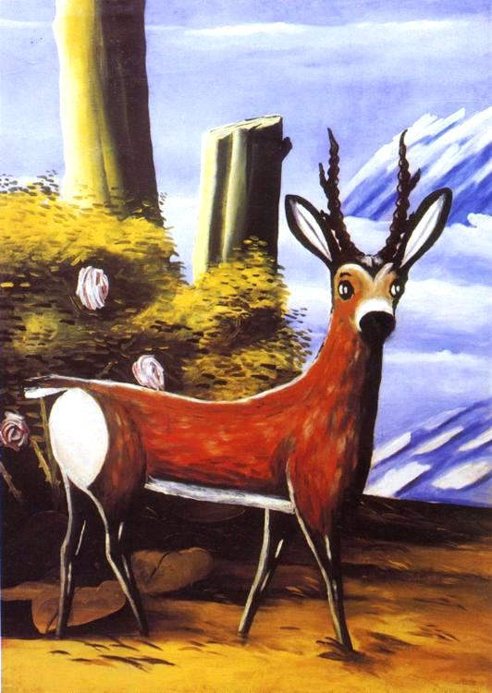
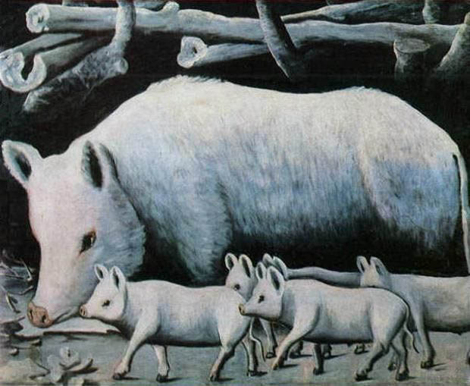
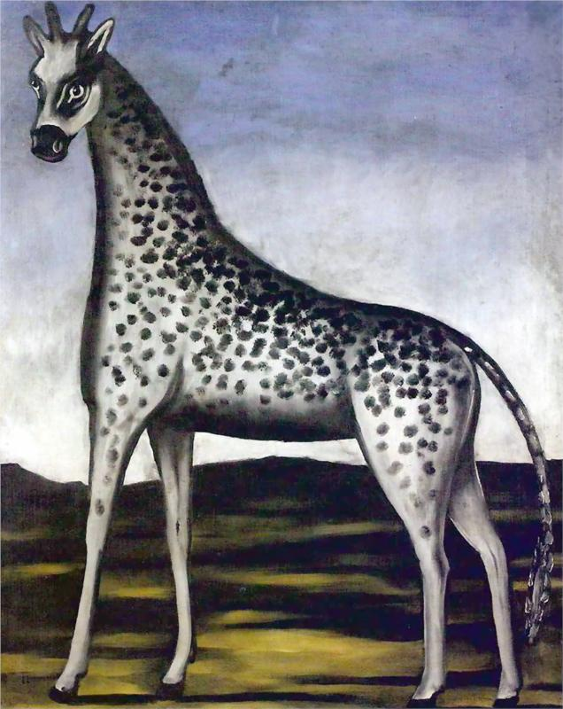
Niko Pirosmani (1862-1918)

Slide 5
Electron effective mass in an ultra-high mobility GaAs/AlGaAs quantum
well from MIRO and DPPH EPR experiment
Outline
Introduction: methods for m*-measurements
Sample and Experimental setup
B calibration with DPPH in 5-70 mT range
m*_{MIRO} measurement
Conclusions
Notes:
.

Slide 6
Why it is interesting to precisely measure m*?
m*₀ is a band parameter
m* (w, E_{i}, B, ….) is sensitive to details
m* is sensitive to e-e interactions
Can MIRO be used as a precise tool for m* ?
What kind of m* is deduced from MIRO ?
Notes:
m* engineering …. What matters how precisely and reliably we measure
Can MIRO be used to precisely measure m* in small fields?

Slide 7
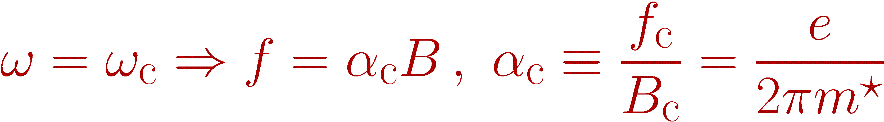
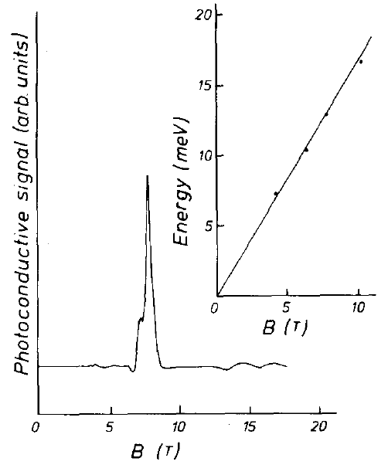
Known methods to measure 2DEG m*: FIR cyclotron resonance
Maan et al. APL 40, 609 (1982).
S.S. et al. Phys. E 34, 73 (2006).
In FIR experiments m* is affected by high B, SdH, plasmons
Important comment: CR resonance is not effected by e-e interactions
Kohn’s theorem - Phys. Rev. 123, 1242 (1961)

Slide 8
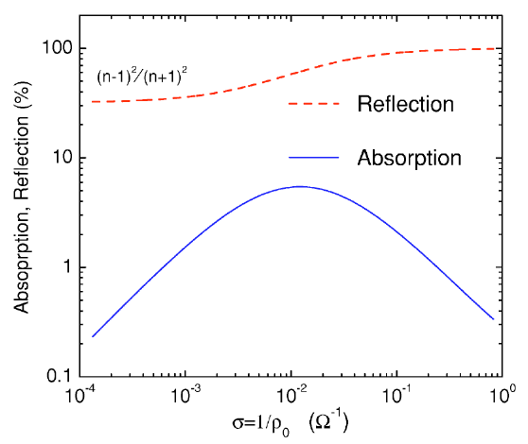
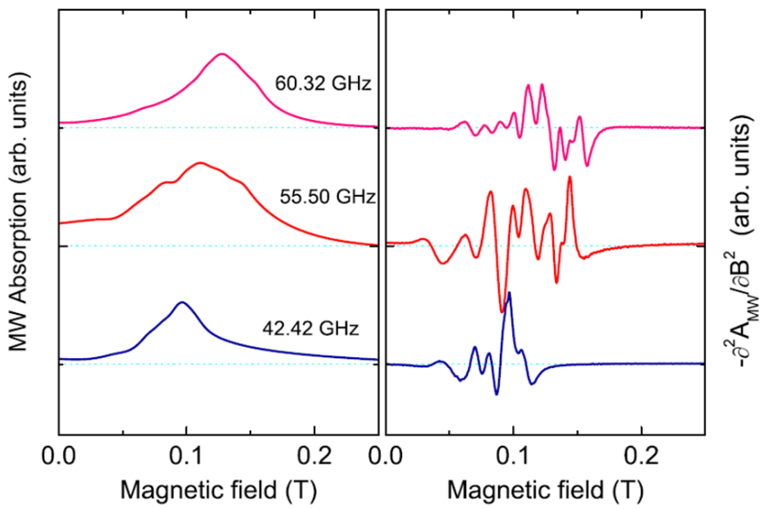
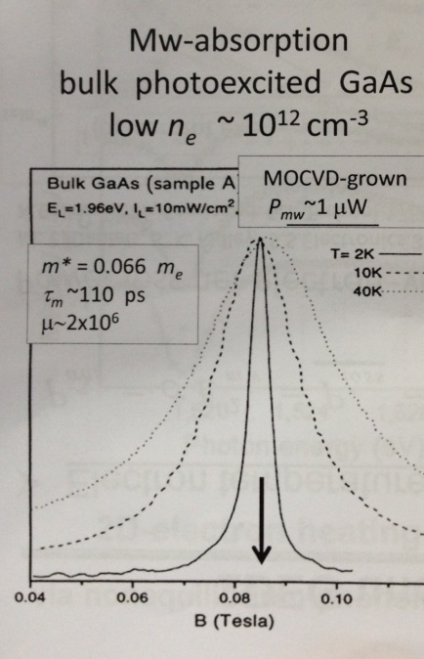
Remark: CR cannot be reliably measured in high-mobility 2DEG at MW
(1)
(2)
(3)
Calculated reflection/absorbtion by ideal 2DEG
A cavity measurements of absorption in a 1mm 2DEG strip
CR on photo-excited electrons in bulk GaAs by B.Ashkinadze PRB 52, 17165 (1995)
S.S., et al., Phys. Rev. B 76, 165321 (2007)
Notes:
Unfortunately we cannot faithfully measure CR in so high-mobility samples in low B

Slide 9
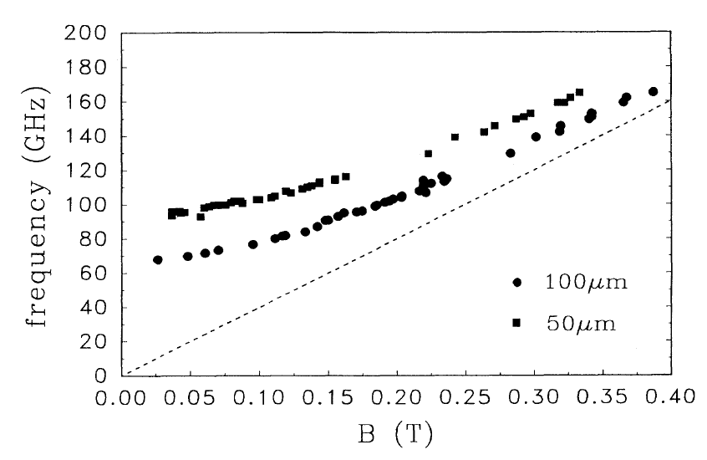
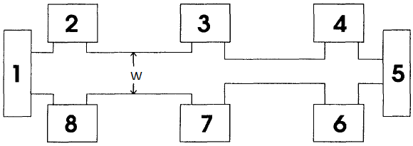

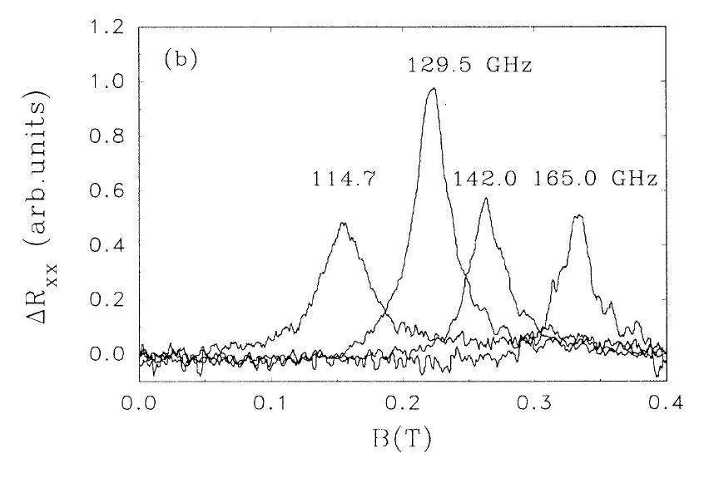
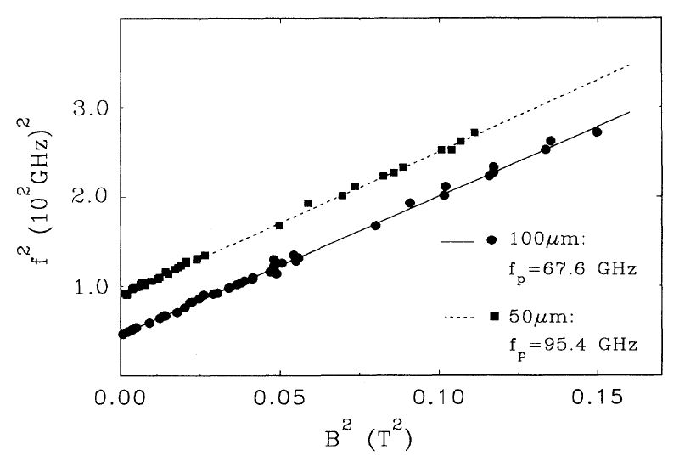
Known methods to measure m*: magneto-plasmon resonance
n=2.3x10¹¹ cm⁻², μ=1.2x10⁶ cm²/Vs
m*=0.070 m₀
Vasiliadou, Miller, Heitmann, Weiss, von Klitzing, PRB 48, 17145 (1993)
Notes:
Retardation effects may effect MPR position
CR simply does not work in such high mobility samples

Slide 10
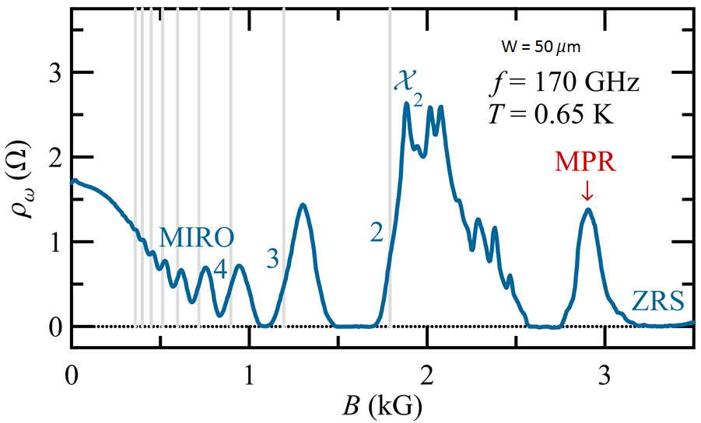
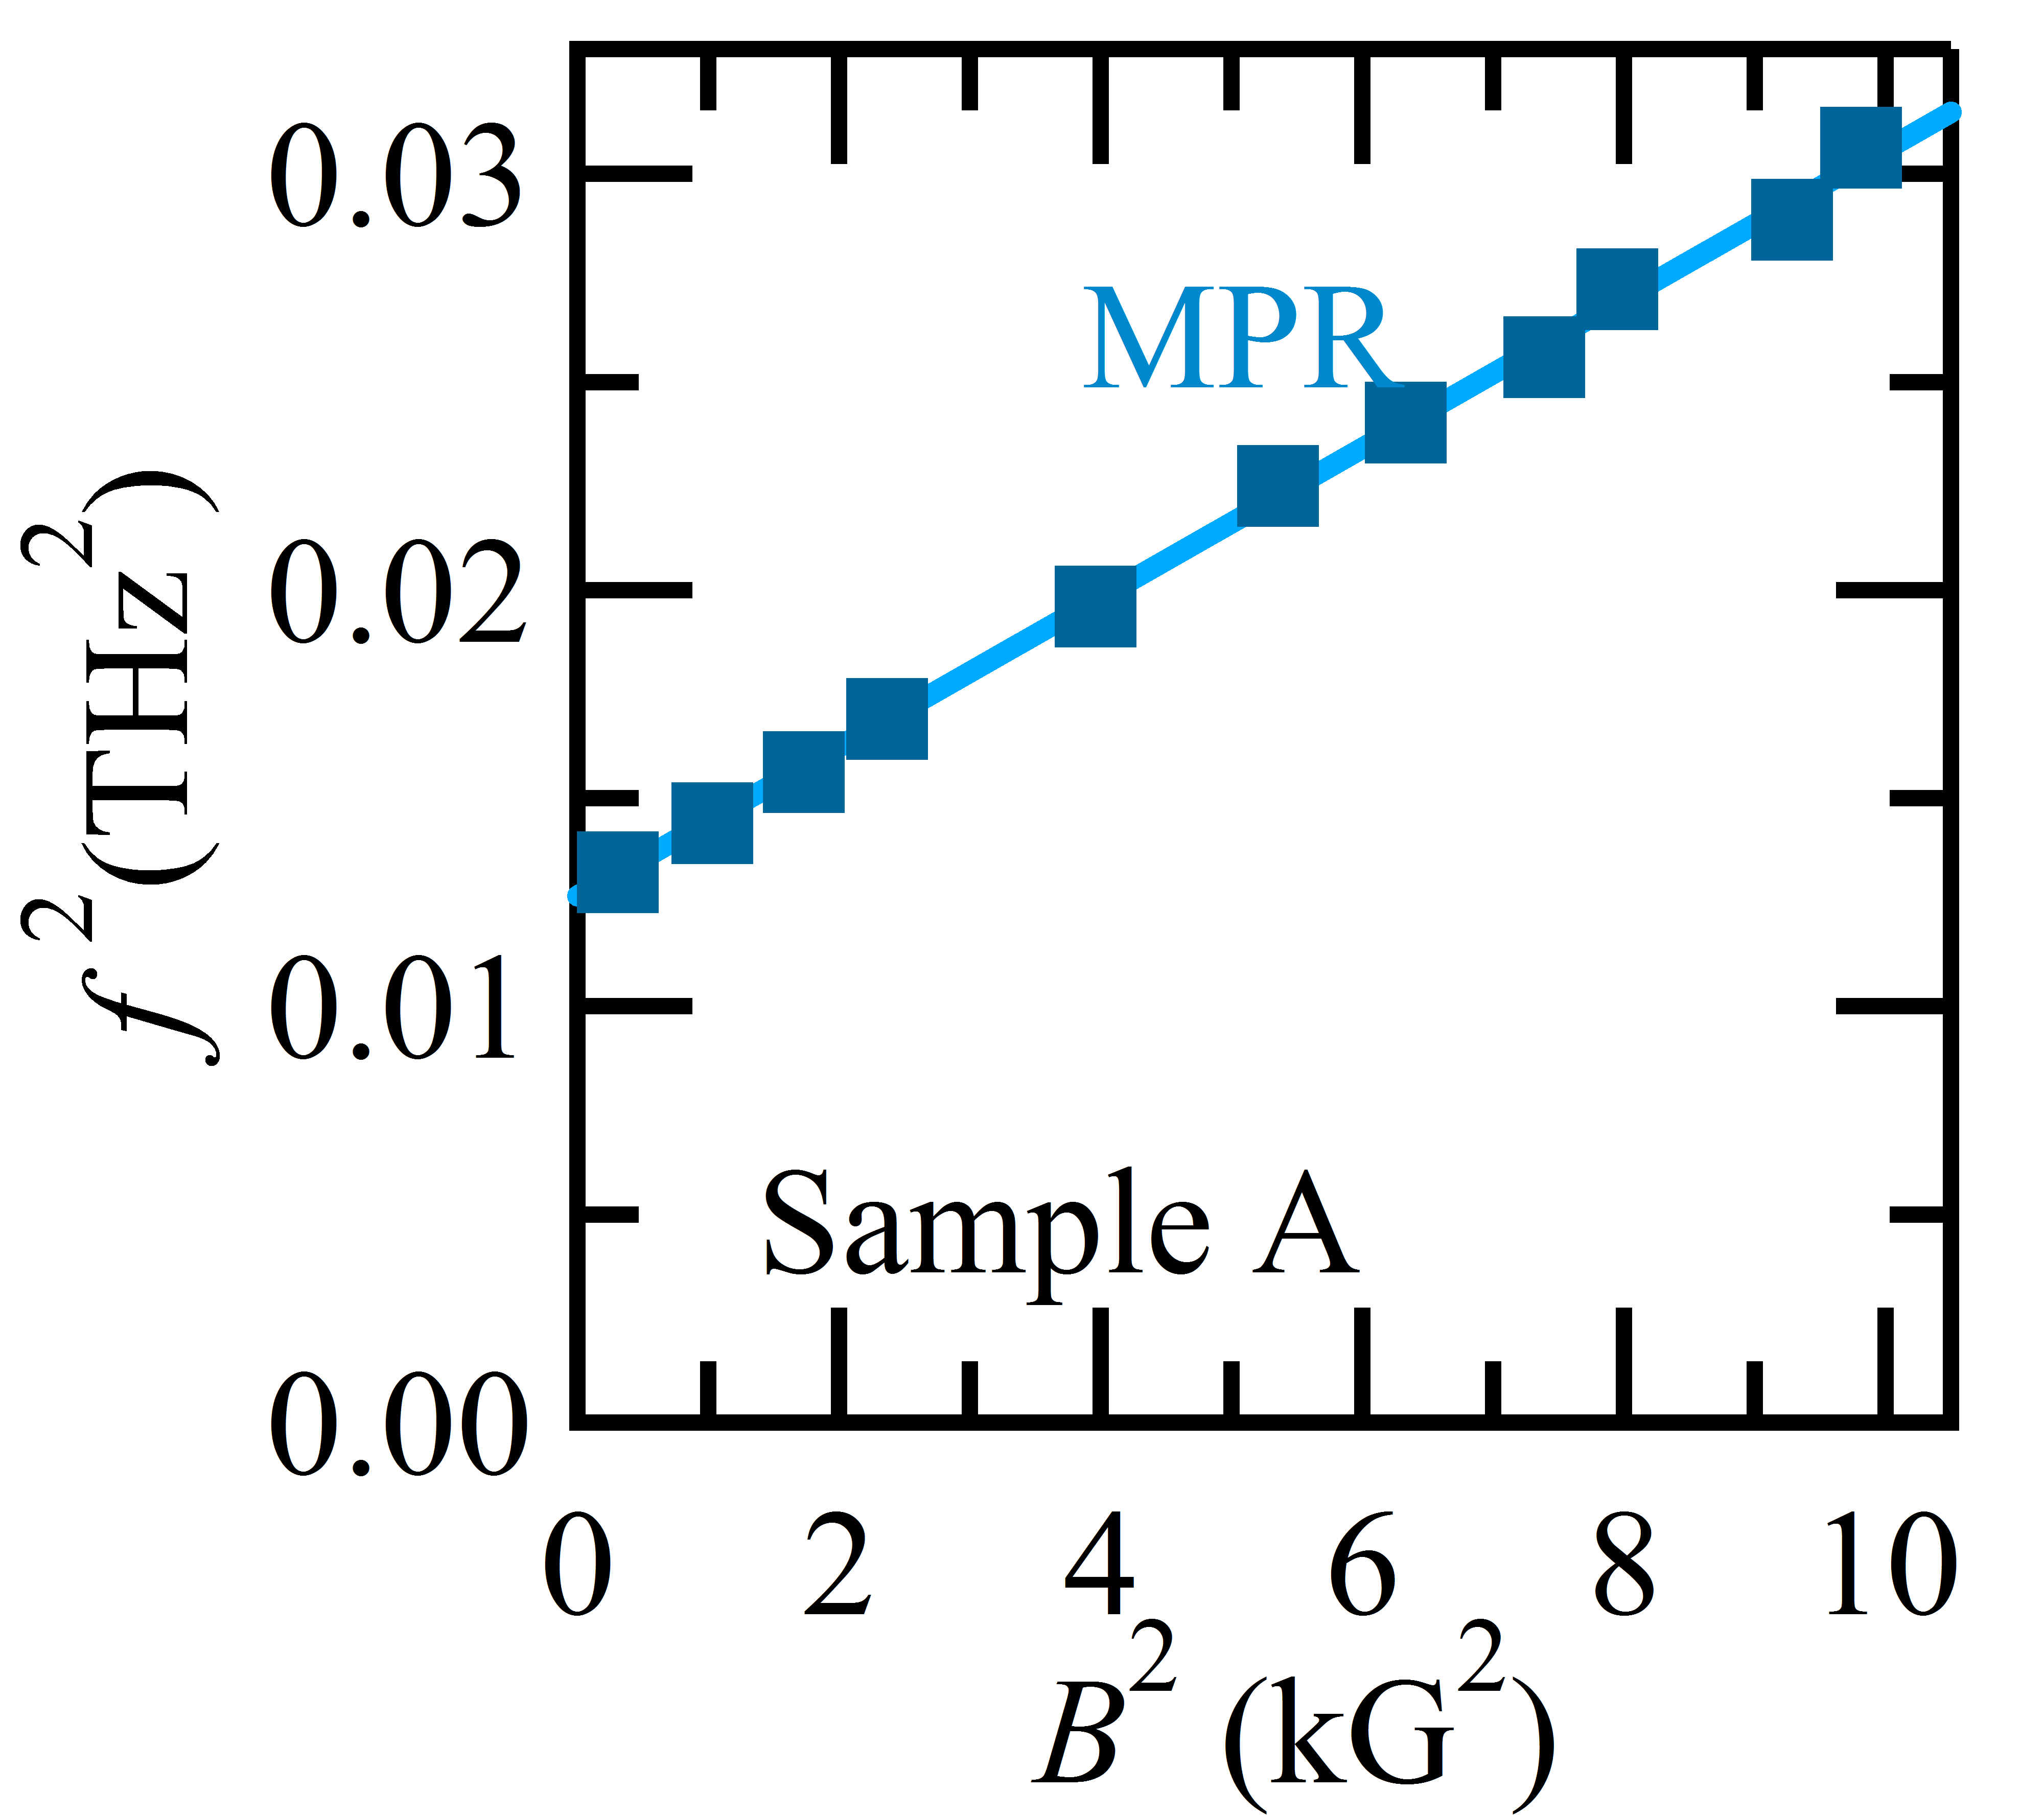
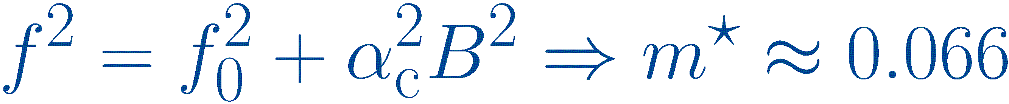

Magneto-plasmon resonance experiment on high-mobility samples
n=2.7x10¹¹ cm⁻² , μ=1.3x10⁷ cm²/Vs
Hatke, Zudov, Watson, Manfra, Pfeiffer, West, PRB 87, 161307(R) (2013)
$α_{c}$=e/2$πm^{∗}$

Slide 11
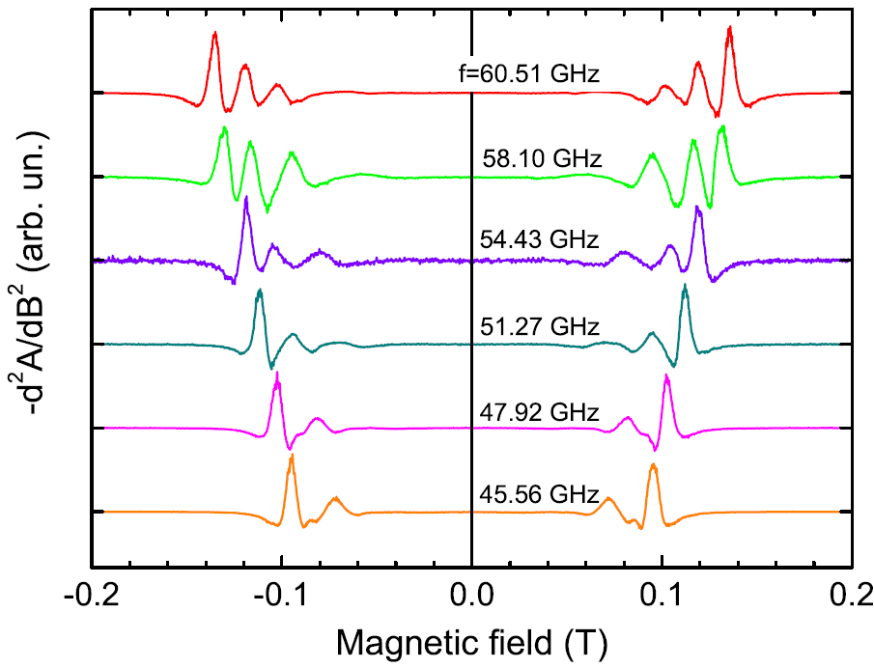
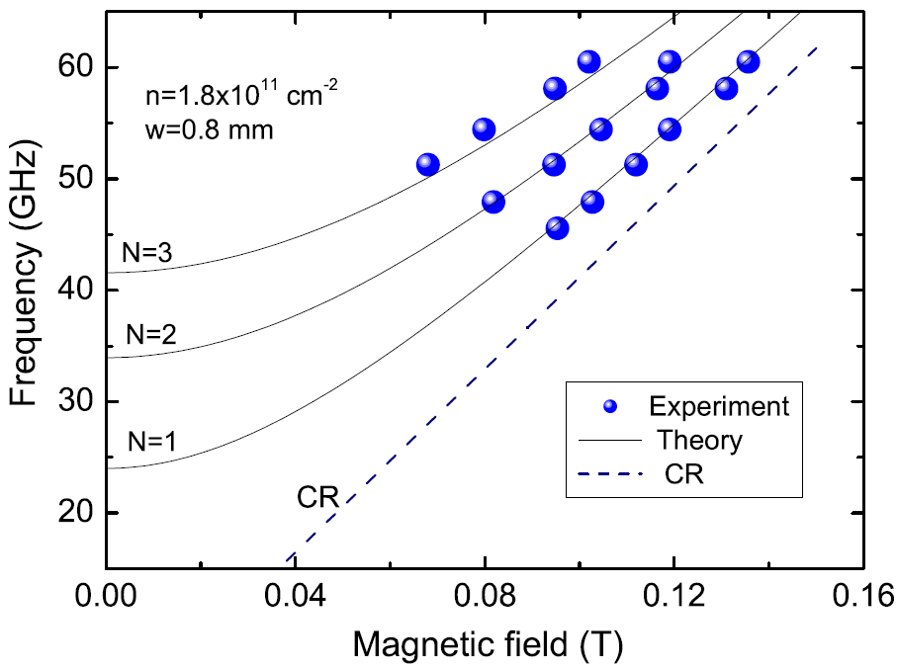
Magneto-plasmon resonance in MW absorption on a high-mobility sample
m*=0.068 m₀
w=0.8 mm
n=1.8x10¹¹ cm⁻²
μ=3x10⁶ cm²/Vs
m* ≈ 0.068 m₀
FEDORYCH, STUDENIKIN, MOREAU, POTEMSKI, SAKU, HIRAYAMA, Int. J. Mod. Phys. B 23, 2698 (2009).

Slide 12
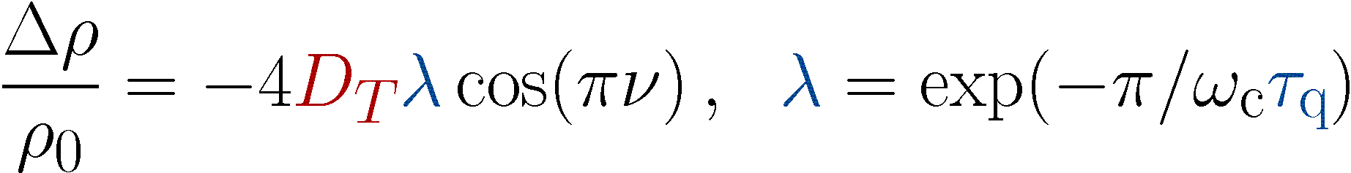
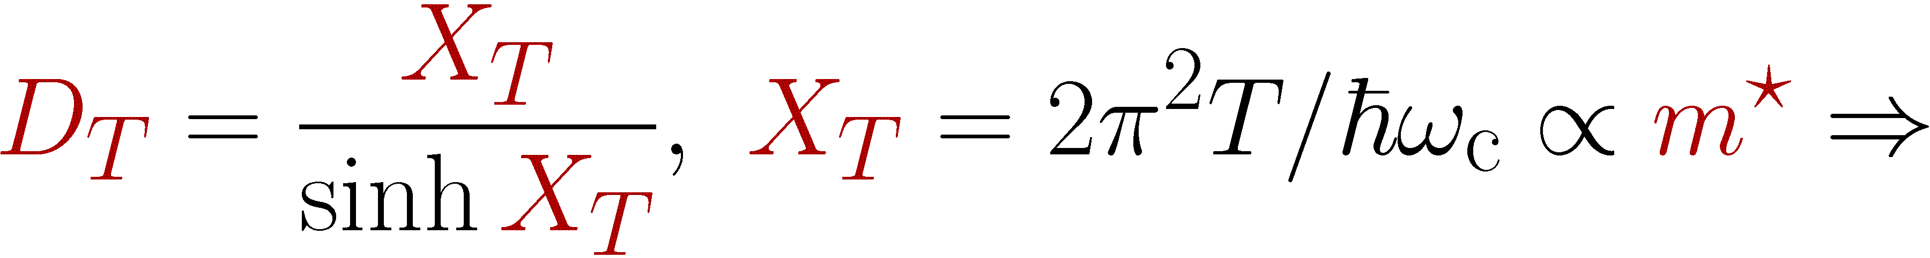
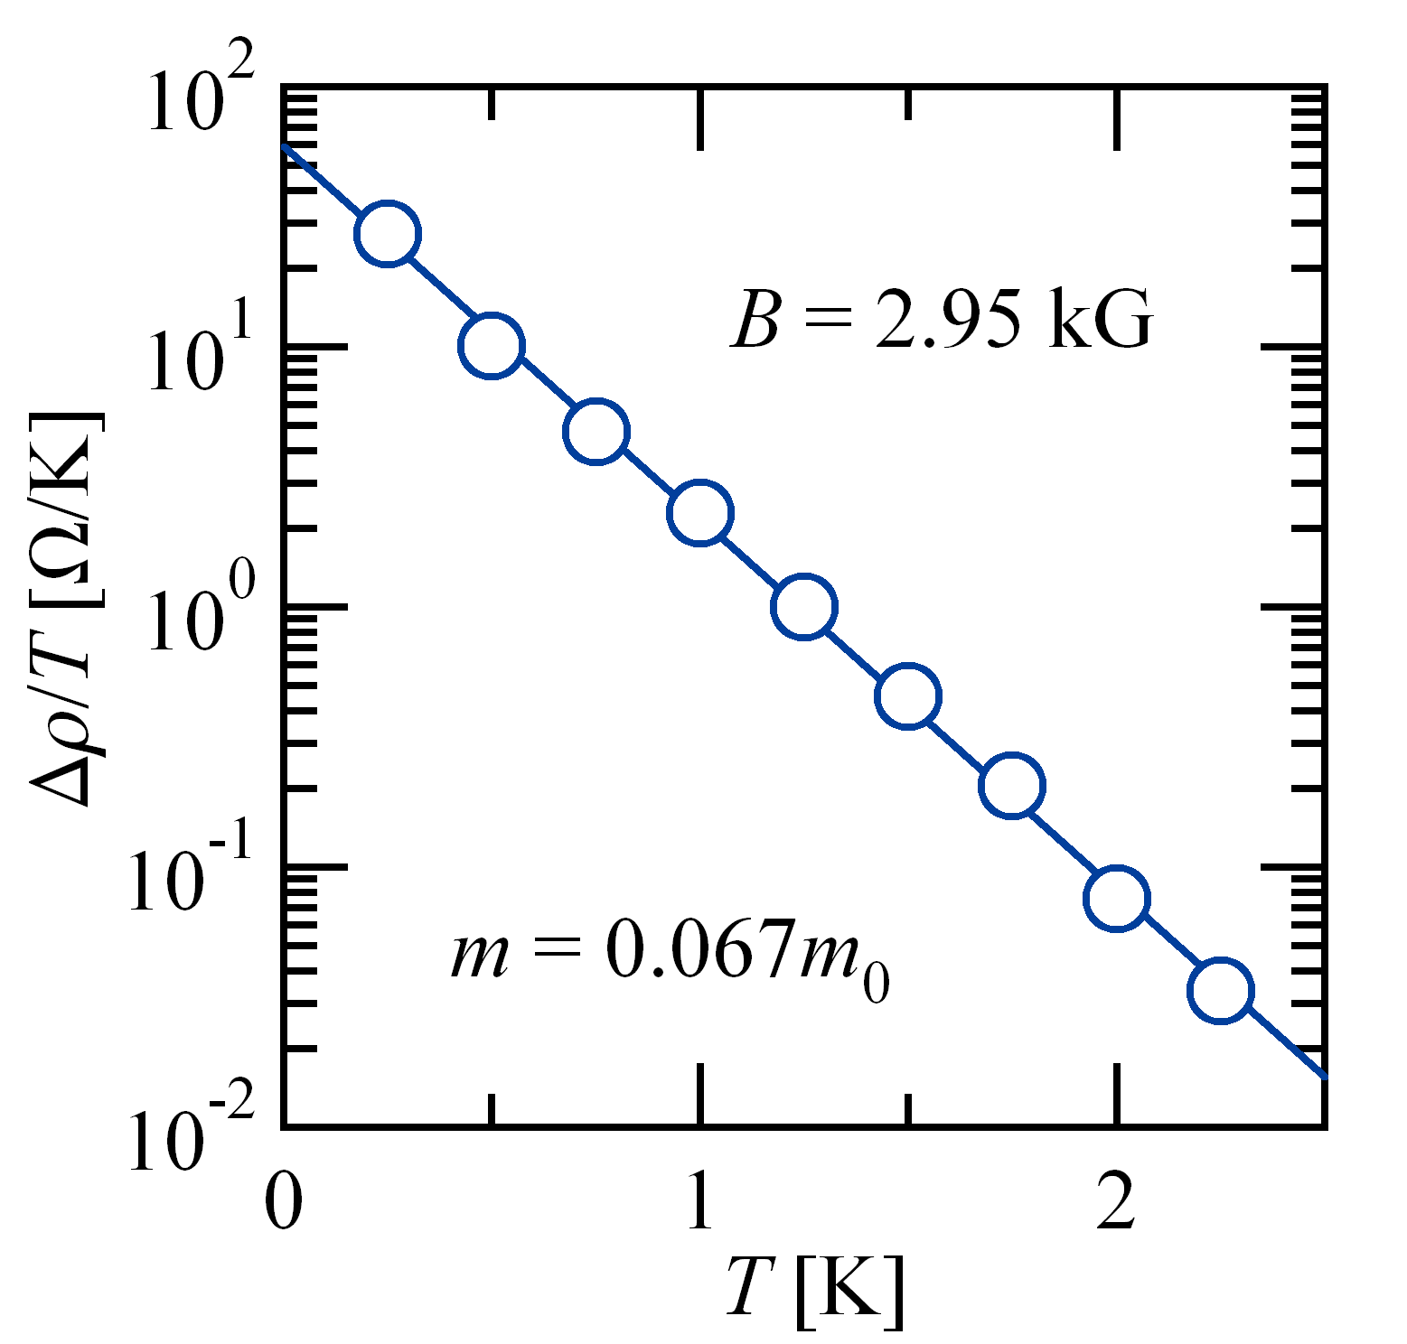
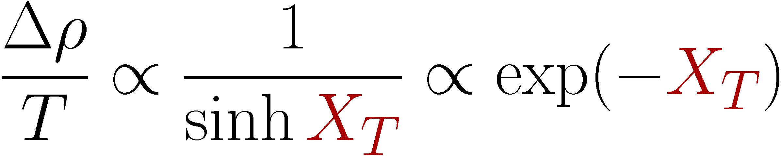
Effective mass m* from T-dependence of Shubnikov – de Haas oscillations
BUT:
SdH m* measurements can be affected by side effects…
M. Zudov (not published)

Slide 13
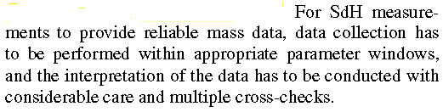
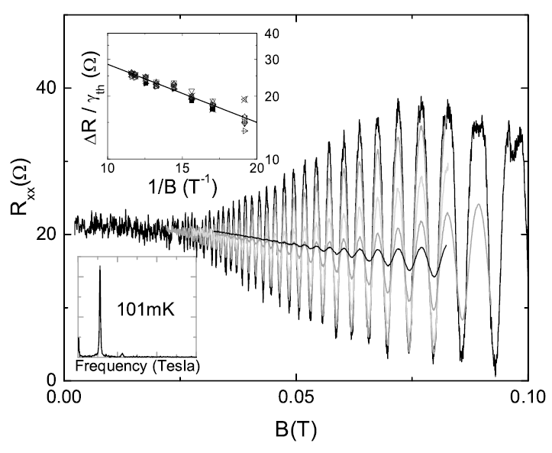
Effective mass m* from SdH oscillations: side effects
Tan, Zhu, Stormer, Pfeiffer, Baldwin, PRL 94, 016405 (2005) :
Possible technical issues:
SdH sensitive to n-gradients and fluctuations
Possible extra heating
Reliable T_{e}- control in B-field
SdH amplitude may be affected e.g. by spin splitting
SdH may be non-sinusoidal: higher harmonics

Slide 14
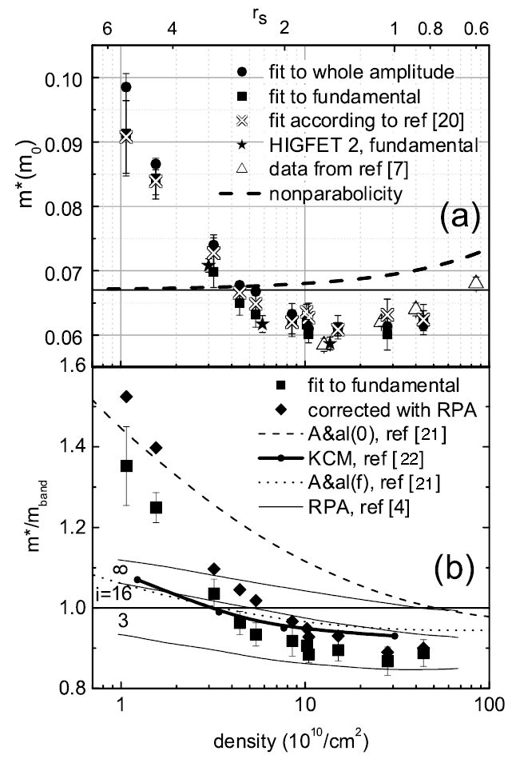
Effective mass m* from SdH oscillations: side effects
Tan, Zhu, Stormer, Pfeiffer, Baldwin, PRL 94, 016405 (2005)
Physical reasons for m* variations:
Assumes Lifshitz-Kosevich formula is correct for 2DEG
Depends on LL index i
Non-parabolicity
Different models
SdH m* depends on e-e interaction

Slide 15
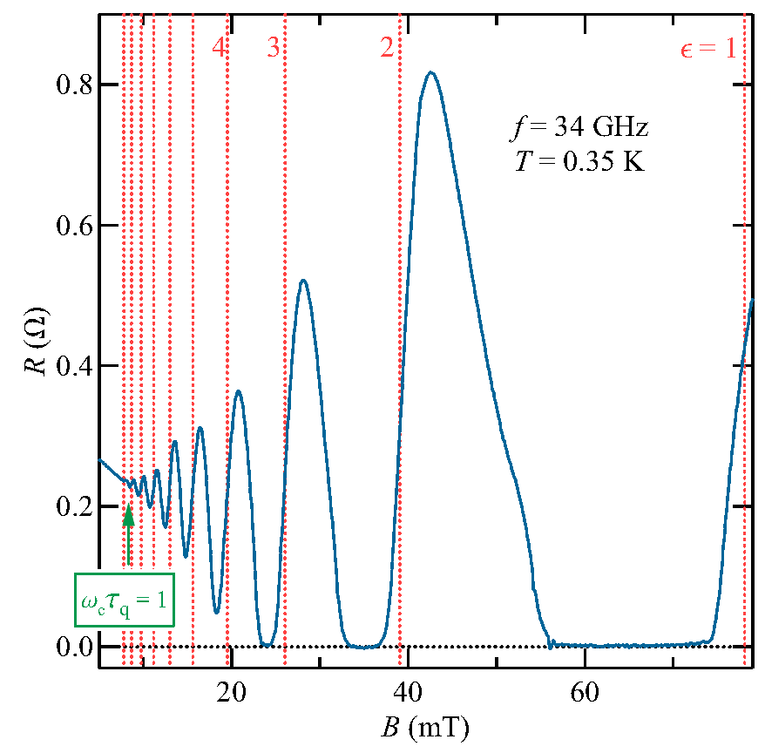




MIRO is a beautiful phenomenon: access to new physics?
Dmitriev, Mirlin, Polyakov, Zudov, Rev. Mod. Phys. 84, 1709 (2012):
$$δρ=−A\sin\left(2πε\right)$$
$$ϵ=\frac{ω}{ω_{c}}, ω_{c}=\frac{eB}{m^{∗}} \text{is} \text{the} \text{cyclotron} \text{frequency}$$
$$λ=exp⁡(−\frac{π}{ω_{c}τ_{q}})$$
$$𝒜(T)=2πρ_{0}(τ/(2τ_{∗})+2τ_{in}/τ)$$
Amplitude vs. B → τ_{q} quantum scattering time, e.g.
Amplitude vs. B vs. B|| - τ_{q} in B||
Amplitude vs. T scattering mechanism
Amplitude vs. T → scattering mechanisms
Waveform → access to LL shape
Precise MIRO positions → m*
(B ∼ 10mT, precise B - calibration needed)
Shi, Zudov, Studenikin, Baldwin, Pfeiffer, West (2015)

Slide 16
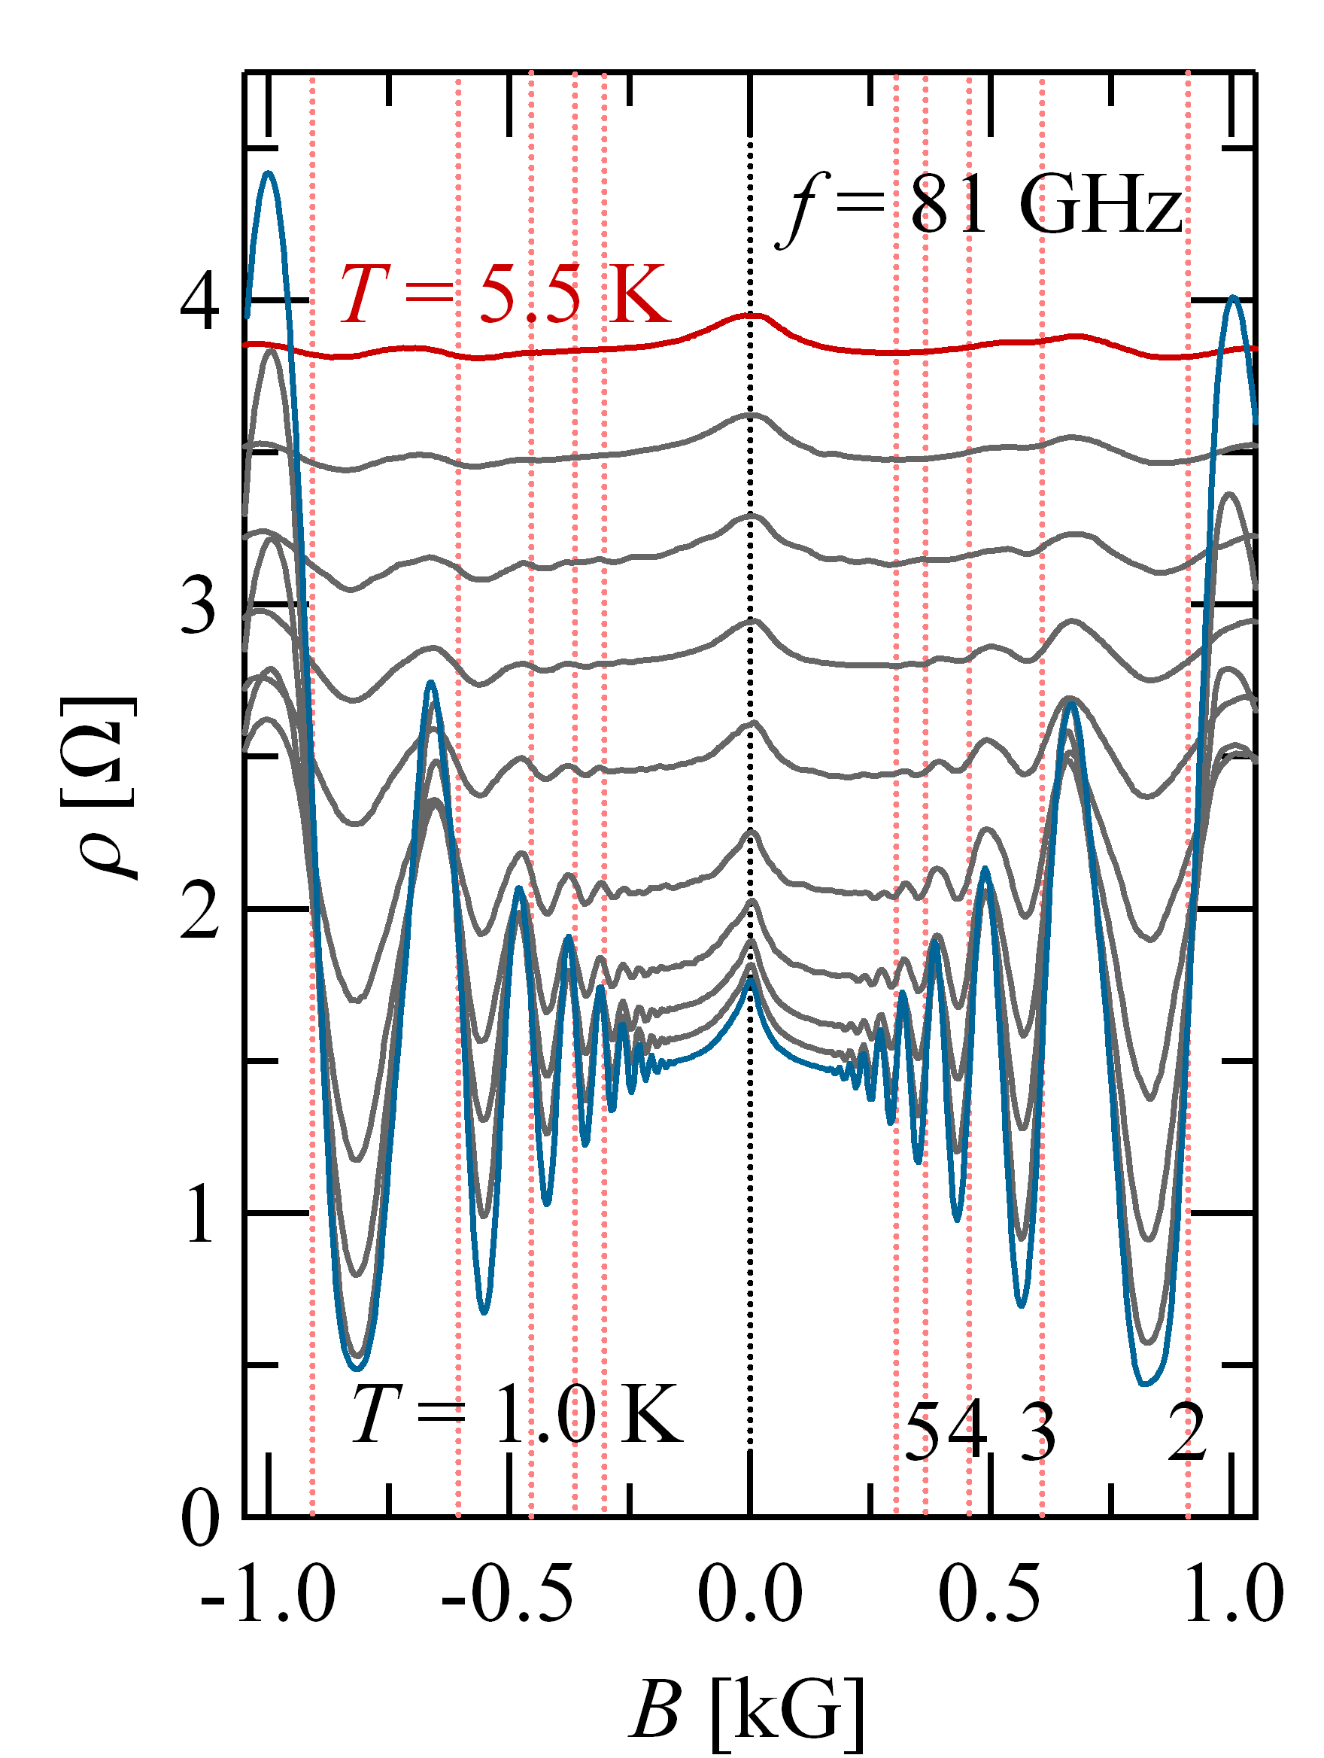
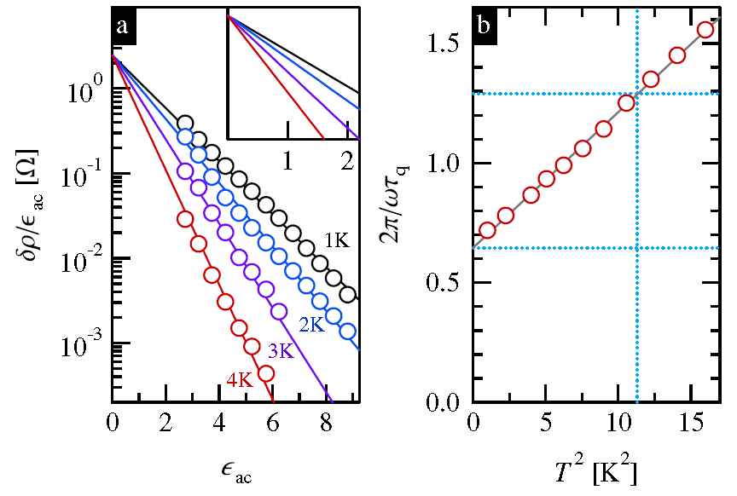

Example of MIRO T-dependence at 1K<T<4K, μ=1.3×10⁷ cm²/Vs
Hatke, Zudov, Pfeiffer, West, PRL 102, 066804 (2009)
No signature of the inelastic contribution
16

Slide 17
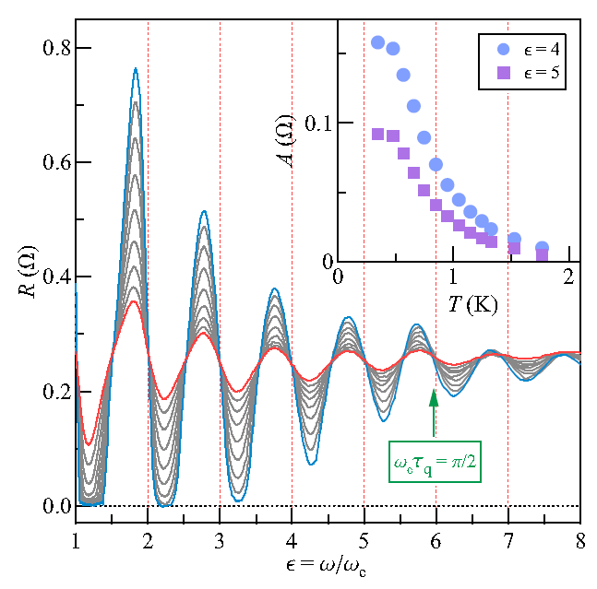
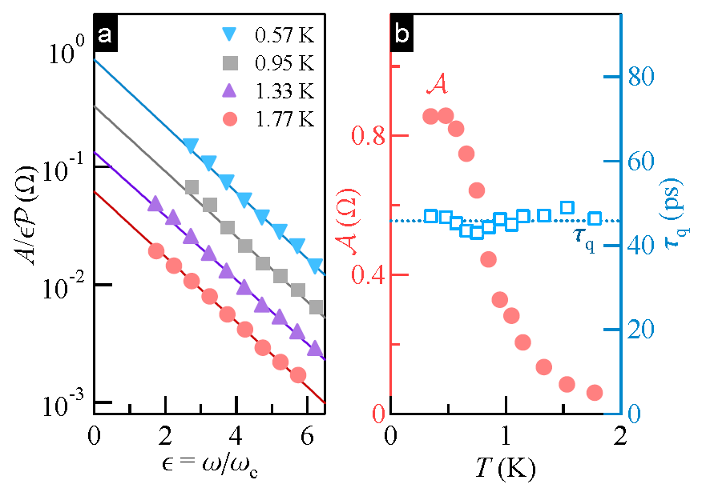



Example of MIRO T-dependence at 0.35K<T<1.7K, μ>3×10⁷ cm²/Vs
Shi, Zudov, Studenikin, Baldwin, Pfeiffer, West (2015)
$$𝒜(T)=2πρ_{0}(τ/(2τ_{∗})+2τ_{in}/τ)$$
17

Slide 18
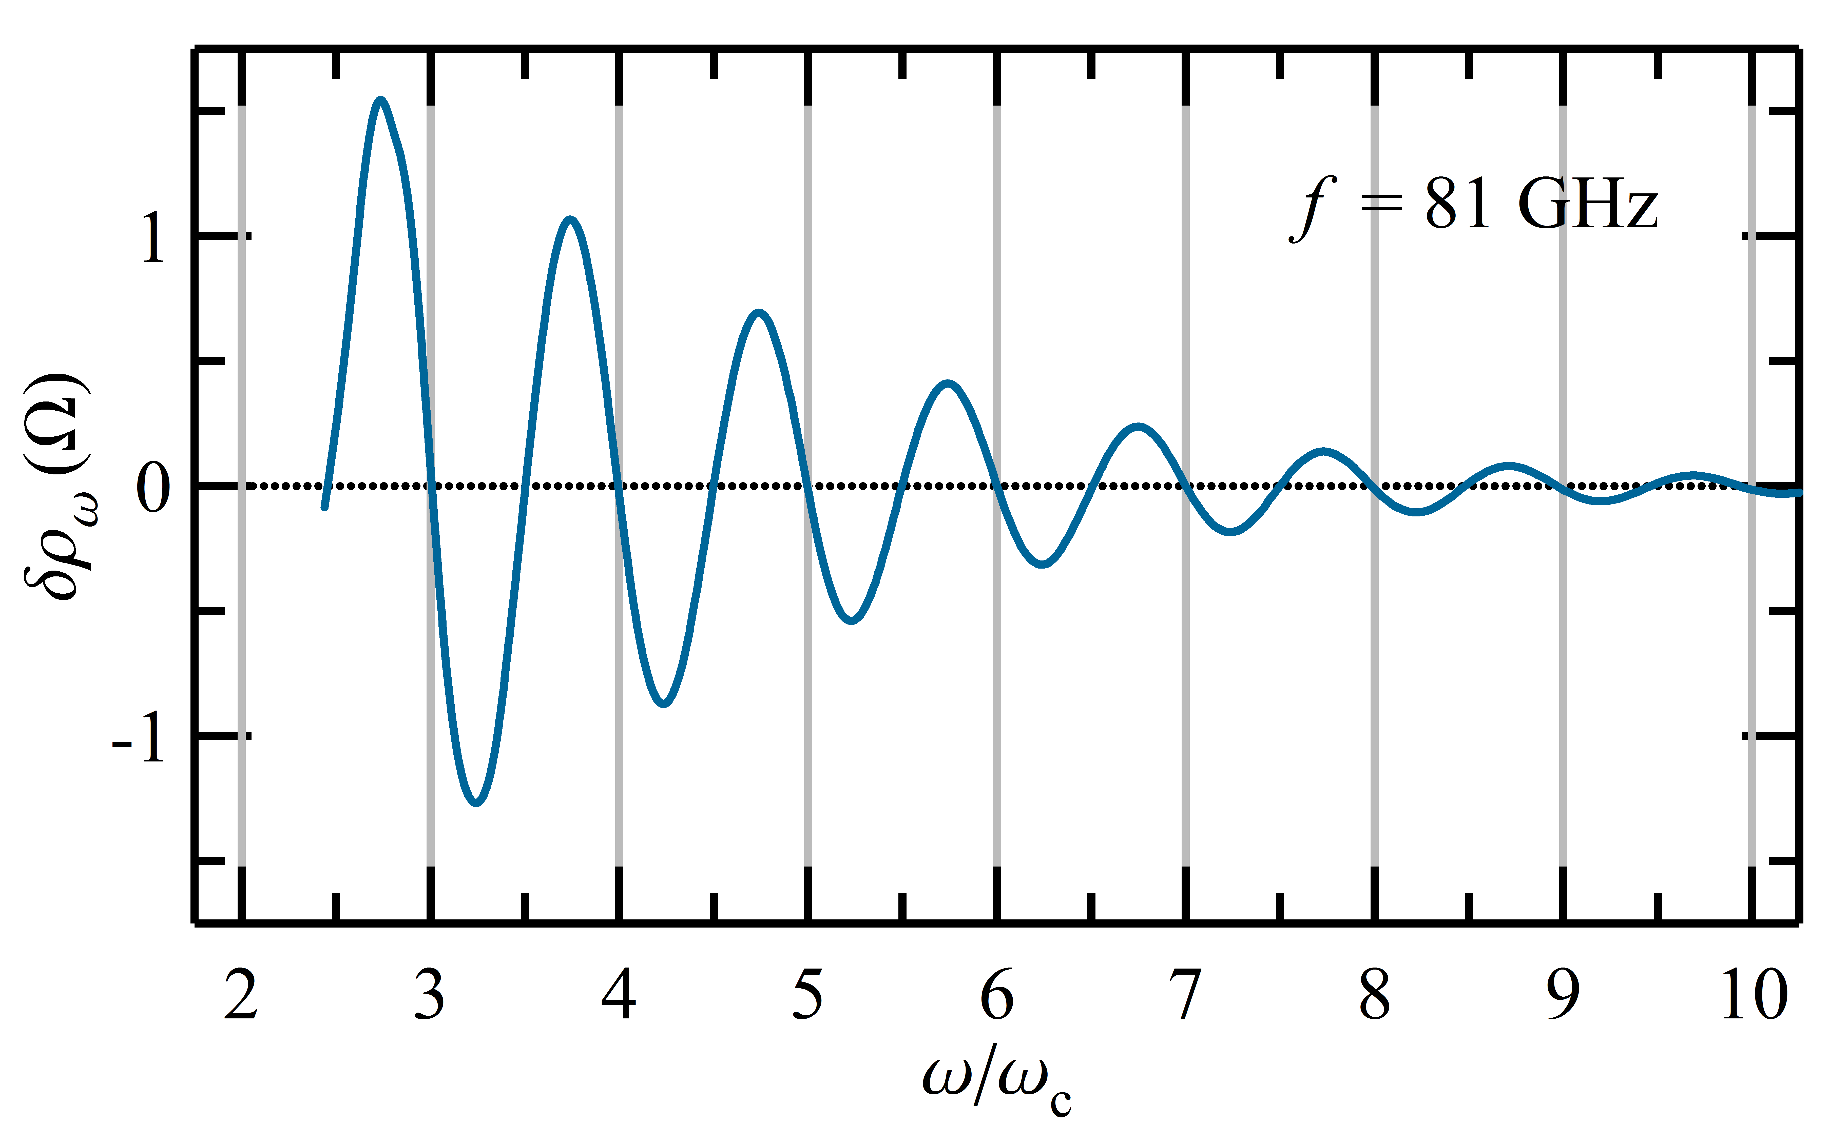
Can MIRO be used for precise measurements of m* at large LL?
?
What kind of m* :
Band parameter (CR)
Modified by e-e exchange interaction
Else?
m*_{MPR} = 0.066
m*_{MIRO}= 0.059
Hatke, MZ, Watson, Manfra, Pfeiffer, West, PRB 87, 161307(R) (2013)
Notes:
m_MIRO=0.059 was reported

Slide 19
Example of MIROs on μ~3x10⁷ sample
Many MIRO harmonics observed, but very small field => limited by magnet precision…

Slide 20
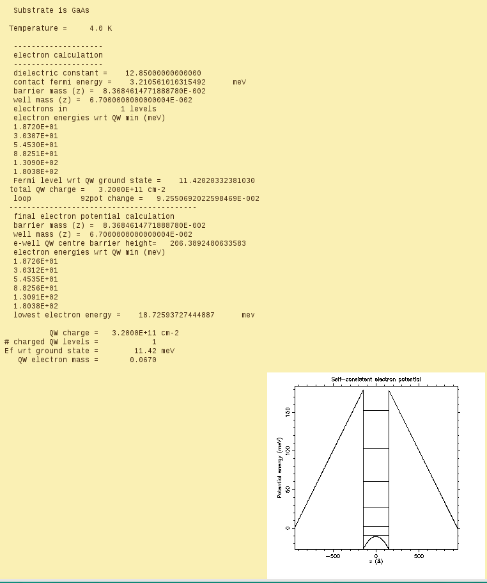
Sample: n=3.2 x 10¹¹ cm², μ∼3×10⁷ cm²/Vs, τ_{q}=46 ps, μ_{q}=1.2×10⁶ cm²/Vs
Al_{x}Ga_{1-x}As/GaAs/AlGaAs QW
Width 30 nm, x=0.24
Symmetrically doped on both sides
Spacers - 80 nm,
Distance to the surface - 195 nm
Cooling process (~2h) under illumination by a red LED (i=50 μA), illumination stopped at 25K
n=3.2x10¹¹ (E_{F}=11.4meV)
m*(E1+Ef)=0.06793

Slide 21
Self-consistent calculations of m*
Following: Vurgaftman et al., JAP 89, 5815 (2001)
Notes:
D:\QuantumNanolab\2014\Z1-MIRO\OPJ Files\QuantumCodesmCalculation.OPJ*(Graph1)

Slide 22
Self-consistent calculations of m* vs. E
E_{max}≈-en/ε₀ε
Notes:
D:\QuantumNanolab\2014\Z1-MIRO\OPJ Files\QuantumCodesmCalculation.OPJ*(Graph1)

Slide 23
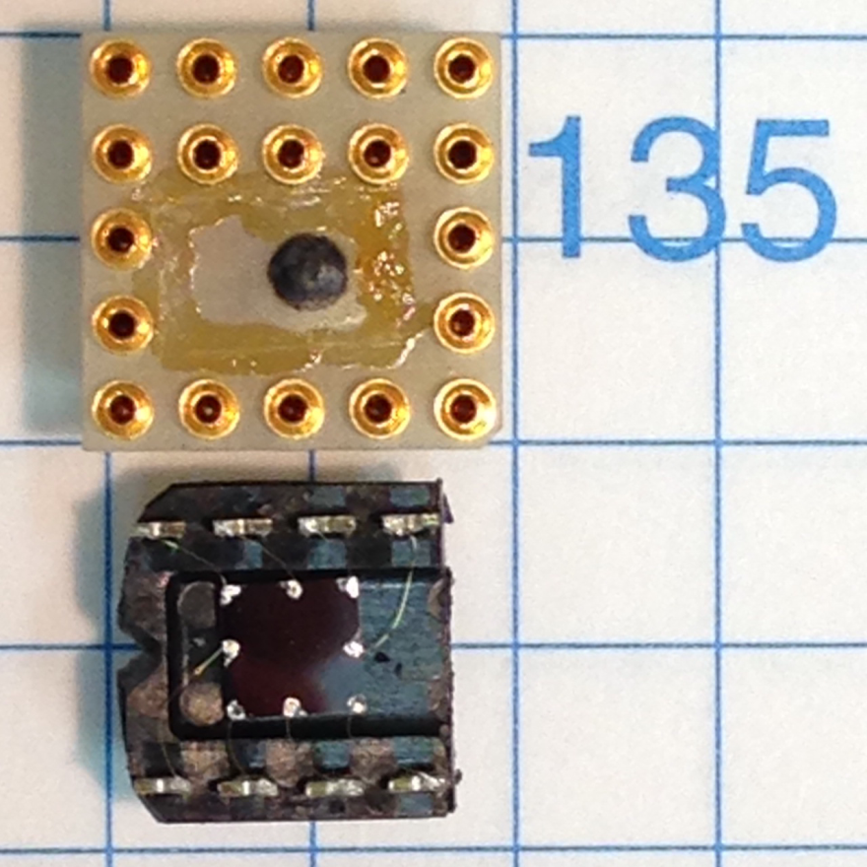
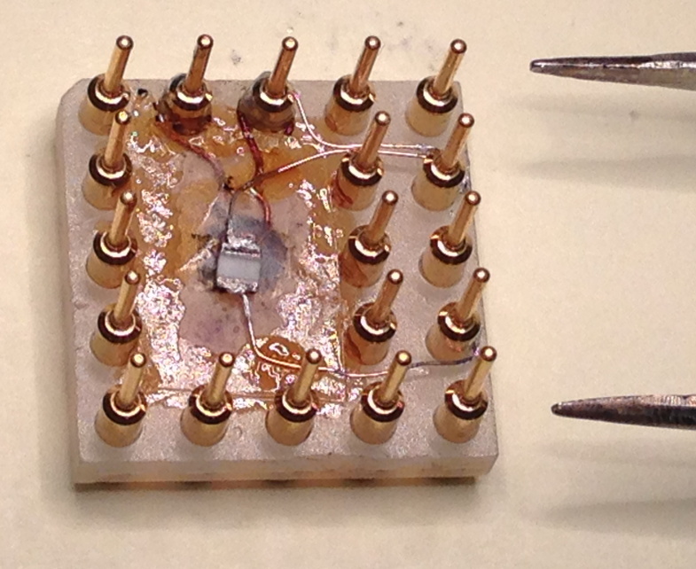
Chip holder for DPPH+MIRO experiment
DPPH C₁₈H₁₂N₅O₆
(1,1-Diphenyl-2-picrylhydrazyl, Free Radical)
g*=2.0036
J. Krzystek, A. Sienkiewicz, L. Pardi, and L. C. Brunel, "DPPH as a Standard for High-Field EPR," Journal of Magnetic Resonance, vol. 125, pp. 207-211, 1997.
RuO₂ Thermo-resistor:
LakeShore RX-102A-BR

Slide 24
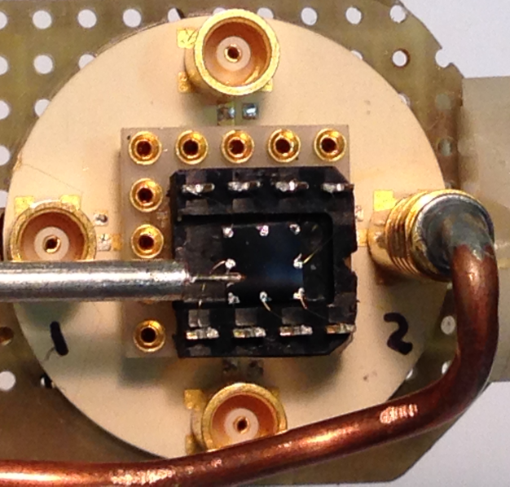
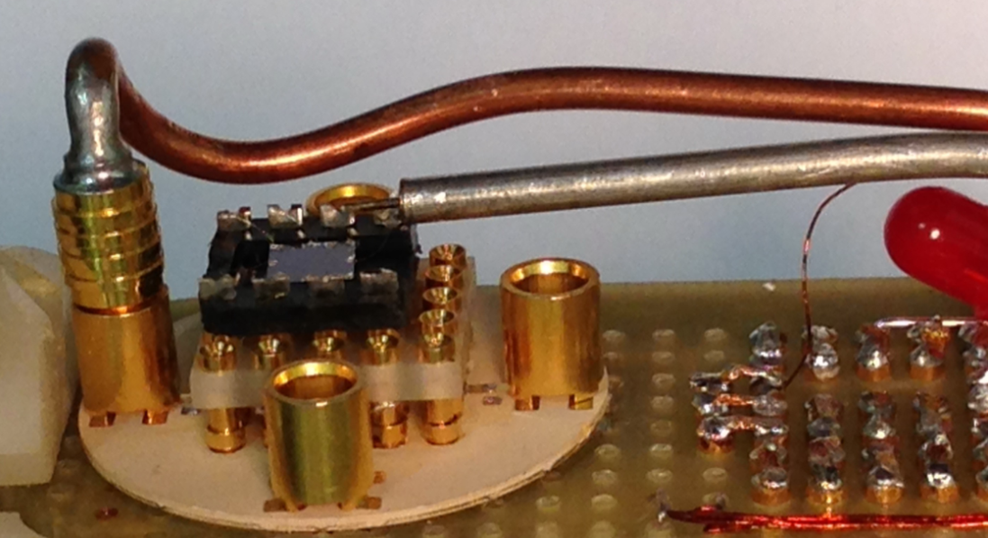
Chip and MW antenna arrangement for MIRO experiment

Slide 25
MIRO Frequency dependence excited by an antenna
Notes:
MIROs&SdH D:\QuantumNanolab\2014\Z1-MIRO\OPJ Files\CalculatingMfromDPPH&MIRO.OPJ*(Graph11)

Slide 26
DPPH resonance from 5 to 70 mT, T=300mK
g*=2.0036
dR/dB
d²R/dB²
At B=10 mT gμ_{B}B=1.16 μeV=13 mK
T=300mK => ( n$↑−n↓)$/n=1-exp(-g*μ_{B}B/k_{B}T) ∼ 4%

Slide 27
B-field calibration using DPPH resonance from 5 to 70 mT
90° Angle was optimized by maximizing V_{Hall} to the fifth digit.
Notes:
D:\QuantumNanolab\2014\Z1-MIRO\Calculating M from DPPH&MIRO.OPJ*(Graph1)

Slide 28
MIRO vs 1/B_{IPS} and 1/B_{DPPH}

Slide 29
m* from MIRO and DPPH
Measured m*=0.0649, Theory: m*(E1+Ef)=0.06793
Notes:
D:\QuantumNanolab\2014\Z1-MIRO\OPJ Files\CalculatingMfromDPPH&MIRO.OPJ*(Graph15)

Slide 30

Measured m*=0.0649, band theory m*=0.06793
${\text{cos}}^{−1}$(0.0649/0.0679)=17°

Slide 31

Electron effective mass in an ultra-high mobility GaAs/AlGaAs quantum well from MIROs and EPR experiment on DPPH
Conclusion
Measured m*_{MIRO}= 0.0649 is smaller than theoretically calculated m*_{theory}=0.0679
Question
is m*_{MIRO} sensitive to e-e interactions? Or else?
Notes:
In this talk I will share our experience in stabilizing a particular kind of devices – lateral SiGe QDs.

