Slide 1
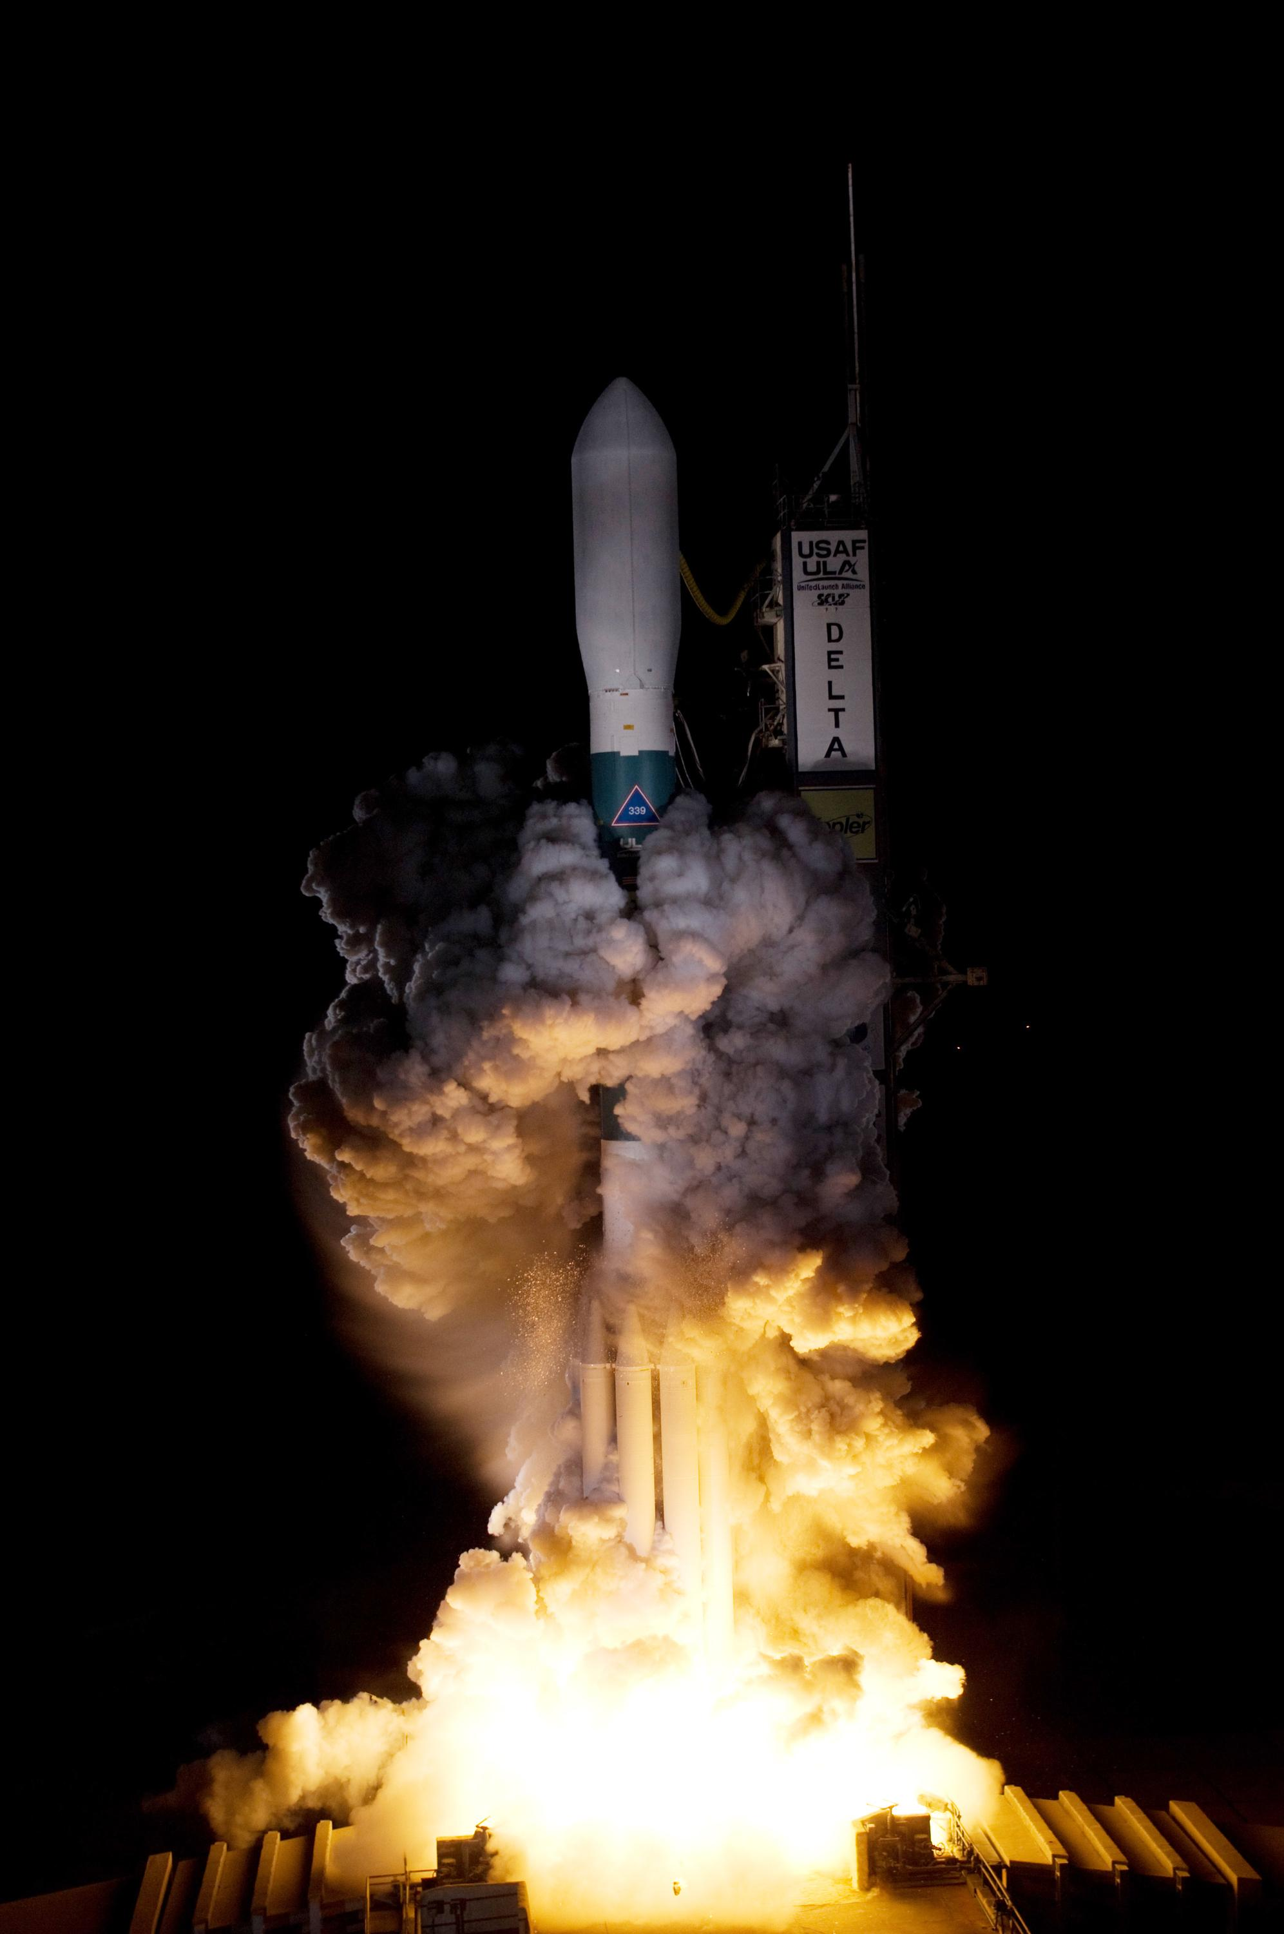
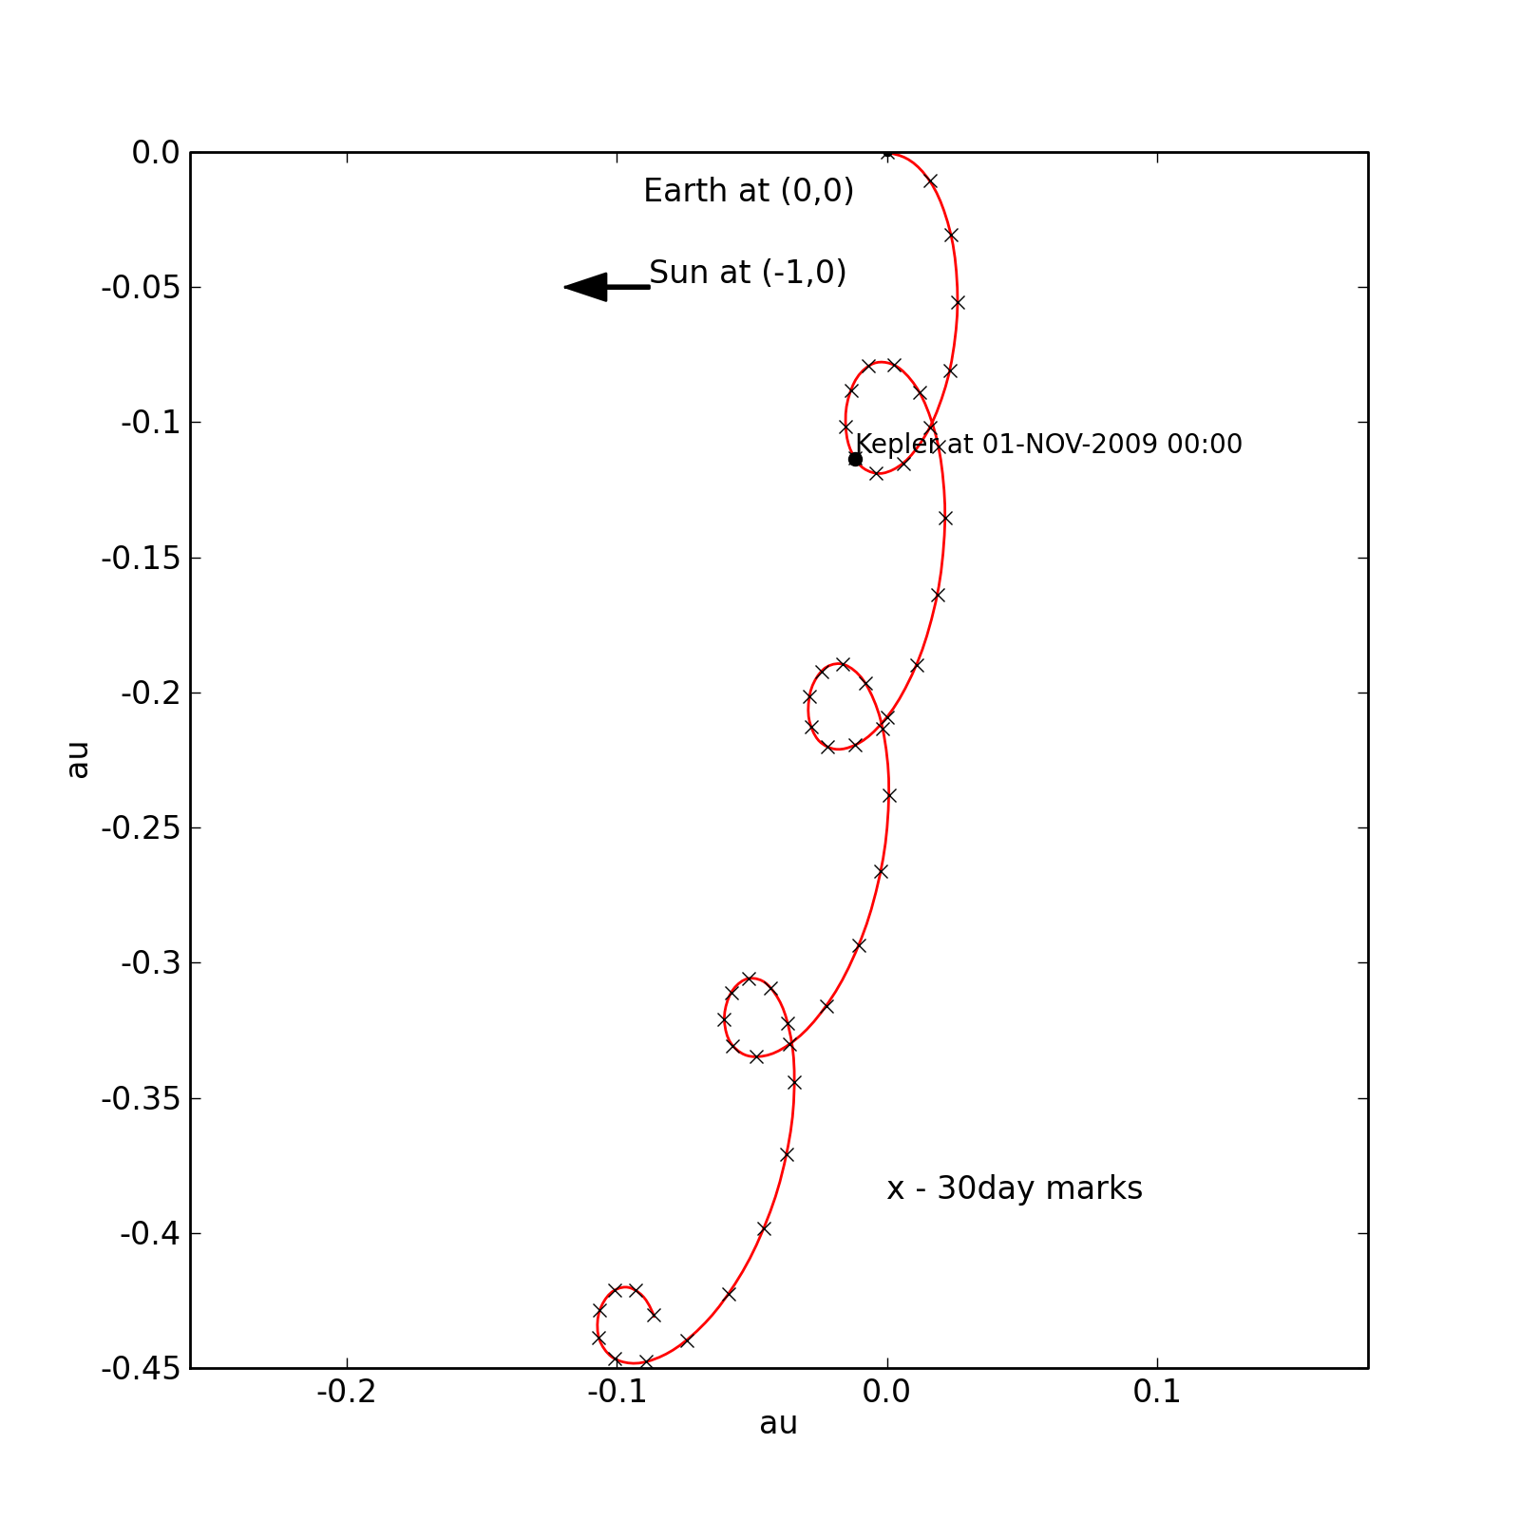
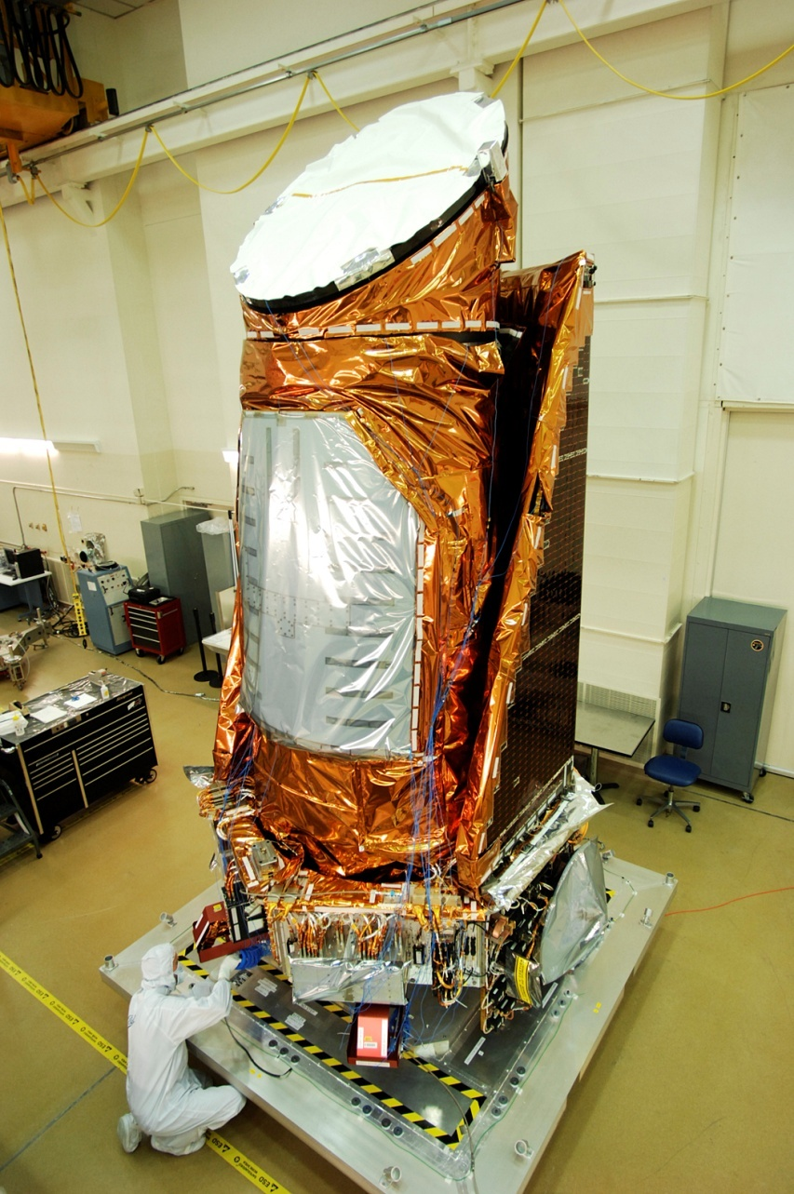
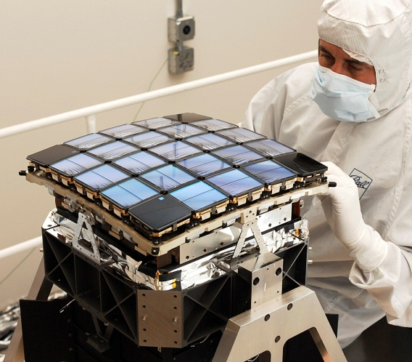
Kepler, K2, & Planetary Chaos
Jack Lissauer, NASA Ames
Chaos in planetary dynamics
NASA’s Kepler Mission
Kepler’s closely packed systems
Kepler-36: A very chaotic two-planet system
The atmospheres of Neptune & Uranus
Earth-trailing heliocentric orbit

Slide 2
Chaotic Motion in the
Solar System & Beyond
“Trivial” Chaos: Close Approaches
Resonances & Chaos
Chaos & Planet Formation
Gas Drag: Non-Hamiltonian System
Stability of Planetary Systems

Slide 3
Transit Lightcurve
Δf =
(R_{p}/R*)²
flux
~1%
for Jupiter
R_{p} R_{p}
time
Josh Pepper

Slide 4
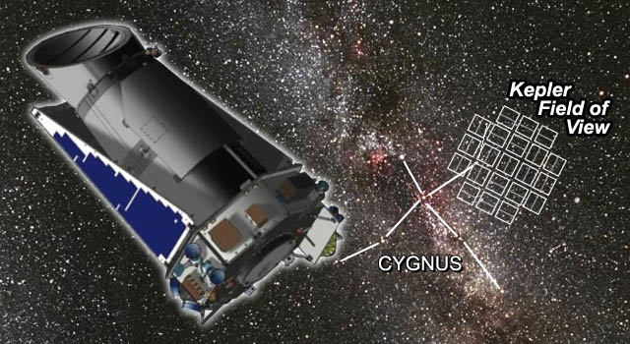
Kepler Mission
NASA, photometry of > 150,000 stars
Searched for Earth-like planets in transit
30 minute cadence; 4 years observing same FOV
~ 30 ppm in 6 hours for bright targets (m_{v} < 12)
Notes:
4

Slide 5
Kepler Mission Goals
Explore the structure and diversity of extrasolar planetary systems
1. Determine the frequency of terrestrial planets in or near the habitable zone of a wide variety of spectral types of stars;
2. Determine the distributions of size and semi-major axis of these planets;
3. Estimate the frequency and orbital distribution of planets in multiple-star systems;
4. Determine the distributions of semi-major axis, albedo, size, mass and density of short-period giant planets;
5. Identify additional members of each photometrically-discovered planetary system using complementary techniques;
6. Determine the properties of those stars that harbor planetary systems.

Slide 6
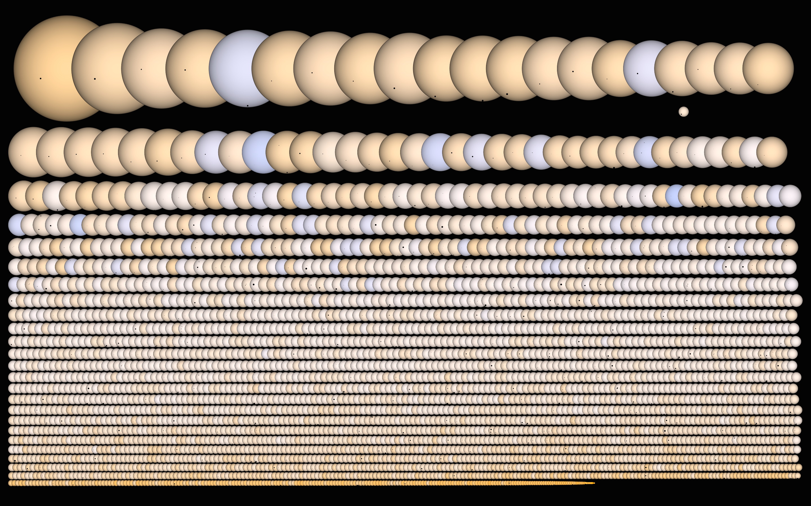
Kepler Planet Candidates & Their Stars
Jason Rowe, 2015

Slide 7
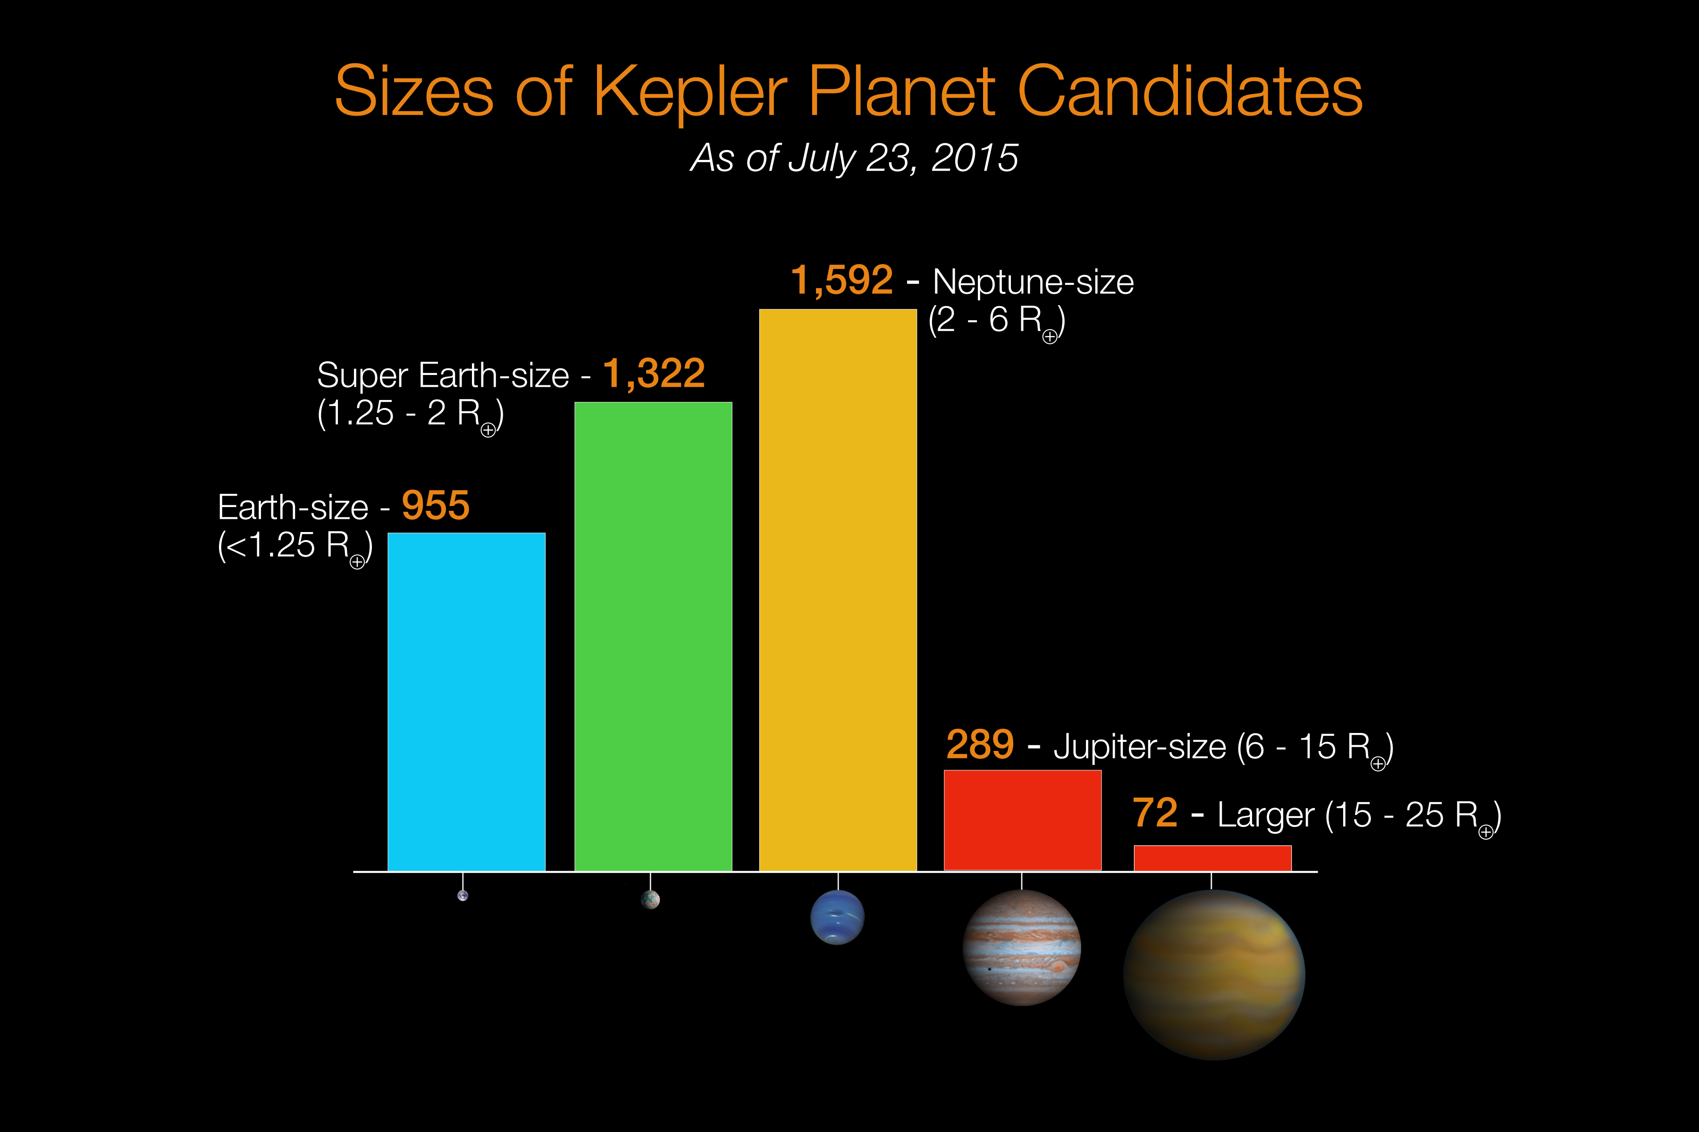

Slide 8
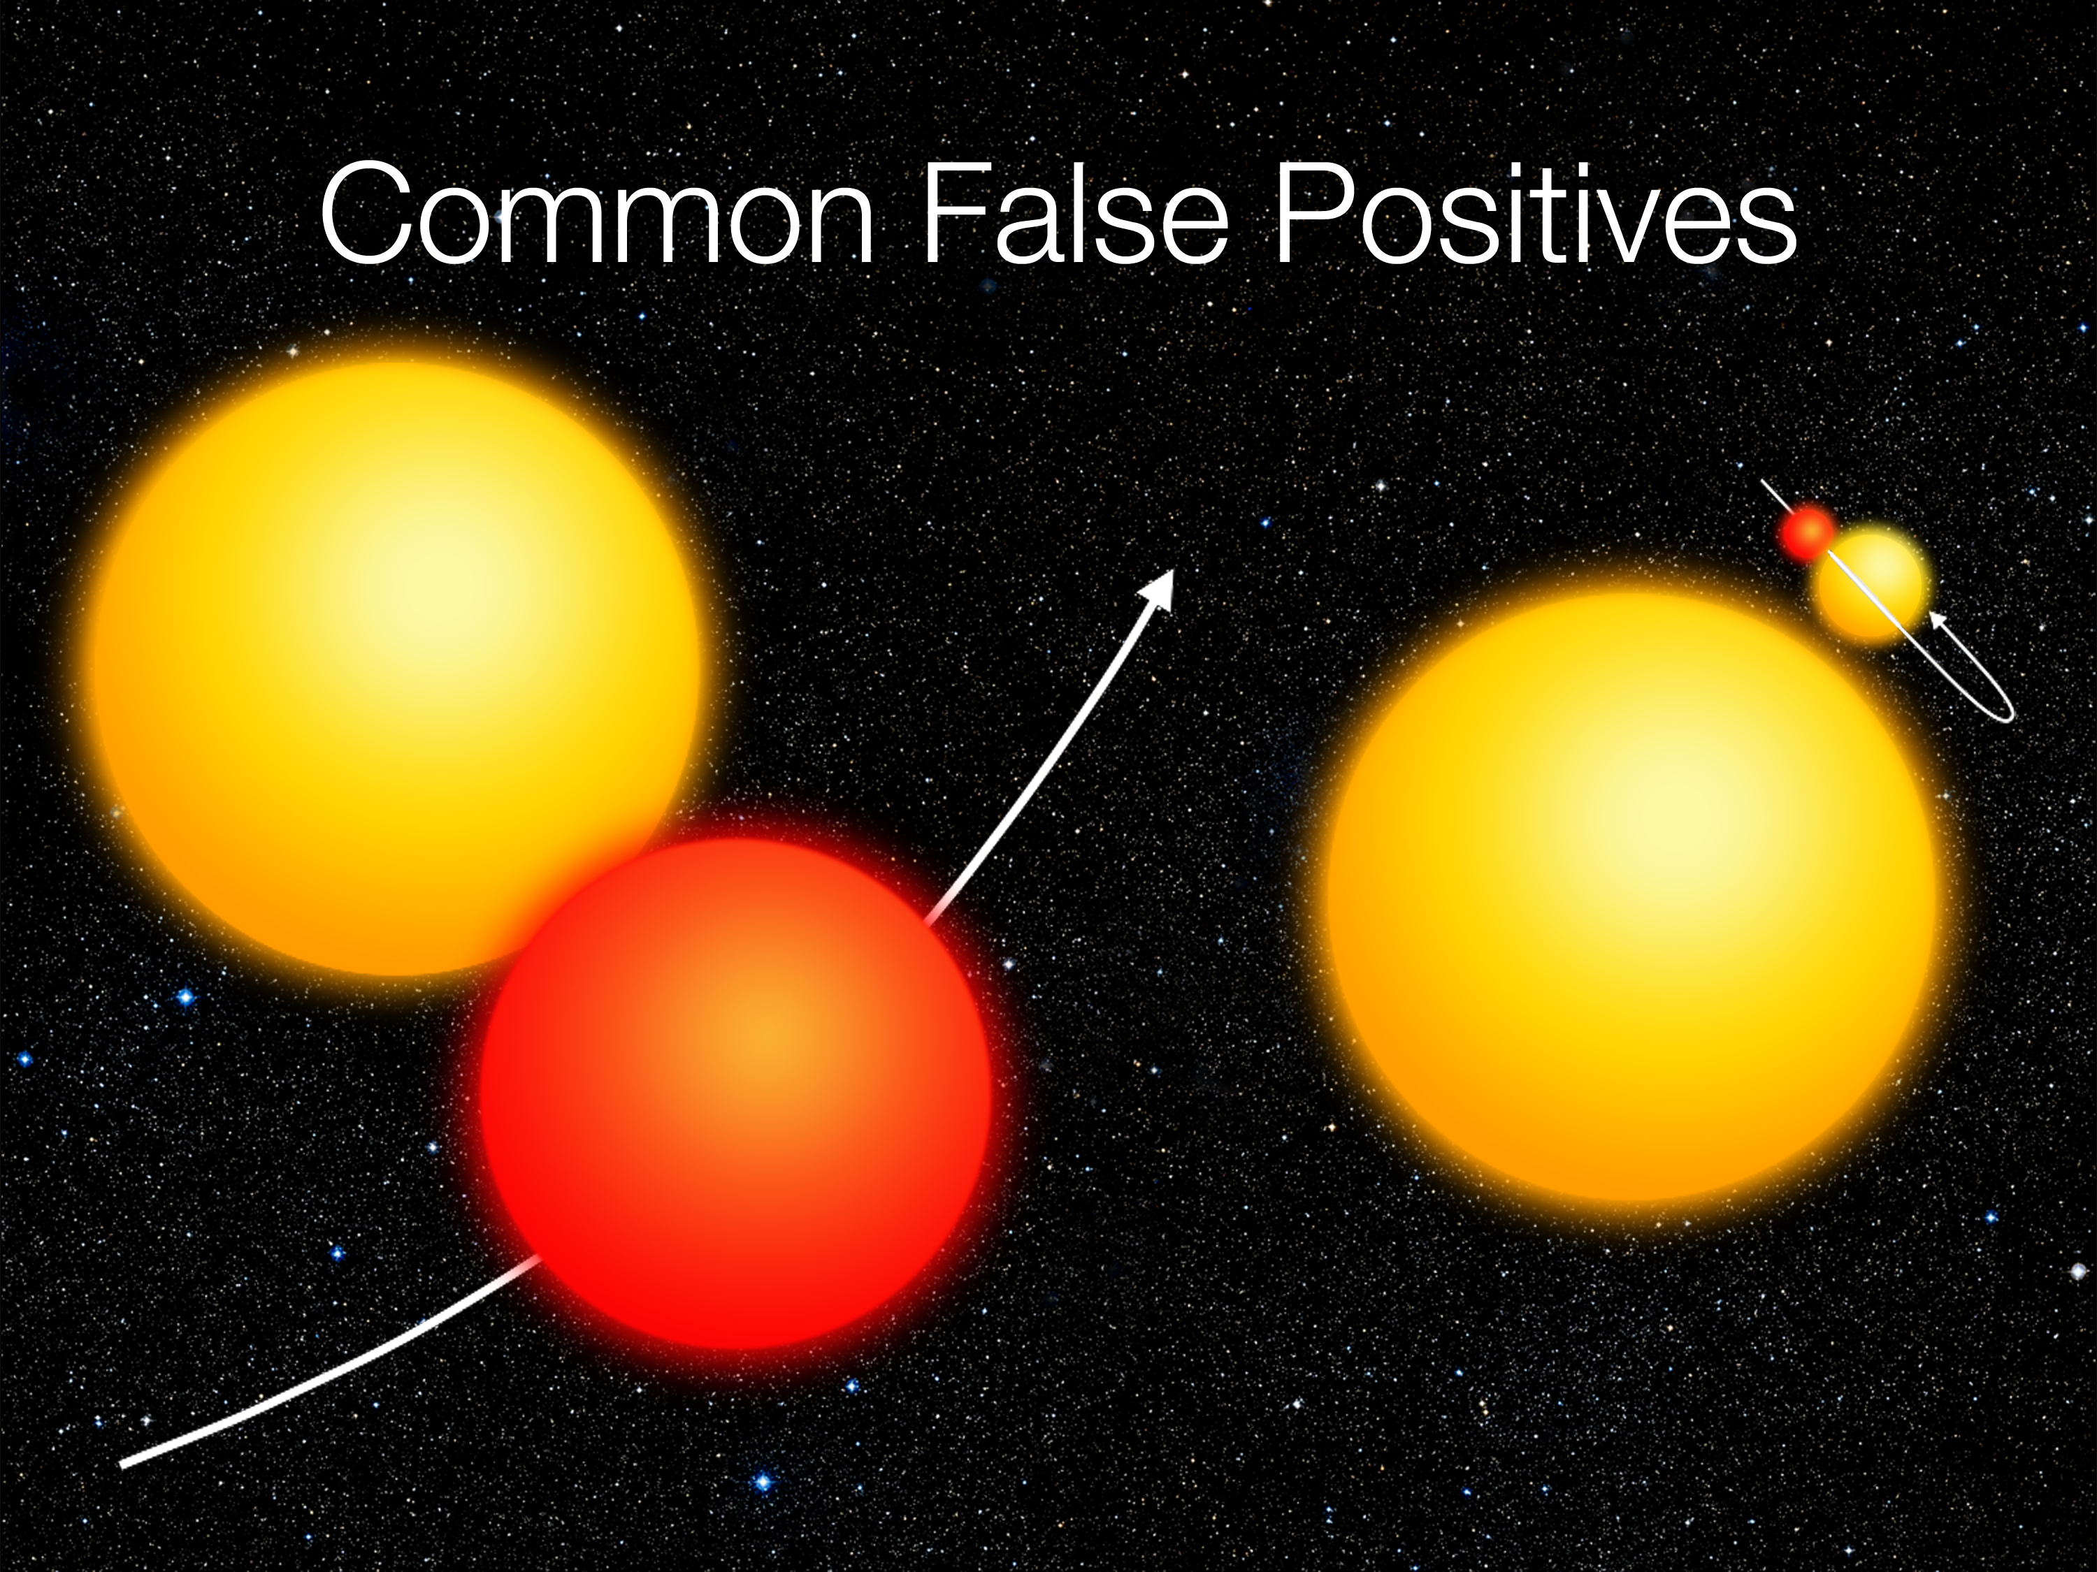

Slide 9
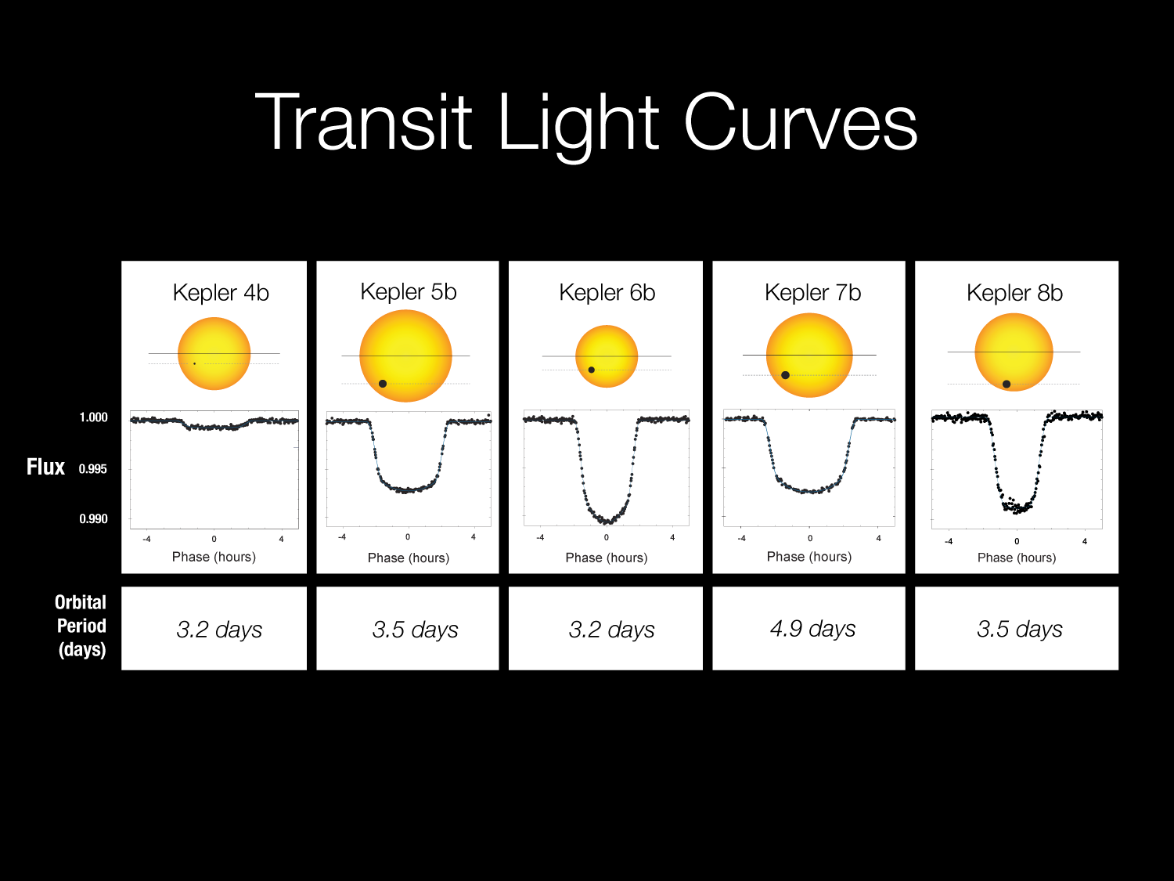

Slide 10
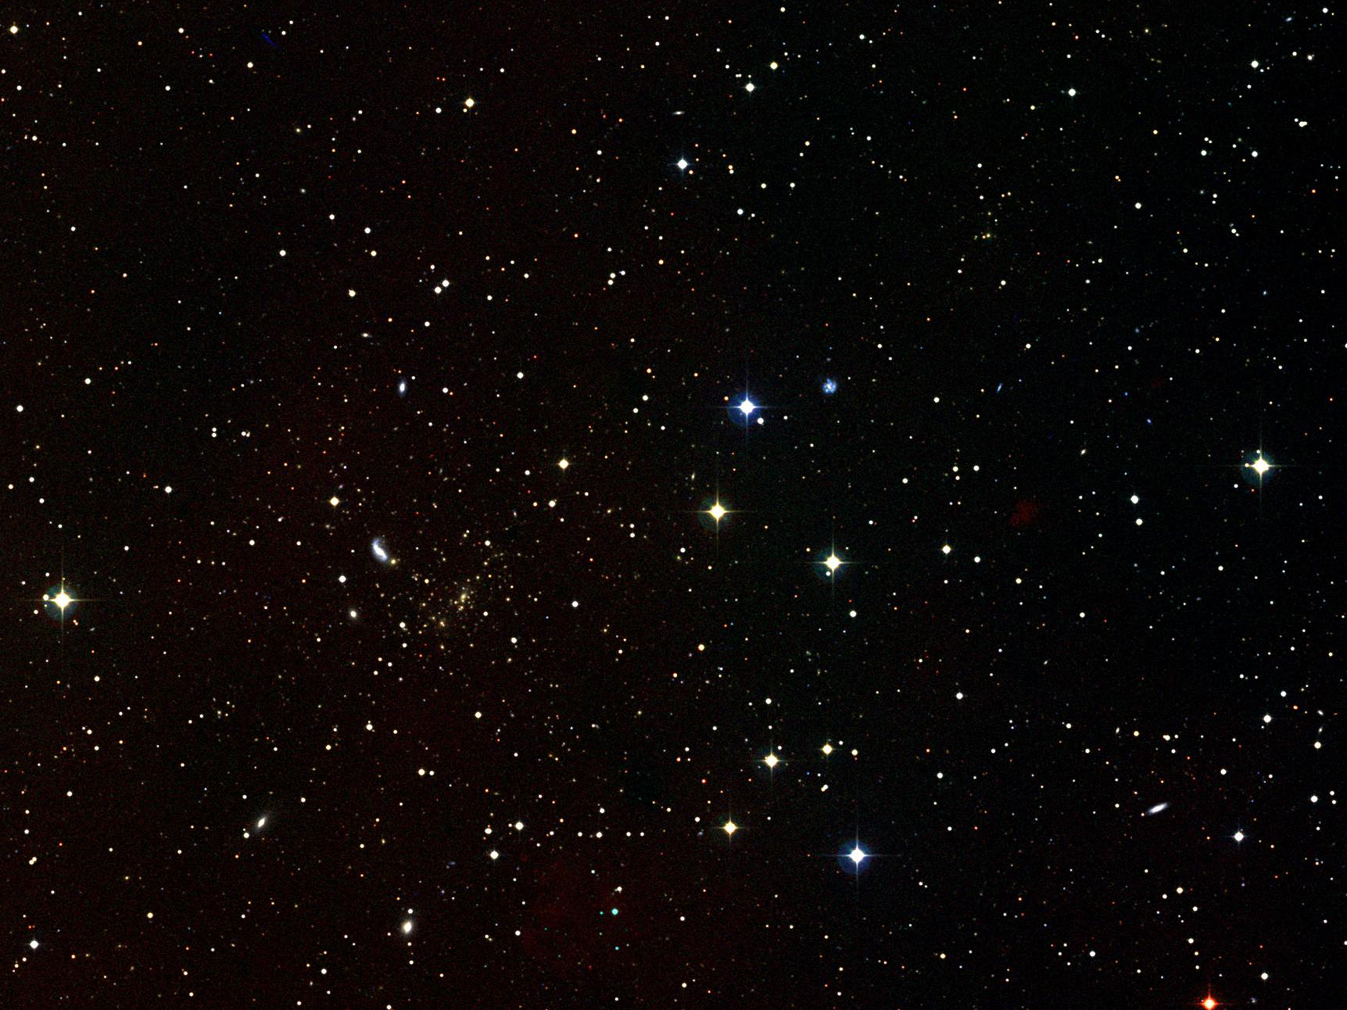
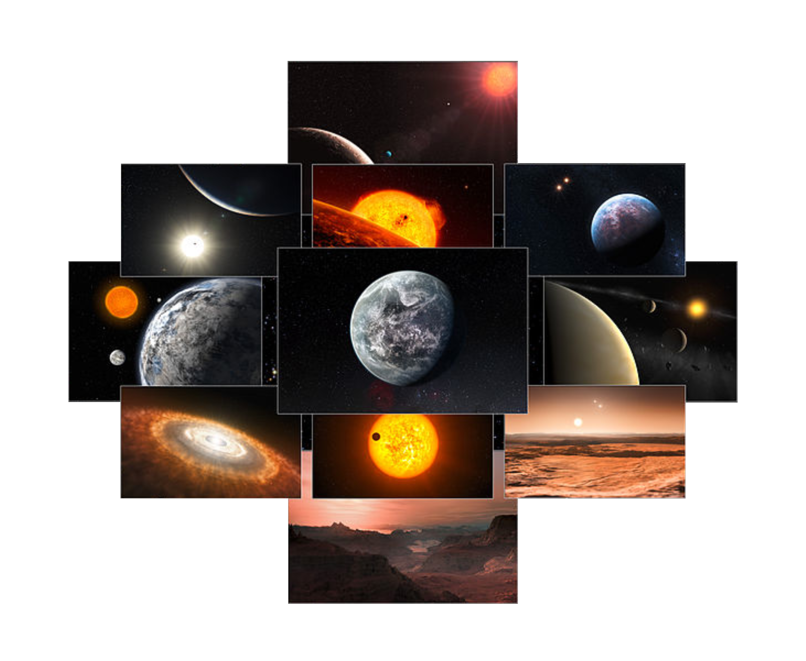
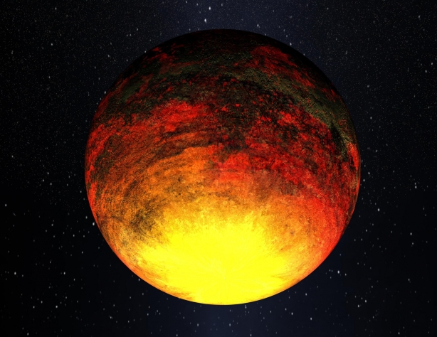
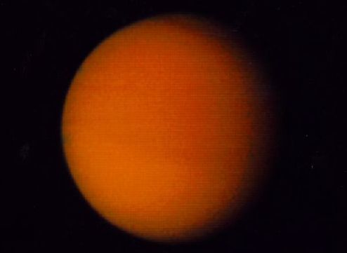
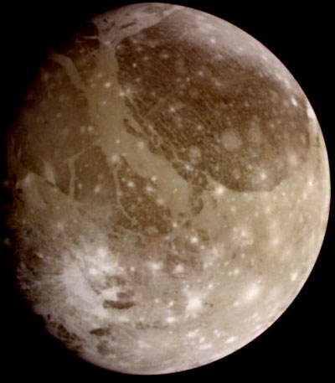
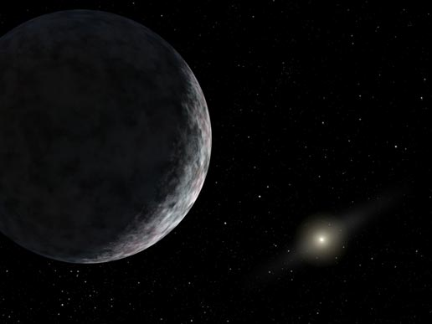
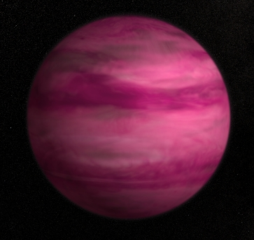
Notes:
http://commons.wikimedia.org/wiki/File:A_decade_of_discoveries_from_HARPS.jpg
http://www.nasa.gov/mission_pages/kepler/multimedia/images/kepler10_3.html#.U0ICjbRjDHg
http://apod.nasa.gov/apod/ap000620.html
http://apod.nasa.gov/apod/ap990207.html
http://www.nasa.gov/content/goddard/astronomers-image-lowest-mass-exoplanet-around-a-sun-like-star/#.U0MDelzvahM
http://www.nasa.gov/vision/universe/solarsystem/newplanet-072905-images.html

Slide 11
Artist Conceptions
(Science fiction)
Notes:
http://commons.wikimedia.org/wiki/File:A_decade_of_discoveries_from_HARPS.jpg
http://www.nasa.gov/mission_pages/kepler/multimedia/images/kepler10_3.html#.U0ICjbRjDHg
http://apod.nasa.gov/apod/ap000620.html
http://apod.nasa.gov/apod/ap990207.html
http://www.nasa.gov/content/goddard/astronomers-image-lowest-mass-exoplanet-around-a-sun-like-star/#.U0MDelzvahM
http://www.nasa.gov/vision/universe/solarsystem/newplanet-072905-images.html

Slide 12
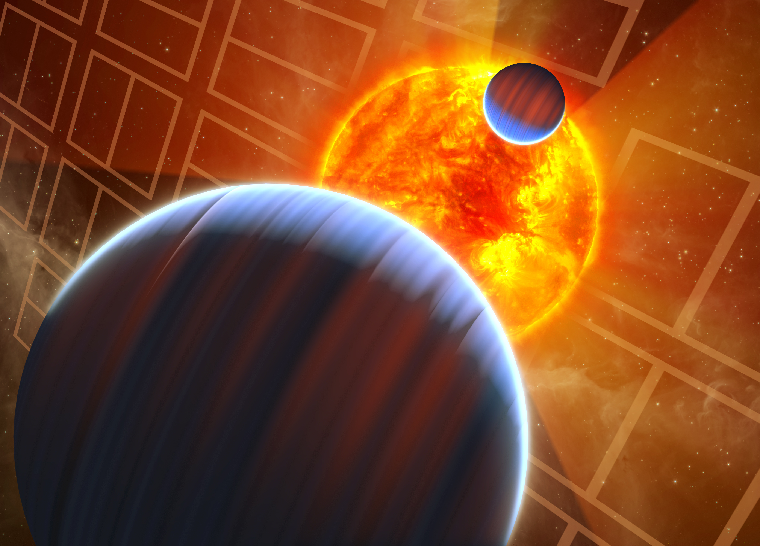
Kepler-9b,c
Notes:
12

Slide 13
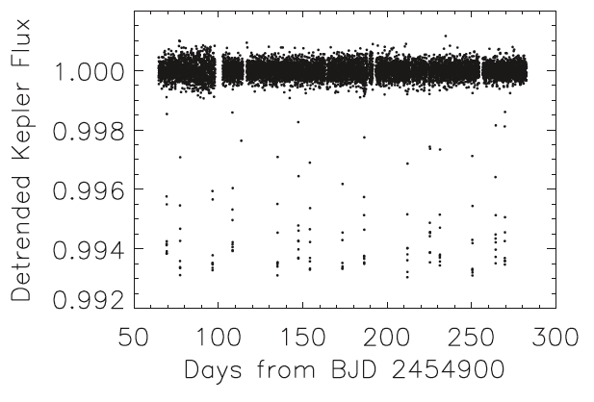
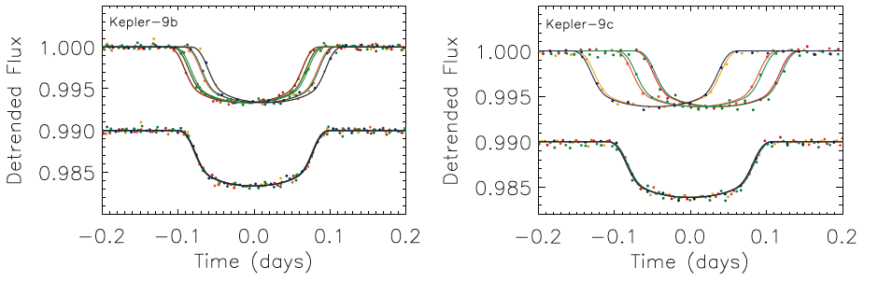
Kepler-9 b,c: Transit Timing Variations
Notes:
13

Slide 14
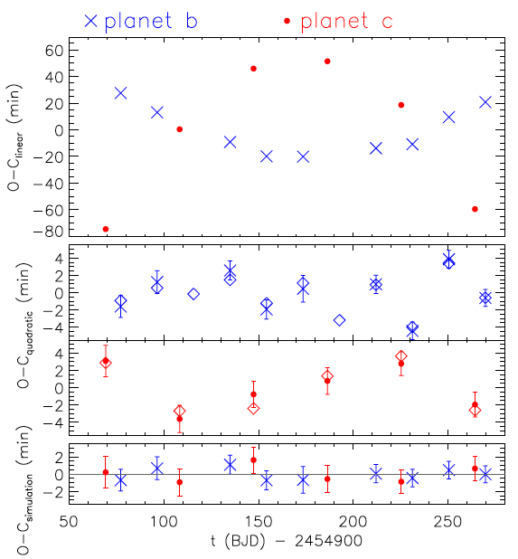
Transit timing - Planet perturbations
Kepler-9 models without interactions give poor fits
Models with planets affecting each other give good fits
TTVs can be used to confirm planets & measure masses
Notes:
14

Slide 15
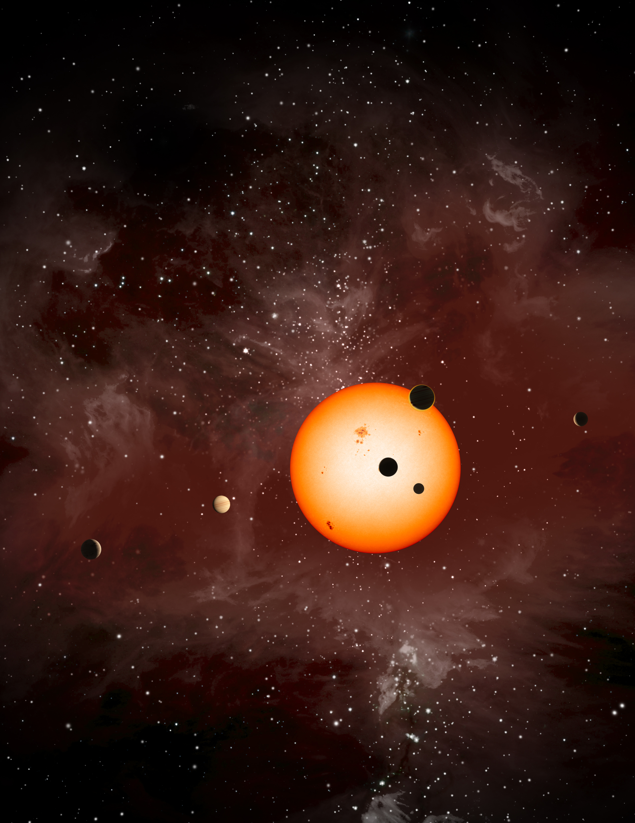
Kepler-11
A really cool system with 6 transiting planets

Slide 16
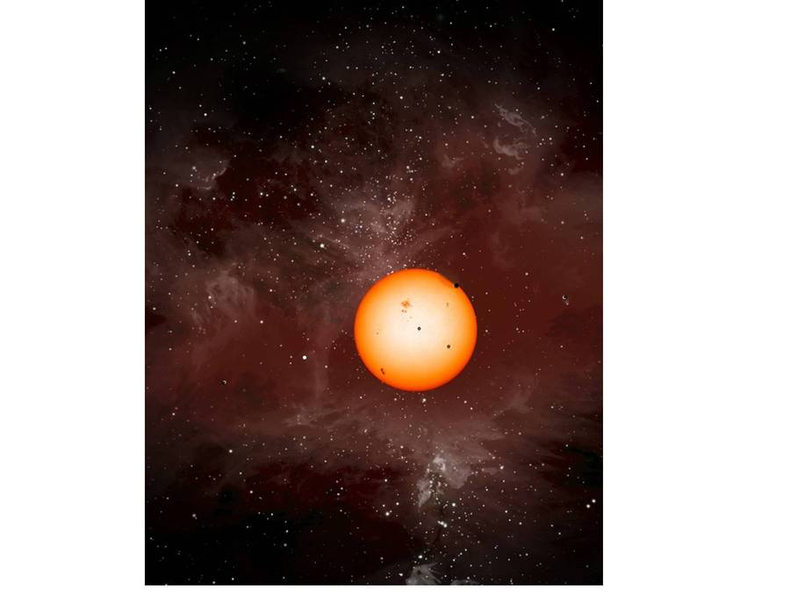
Kepler-11 Planets
Correct sizes relative to star
(Dan Fabrycky)

Slide 17
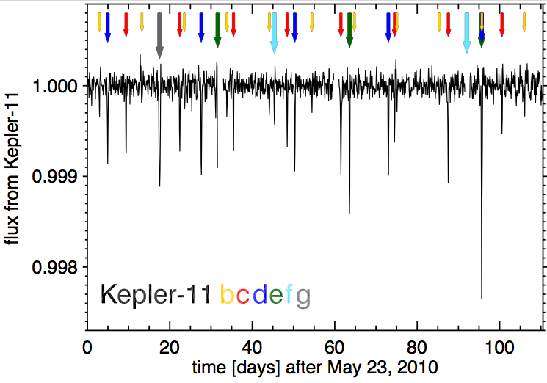
Kepler-11: Six Transiting Planets

Slide 18
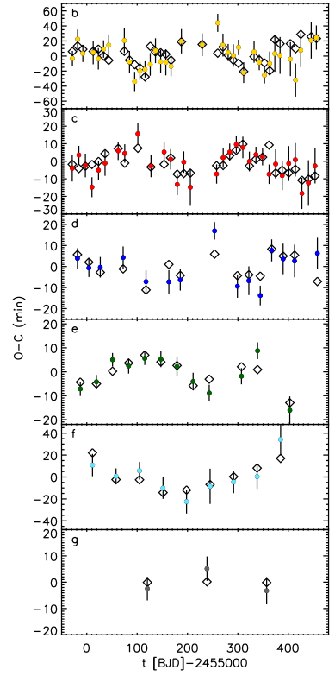
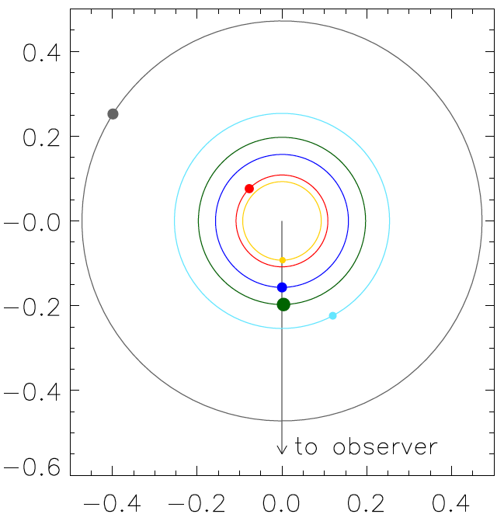
<−Transits
TTVs −>

Slide 19
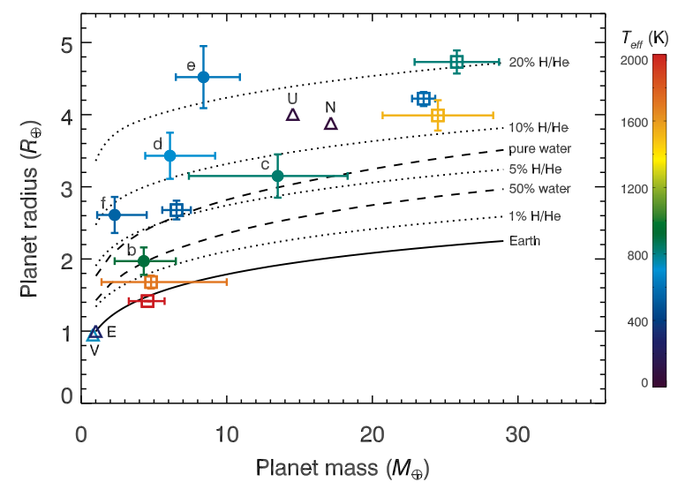

Slide 20
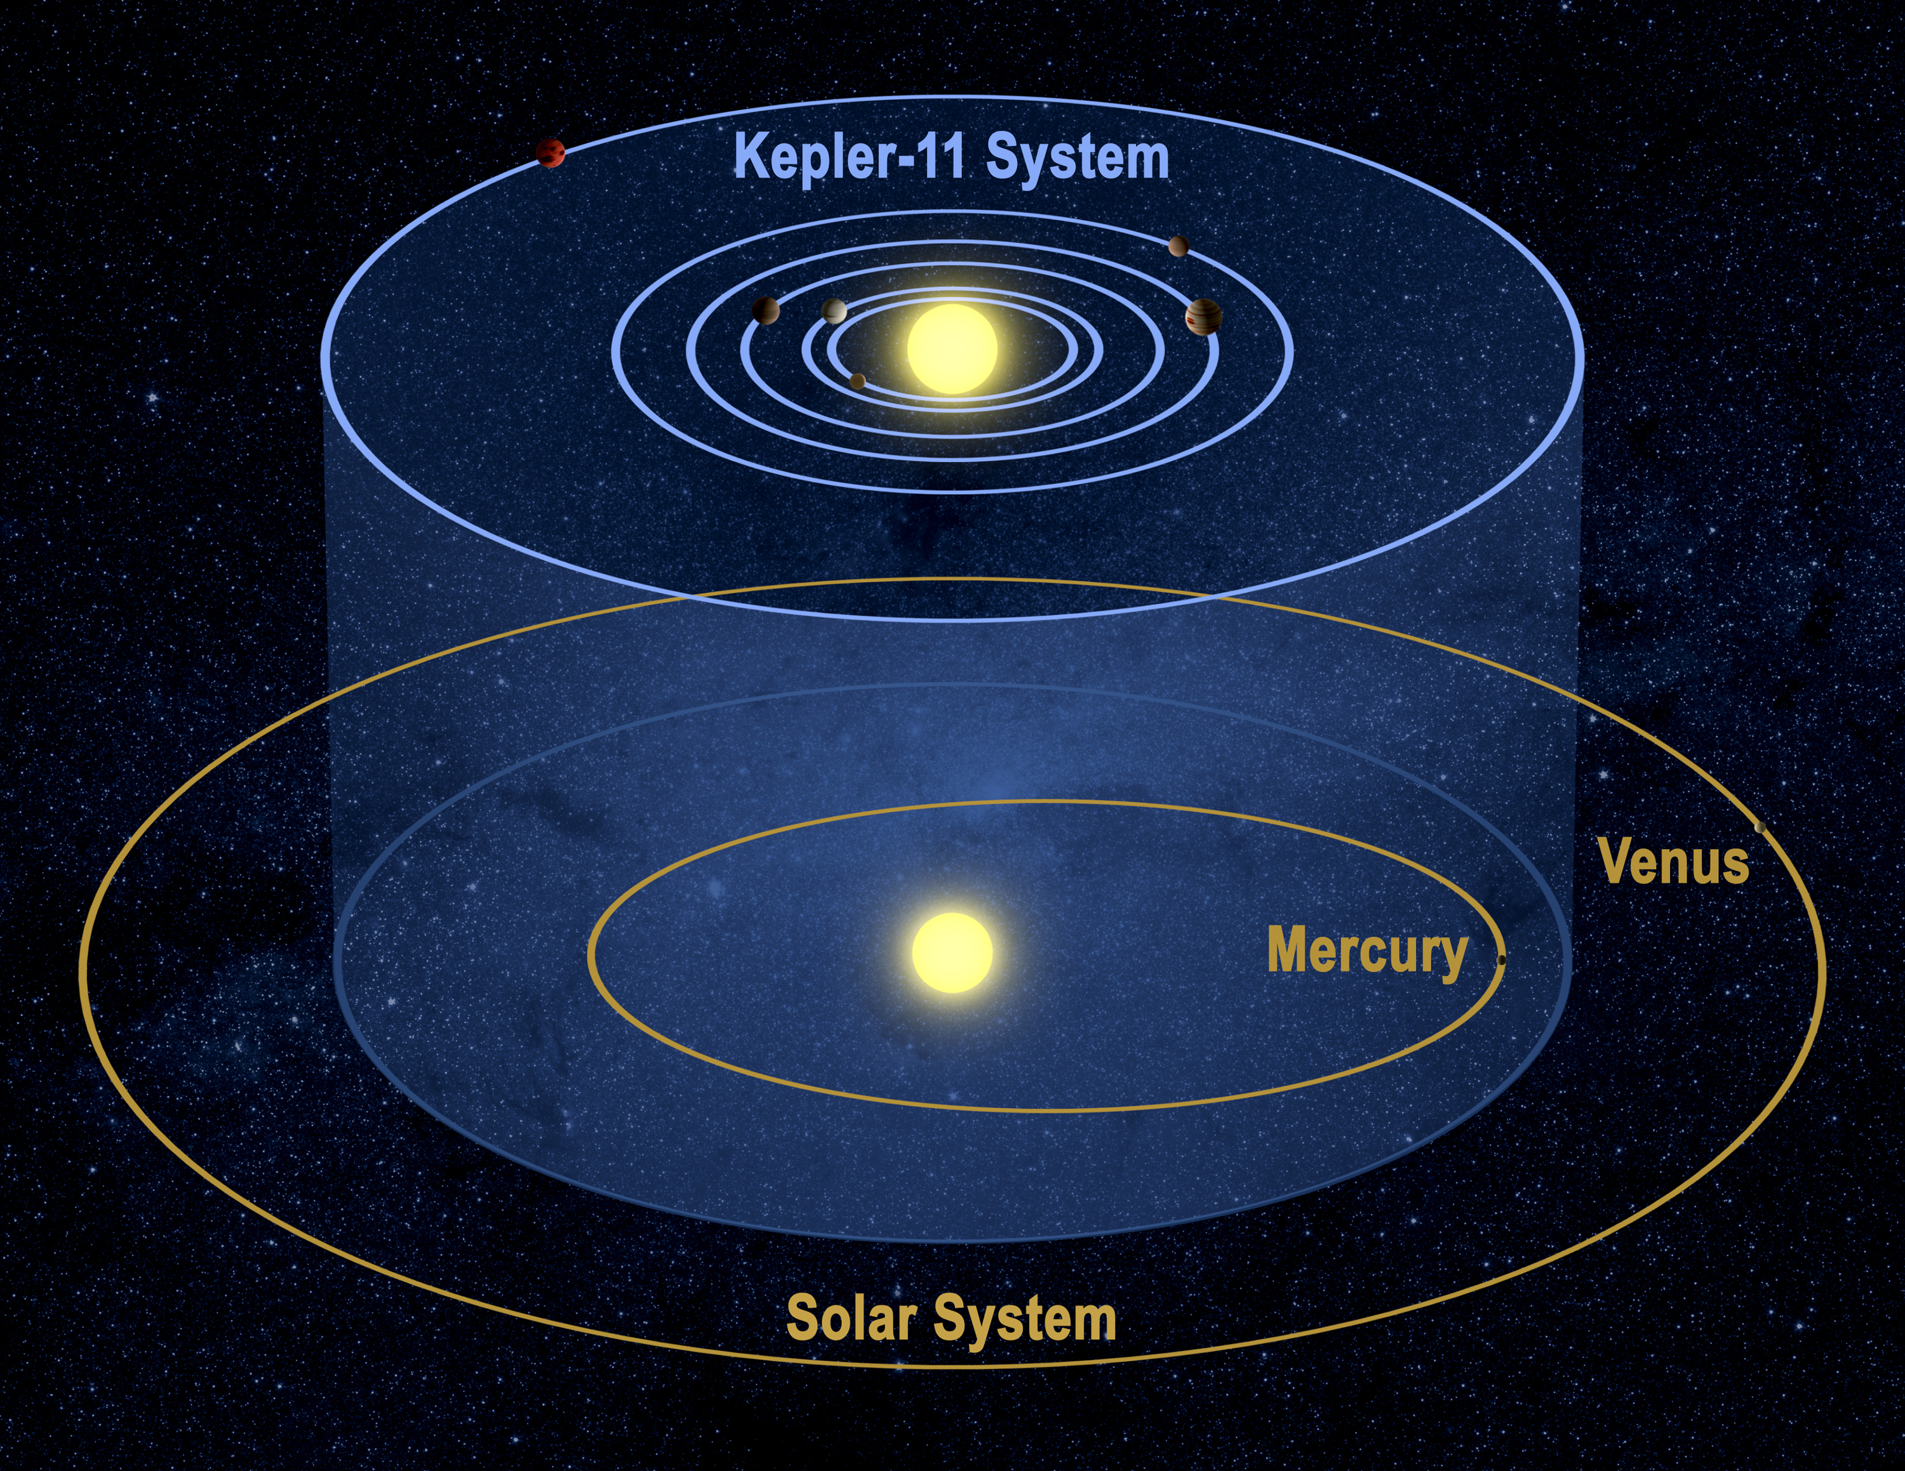

Slide 21
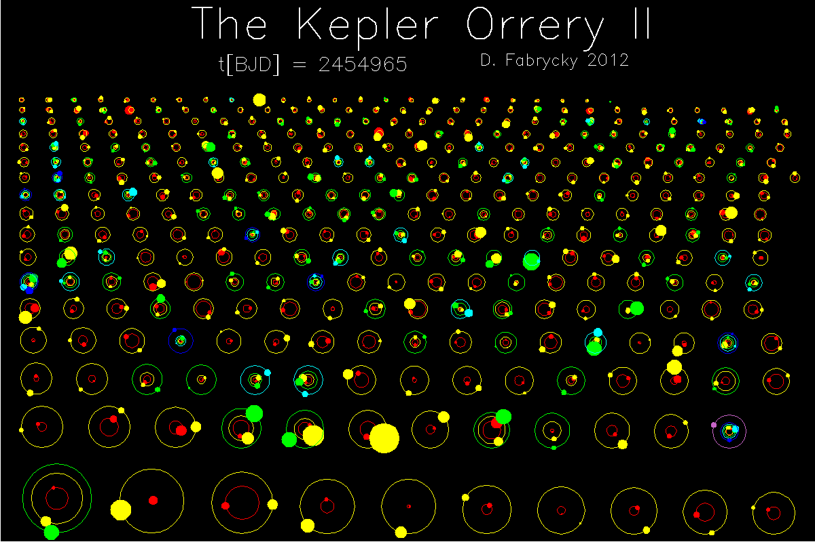

Slide 22
Kepler-36: A Pair of Planets with Neighboring Orbits and Dissimilar Densities
(Carter et al. 2012)

Slide 24
Orbits Are Extremely Close
Kepler-36 A
M⋆ = 1.071±0.043 M⊙
R⋆ = 1.626± 0.019 R⊙
T_{eff⋆} = 5911 ± 66 K
Kepler-36 b
M_{p} = 4.32±0.20 M
R_{p} = 1.486±0.035 R
P= 13.83989 d
Kepler-36 c
M_{p} = 7.84±0.35 M
R_{p} = 3.679±0.054 R
P = 16.23855 d
a_{b} = 0.1153±0.0015 AU
Parameters from:
Carter et al. (2012)
Deck et al. (2012)
a_{c} = 0.1283±0.0016 AU
Notes:
The planet orbits are extremely close, an average period ratio of only 1.173. Their semi-major axes differ by just 1.3% of an AU.

Slide 25
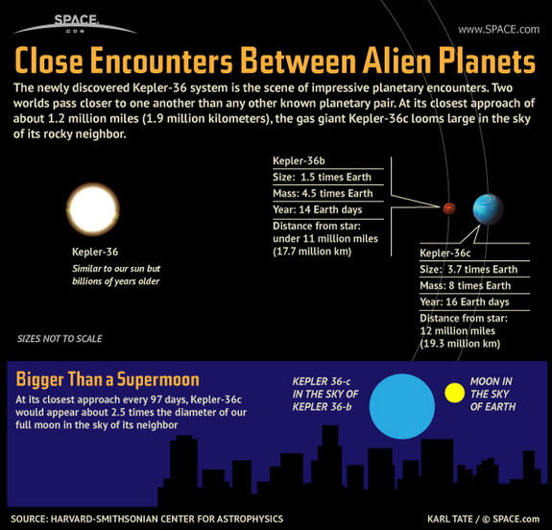
Orbits Extremely Close
Inner planet: P_{b} = 13.84 d; M_{b} = 4.5 M_{Earth}
Outer planet: P_{c} = 16.24 d; M_{c} = 8 M_{Earth}
Near boundary of Hill stability, h_{crit}

Slide 26
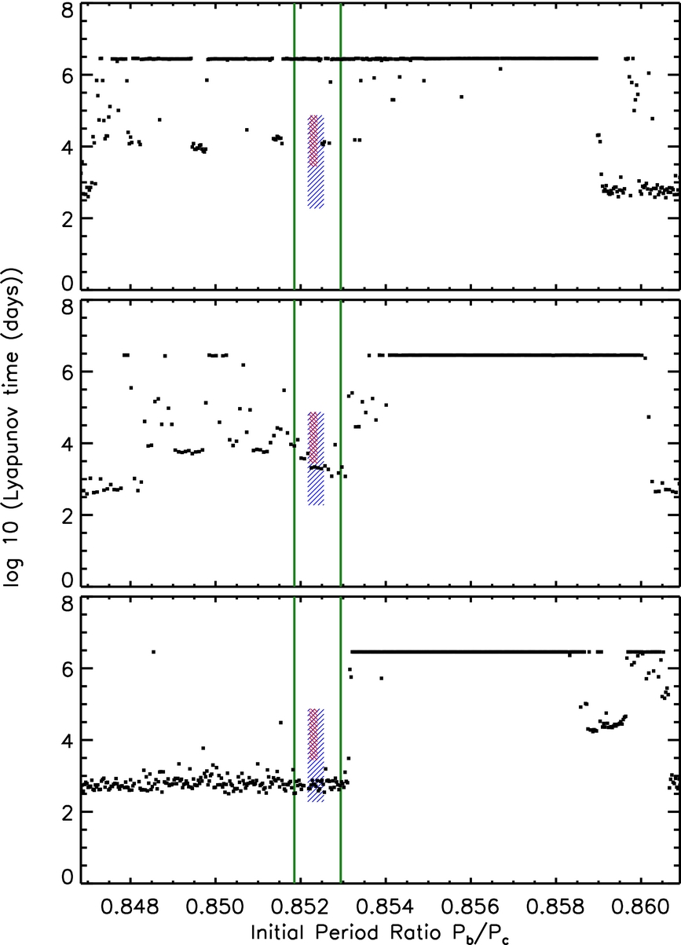
Kepler-36 Chaos
Blue fits data
Red also long-lived
Green lines 23:27 & 34:39 resonances
Eccentricities: e_{b}, e_{c}
_{Top: 0.02, 0}
_{Middle: 0.021, 0.006}
_{Bottom: 0.36, 0}
(Deck et al. 2012)
Notes:
Structure of the phase space near the Kepler-36 initial conditions. Red indicates the span of the long-lived trajectories on this plane and blue the entire sample. Black points correspond to trajectories that do not fit the data. Green lines indicate the nominal location of the 23:27 and 34:39 MMR. Only ab varies within each panel. Top: (eb, ec) ~ (0.02, 0.0). Middle: (eb, ec) ~ (0.021, 0.006). Bottom: (eb, ec) ~ (0.036, 0.0).

Slide 27
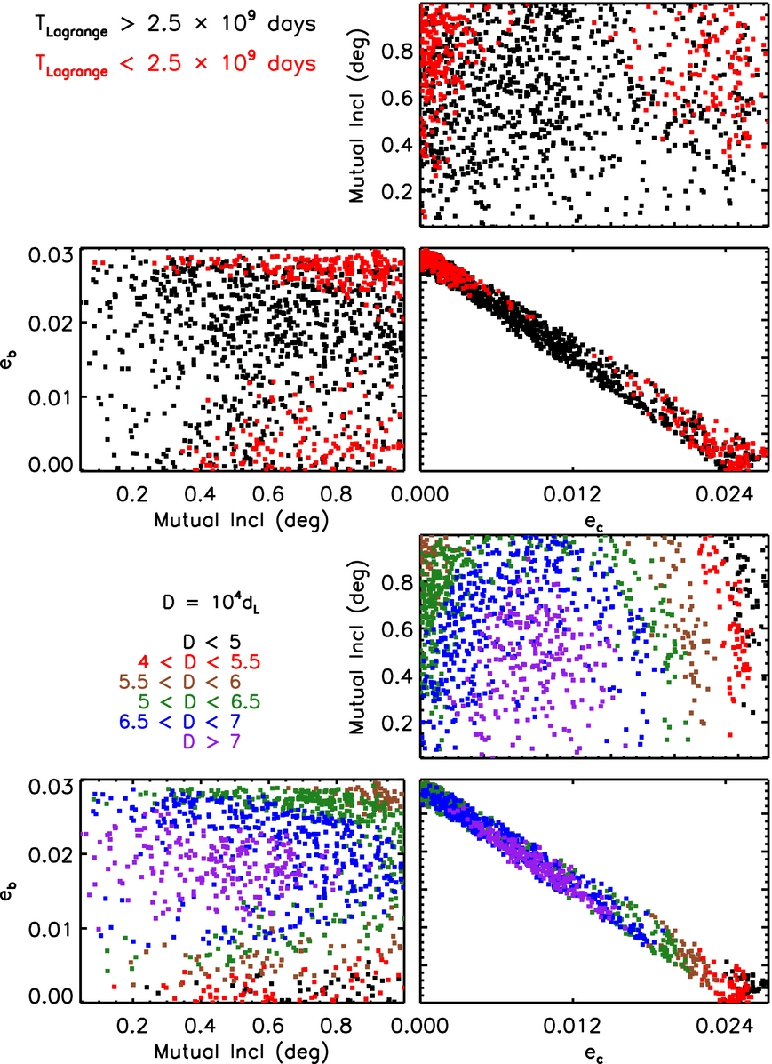
Kepler-36 Chaos
Red short-lived
Black long-lived
Colors in lower plots indicate quasi-Lyapunov time
(Deck et al. 2012)
Notes:
Relationship between Hill and Lagrange stability. Upper trio of plots: the region of orbital element space where orbits can be long-lived. Lagrange unstable orbits are shown in red, orbits that have not undergone Lagrange stability in 2.5 × 109 days are in black. Lower trio of plots: grouping initial conditions based on their values of dL reveals the Lagrange long-lived core.

Slide 28
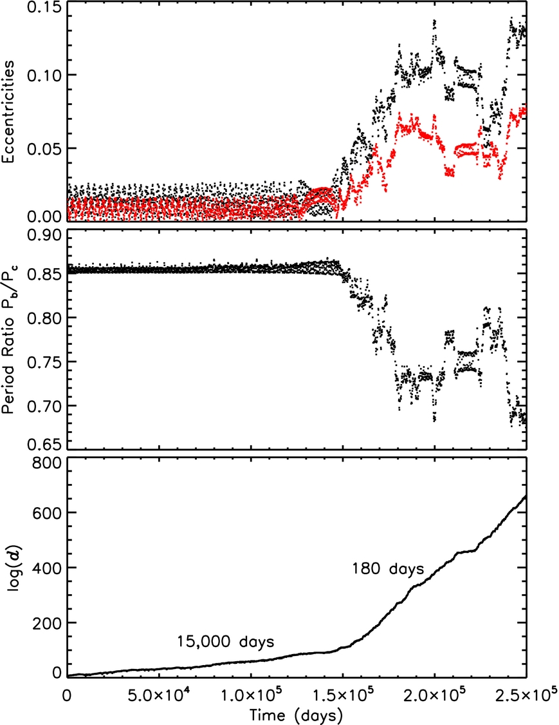
Kepler-36 Chaos
Evolution of eccentricities, period ratio and quasi-Lyapunov time of an unstable trajectory
(Deck et al. 2012)
Notes:
Period ratio and eccentricity evolution (eb in black, ec in red) for a Lagrange unstable orbit. When the orbit begins to change qualitatively in an erratic way, the slope of log (d) changes, indicating a change in the estimated Lyapunov time. log (d) is the natural logarithm of the magnitude of the perturbation of the trajectory, as defined in Equation (1).

Slide 29
Hill Stability of Photo-dynamical Model Solutions
Notes:
The distribution of the stability parameter h − hcrit = dL for the ensemble of initial conditions studied, generated using only 10 quarters of data (in red) and generated using 14 quarters of data (in black). The distribution has shifted towards larger values of dL.

Slide 30
Lagrange Instability Eliminates some Solutions allowed by Kepler Data, Refining Measured Parameters
All Initial Conditions
Long-Lived Core
Mixed Long-Lived Orbits
Notes:
The distribution of the stability parameter h − hcrit = dL for the ensemble of initial conditions studied (in black), for those comprising the long-lived core (Set A, in red) and for those comprising all long-lived trajectories on 5 × 109 day timescales (set B, in blue).

Slide 31
Kepler-36 b Mass Measured within 4.2%,
Radius Measured within 1.8%
K36c
H₂O
Earth Composition
K36b
Fe
Notes:
In the end, K36b’s mass is measured within 4.2%, and the radius is measured within 1.8%.
Showing M-R diagram with K36 planet properties in red.
Already by eye, one can see that K36b is consistent with and Earth-like composition, while K 36c requires an envelope of light gases.
Also want to highlight that the masses and radii are correlated (due to the fact that asteroseismology constrains the stellar density very well).
These correlations help the composition retrieval for K36b since the, since long axis of the error ellipse roughly lines up along the isocomposition curves for rocky bodies. Doesn’t help Kepler-36c, since the M-R curves for planets with H-rich envelopes of nearly flat in this regime.
Kepler-93

Slide 32
Kepler-36 b is Consistent with an Earth-like Composition
Leslie Rogers et al., in preparation
All Initial Conditions
Long-Lived Zone
Mixed Long-Lived Orbits
MgFeSiO₃
Fe
M_{p} = 4.40±0.18 M
R_{p} = 1.481±0.027 R
M_{core}/M_{p} = 0.33±0.05

Slide 33
Compositional Constraints on Kepler-36 c
Envelope composition
30 x Solar H/He
M_{env}/M_{p} = 0.106±0.005
Solar H/He
M_{env}/M_{p} = 0.077±0.004
Hydrogen
M_{env}/M_{p} = 0.052±0.003
Notes:
Composition constraints shown for the long-lived core of ICs. Earth-like heavy element interior composition assumed.

Slide 34
Main Take Away Points
Kepler-36 b is the rocky exoplanet with the best constraints on its mass and radius: its mass is known within 4.2%, while the radius is known to 1.8%
Kepler-36 b’s mass and radius are consistent with an Earth-like composition. An iron-enhanced mercury-like composition is ruled out.
In contrast, Kepler-36 c requires several percent of its mass in a hydrogen-rich envelope.
Notes:
Graphic from: http://www.space.com/16246-alien-planets-night-sky-kepler-36-infographic.html

Slide 35

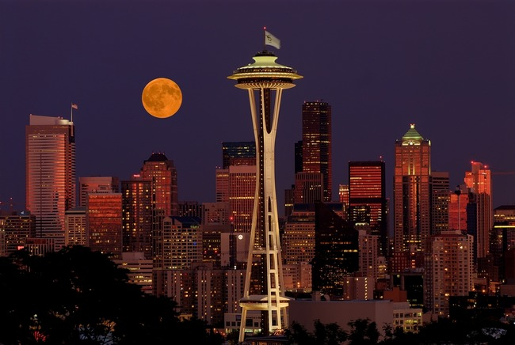

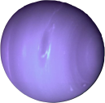
Main Take Away Points
Kepler-36 b is the rocky exoplanet with best constrained mass, density, and composition: mass known within 4.2%, radius to 1.8%, density to 4.6%.
Kepler-36 b’s mass and radius are consistent with an Earth-like composition. An iron-enhanced Mercury-like composition is ruled out.
In contrast, Kepler-36 c requires several percent of its mass in a hydrogen-rich envelope. (L. A. Rogers et al. in prep)
Figure Credit: NASA; Frank Melchior, frankacaba.com; Eric Agol
Notes:
Graphic from: http://www.space.com/16246-alien-planets-night-sky-kepler-36-infographic.html

Slide 37
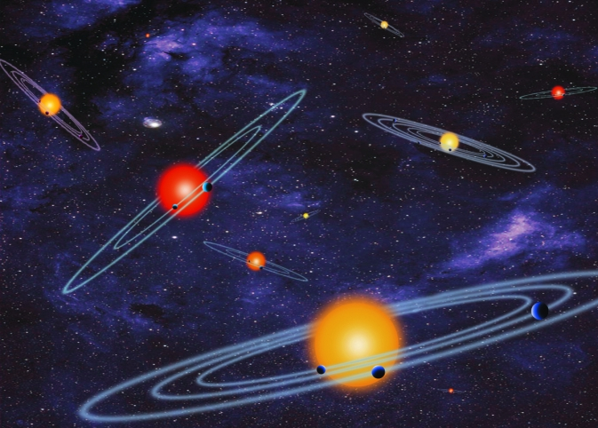

Slide 38
Systems with 3+ planet candidates Daniel Fabrycky

Slide 39
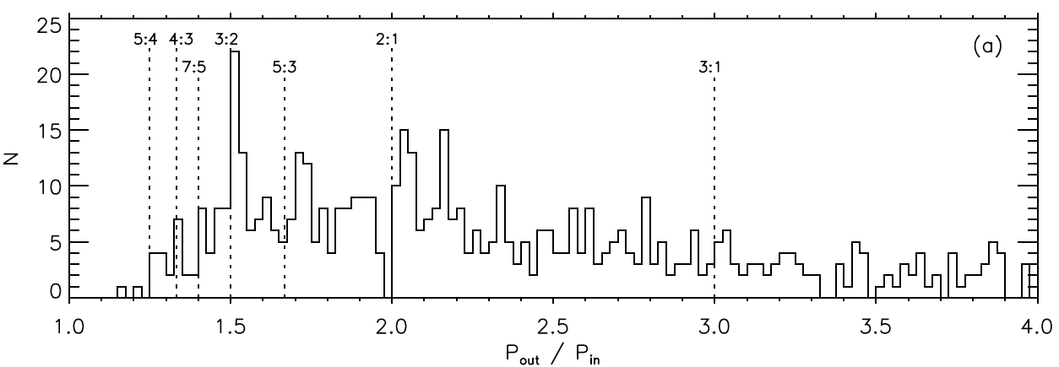
Period ratios
Broad distribution – most pairs are non-resonant
Factor-of-2 enhancements near 2:1 and 3:2 resonance
Enhancement is on the wide side of the resonance

Slide 40
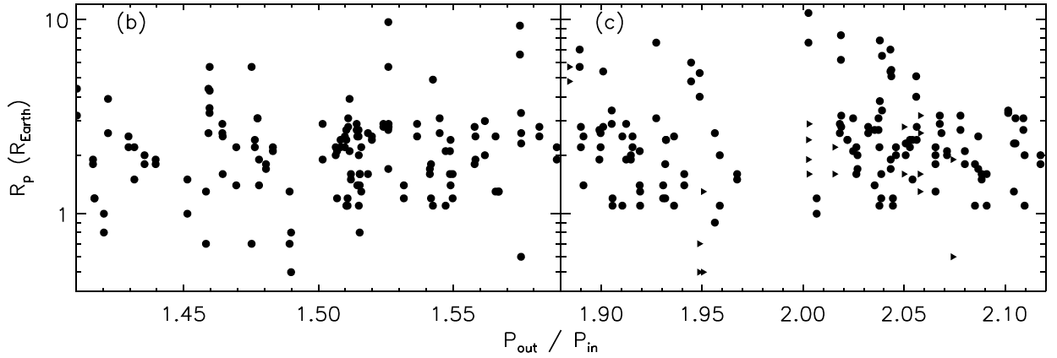
Near-resonance Features
Gravitational effect? (a la Kirkwood gaps)
pro: Gap seems to scale with planet radius (mass?)
con: Gap is not symmetric about the resonance Tidal repulsion?
pro: Qualitative match to data
con: Requires substantial tidal damping
Prediction: Gap shrinks/vanishes farther from star

Slide 41
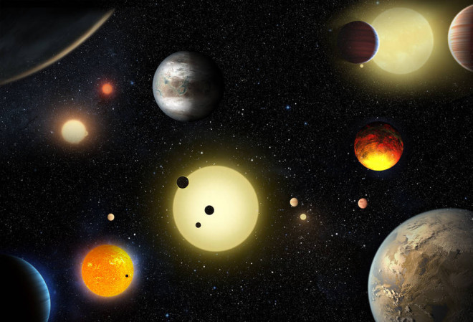
Kepler found a w i d e diversity of planets and planetary systems

Slide 42
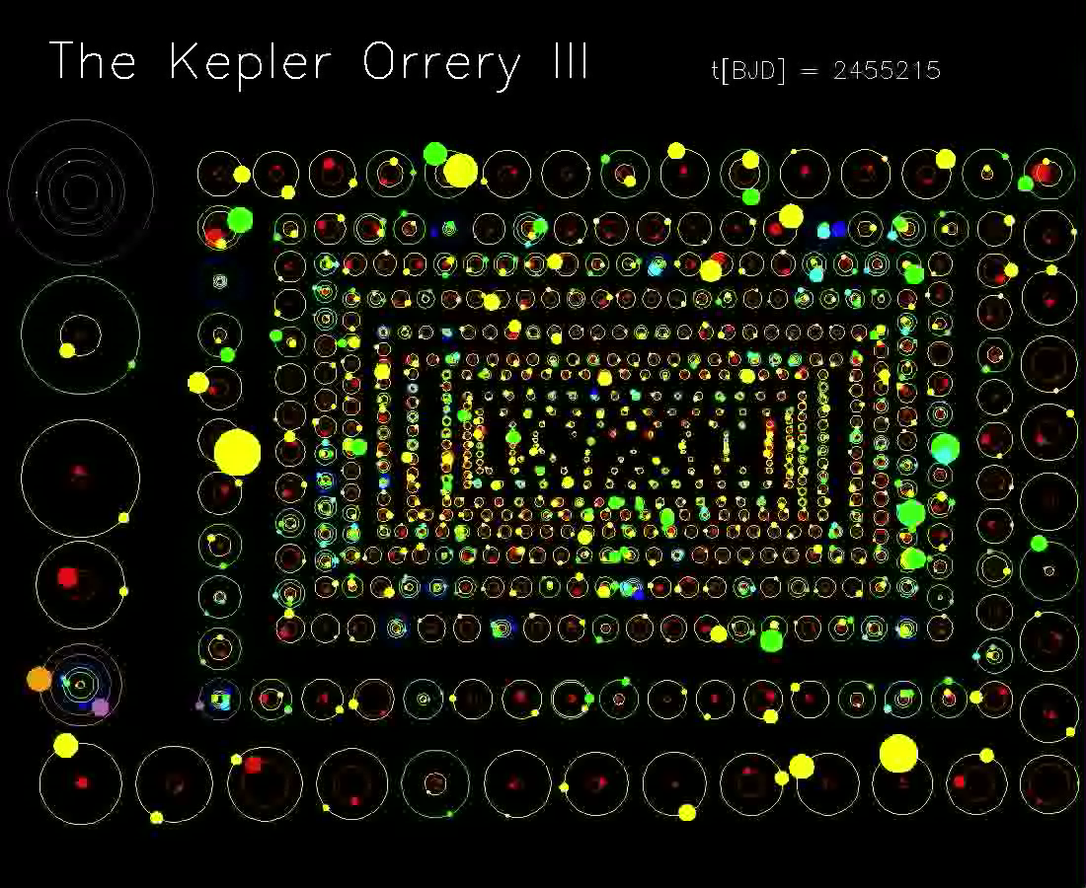

Slide 43
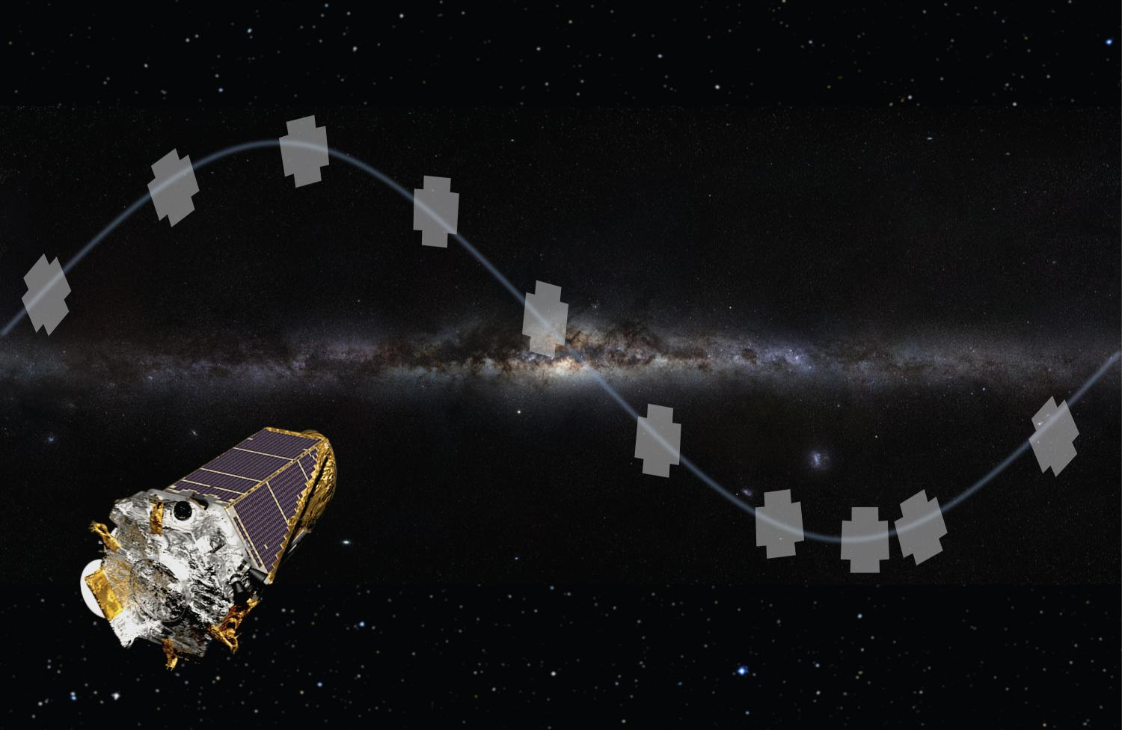
K2: Good Science from a Broken Spacecraft
In May of 2013, Kepler lost its 2nd gyroscope and could no longer point at its original field of view
Kepler can still observe in its orbital plane

Slide 44
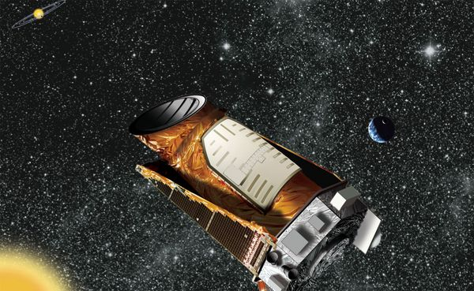
Observing the Ice Giants with K2
Amy Simon (NASA GSFC)
Jason Rowe (SETI)
et al.

Slide 45

Neptune – K2

Slide 46
Uranus – K2

Slide 47

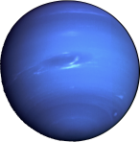

Credit: NASA; Frank Melchior, frankacaba.com; Eric Agol

