Slide 1
Genes and geography-2
Tatiana Tatarinova

Slide 2
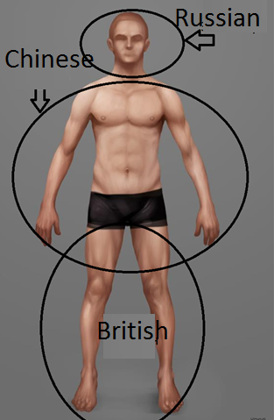
More complex cases?
reAdmix
ReAdmix developed to treat individuals of mixed origin and represents an individual as a linear combination of admixture vectors of reference populations
30%British+10%Russian+60%Chinese
P=a₁rs₁ + a₂rs₂ +... + a_{p}rs_{p}+error

Slide 3
How it works
We assume right away that the given ancient proportions contain error
Start with a guess population
Add/remove populations to achieve optimal fit
Conditional optimization (such as “I know that there was a Jewish ancestor somewhere in my pedigree”)

Slide 4
Reference genomes (R)
Group_ID | NORTHEASTASIAN | MEDITERRANEAN | SOUTHAFRICAN | SOUTHWESTASIAN | NATIVEAMERICAN | OCEANIAN | SOUTHEASTASIAN | NORTHERNEUROPEAN | SUBSAHARANAFRICAN
Abkhazians_0 | 0.02685 | 0.5161 | 0.00245 | 0.33155 | 0 | 0.00135 | 1.00E-04 | 0.119125 | 0.00245
Altaians_3 | 0.62205 | 0.006133 | 0 | 0.194183 | 0.036383 | 0.009583 | 0.01305 | 0.118567 | 0
Altaians_4 | 0.499943 | 0.000771 | 0.000686 | 0.245629 | 0.042386 | 0.003171 | 0 | 0.207343 | 0
Ambilobe_Madagascar_3 | 0.1882 | 0.0098 | 0.02975 | 0 | 0 | 0.00825 | 0.23685 | 0.0032 | 0.52385
Andilambe_Madagascar_0 | 0.1163 | 0.0113 | 0.054133 | 0.003467 | 0 | 0.0025 | 0.144633 | 0.0049 | 0.662767
Andriesvale_Northern_Cape_RSA_0 | 0 | 0.04265 | 0.7374 | 0.0647 | 0.0101 | 0.00135 | 0.0596 | 0.0436 | 0.04055
Antananarivo_Madagascar_0 | 0.215967 | 0.0066 | 0.024167 | 0 | 0.002233 | 0.003867 | 0.301667 | 0.004733 | 0.4407
AYMARA_URO_0 | 0.00001 | 0.00001 | 0.00001 | 0.00001 | 0.99992 | 0.00001 | 0.00001 | 0.00001 | 0.00001
Bermudian_1 | 0 | 0.3149 | 0.01145 | 0.1489 | 0.0114 | 0.00305 | 0.01425 | 0.38095 | 0.11515
Bermudian_2 | 0.008967 | 0.168417 | 0.024 | 0.0805 | 0.050083 | 0.004583 | 0.0069 | 0.23515 | 0.421367
Bermudian_3 | 0.006 | 0.13138 | 0.03776 | 0.06444 | 0.04942 | 0.0022 | 0.00772 | 0.14192 | 0.5591
Bermudian_4 | 0.0063 | 0.0796 | 0.059733 | 0.033433 | 0.0399 | 0.000767 | 0.008067 | 0.086933 | 0.6853
Binjhal_0 | 0.02055 | 0 | 0 | 0.3734 | 0.001 | 0.0244 | 0.58055 | 0 | 0
Bulgaria_1 | 0.0052 | 0.513233 | 0 | 0.205733 | 0.0085 | 0 | 0.005633 | 0.261667 | 0
Bulgaria_2 | 0.0493 | 0.44275 | 0 | 0.21655 | 0.00785 | 0.0014 | 0.0095 | 0.27265 | 0
Bulgaria_3 | 0.0209 | 0.4395 | 0 | 0.19625 | 0 | 0.0046 | 0 | 0.33865 | 0
Bulgaria_4 | 0.011575 | 0.466175 | 0 | 0.199525 | 0.003988 | 0.003675 | 0.0025 | 0.312538 | 0

Slide 5
Why there are sub-populations
We have approximately 30-50 samples per country
Sometimes they are drastically different from each other
In this case we run K-means clustering (starting from K=4 and reducing K by 1 at each step) to find the optimal number of clusters
At each iteration, we calculated the ratio of the sum of squares between groups and the total sum of squares. If this ratio was >0.9, then we accepted the k-component model. Since k-means clustering cannot be implemented for k=1, to decide between two clusters or a possible single cluster, we also calculated Kullback-Leibler distance (KLD) between the k=2 and k=1 models. If the KLD <0.1 and the ratio of the sum of squares between groups and the total sum of squares for two-component model is above 0.9, then the k=1 model was selected (no subgroups).

Slide 6
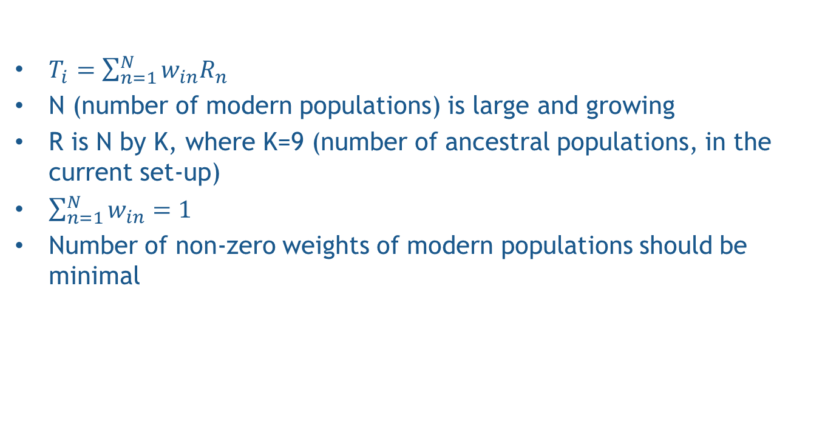
Problem formulation
$T_{i}=\sum_{n=1}^{N}{w_{in}R_{n}}$
N (number of modern populations) is large and growing
R is N by K, where K=9 (number of ancestral populations, in the current set-up)
$\sum_{n=1}^{N}{w_{in}=1}$
Number of non-zero weights of modern populations should be minimal

Slide 7

reAdmix approach
Aim: to find the smallest subset of modern populations whose combined admixture components are similar to those of the individual within a small tolerance margin.
Let
R={r_{i}}_{i=1..I}
be the set of modern populations
where
each
r_{i}=(r_{i,1}, ..., r_{i,K})
and K is the dimension (K=9).
We seek two sets S=(s₁,...,s_{p}) and A=(a₁,...,a_{p})
where
s_{i} are the indices of modern populations
a_{i} are the coefficients of modern populations
in the approximation
of test vector T
The algorithm consists of three phases:
1. Iteratively build the first candidate solution and improve it.
2. Generate the predefined number M of additional candidate solutions randomly.
3. Identify the populations that have stable membership in the solution across the set, that is, are part of solution in at least 75% of cases.

Slide 8


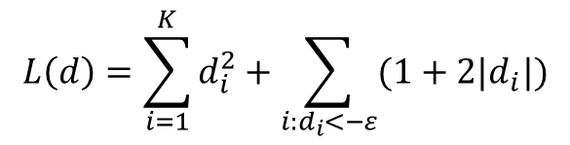
Phase 1. Build and improve the initial solution set
Find the population vector with the highest affinity score.
j=arg max[F(r_{j},T)]
S = S ∪ {j}
a_{j}=max[α:α·r_{j}<T+ε]×β
T = T − a_{j}r_{j}
i=0..dim(S)
k=0..dim(R)
Append this population to the solution set.
Calculate the weight of the population vector to be proportional to the maximal possible.
S₀ = (S \ s_{i}) U {r_{k}}
dim(S) < N
f(S₀,T) < f(S,T)
Affinity score
S - individual’s ancestry
N - desired size of the solution
S = S₀
minimizes the loss function
$$L\left(d\right)=\sum_{i=1}^{K}{d_{i}^{2}}+\sum_{i:d_{i}<−ε}{(1+2|d_{i}|)}$$
T – test vector
For all populations x in the current solution and for all y outside the solution, replace x with y, if it reduces the error.
R – the set of modern
populations
where

Slide 9
Random step
Try all possible combinations
Simulated annealing
Differential Evolution

Slide 10

Phase 2. Optimize the solution by global stochastic and local search
Objective function
where
is the approximation of T
S₁,S₂,...,S_{M}
1. Differential Evolution
G_{max} number of iterations
S₂,...,S_{M}
- are generated randomly
2. Local search over all populations
close to the preliminary solution
This step selects between related populations (e.g. Belorussian, Russian, and Ukrainian) that could have been misplaced in previous steps
DE: optimization method used for multidimensional real valued functions. Good for
Treatment of noisy problems (Storn and Price, 1997)

Slide 11
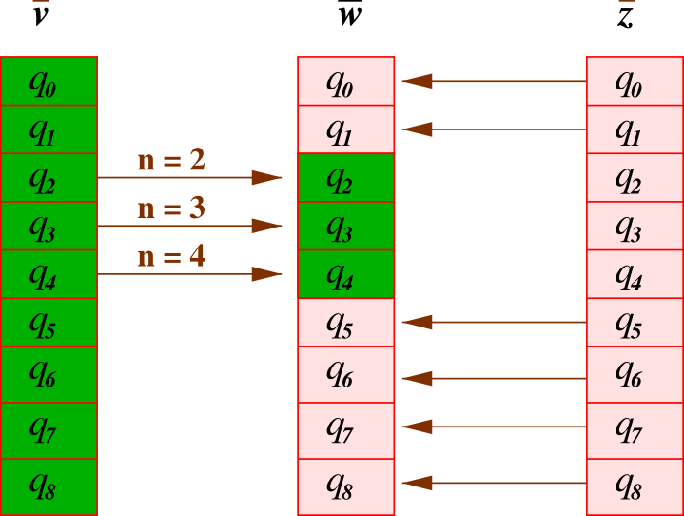
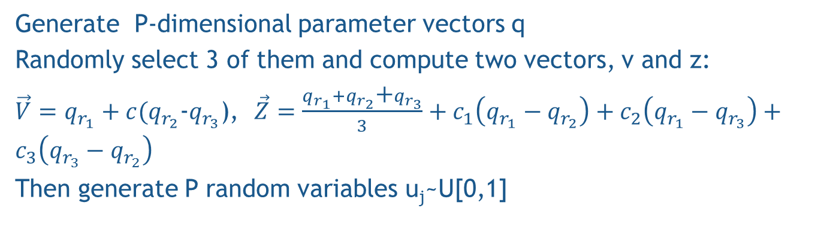
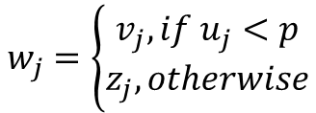
Phase 2
Generate P-dimensional parameter vectors q
Randomly select 3 of them and compute two vectors, v and z:
$\vec{V}=q_{r_{1}}+c(q_{r_{2}}$-$q_{r_{3}}$), $\vec{Z}=\frac{q_{r_{1}}+q_{r_{2}}\text{+}q_{r_{3}}}{3}+c_{1}\left(q_{r_{1}}−q_{r_{2}}\right)+c_{2}\left(q_{r_{1}}−q_{r_{3}}\right)+c_{3}\left(q_{r_{3}}−q_{r_{2}}\right)$
Then generate P random variables u_{j}~U[0,1]
Create a new array, w, from v and z
For each index j =1,…,P
$$w_{j}=\left\{\begin{matrix}v_{j}, if u_{j}<p \\ z_{j}, otherwise\end{matrix}\right.$$
Then, convert real-valued vector w to the vector of integers by rounding
Compute cost functions and make a decision about accepting w

Slide 12
Phase 3. Averaging
Reliable estimate:
- the populations that are part of solution in at least 75% of cases,
- their averaged estimates of admixture proportion.
S=(s₁,...,s_{p})
Final solution:
A=(a₁,...,a_{p})
S₁, S₂, ... , S_{M-1}, S_{M} — the set of candidate solutions.
S₁:(a₁,r₁)₁,(a₂,r₂)₁,..,(a_{p-1},r_{p-1})₁,(a_{p},r_{p})₁
r belongs to final solution if:
r=r_{1,1}=r_{2,M-1}=...=r_{p,M} — is the same
modern population
and
is present in L > 75% solutions
and
S₂:(a₁,r₁)₂,(a₂,r₂)₂,..,(a_{p-1},r_{p-1})₂,(a_{p},r_{p})₂
...
S_{M-1}:(a₁,r₁)_{M-1},(a₂,r₂)_{M-1},..,(a_{p-1},r_{p-1})_{M-1},(a_{p},r_{p})_{M-1}
S_{M}:(a₁,r₁)_{M},(a₂,r₂)_{M},..,(a_{p-1},r_{p-1})_{M},(a_{p},r_{p})_{M}
a=(1/L)(a_{1,1}+a_{2,M-1}+..+a_{p,M})

Slide 13
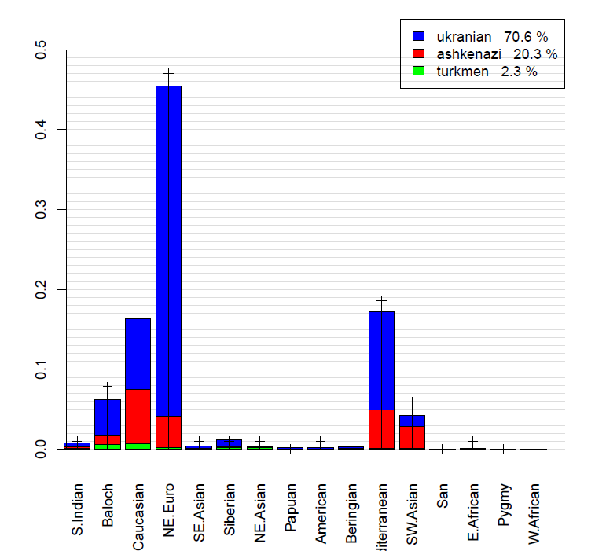
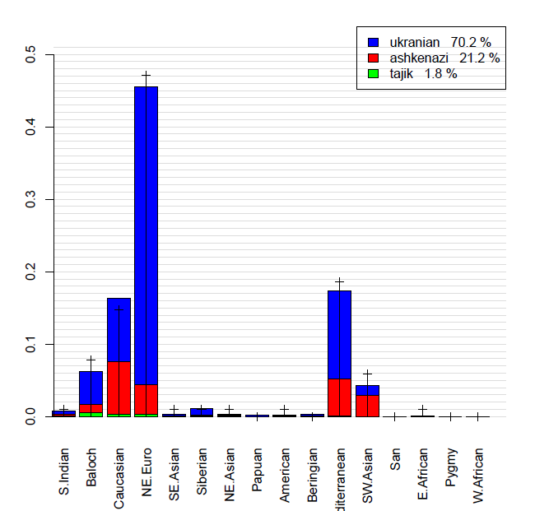
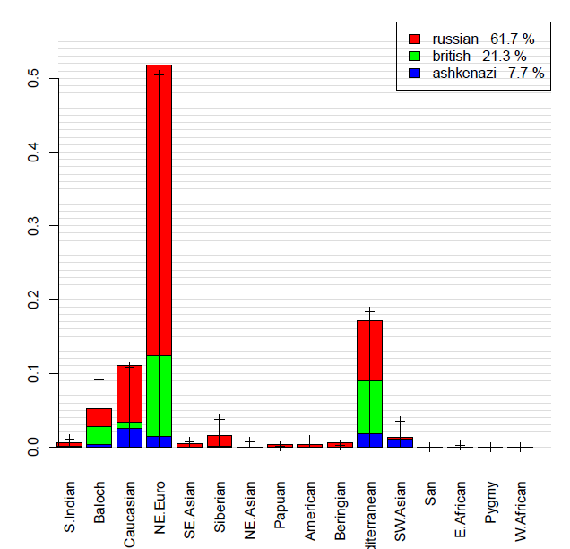
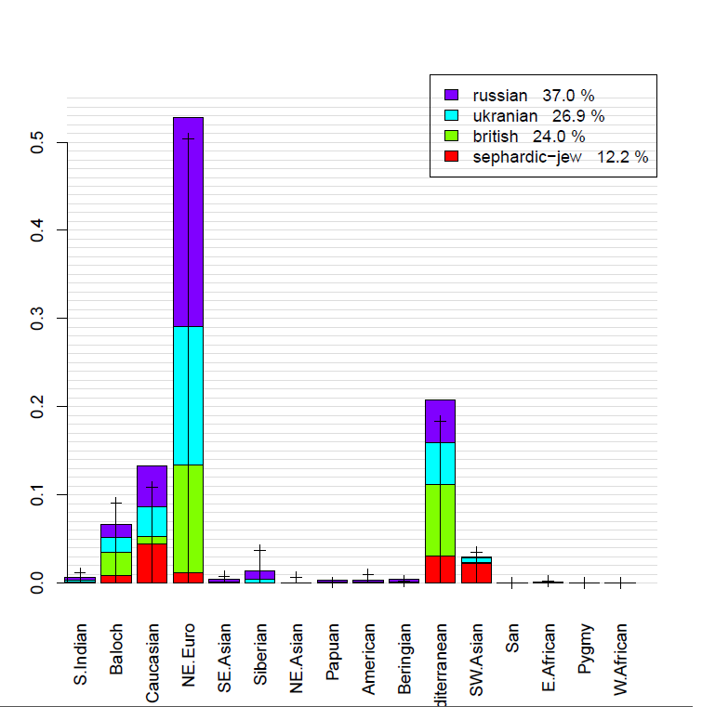
Example

Slide 14
Benchmark-1
Take sample that were validated by GPS₁
Then we used ReAdmix in (a) unconditional and (b) conditional with incorrect guess mode.
94% of the samples were mapped to their reported ethnic group, and average distance to the correct location was 54±13 miles.
with randomly chosen incorrect guess, 92% of samples was mapped to the reported ethnic group, with average distance to the correct location equal to 65±17 miles.
In all cases ReAdmix correctly identified the cases as un-mixed

Slide 15
Benchmark-2: simulated 500 50:50 mixtures
Testing mode | Percent of at least one correctly predicted origin | Percent of completely correct predictions | Average distance to correct population, miles
Unconditional | 78% | 56% | 324±46
Conditional on the equal weights, populations unknown | 91% | 74% | 176±33
Conditional on one of the populations, weights unknown | NA | 71% | 104±16

Slide 16
Benchmark-2: simulated 500 50:25:25 mixtures
Testing mode | Percent of at least one correctly predicted origin | Percent of completely correct predictions | Average distance to correct population, miles
Unconditional | 88% | 21% | 346±34
Conditional on the major population, weights unknown | 73% | 27% | 222±26
Conditional on one of the minor populations, weights unknown | 78% | 33% | 234±30
http://chcb.saban-chla.usc.edu/reAdmix/calculator.php

Slide 17
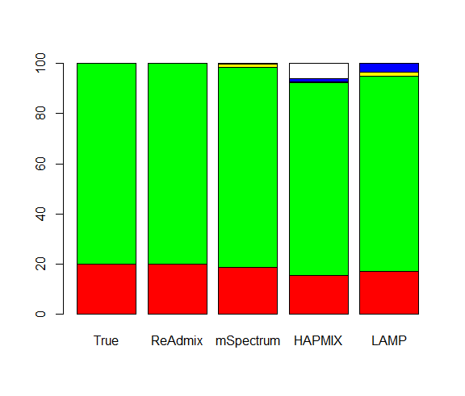
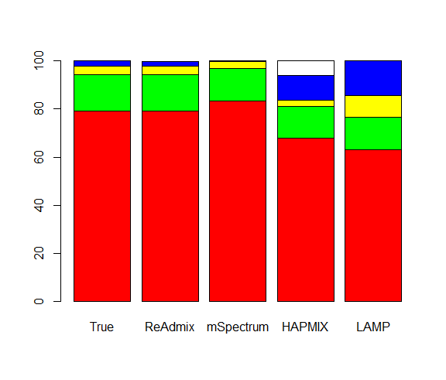
Sohn et (2012) al benchmark
2 components
4 components
4-х мерное пространство European, African, Native American and East Asian
Color coding: red-European, green-African, yellow- Native American, blue-East Asian, and white- unassigned

Slide 18
Arabic data Analysis

Slide 19
Admixture Analysis
2,327,472 SNPs extracted from vcf files
67,614 of them were common between our reference set (150,541 of Ancestry-Informative SNPs) and Arabic sequencing project
We used ADMIXTUTRE in supervised mode, using K=9

Slide 20
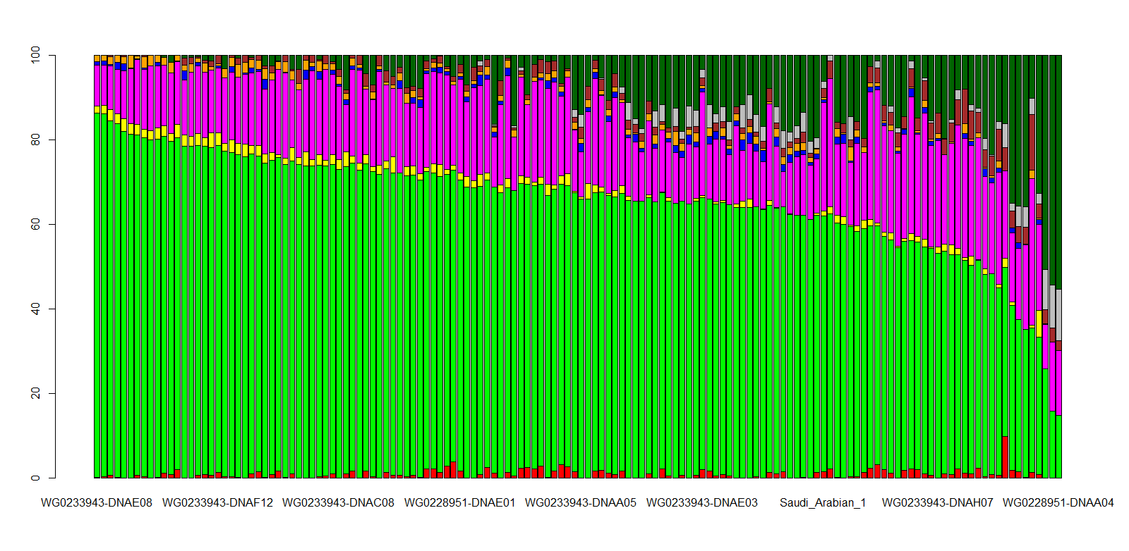
ADMIXTURE:
Green – Mediterranean component, Magenta – South West Asian, Dark green –Sub-Saharan African
Notes:
Green – Mediterranean component, Magenta – South West Asian, Dark green –Sub-Saharan African

Slide 21
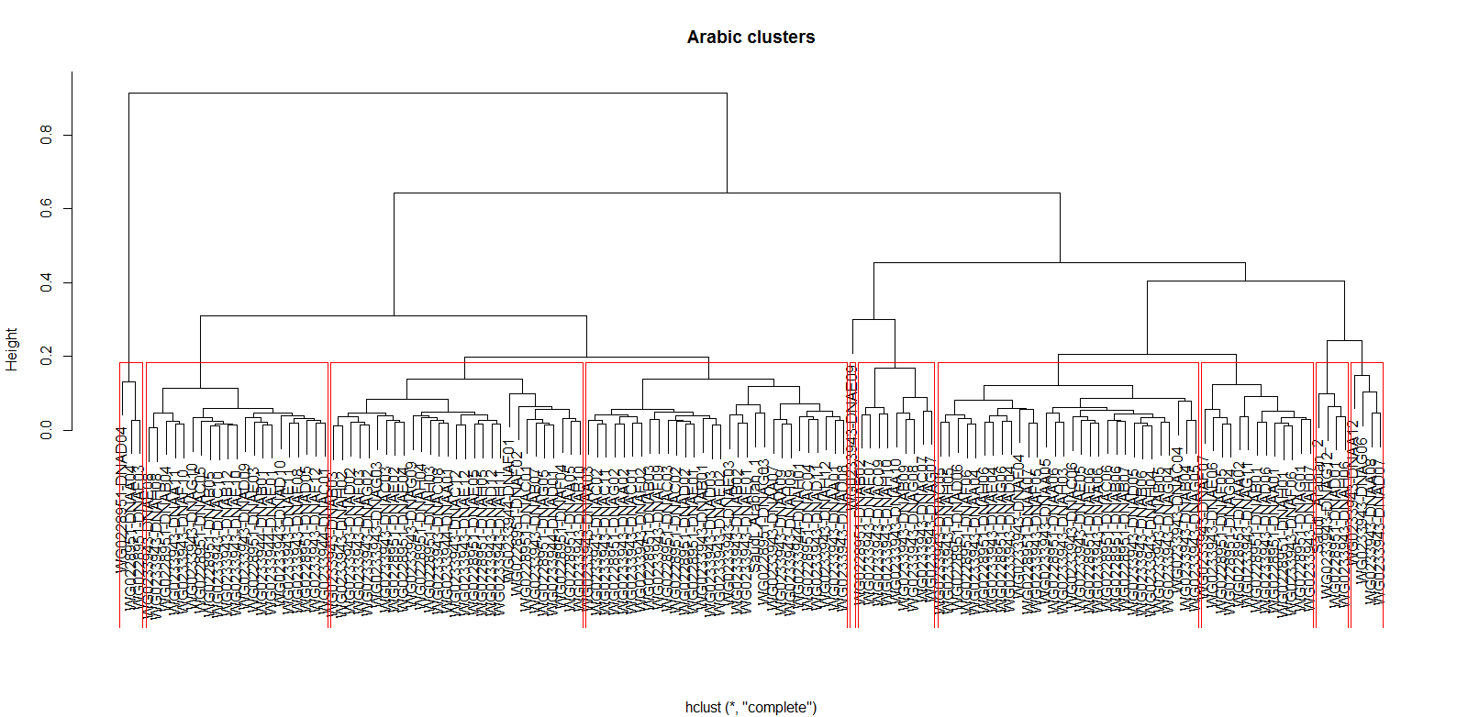
Hierarchical clustering
Notes:
Added two individuals of known Saudi Arabian ancestry from literature

Slide 22
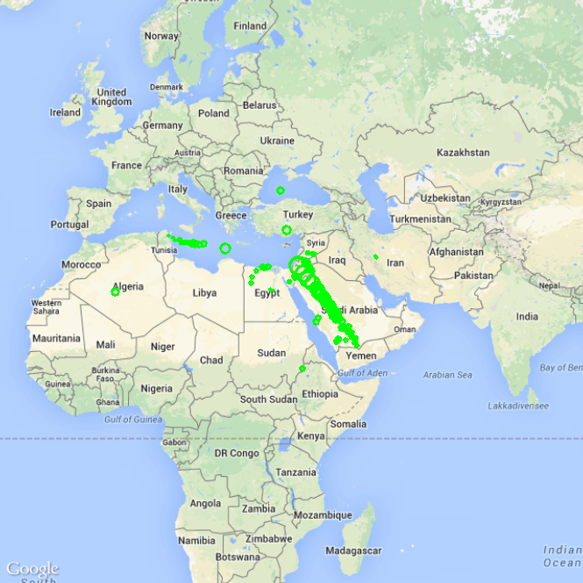
GPS₁ results
Vast majority of the Arabic individuals have pronounced Arabian origin, spanning the Arabian Peninsula.
However, some of the individuals have Northern African, Anatolian or mixed African-European origin.
reAdmix results, shown below, can further elaborate on this
Diameter of the circle is proportional to the prediction uncertainty.

Slide 23
reAdmix
We applied reAdmix to 142 Arabic individuals, and discovered that 10 most common original populations were (in order of decreasing influence):
  Yemenese
  Tunisian
  Sardinian
  Lebanese
  Egyptian
  Southeastern Namibian
  Tygray
  Kuwait
  Afar
  Auak

Slide 24
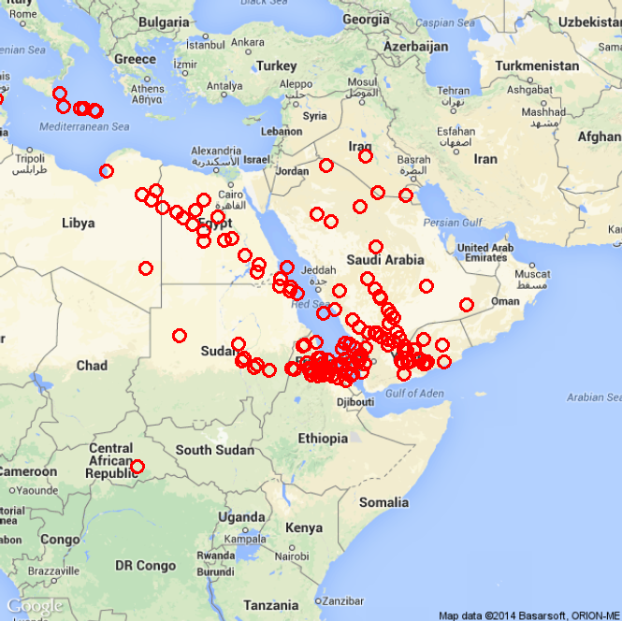
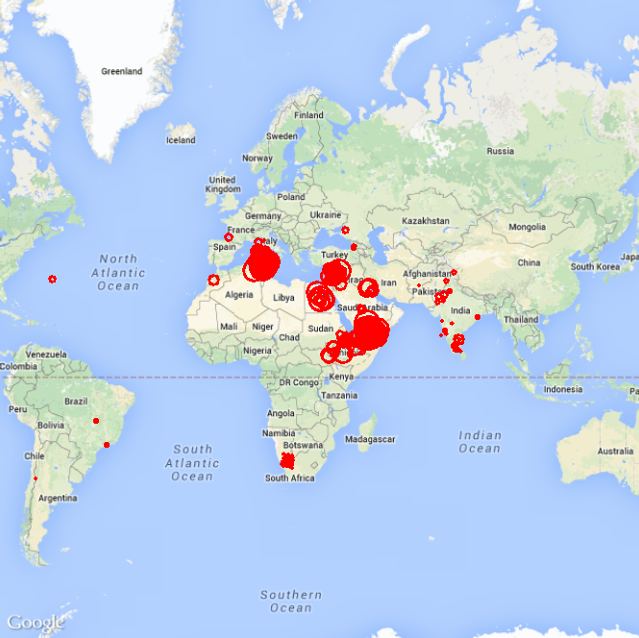
reAdmix
Average position of ancestors
Origins for Arabic individuals. Size of the circle is proportional to the weight of the component
Notes:
reAdmix is a novel program finding multiple ancestors for individuals of unknown origin.

Slide 25
Using readmix
Ket results

Slide 26
SAMPLE_ID | NatGeno | NatGeno+
GRC13273878 | Ket: 0.877; | Ket: 0.642;
GRC13273879 | Ket: 0.933; | Ket: 1.000;
GRC13273880 | Ket: 0.908; | NA
GRC13273881 | Ket: 0.934; | Ket: 0.992;
GRC13273882 | Ket: 0.909; | NA
GRC13273883 | Selkup: 0.990; | NA
GRC13273884 | Ket: 0.882; | Selkup: 0.932;
GRC13273885 | Ket: 0.933; | Ket: 0.686;
GRC13273886 | Ket: 0.702; Altaian: 0.293; | Ket: 0.874;
GRC13273887 | Ket: 0.930; Yukaghir: 0.062; | Ket: 0.819;
GRC13273888 | Ket: 0.906; Yukaghir: 0.030; Abkhazian: 0.023; | Selkup: 0.999;
GRC13273889 | Nganasan: 0.955; | Ket: 0.524;
GRC13273890 | Nganasan: 0.853; | Selkup: 0.596;
GRC13273891 | Ket: 1.000; | Ket: 0.881;
GRC13273892 | Ket: 0.911; | Ket: 0.932;
GRC13273893 | Ket: 0.932; | Ket: 0.865;
GRC13273894 | Ket: 0.972; | Ket: 0.888;
GRC13273895 | Selkup: 0.902; | Selkup: 0.915;
GRC13273896 | Selkup: 0.979; | Ket: 0.792;
GRC13273897 | Ket: 0.885; Yukaghir: 0.048; | Ket: 0.930;
GRC13273898 | Shor: 0.917; | Ket: 0.772;
GRC13273899 | Selkup: 0.823; | Ket: 0.740;
GRC13273900 | Ket: 0.945; | Ket: 1.000;
GRC13273901 | Ket: 0.900; | Ket: 0.971;
GRC13273902 | Ket: 0.977; | Ket: 1.000;
GRC13273903 | Ket: 0.959; | Ket: 1.000;
GRC13273904 | Ket: 0.962; | Ket: 0.979;
GRC13273905 | Selkup: 0.947; | Selkup: 0.837;
GRC13273906 | Ket: 0.928; | Ket: 0.951;
GRC13273908 | Ket: 0.919; | Ket: 0.931;
GRC13273909 | Ket: 0.927; | Ket: 0.850;
GRC14460044 | Selkup: 0.798; | Selkup: 0.869;
GRC14460062 | Nganasan: 0.824; | NA
GRC14460071 | Ket: 0.966; | Ket: 0.952;
GRC14460074 | Ket: 0.973; | Ket: 1.000;
GRC14460075 | Ket: 0.998; | Ket: 1.000;
GRC14460076 | Ket: 0.990; | Ket: 1.000;
GRC14460077 | Ket: 0.979; | Ket: 0.935;
GRC14460078 | Ket: 1.000; | Ket: 1.000;
GRC14460079 | Ket: 0.940; | NA
GRC14460080 | Ket: 0.941; | NA
GRC14460081 | Ket: 0.968; | Ket: 0.943;
GRC14460082 | Ket: 0.922; | Ket: 1.000;
GRC14460084 | Ket: 0.944; | Ket: 1.000;
GRC14460085 | Nganasan: 0.830; | Ket: 0.717;
GRC14460086 | Ket: 0.945; | NA
GRC14460087 | Ket: 0.985; | NA
GRC14460088 | Ket: 0.952; Yukaghir: 0.048; | Ket: 0.966;
GRC14460089 | Ket: 0.924; | Ket: 0.930;
GRC14460090 | Ket: 0.939; | NA
GRC14460091 | Ket: 0.981; | Ket: 1.000;
GRC14460093 | Ket: 0.979; | NA
GRC14460094 | Selkup: 0.810; | NA
GRC14460095 | Ket: 0.974; | Ket: 0.946;
GRC14460096 | Ket: 0.962; | NA
GRC14460097 | Ket: 0.952; | Ket: 0.865;
GRC14460098 | Ket: 0.917; | Ket: 0.875;

Slide 27
Other organisms
Application of GPS and reAdmix to

Slide 28
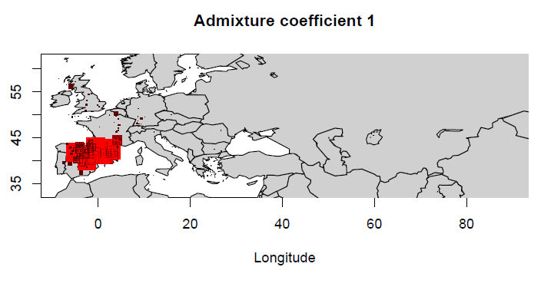
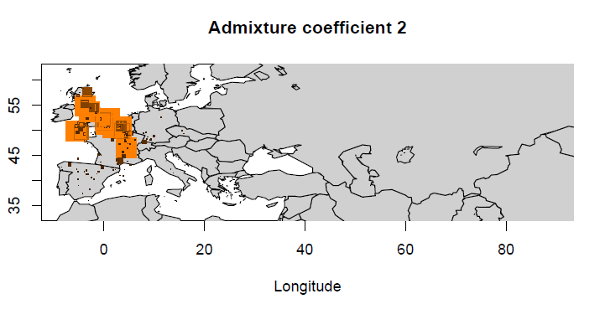
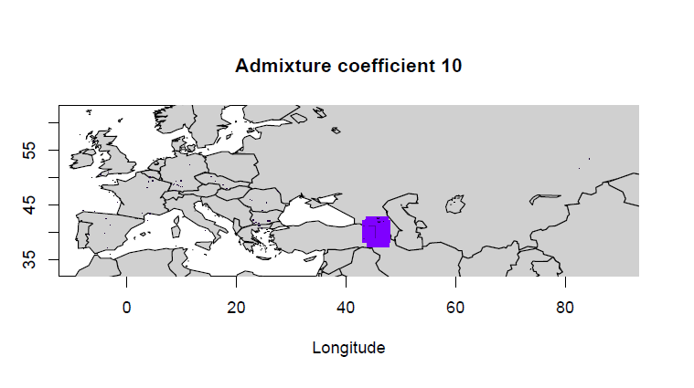
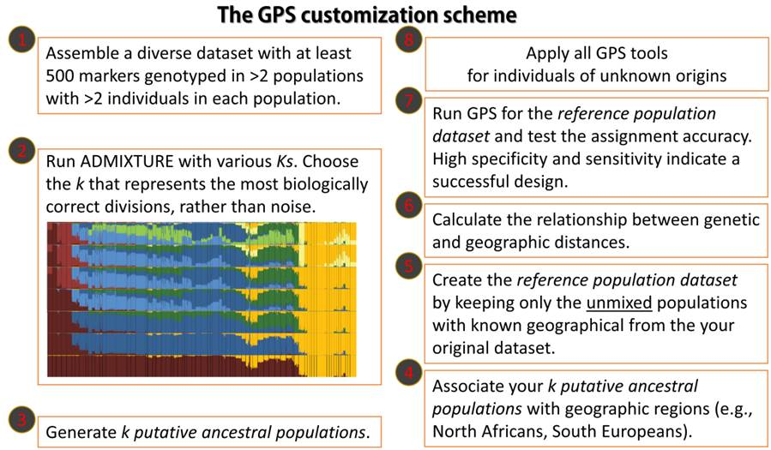
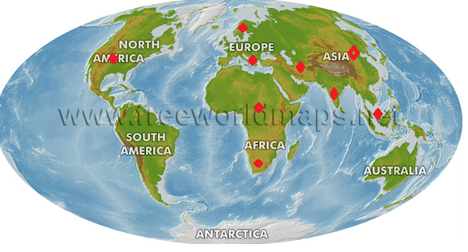
Modeling Admixture
Notes:
Used Admixture in unsupervised mode. We experimented with different Ks ranging from 6 to 10, until we identified a clear substructure at K=10. ADMXITURE outputs the speculated allele frequencies of each SNP for each K putative population.

Slide 29
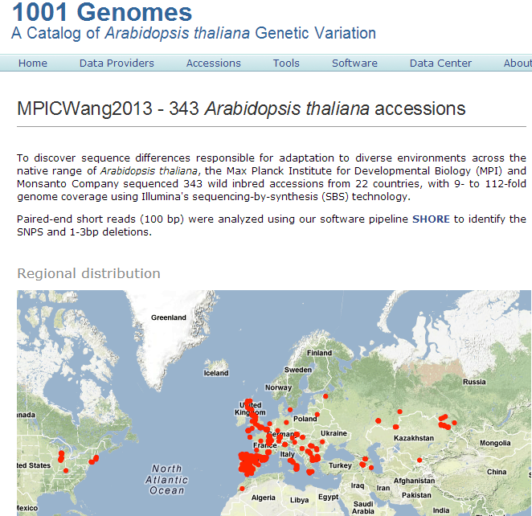
Data
We took 343 inbred strains of A. thaliana from 22 countries sequenced and analyzed by Max-Plank Institute for Developmental Biology and Monsanto Company from 1001 Genomes project (http://1001genomes.org/projects/MPICWang2013/)

Slide 30
Filtering SNPs
We took the variant files available at http://1001genomes.org/data/MPI/MPICWang2013/releases/current/
filtered out indels and non-autosomal variants. About ~8M variants were detected.
Final dataset contains 40K SNPs.

Slide 31
ADMIXTURE
We performed several ADMIXTURE analyses with number of ancestral populations K from 3 to 14, and then K=12 was chosen for subsequent analyses, because of it gave smallest median distance in leave-one-out validation
Then we split some of the initial populations into 41 genetically homogeneous subpopulations using K-means.
The number of components was estimated using stepwise reduction method using KLD

Slide 32
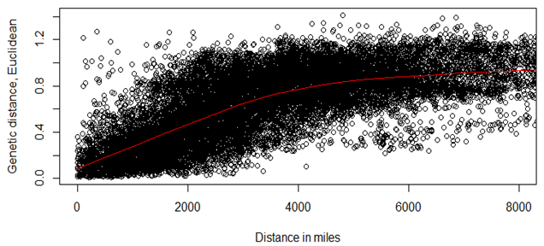
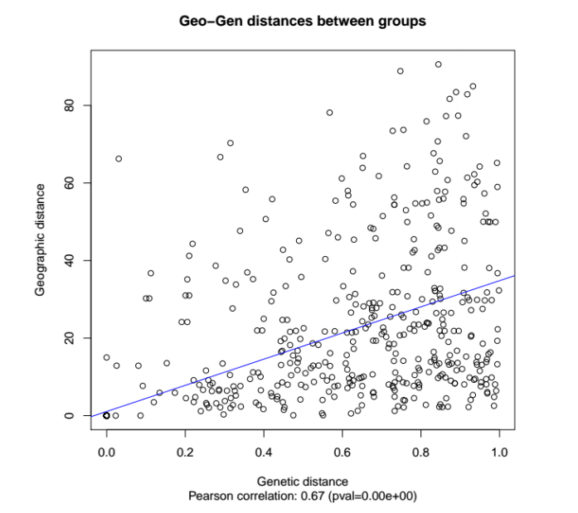
Relationship between genetic and geographic distances
For all reference samples, compute genetic and geographic distance between samples

Slide 33
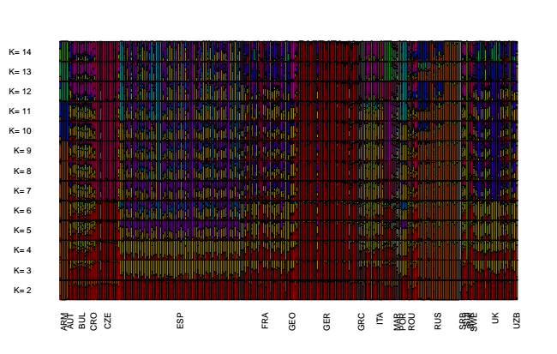
Admixture coefficients

Slide 34
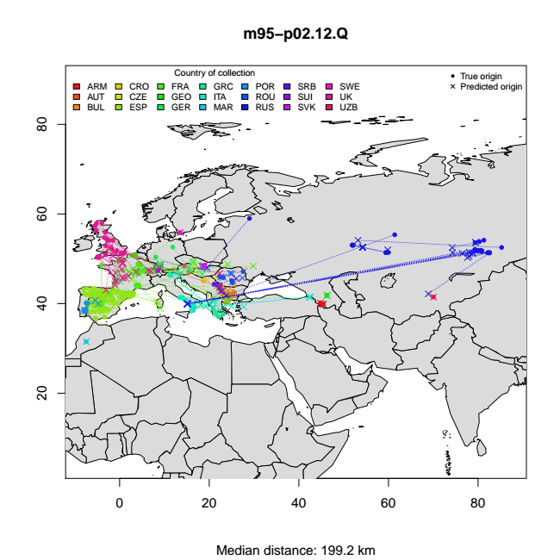
GPS Leave-one-out validation
Percent of populations that are perfectly mapped: 60%
Average distance to correct population: 200 km

Slide 35
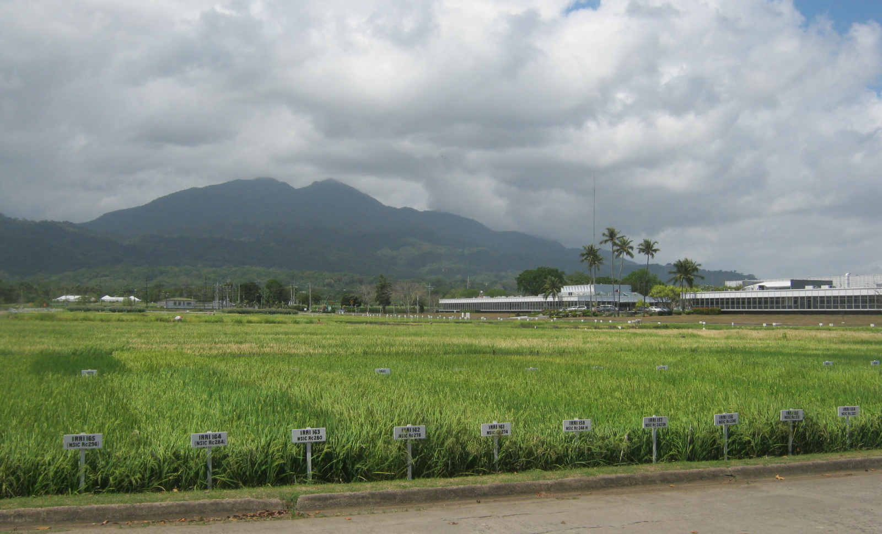
GPS analysis of O. sativa

Slide 36
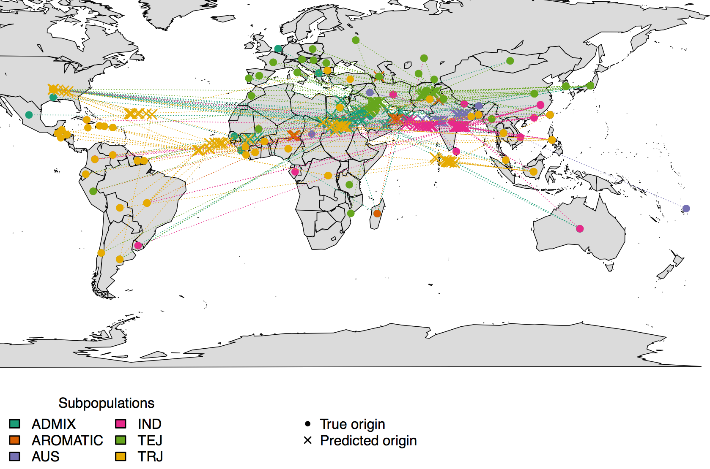
Accuracy for rice
Median distance: 4043 km

Slide 37
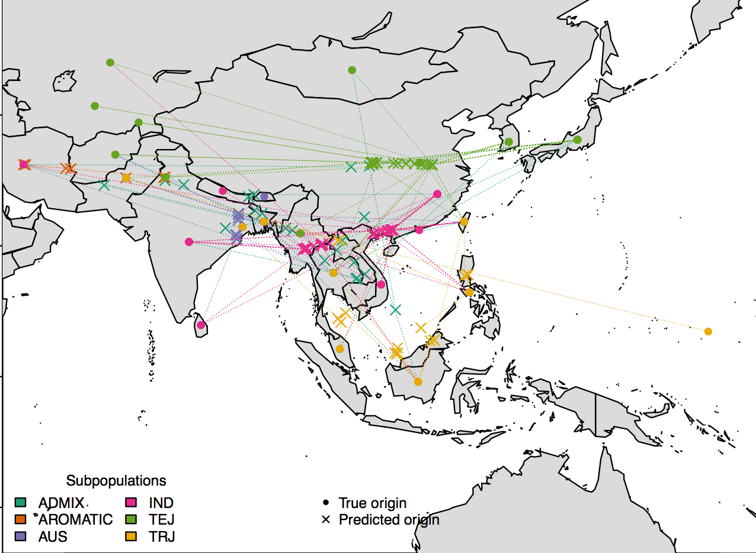
GPS prediction after SNP and geographic filtering
Median distance : 1141 km

Slide 38


Why it does not work for rice?
Rice cannot choose its soul mate, but Arabidopsis can.

Slide 39
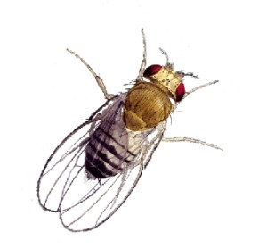
Fruit fly migration
D. melanogaster originated in Africa and migrated to Europe about 10,000 to 15,000 years ago.
The colonization of the Americas occurred in two waves with the first wave about 400-500 years ago with West African flies arriving into the Caribbean Islands via the transatlantic slave trade.
The second wave of D. melanogaster migration followed the European colonization about 200 years ago on the northern east coast of the US bringing over European flies. After the initial colonization, flies on the East coast quickly expanded westwards across the continent.

Slide 40
Fruit fly example
Three ancestral populations:
  Montpellier, France (FRA, n=20 samples)
  Oku, Cameroon (CAM, n=10)
  Winters, CA, USA (WIN, n=35)
Every American fruit fly can be represented as a linear combination of the three ancestral genotypes
Данные получены в лаборатории Сергея Нуждина, USC

Slide 41
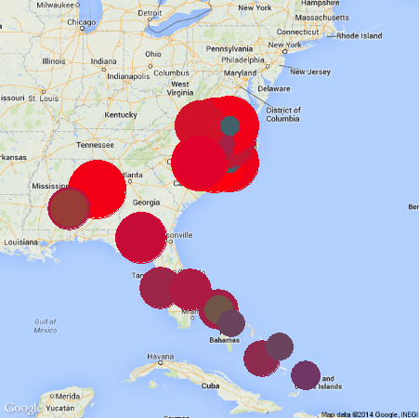
Fruit fly example
 | CAM | FRA | WIN
Raleigh, NC | 0.21 | 0.12 | 0.67
Southern US | 0.21 | 0.11 | 0.68
Caribbean | 0.34 | 0.22 | 0.44
SEU, RAL and CAR population structure, given three ancestral populations. Table elements show relative weights of the established populations in the hybrid populations.
Size of the dots is proportional to the weight of Winters, CA component. Color is determined by the combination of 3 ancestral vectors.
Notes:
Since the population weights were scaled to add up to 1, these weighs are not equal (although related to) the proportion of given ancestry. For example, Caribbean and the Raleigh flies were reported to have ~25% and ~15% African ancestry, respectively (ratio 1.67). reAdmix found the weight of the African (CAM) component in the mixture to be 0.34 and 0.21 (ratio 1.62).

Slide 42
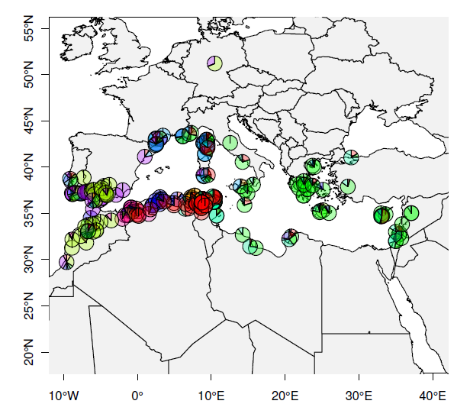
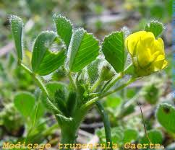
Medicago
Can predict correct population in 60% of the cases
Average distance to the true position is 300 km

