Slide 1
Recommendation systems and networks
Andras Benczur
Insitute for Computer Science and Control
Hungarian Academy of Sciences (P3 – Budapest)
benczur@sztaki.mta.hu
http://datamining.sztaki.hu
Supported by the EC FET Open project "New tools and algorithms for directed network analysis" (NADINE No 288956)

Slide 2
Milestones to be presented
WP3: Applications to voting systems in social networks
M12: Voting and recommender systems
Generalized Stochastic Gradient Matrix Factorization
Papers 3.7, 3.10, 3.11, 3.16
Also applied for link prediction
Papers 3.9, 3.17
WP5: Database development of real-world networks
M14: Characterization of time evolving Web structures
Online machine learning for time evolving structures
Papers 3.11, 3.12, 3.13, 3.14, 3.17
Fisher “Similarity” kernel Support Vector Learning
Papers 3.8, 3.12

Slide 3
SZTAKI Main Value in Collaboration
Collaboration of Physicists, Mathematicians and CS for applying new theoretical results for practical problems
Machine learning in big networks
Matrix factorization
Recommendation
Link prediction
Use of external data, e.g. geo-location
Online learning: model update after each event
React to immediate trends
Predict links in very near future
Kernel methods
And access to industry partners to use NADINE results

Slide 4
Publications to be presented
P3.9 R.Palovics, F. Ayala-Gomez, B. Csikota, B.Daroczy, L. Kocsis, D. Spadacene, A.A. Benczur, "RecSys Challenge 2014: an ensemble of binary classifiers and matrix factorization", Proceedings of the 2014 Recommender Systems Challenge (p. 13) ACM (2014)
P3.12 Balint Daroczy, David Siklosi, Robert Palovics, Andras A. Benczur, "Text Classification Kernels for Quality Prediction over the C3 Data Set", WebQuality 2015 in conjunction with WWW 2015
P3.16 Robert Palovics, Balint Daroczy, Andras A. Benczur, Julia Pap, Leonardo Ermann, Samuel Phan, Alexei D. Chepelianskii, Dima L. Shepelyansky, "Statistical analysis of NOMAO customer votes for spots of France", preprint arXiv (2015)
P3.17 Robert Palovics, Ferenc Beres, Nelly Litvak, Frederick Ayala-Gomez and Andras A. Benczur, "Centrality prediction in temporally evolving networks", preprint arXiv (2015)

Slide 5
Web classification (P 3.12)
Web Quality aspects
Several components (credibility, presentation, depth, factuality, language, style, …)
Research focused mostly on micro level (posts, comments)
Our work in Period I classifies Web hosts (page collections) by genre, spam, trust, factuality and bias
Quality is harder to classify than Web spam
Difficult, often subjective, task
More difficult even for human assessors
For level of trust, German assessors rated 0-1 while French and Hungarian 1-2
Multiple assessors needed
Previous data: Microsoft reference data set
C3 – the WebQuality Data Challenger collected in the EU Reconcile project
22 325 Web page evaluations, 5704 pages by 2499 assessors
Recommender task? Triplets of (People, URL, Evaluation)

Slide 6
Text Similarity Kernel Warmup
Maximal margin linear classifier
Kernel trick transforms into a high-dimensional nonlinear space
We want to use pairwise similarities to define the space …
(w,b)
x
f
y
denotes +1
denotes -1
f(x,w,b) = sign(wx+b)
Support Vectors: data points that the margin pushes up against

Slide 7
Warmup: linear SVM
Maximal margin linear classifier
(w,b)
x
f
y
denotes +1
denotes -1
f(x,w,b) = sign(wx+b)
Margin can be NEGATIVE!

Slide 8
Support Vector Machine optimization
Need to minimize
Subject to
But w is a linear combination of the support vectors:
All we need is a way to compute w ● x for a support vector w and another vector x → any two data points
Goal: a mathematically sound notion of w ● x based on the similarity of the document!

Slide 9
Support Vector Machine optimization
In a transformed space (x → φ(x)) we only need the value of the dot product (kernel value):
K(x_{i},x_{j}) = φ(x_{i})^{T}φ(x_{j})

Slide 10
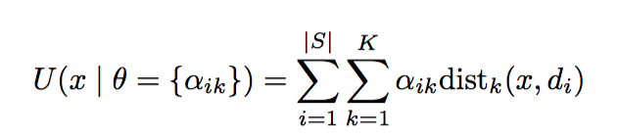
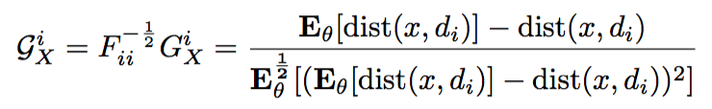
Central tool 1: the Similarity Kernel
Represent doc X as Random Field P(X|θ) generated by distances from other docs d₁, d₂, … by energy function
Sample set S can be all training set, a sample, or cluster representatives
Fisher score of X is vector G_{X} = ∇θ log P (x|θ)
Define a mapping x → G_{x}F^{-1/2}
Yields the Kernel K(x, y ) = G_{x}^{T} F⁻¹ G_{y}
Intuitive interpretation: G_{X} is the direction where the parameter vector θ should be changed to fit best to data point X.
For a Gibbs Random Field (with approx. Fisher Information matrix) we get a natural normalization of the distances from the sample set S:
d₁
d₂
d₃
d_{|s|}
…..
The simplest Random Field
x

Slide 11
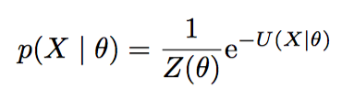
Options for distance in Sim kernel
L2 over C3 attributes: PageRank, Social media, NLP, …
Combinations of bag of words
TF, TF-IDF, BM25, bicluster
L2, Jensen-Shannon
Multiple similarities can be used in the kernel
Our method scales different distances in a theoretically justified way
Energy function
Gibbs Field
 | C3 | Bi-cluster | TF |  | TFIDF |  | BM25 |  |  | BM25 + C3 | All
 |  |  | J-S | L2 | J-S | L2 | J-S | L2 | +
AUC | .66 | .68 | .70 | .65 | .70 | .66 | .67 | .71 | .72 | .73 | .73

Slide 12
Web quality classification results
Bag of words gives strong results, similar to spam and genre classification
Best result is all Sim kernels, in a few occassions marginally improved by GBT and LibFM (*)
The Similarity Kernel is a very powerful general technique
 | Credibility | Presentation | Knowledge | Intentions | Completeness | Average
AUC | 0.74 * 0.75 | 0.81 * 0.82 | 0.71 | 0.72 | 0.70 * 0.71 | 0.73
RMSE | 0.71 | 0.84 | 0.78 | 0.79 | 0.77 | 0.78
MAE | 0.54 | 0.63 | 0.59 | 0.60 | 0.58 | 0.59
Average | AUC
Gradient Boosted Trees | 0.67
LibFM | 0.67
BM25 linear kernel | 0.69
BM25 sim kernel | 0.71

Slide 13
Integrated into BubiNG Crawler
BM25 of top terms can be aggregated in memory
SVM training is “expensive” but …
SVM learning just needs the support vectors
Classification result is immediately available once sufficient number of sample pages (~100) crawled
Also tested by Ericsson HU for user profiling (Spanish)
0-Porn
1-Arts
2-Music
3-Movies
4-Literature
5-VisualArts
6-Television
7-Games
8-Reference
9-Shopping
10-Clothing
11-Consumer
12-Food
13-Gifts
14-Vehicles
15-Business
16-Financial
18-Electronics
20-Telecom
21-Transportation
22-Health
23-News
24-Newspapers
25-Society
26-Computers
27-Home
28-Recreation
29-Science
30-Sports
31-AmericanFootball
32-Baseball
33-Soccer
34-Basketball
35-Golf
36-Motorsports
37-Watersports

Slide 14
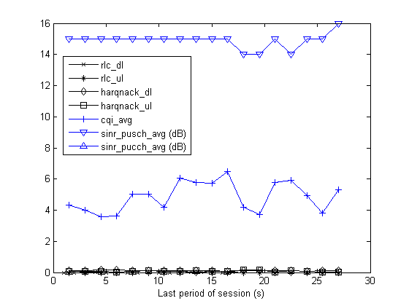
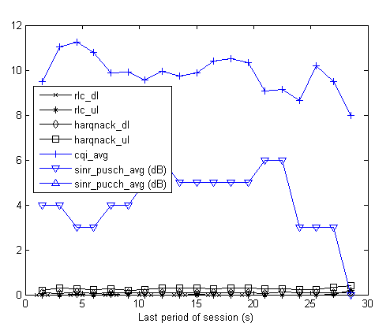
Further work, collaboration, exploitation
Fisher similarity kernel
Tool to use arbitrary similarity functions in classification
Combine similarities of even completely incompatible attribute sets
Works well for quite a few practical problems
Ericsson HU: Time series classification
Planned to use for advanced network similarity measures in a continuation proposal
no drop
drop

Slide 15





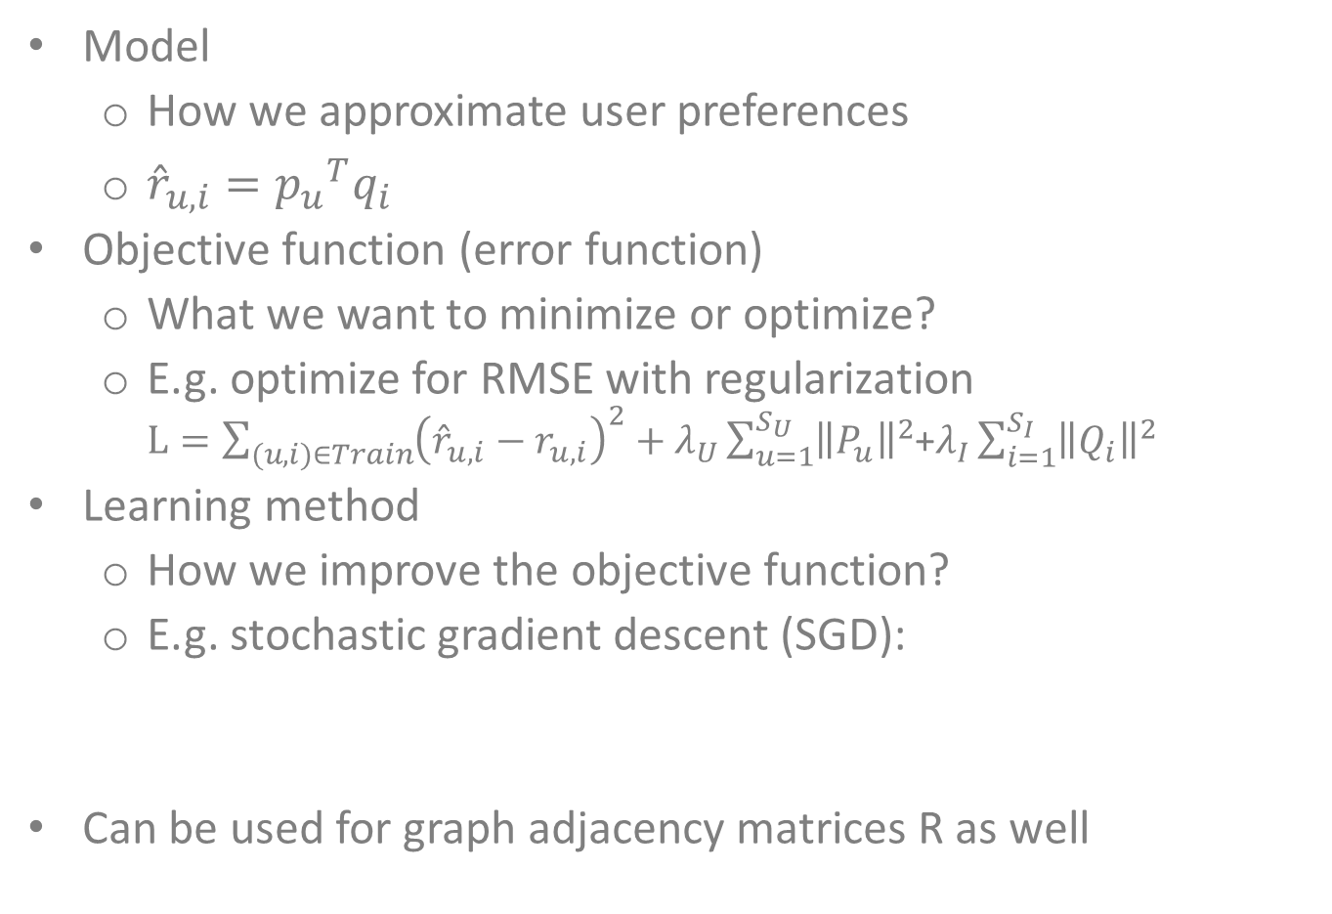


Central tool 2: Matrix Factorization
Model
How we approximate user preferences
${\hat{r}}_{u,i}={p_{u}}^{T}q_{i}$
Objective function (error function)
What we want to minimize or optimize?
E.g. optimize for RMSE with regularization $L=\sum_{(u,i)∈Train}{{\left({\hat{r}}_{u,i}−r_{u,i}\right)}^{2}}+λ_{U}\sum_{u=1}^{S_{U}}{{\left\|P_{u}\right\|}^{2}}$+$λ_{I}\sum_{i=1}^{S_{I}}{{\left\|Q_{i}\right\|}^{2}}$
Learning method
How we improve the objective function?
E.g. stochastic gradient descent (SGD):
Can be used for graph adjacency matrices R as well
Q
$$K$$
R
$$≈$$
$$S_{U}$$
P
$$S_{U}$$
$$S_{I}$$
$$S_{I}$$
$$K$$

Slide 16
Influence Learning by Gradient Descent
Influence recommender reported in Period I:
heuristic weighted network learning
no artist based learning part
Heuristic combination of the influence and factor models
Is it likely that user v influences user u on artist a?
Can user a be influenced at all in case of artist a?
Now we use SGD to learn user and artist factors

Slide 17
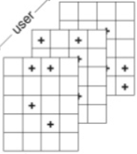
The Factorization Machine
We found many applications to Steffen Rendle’s technique:
General formula:
Matrix factorization: x=(0…0,1,0…0;0…0,1,0…0)
Can be extended with more context:
Tensors
Nearest neighbors
Time series, history
…
Global bias
Pairwise interaction
Regression: strength of variable i
Factorization
Row
Column
Context
Items
Users

Slide 18
New users of factorization technology
WTO: tensor factorization
Dyadic prediction: generalization of recommender systems – classification or regression is over two classes of objects: users and items.
Triadic or higher order tensor factorization: higher order interactions are also modeled
Unified model of importer, exporter and product tensors.
Challenge: find appropriate methods to learn the non-diagonal core tensor and interpret the triadic factor interactions
H2020 and EIT ICTLabs proposals: Rovio (FI), Portugal Telecom (PT), NMusic (PT): Recommender systems in very large networks
Use of context: geography; walking, jogging, cycling, driving; weather, mood – obtained from different sensors and sources
React immediately: show different or no ads right after an upgrade purchase, immediately distinguish from free service users
Support service convergence (mobile, internet, TV)

Slide 19
The RecSys Challenge 2014 (P 3.9)
A multi-facet regression task: 2014.recsyschallenge.com
user_id | 824143586
tweet_id | 324077847926931000
movie_id | 1045658
rating | 8
rating_diff_from_avg | 0,8
user_created_at | 1347659915
user_followers_count | 165
user_friends_count | 258
user_favourites_count | 33
user_statuses_count | 451
tweet_creation_time | 1366097554
tweet_hashtag_num | 1
tweet_url_num | 1
tweet_mention_num | 0
tweet_is_retweet | 0
tweet_has_retweet | 0
movie_avg_rating | 41829
movie_rating_num | 384348
movie_genre | Romance, Comedy
…
engagement | ?
Over the evaluation set:
Winner (INRIA) SZTAKI (2nd place) Best combination | 0.876 0.874
Support Vector Machines | 0.868
Gradient Boosted Tree | 0.871
Linear Regression | 0.860
Logistic Regression | 0.860
Matrix Factorization with Side Information | 0.862
LibFM: Factorization Machine | 0.841
Learning to Rank (NDCGBoost) | 0.862

Slide 20
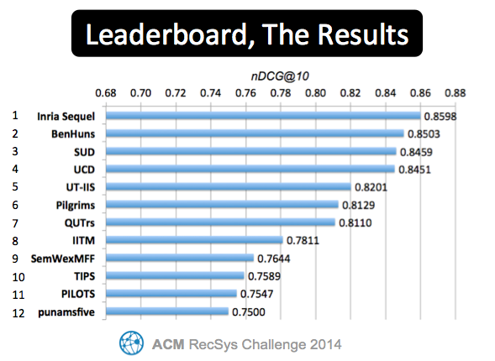
The RecSys Challenge 2014
Published as an IPython notebook - research cooperation w/ Dato: http://dato.com/learn/gallery/notebooks/recsys2014_palovics.html

Slide 21
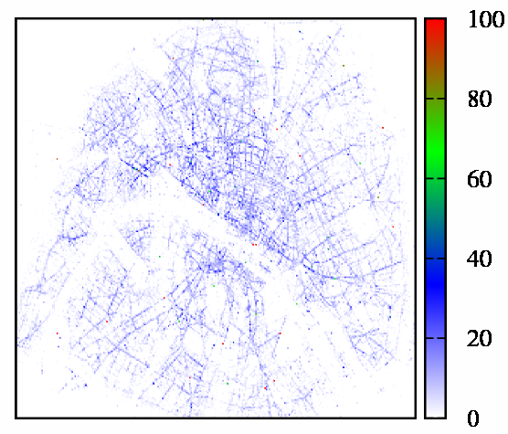
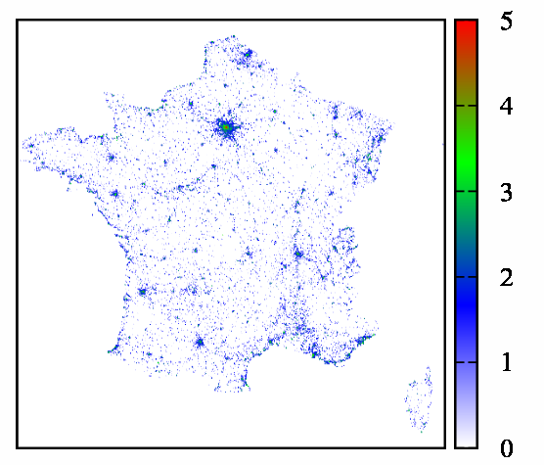
NOMAO: restaurants in France (P3.16)
Analyzing the spectrum of the ratings matrix (Toulouse), for
Giving improved recommendations (Budapest)
NOMAO: Toulouse based startup for restaurant recommendations

Slide 22
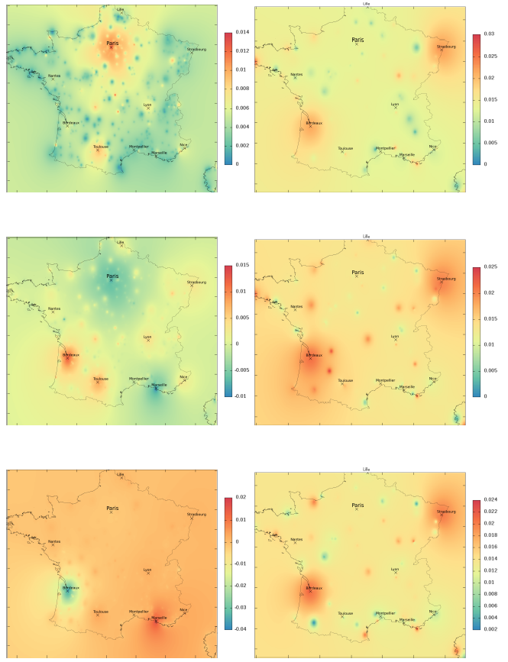
Eigenvectors vs. SGD optimization
Eigenvectors
SGD

Slide 23
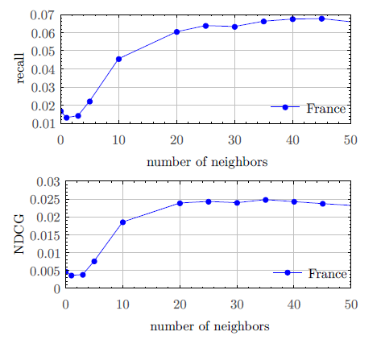
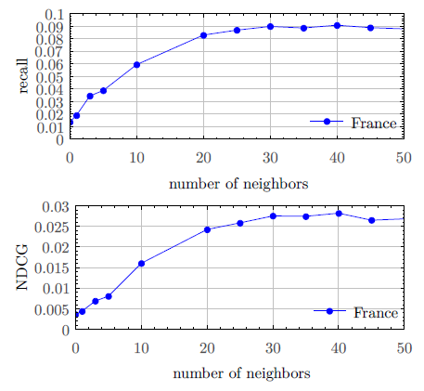
Recommendation quality
Expand ratings matrix by nearby locations

Slide 24
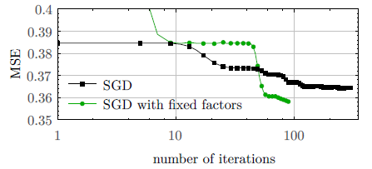
Factor hints to SGD
Select top 10 cities, in order, for factors
Paris, Marseille, Lyon, Toulouse, Nice, Nantes, Strasbourg, Montpellier, Bordeaux, Lille
Train SGD by fixing these factors
Better quality,faster convergence

Slide 25
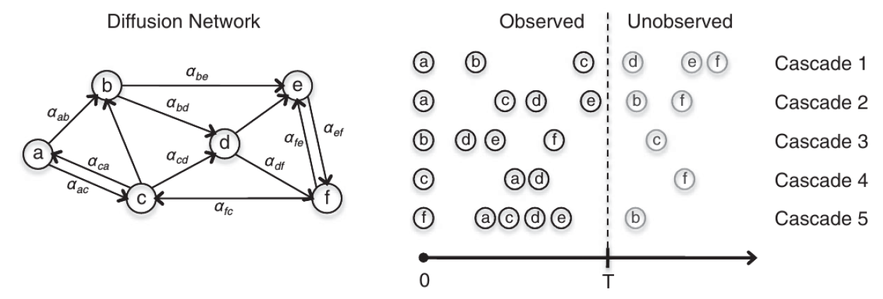
Centrality prediction in time (P 3.17)
Toulouse: analysis of Google matrix
Milan: axioms for centrality, comparison PageRank and beyond
Twente: probabilistic properties of centrality
Budapest: use online matrix factorization to predict future centrality
Data: Twitter global movements from Barcelona Media (oc, 20n, yo, …) and Twente (euromaidan, …)

Slide 26
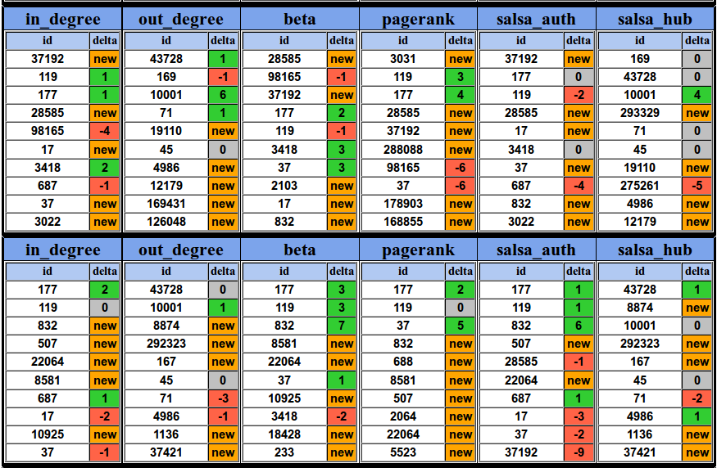
Changes in centrality (oc)

Slide 27
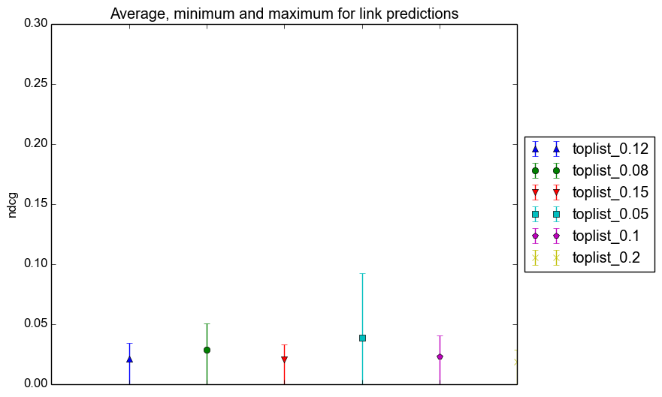
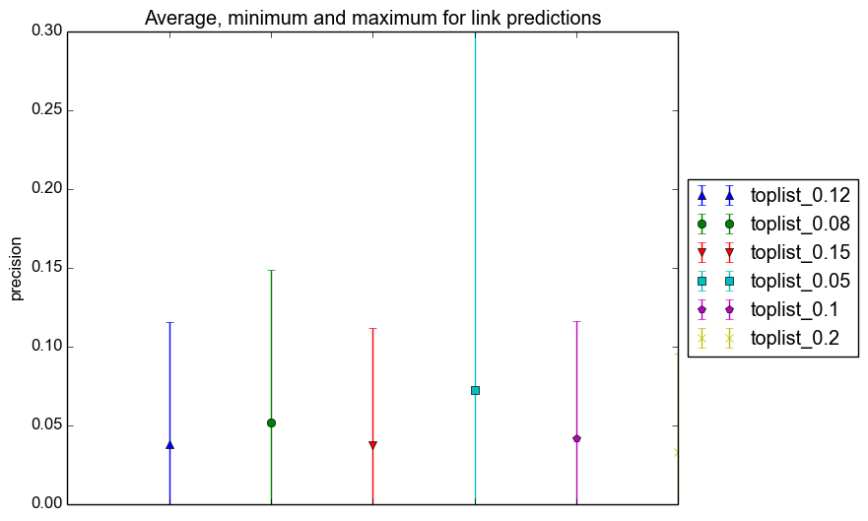
Link prediction by online SGD

Slide 28
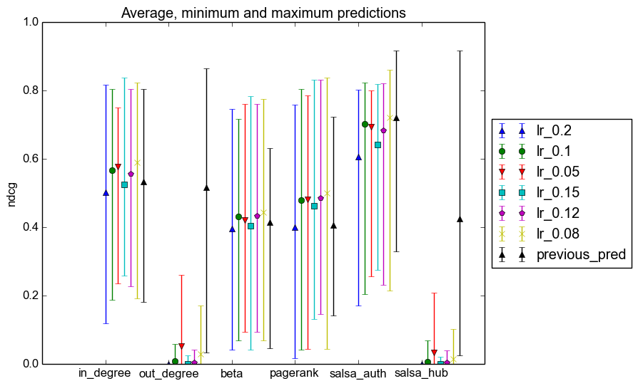
Centrality prediction (NDCG)

Slide 29
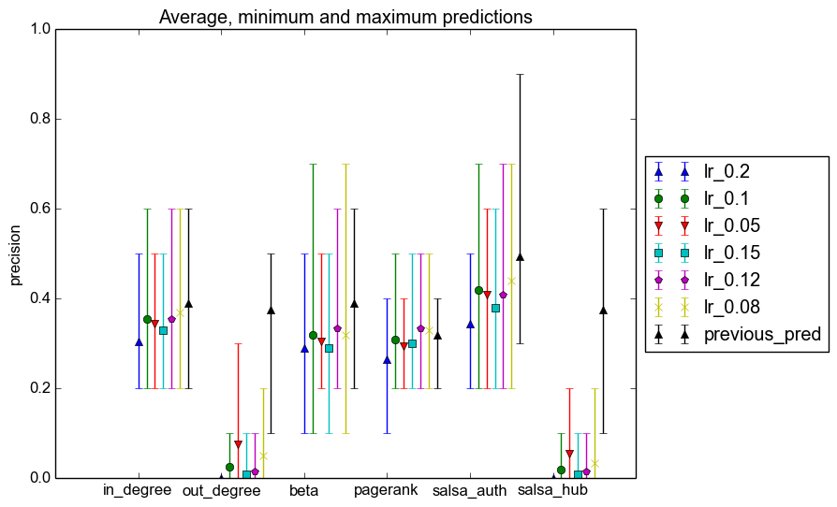
Centrality prediction (Precision)

Slide 30
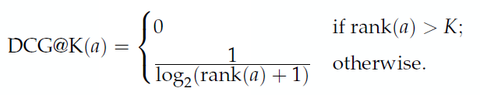
New tool 3: online machine learning
After each event, update the model
Online evaluation: new predictions potentially after each event
New evaluation measure: temporal average DCG
New methods with highly improved performance, e.g. online stochastic gradient

Slide 31
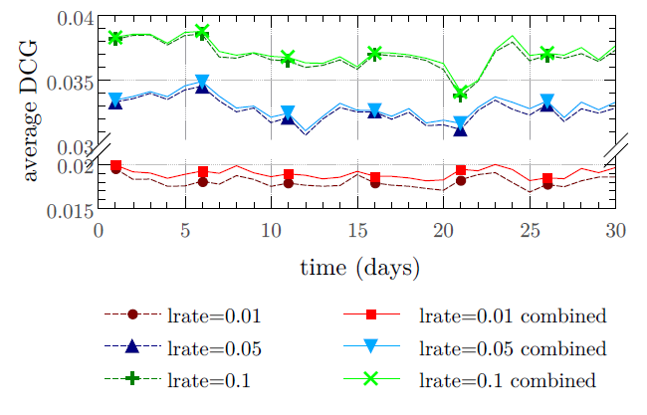
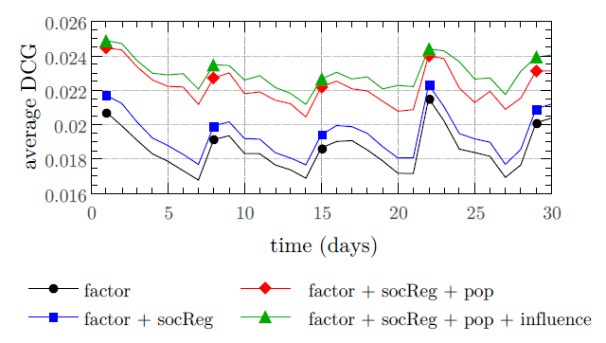
New tool 3: online machine learning
Batch, best lrate =0.01
Online

Slide 32
More NADINE results in Period 2
Journal
Róbert Pálovics, András A. Benczúr. Temporal influence over the Last.fm social network. Social Network Analysis and Mining (Springer) 2015
Conferences
P3.7 Marton Balassi, Robert Palovics and Andras A. Benczur, "Distributed Frameworks for Alternating Least Squares (Poster presentation)", Large-Scale Recommender Systems in conjunction with RecSys, Foster City, Silicon Valley, USA, 6th-10th October 2014
P3.11 R.Palovics, A.A.Benczur, L.Kocsis, T.Kiss, E.Frigo, "Exploiting temporal influence in online recommendation", Proceedings of the 8th ACM Conference on Recommender systems (pp. 273-280), ACM (2015)
P3.13 Frederick Ayala, Robert Palovics, Andras A. Benczur, "Temporally Evolving Models for Dynamic Networks", accepted poster presentation at the International Conference on Computational Social Science, Helsinki, June 2015
Drafts under review
P3.8 Balint Daroczy, Krisztian Buza, Andras A. Benczur, "Similarity Kernel Learning"
P3.10 Andrea N. Ban, Levente Kocsis, Robert Palovics, "Peer-to-peer Online Collaborative Filtering"
P3.14 Balint Daroczy, Robert Palovics, Vilmos Wieszner, Richard Farkas, Andras A. Benczur, "Temporal Twitter prediction by content and network"
P3.15 Robert Palovics, Andras A. Benczur, "Modeling Community Growth: densifying graphs or sparsifying subgraphs?

Slide 33
Exploitation
Contract with AEGON Hungary
Cleaning their user database by finding networked connections in transactions
Contract with Ericsson Hungary
Presentation of NADINE research results including the Similarity Kernel helped moving the Ericsson Expert Analytics platform development from US to Budapest
NADINE Presentation at Airbus Toulouse
Workshop on Sensor Fusion, December 10th 2014 at Airbus St-Martin
Philippe Goupil, RTG12, Franck Angella, RTG16
New project proposals
FET FAPLIDIN (Toulouse, Twente, Barcelona Media, DFKI, WTO)
ICT and EIT ICTLabs Streamline (TU Berlin, SICS, Rovio, NMusic, Portugal Telecom, Ericsson)
Hungarian projects
Recommender systems: Book publishing house; Leading entertainment portal
Blog trend analysis with opinion poll companies

Slide 34
Conclusions
Matrix factorization used in conjunction with
Toulouse: geographic recommendation
Twente: centrality prediction in fast evolving networks
Social media
Social recommendation
Influences, information spread prediction
Online machine learning in highly dynamic networks
Fisher Similarity Kernel to be used for advanced network similarities
We have learned a lot from our partners
Plans for future research collaboration
Plans to exploit the results

Slide 35
Questions?

Slide 36
Supplementary slides

Slide 37
Mobile session drop prediction
LTE Base Station eNodeB CELLTRACE logs
no drop
RRC connection setup / Successful handover into the cell
UE context release/ Successful handover out of the cell
START
END
Per UE traffic report (traffic volumes, protocol events (HARQ, RLC))
Per radio UE measurement (CQI, SINR)
Period: 1.28s
Per UE measurement reports (RSRP, neighbor cell RSRP list)
drop

Slide 38
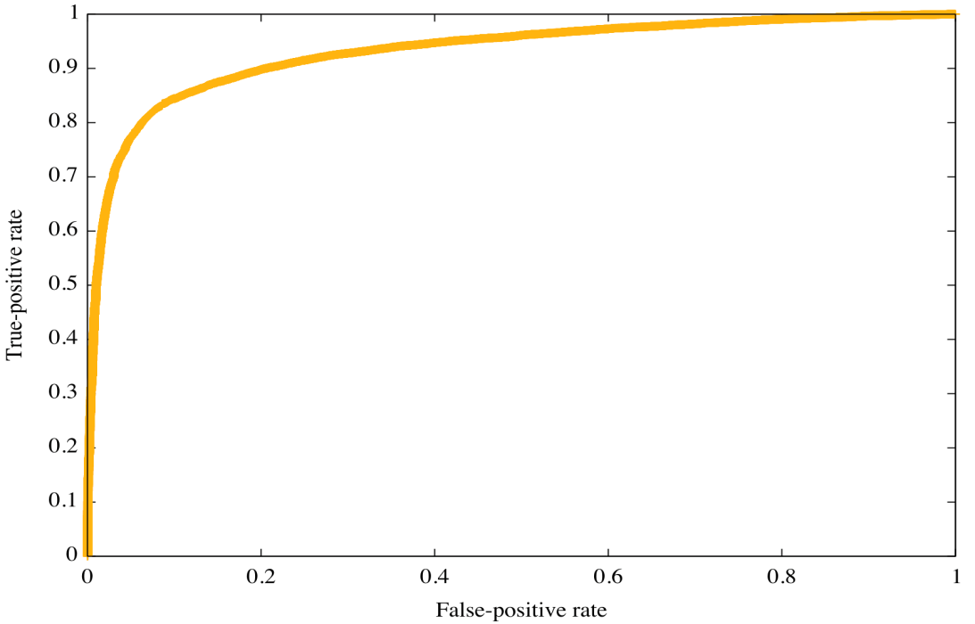
Baseline: AdaBoost
Base classifiers are Decision Stumps: C₁, C₂, …, C_{T} (attribute-threshold pairs)
In step m, find best C_{m} in predefined class using weights w_{i}
Error rate ε_{m}, sent through logit function to get α_{m}, the importance of the classifier
Weight of an instance
(mobile session):
Best attributes selected:
Maximum of RLC uplink
Mean of RLC uplink
HARQNACK downlink Max
Mean Change in RLC uplink
Mean of SINR PUSCH
FPR: 0.2 ,TPR: 0.89
FPR: 0.03 ,TPR: 0.7
AUC: 0.9315

Slide 39
Dynamic Time Warping
i
i
i
i
i+2
time
time
A non-linear (elastic) alignment produces a more intuitive similarity measure, allowing similar shapes to match even if they are out of phase in the time axis.
Any distance (Euclidean, Manhattan, …) which aligns the i-th point on one time series with the i-th point on the other will produce a poor similarity score.

Slide 40
By using the Similarity Kernel
Full similarity matrix is too large, and …
We have six and not just one time series, hence …
Select a set R of labeled instances, by …
Random sampling
Measuring the importance
Each instance is represented by a 6R dimensional vector of distances from instances in R
Choose appropriate metric
AdaBoost and other methods perform poor for the similarity representation
Use theoretical foundation of the Markov Random Field generated by pairs of sessions
Proof: Fisher information kernel equal to the linear kernel
Linear Support Vector Machine over the 6R dim representation normalized as given by the theory

Slide 41
Similarity Kernel in different tasks
 | Traditional method | Similarity Kernel
Web classification | Linear text kernel | Multimodal kernel
Area Under ROC curve | 0.69 | 0.74
Kernel size | 30K dim, 90MB sparse | 6K dim, 18MB dense
Image Concept Detection | Color HOG descriptors | Color HOG + text similarity (multimodal)
Mean Avg Precision | 0.367 | 0.426
Kernel size | 660K dim, 9.9GB floats | 15K dim, 450MB floats
Session Drop Prediction | AdaBoost over Statistics | DTW
Area Under ROC curve | 0.90 | 0.93

Slide 42
Software Technology: Map and Reduce
All starts here: Google idea to build search index
Input Splitting Mapping Shuffling Reducing Output
Map
Reduce
data,1 air,1 tlse,1
air,1 air,1
air,2
data air tlse
data air tlse stream tlse data tlse air stream
data,1 data,1
data,2
air,2
data,2
stream,2
tlse,3
stream tlse data
stream,1
tlse,1 data
stream,1 stream,1
stream,3
tlse air steam
tlse,1 air,1
stream,1
tlse,1 tlse,1
tlse,1
tlse,3
Second-order
function
Data
First-order function (user code)
Data

Slide 43

Parallelization second order functions
Introduced by Stratosphere/Apache Flink
Complex workflows automatically optimized
Model: RDBMS executing SQL commands
Second-order
function
Data
First-order function (user code)
Data
Cross
Join
CoGroup

Slide 44
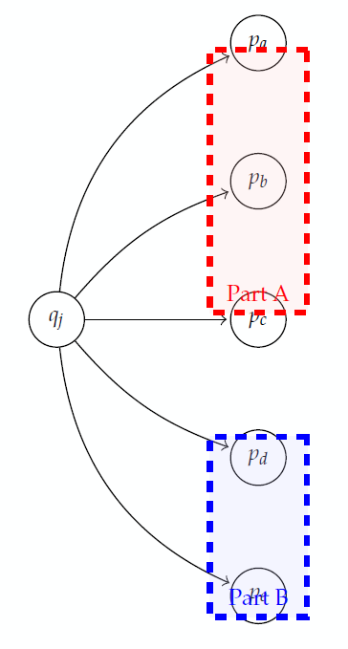
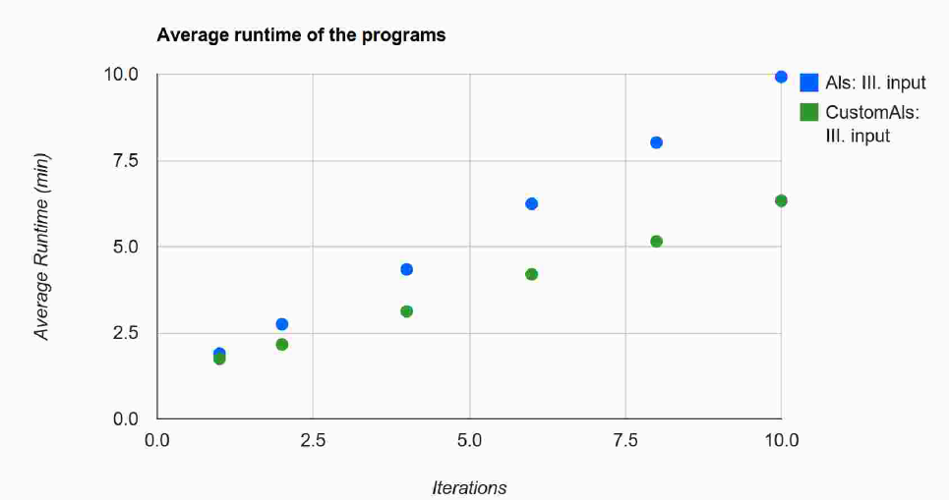



Parallel Matrix Completion may be Difficult
Alternating Least Squares single iteration:
$q_{i}={\left(P^{T}P\right)}^{−1}{P^{T} R}_{i}^{}=\sum_{j=1}^{N}{{\left(P^{T}P\right)}^{−1}{{P_{j}}^{T} R}_{ij}^{}}$
Partition by i
Broadcast $P^{T}P$, just a kxk matrix – but vast communication overhead
More iterations
$${\left(P^{T}P\right)}^{−1};$$
$${{P_{a}}^{T};R}_{ia}^{}$$
…
$${\left(P^{T}P\right)}^{−1};$$
$${{P_{e}}^{T};R}_{ie}^{}$$

Slide 45
Streaming parallelization
Same operations available over streams
Workflow optimization
Below is example for a matrix completion learning
Feedback loop for previous model iteration
red.
map
join
join
Streaming dataflow with feedback

Slide 46
The Streaming Lambda Architecture
Model precomputed by analyzing very large historic collections stored on eg. a large distributed file system
Model needs to be (1) applied to predict over a stream (2) adapted to changes in environment

Slide 47
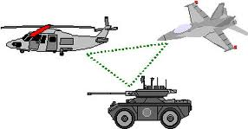
Fully Distributed Modeling
Needs no central service – suitable for:
Ad hoc networks
Privacy requirements
Model delta updates are sent to peers
Results for applicability in:
Classification
Matrix completion
Measurement
ΔQ
R ≈ P₁Q₁
ΔQ
Hegedus, I., Jelasity, M., Kocsis, L., & Benczúr, A. A. (2014). Fully distributed robust singular value decomposition. In Peer-to-Peer Computing (P2P) IEEE. Best Paper
R ≈ P₂(Q₂+ΔQ)

