Slide 1



Clustering and ranking countries and their products: a network analysis
Trento, Italy
23 - 27 July 2012
Andrea Gabrielli
Istituto dei Sistemi Complessi – CNR, Rome (Italy)
& IMT - Alti Studi di Lucca (Italy)
Email: andrea.gabrielli@roma1.infn.it
Collaborators: Luciano Pietronero, Andrea Tacchella
Guido Caldarelli, Matthieu Cristelli, Antonio Scala

Slide 2
Standard Economic Theories: Specialization of Countries production (D. Ricardo et al.). Assumption of static equilibrium
But observations (see triangular matrix M below) show that diversification is (in general) more important.
Globalization: dynamic world, adaptability, evolution, biodiversity.
Qualitative ➔ Quantitative
New Metrics for the competitiveness of Countries and Products
Diversification of Countries and Complexity of Products as non monetary metrics to identify the hidden potential for development
Database: UN COM.TRADE (1962-2011)
New algorithm to identify these metrics in the spirit of the Google page rank problem
Excellent performance on model systems and backtests

Slide 3
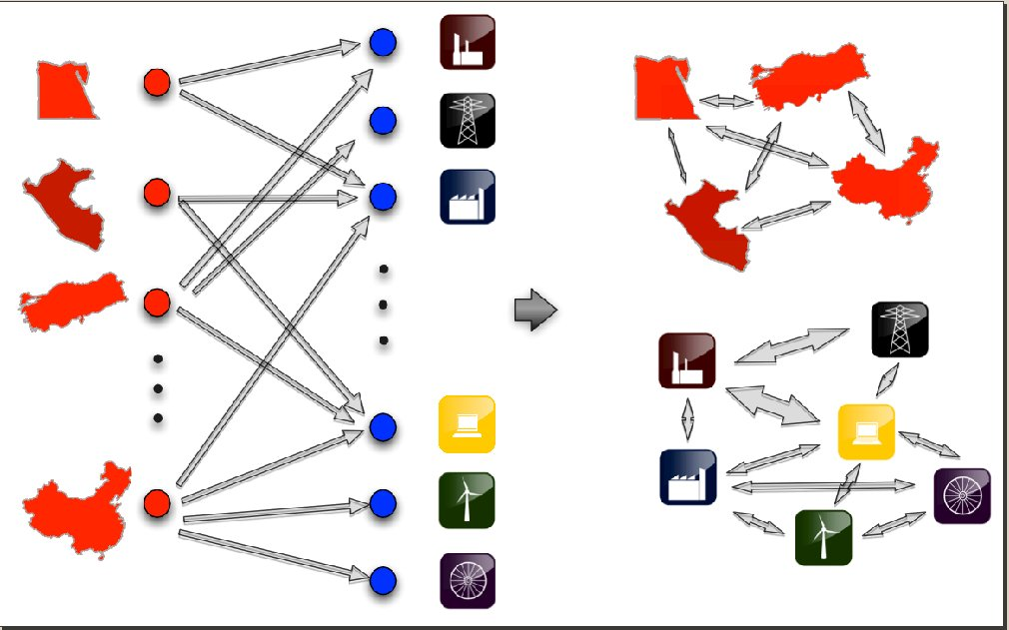
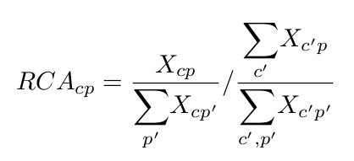
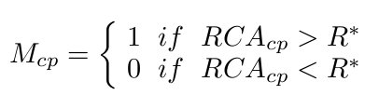
Bipartite country-product network (Hidalgo-Hausmann, PNAS, 2009)
Weighted matrix

Slide 4
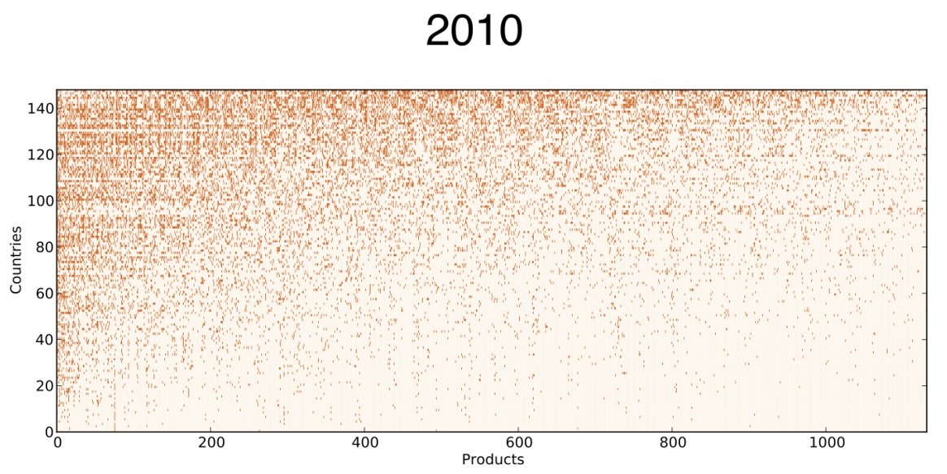
Triangularity of the M matrix
We reorder M for decreasing k_{c} and k_{p}
Information from triangularity:
“Rich” countries export almost all
products;
“Poor” countries export only few
ubiquitous products;
“Complex” products are exported
only by diversified countries;
Countries
Products
If a country is able to make high quality products, it also makes most of the others of lower quality.
Diversification is more important than specialization.
The “complexity” of a product is not determined by the “richest” producers, but by the “poorest” ones: NON-LINEAR INFORMATION!

Slide 5
Capabilities (Hidalgo-Hausmann, PNAS, 2009)
The optimal strategy is not specialization but diversification (≈Ecology)
Countries tend to accumulate “capabilities”= non-tradable goods and
socio-economical non-monetary resources which permit production
(e.g. high educational system, natural resourches, good burocracy,
technological transfer, infrastructures etc.)
From the mix of “old” and “new” capabilities new complex product may
appear
This explain why rich countries (with many and advanced capabilities)
export both complex and simple products
The larger is the basket of capabilities the larger is the effect of adding
a new advanced capability (combinatorics): NON-LINEAR RELATION
NEED OF A NEW METRICS TO QUANTIFY!

Slide 6
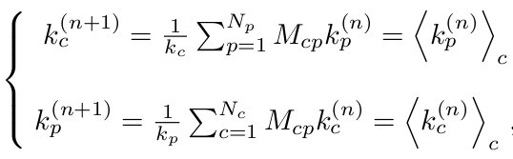
Methods of Reflections (Hidalgo-Hausmann, PNAS, 2009)
k_{c} provides only a “zero order” information on the wealth and
competitiveness of the country c.
Each product is weighted 1 or 0 independently of its complexity
k_{p} provides a zero order measure of the “disquality” of product p
New iterative linear algorithm to weight self-consistently
k_{c}^{(n)} and k_{p}^{(n)} give more an more refined information on the
“competitveness” of countries and products

Slide 7
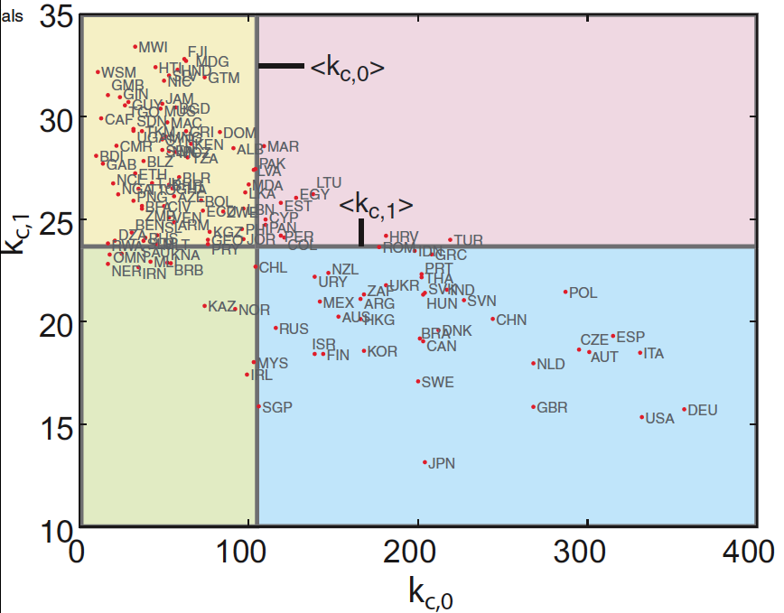
The Building Blocks of Economic Complexity
(C. Hidalgo, R. Hausmann,PNAS,2009)
Starting information
Odd and even iterations have anticorrelated meanings
Ubiquity of exports
Not differentiated countries export ubiquitous products
Differentiated countries export less available products
Differentiation of exports

Slide 8
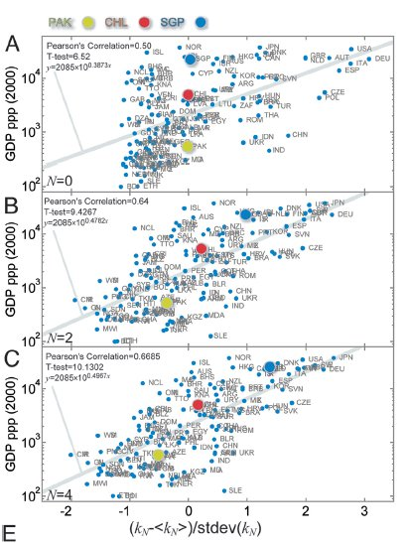
Correlation log(GDP)-δk_{c}^{(2n)}
Once k_{c}^{(2n)} is so renormalized one
observes a positive correlations
with the log of the GDP per capita
Countries departing from average line are interpreted to converge in some way in the future.
WARNING: such a renormalization is
Necessary (see next slide)

Slide 9
Algebraic analysis of the Method of Reflections (in publ. PlosOne)
Even (odd) iterations are a sort of refinement of the previous even (odd) iterations
C and P are ergodic Markov matrix (largest eigenvalue λ₁=1 and |λ_{n}|<1)
However f^{(2n)} and u^{(2n)} are not Markov chains!
C and P operate in the wrong direction

Slide 10
Consequence: f^{(2n)} and u^{(2n)} converge to uniform vectors !!!!!
The main right eigenvector (eigenvalue λ=1) of an E.M.M. is uniform
The information in the bipartite graph is averaged and
equally redistributed over all the nodes
Algebraic explanation
is a measure of the component along c of the
second right eigenvector of matrix C:

Slide 11
Weakness of the Methods of Reflections (submitted to PLOSone)
Convergence to a uniform fixed point of k_{c}^{(2n)} for all c (fundamental right
eigenvector of an ergodic left Markov chain)
Odd and even iterations have different meanings
Mathematical/economical meaning lost with iterations
Need to subtract the mean of k_{c}^{(2n)} to find correlations with log(GDP):
second eigenvector of the ergodic Markov matrix
Only a small fluctuation of the iterated variables k_{c}^{(2n)} is meaningful:
but it is an heuristic algorithm for such empirical variables
Transformations are linear while a non-linear relation between fitness
of countries and complexity of products is expected: almost extremal
feedback is expected from triangularity of M and capability th.!

Slide 13
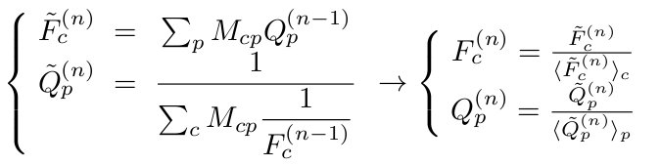
New Approach: Fitness & Quality (in publ., Scientific Reports Nature)
Two variables which are improved by iterations, while keeping the same meaning
High Fitness: a country exporting many products of high quality
High Quality: a product which is not exported by any low fitness country
M_{cp} can be taken to be both the binary or
the weighted matrix

Slide 14
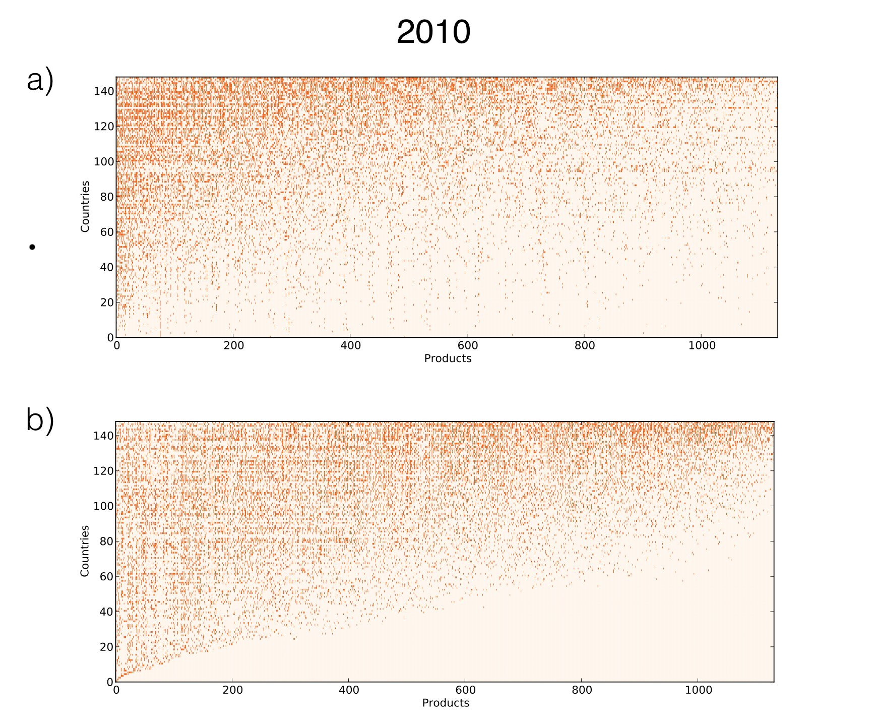
M_{cp} rerranged for
decreasing k_{c} and k_{p}
M_{cp} rerranged for
decreasing f_{c}* and
increasing q_{p}*

Slide 15
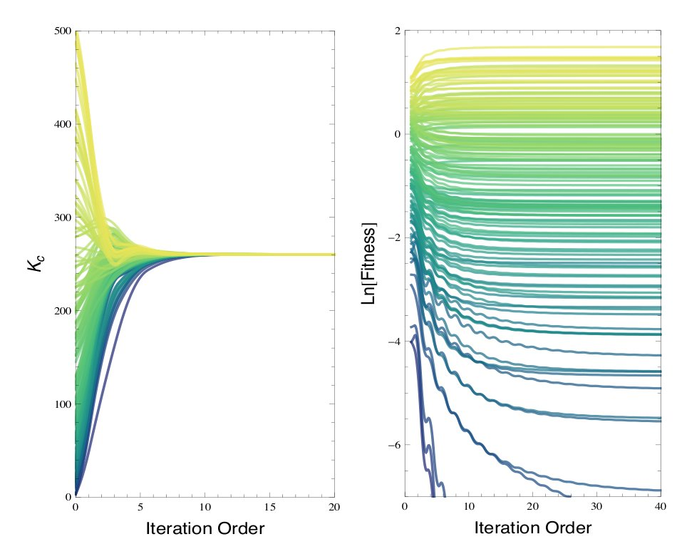
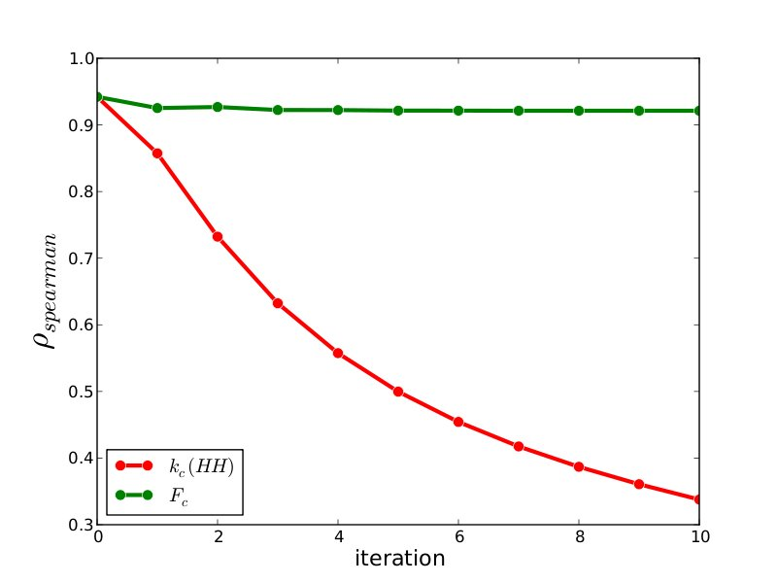
Comparison with the Method of Reflections
Convergence of all k_{c} compared to the
Spread of f_{c}
Introduce two binary matrices A_{ck} (country-capability)
and B_{kp} (capability-product) with random entries
A country export a product iif it owns all the
capabilities to produce it
M_{cp}=Π_{k} [1- B_{kp}(1-A_{ck})]
We evaluate the correlation respectively between
k_{c}^{(n)} and f_{c}^{(n)} and the number of capabilities of c

Slide 16
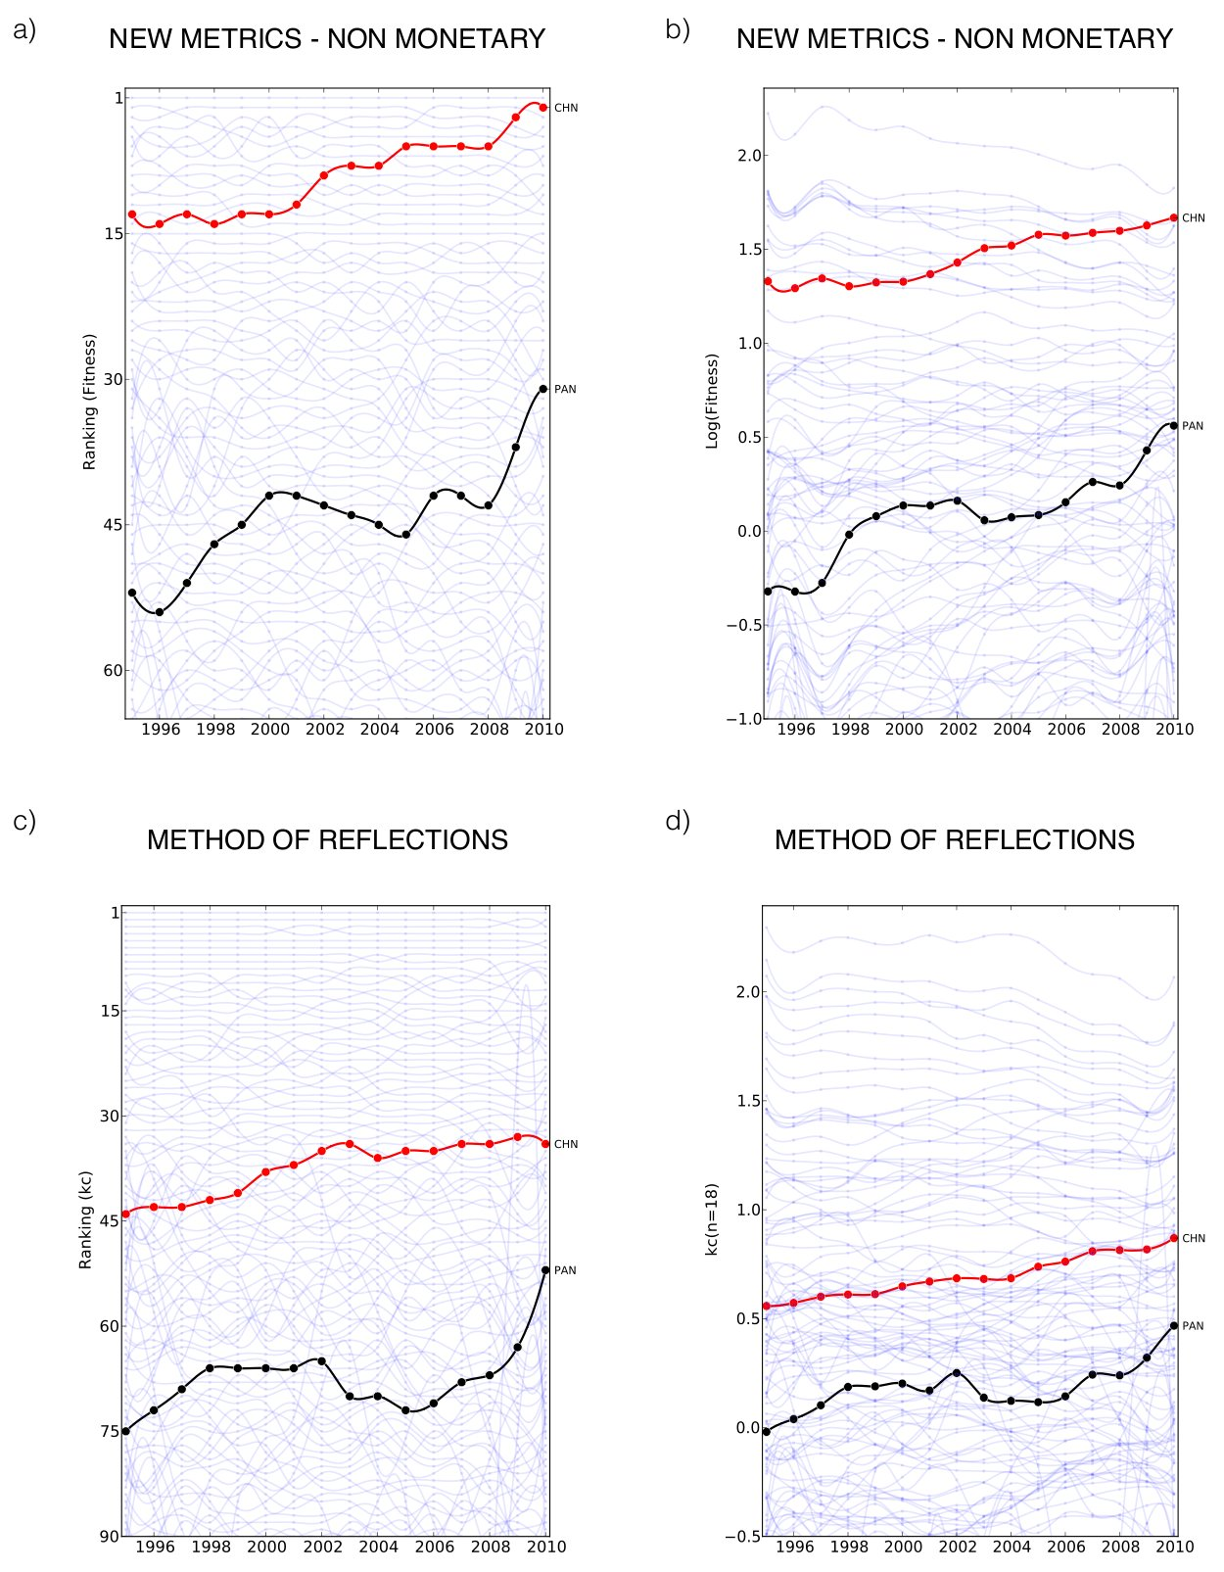
Comparison between the new
non-linear algorithm and the
Method of Reflections:
Relative positions of China
and Panama

Slide 18
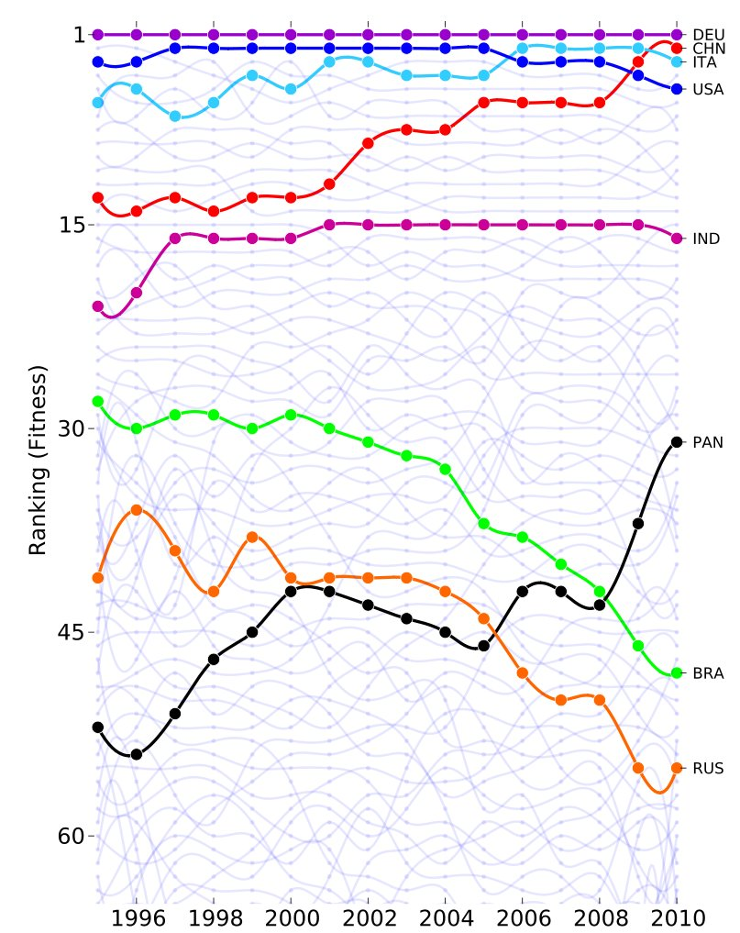
Economic evolution: BRIC Countries
4 digits
1160 products

Slide 19
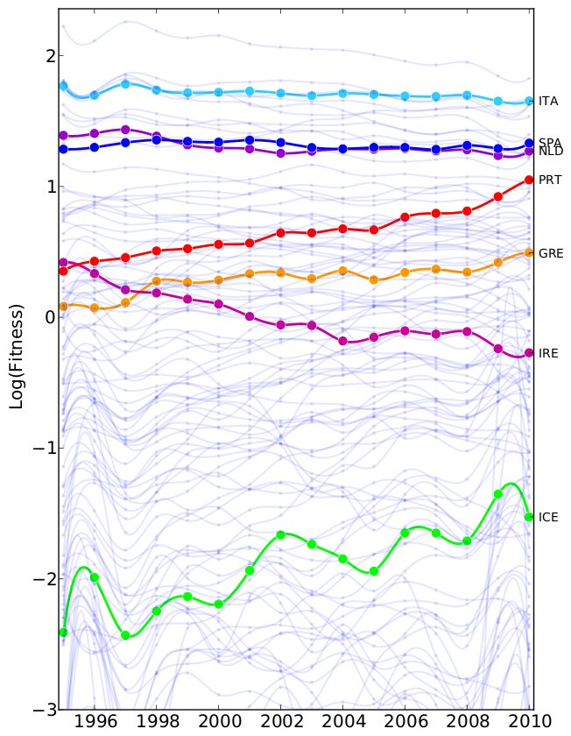
FITNESS Absolute value
BRIC
PIIGS

Slide 20
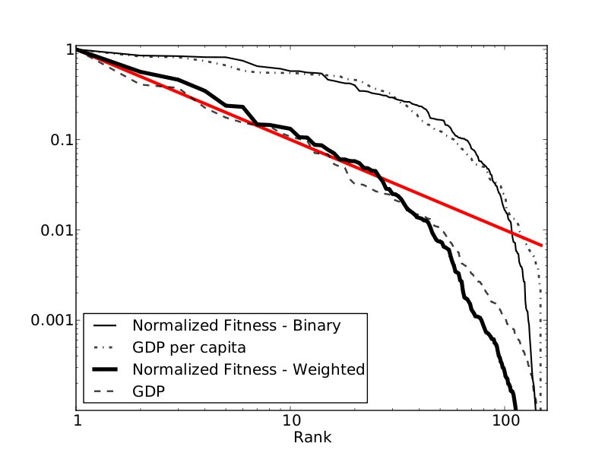
Pareto-Zipf Distributions
The binary model correlates with
intensive quantities, as Per Capita
GDP: it is a measure of efficiency.
The weighted model shows a wider
distribution and its ranking is close
to the GDP ranking.

Slide 21
Quality of Products
Black: Fitness (Binary) – Red: Fitness (weighted)

Slide 22
1995

Slide 23
ECONOMIC DYNAMICS IS HETEROGENEOUS

Slide 24
COARSE GRAINED DYNAMICS

Slide 25
Capability inspired non-linear algorithm for competitiveness of countries and products
Good correlations with GDP and other
observables
Alternative and more realistic definitions of the
variables F and Q
Include geographic elements
Financial elements (debt, cost of labor)
Application to other bipartite networks: Banks,
Companies, Providers …
Modelization of dynamics for optimal strategies
Conclusions

