Slide 1
PageRank opinon formation models on Ulam networks
Levon Chakhmakhchyan
A.I. Alikhanyan National Science Laboratory, Yerevan, Armenia
Laboratoire Interdisciplinaire Carnot de Bourgogne, Dijon, France
In collaboration with D. Shepelyansky
FR/ARM CLASSQUANT

Slide 2
Modeling opinion formation processes
Modern social networks
exhibit scale-free, small world properties: differ much from regular lattices
each node (user) has its degree of authority
Weigh the degree of authority by means of a node’s PageRank
Brin, Page, Comput. Netw. ISDN Syst. (1998)

Slide 3
Ulam networks
y_{n+1}=f₁(x_{n}, y_{n})
x_{n+1}=f₂(x_{n}, y_{n})
y
PageRank and Google matrix properties of Ulam networks share common features with some real networks
j
x
i
Shepelyansky et. al , Phys. Rev. E 81 (2010);
Ermann et al., Phys. Rev. E 81 (2010).
x
Ulam network (Ulam, “A collection of mathematical problems”, NY 1960)

Slide 4
PageRank model of opinion foramtion (PROF)
opinion is influenced by the closest linked nodes (friends)
influential friend’s opinion counts more than less important friend’s opinion
Two possible opinions are incoded by an Ising spin: +1 (red) and -1 (blue)
Σ_{i}=P_{j,in}⁺+P_{j,out}⁺- P_{j,in}⁻-P_{j,out}⁻
Σ_{i}>0 a node votes for red
Σ_{i}<0 a node votes for blue

Slide 5
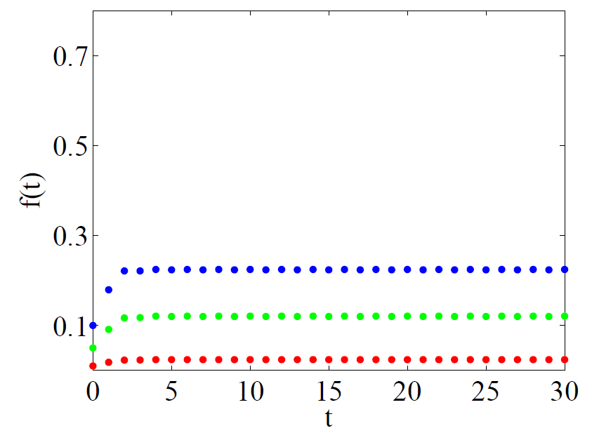
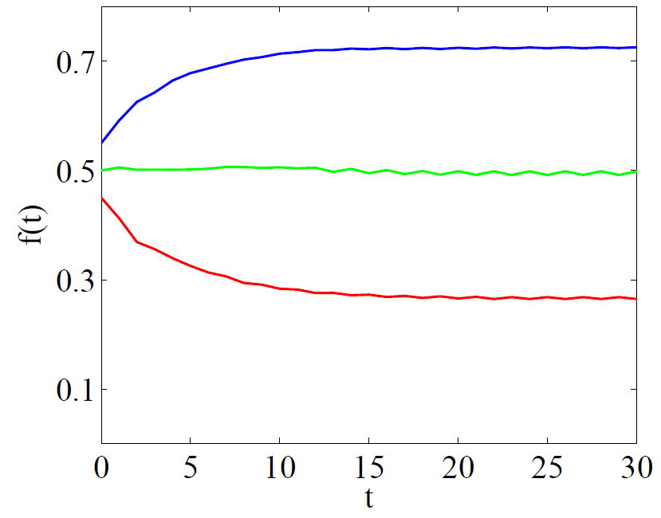
PROF model on Ulam networks
f(t)=N_{red}/N
random distribution
the elite members of the same opinion

Slide 6
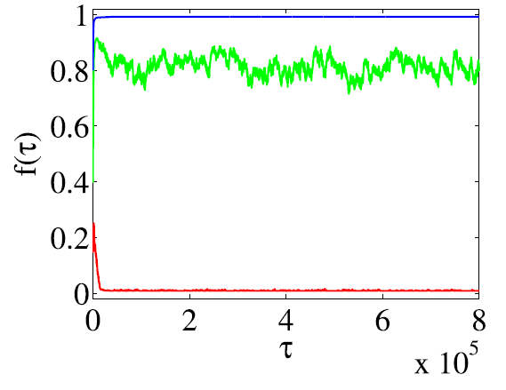
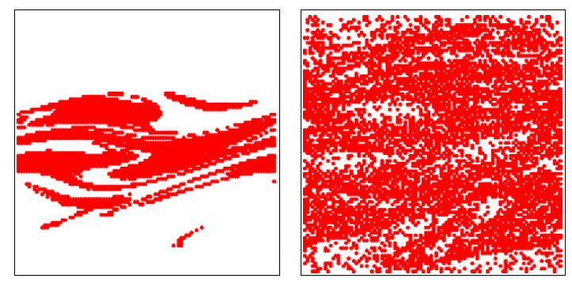
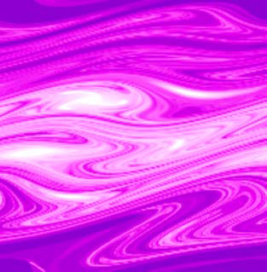
Generalized PROF-Sznajd model for 2D mappings
P₃<P₁+P₂
P=P₁+P₂
P₃
Sznajd-Weron, J.Sznajd, Int. J. Mod. Phys. C (2000).
initial distirbution
final distirbution
The top elite nodes first tend to convince other members of the elite

Slide 7
Summary
PageRank model of opinion formation on Ulam networks is proposed
Elite can impose its opinion up to a certain degree and firstly tends to convince other members of the elite
The system may not come to a steady state if groups of the same opinion are considered
The model exhibits certain distinctions from similar models examined on real networks (Kandiah, Shepelyansky, Physica A (2012))
LC, D. Shepelyansky, Phys. Lett. A 377, 3119 (2013)

Slide 8
Thank you

