Slide 1
Entity-level Temporal Web Analytics – Achieving a High Quality Web Archive
Marc Spaniol
Summerschool “Network Analysis and Applications”
Luchon, France, June 24, 2014

Slide 2
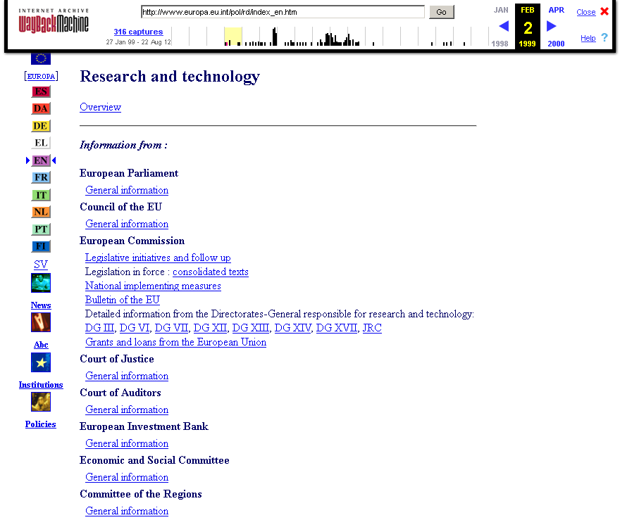
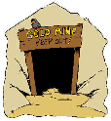
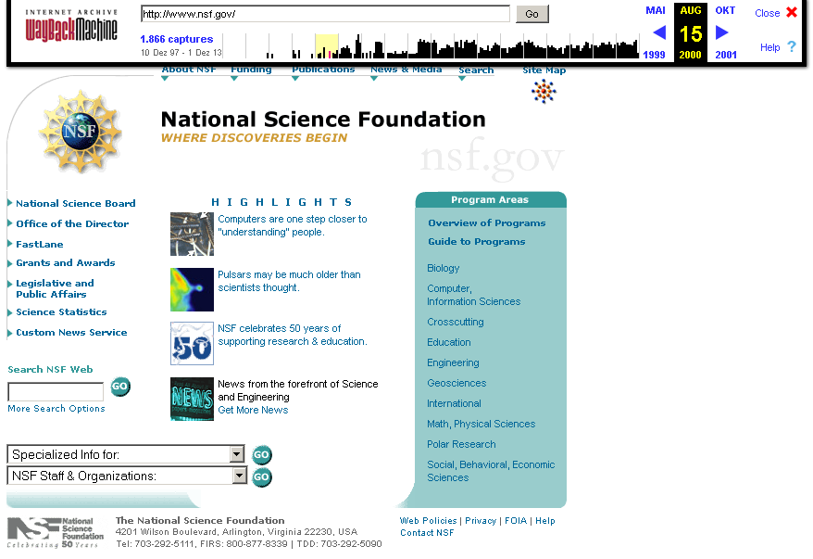
Motivation
EU vs. NSF science funding:
Program structures?
Research objectives?
Budgets per topic?
Web contents are a gold mine for analytics
Track and analyze
Text: statements, quotes, other phrases, …
Entities: persons, organizations, products, technologies, ...
Source for sociological, political, business, and media analysts
Web archives are a gold mine for longitudinal analytics
“How did the EU align its policy towards energy efficiency?”
“Which places did a politician visit during an election campaign?”
“How did the market for smartphone OSs evolve?”
…
⇒ High quality Web archive data for entity-level temporal Web analytics
1996
2000
2002
2006
2010
now
ec.europa.eu/research
nsf.gov
Notes:
The constantly evolving Web reflects the evolution of the society in the cyberspace. Projects like the Open Directory Project can be understood as a collective memory of society on the Web. It represents the topical knowledge in a structured way in form of taxonomy.
Several types of changes can be performed in the taxonomy (category merge/addition/removing).
New concepts first appear in sources external to any classification systems – blogs, news and other social media.
Picture.
We hypothesize, that any concept emerging in news has first to reach a certain cognition level to become a part of taxonomy.

Slide 3
Outline
Challenges of temporally coherent Web archiving
Coherence framework
Single access strategies – best-effort coherence
“Double” access strategies – certified coherence
(In-)Coherence visualization
Conclusions
Challenges of temporally coherent Web archiving
Coherence framework
Single access strategies – best-effort coherence
“Double” access strategies – certified coherence
(In-)Coherence visualization
Conclusions

Slide 4
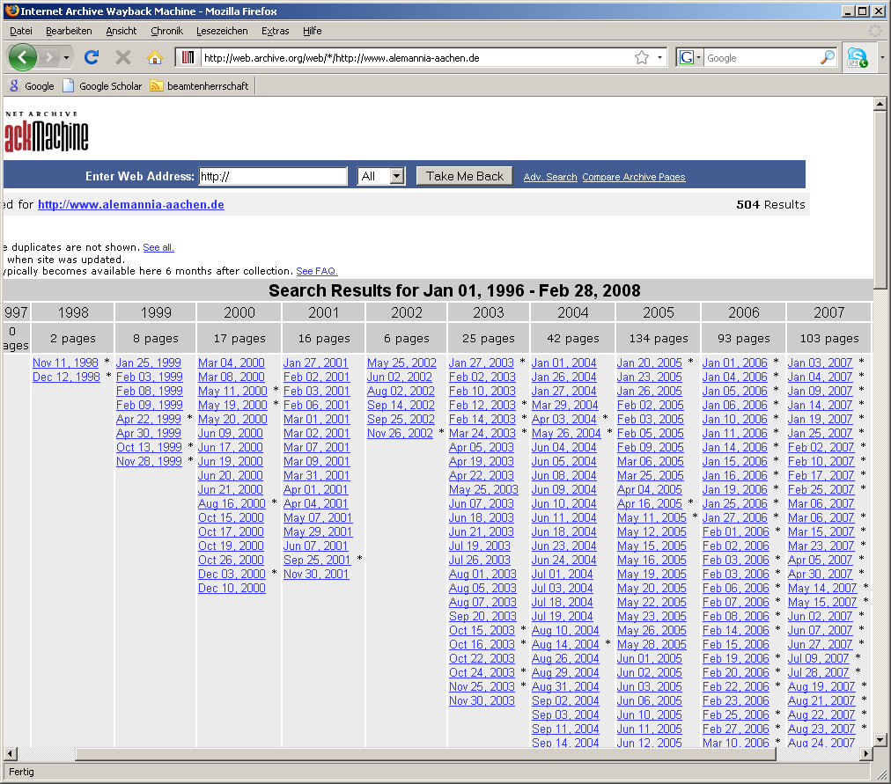
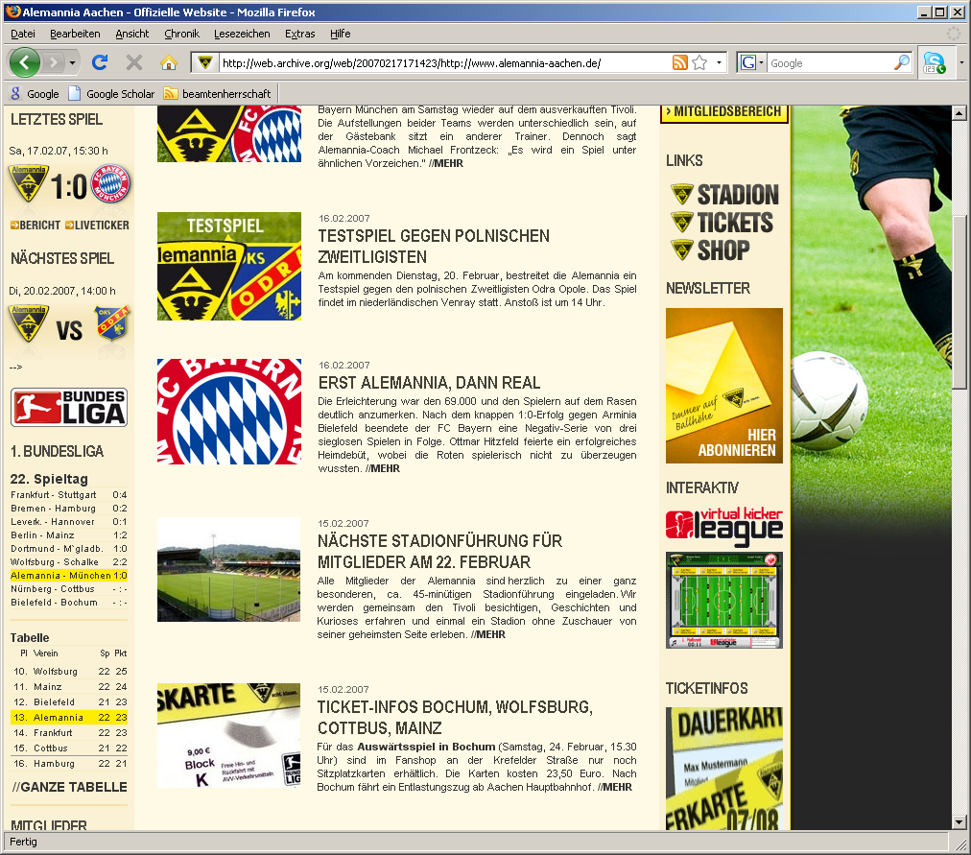
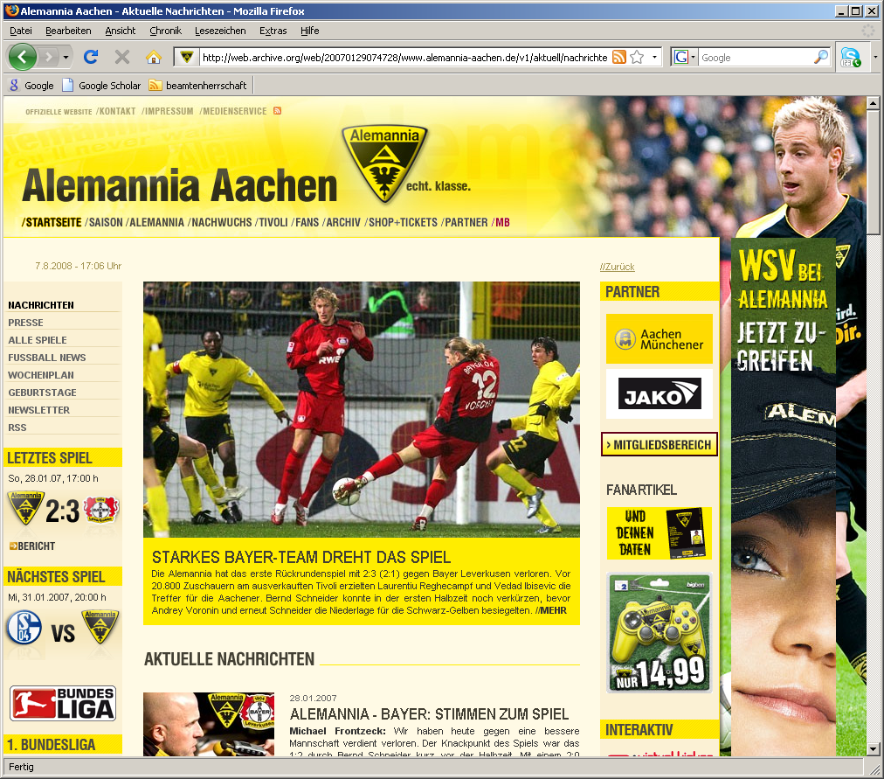
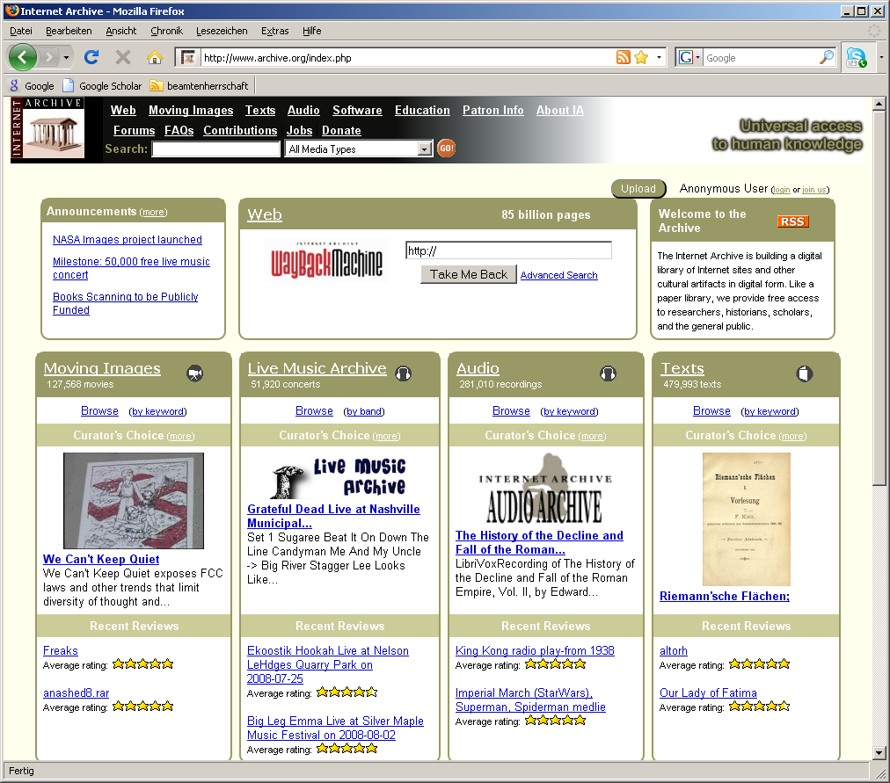
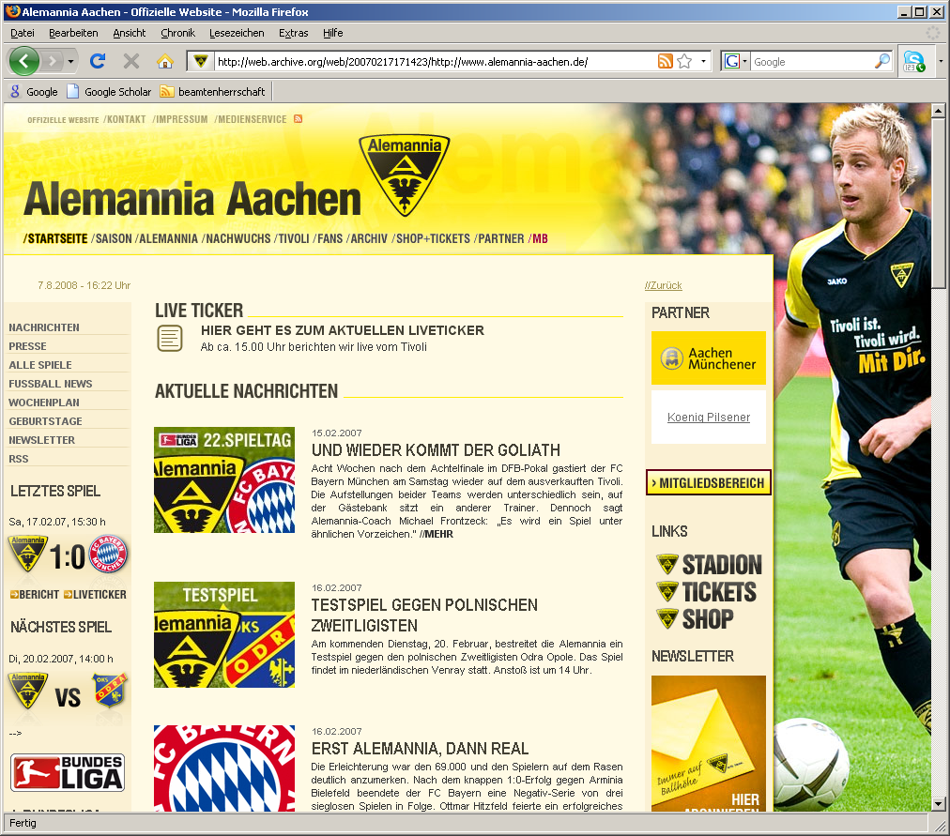
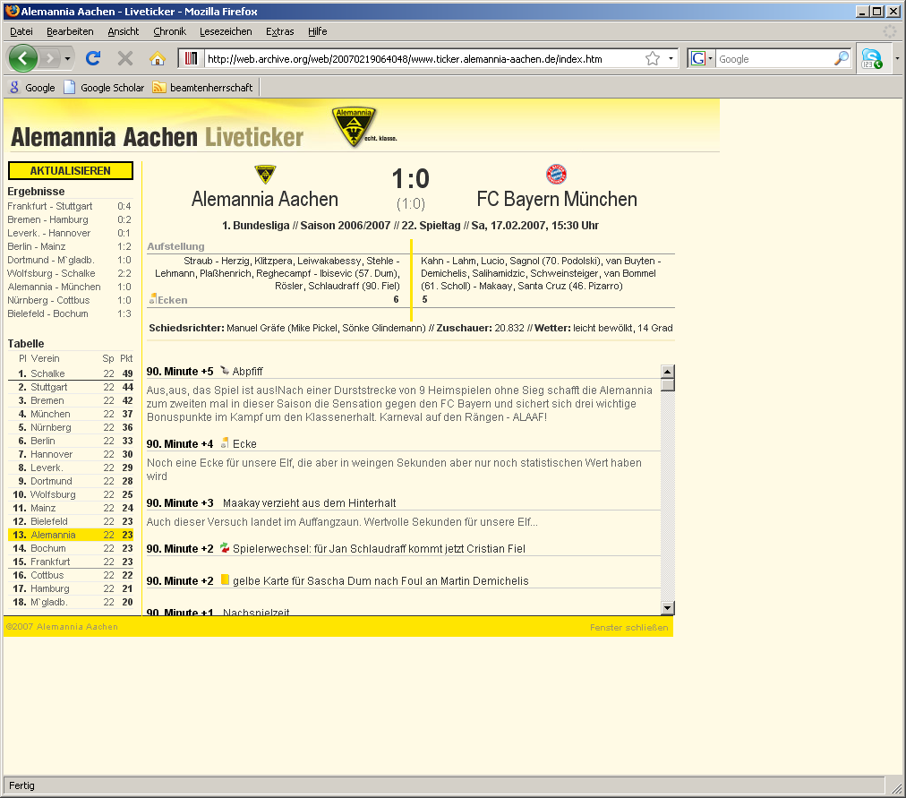
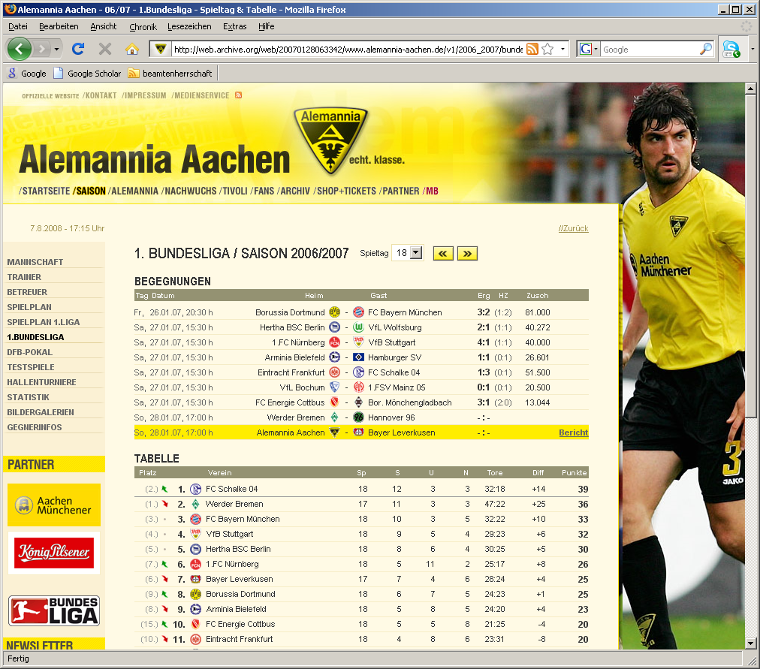
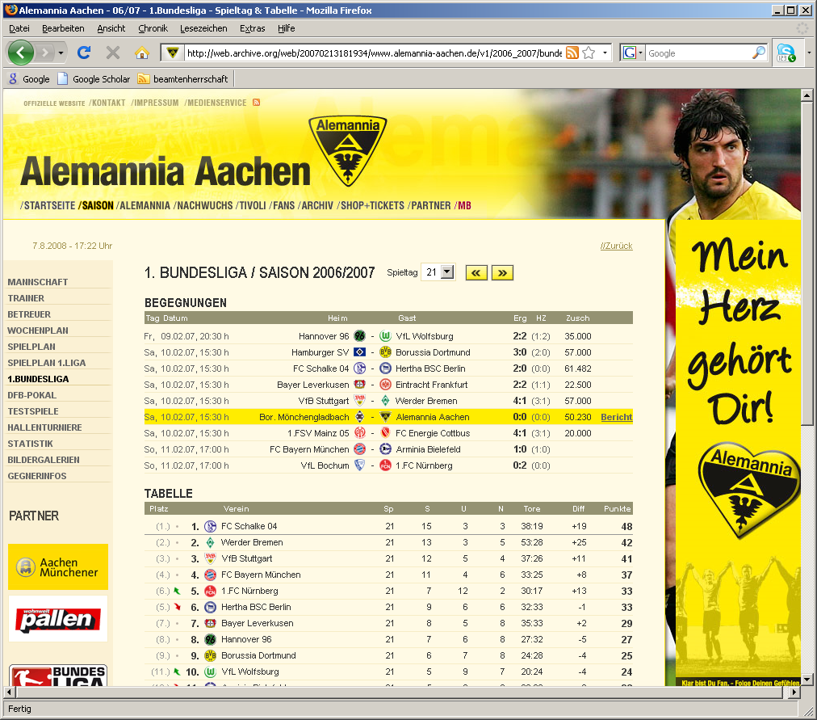
Challenges
Crawling takes a long (!) time
Politeness delays (1-3 seconds)
Multiple seeds per crawl
Spam
Crawler operations
Visit (pages)
Extract (links from pages)
Compare (versions of pages)
Follow (links)
Website operations
Modifications “inside” pages
Content (text)
Structure (links)
Modifications “inside” site
Page creation
Page deletion
Smart(er) crawling strategies
Taking place in parallel
⇓
Potentially incoherent
⇒
Archive in danger!
Evaluation of crawl coherence

Slide 5
Indexing vs. Archiving
Indexing
Completeness
Access to content
Scalability (speed)
Efficiency
Freshness
Archiving
Completeness
Access to content
Scalability (coverage)
Authenticity
Coherence
Durability
⇒
“Taking a Photo”
⇒
“Shooting a Movie”

Slide 6
Crawl Scheduling
Most crawlers have been developed for indexing
Crawl types
Broad crawling
Focused crawling
Continuous crawling
Experimental crawling
Basic process
Choose a URI from among all those scheduled
Fetch that URI
Analyze and/or archive the results
Select discovered URIs of interest, and add to those scheduled
Note that the URI is done and repeat
⇒ “Breadth-first” traversal of Web sites

Slide 7
Problem Statement – Temporally Coherent Web Archiving
What means coherence?
“The action or fact of cleaving or sticking together”
“Harmonious connexion of the several parts,
so that the whole ‘hangs together’”
Temporal coherence in Web archiving:
Capturing Web sites as “authentic” as possible
Ensure an “as of time point x (or interval [x, y])” capture of a Web site
⇒ Periodic domain scope crawls of Web sites to obtain a best possible representation with respect to a time point/interval
Oxford English Dictionary [http://dictionary.oed.com]
M. Spaniol et al. [WICOW 2008]
D. Denev et al. [VLDB 2008]

Slide 8
Motivation
“Easy” for a human to recognize (in-)coherence
“Tough” for a machine to evaluate (in-)coherence (immediately)
Requires semantic analysis of contents
Reliable last-modified stamps
and/or
Smart crawling strategies
Double access of contents required in order to “certify” coherence
?
Missing update
?
?

as of 13/02/2007

as of 29/01/2007
Reference:
as of 17/02/2007
✓
as of 19/02/2007
time
M. Spaniol et al. [WICOW 2009]
M. Spaniol et al.: [IWAW 2009]

Slide 9
Outline
Challenges of temporally coherent Web archiving
Coherence framework
Single access strategies – best-effort coherence
“Double” access strategies – certified coherence
(In-)Coherence visualization
Conclusions
Challenges of temporally coherent Web archiving
Coherence framework
Single access strategies – best-effort coherence
“Double” access strategies – certified coherence
(In-)Coherence visualization
Conclusions

Slide 10
Coherence Framework
Basic Assumptions
Web site to be crawled consists of n Web pages
Changes of Web pages occur per time unit and independent of each other
Change rates are assumed / given
Delay between downloads of pages is the same
Download time is neglected
Basic Notation
Crawl: c
Web pages: p₁,…, p_{n}
Change probability of page p_{i}: λ_{i}
Time of downloading page p_{i}: t(p_{i})
Last modified value of page p_{i}: μ_{i}
Content hash or etag of page p_{i}: θ(p_{i})
Crawl interval: [t_{s},t_{e}]

Slide 11
Outline
Challenges of temporally coherent Web archiving
Coherence framework
Single access strategies – best-effort coherence
“Double” access strategies – certified coherence
(In-)Coherence visualization
Conclusions
Challenges of temporally coherent Web archiving
Coherence framework
Single access strategies – best-effort coherence
“Double” access strategies – certified coherence
(In-)Coherence visualization
Conclusions

Slide 12
Coherence
Definition:
A single Web page is always coherent.
The invariance interval [μ_{i},μ_{i}*] of page p_{i} lies between the last modified time stamp μ_{i} at time t(p_{i}) of downloading p_{i} (μ_{i} ≤ t(p_{i})) and the next change μ_{i}* following t(p_{i}).
Two or more pages are coherent if
there is a time point (or interval) t_{coherence} so that a non-empty intersection among the invariance interval of all pages exists:

Slide 13
Coherence by Example
t_{coherence} = [t₂ , t₃)
p₁
p₂
p₃
p₄
t₁ = t_{s}
t₂
t₃
t₄ = t_{e}

Slide 14
Coherence by Example
t_{coherence} ∈ ∅
p₁
p₂
p₃
p₄
t₁ = t_{s}
t₂
t₃
t₄ = t_{e}

Slide 15
Best-Effort Coherence
Basic idea
Single-visit strategy
Best-effort crawling
Continuous archive access
Optimality on the average
No coherence guarantee
Resource saving archiving strategy
Overall goal
Blur minimization
The less changes “recognizable”,
the better!
Formally
Query for mpi-inf.mpg.de 10/2009
Version available: 08/2009
Version available: 06/2007
Version available: 03/2006
Version available: 06/2005
⇒ Blur = 0
⇒ Blur = 1
⇒ Blur = 2
Denev et al. [VLDB 2009, VLDBJ2011]
⇒ Blur = 3

Slide 16
Best-Effort Coherence by Example
Blur = 5
Blur = 2
Blur = 1
p₁
p₂
p₃
p₄
P₅
Crawl Interval
Observation Interval

Slide 17
Best-Effort Coherence by Example
Blur = 4
Blur = 1
Blur = 0
p₁
p₂
p₃
p₄
P₅
Crawl Interval
Observation Interval

Slide 18
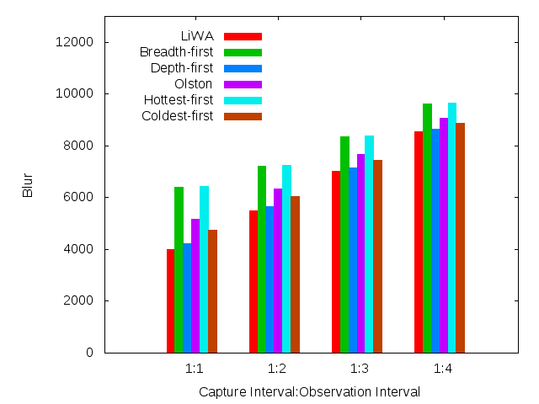
Best-Effort Coherence Crawl Scheduling: Experimental Results – Website 10.000 contents
Best-effort
Notes:
Maximum changes: ~ 20
Minimum unchanged: ~50
10.000 pages (crawl/revisit), 1/sec [e.g. commercial or government]: ~5,5 h
10.000 pages (crawl/revisit), 1/2sec [e.g. private]: ~11 h

Slide 19
Best-Effort Coherence Summary
Definition
Aims at avoiding diffusion (“blur”) on the average
Requires “full world knowledge” for quality assessment
Implementation
Efficient single visit strategy
Crawlers are
aware of the past (“backward-conscious”)
but
unaware of the future (“forward-blind”)
⇒ No coherence guarantee achievable

Slide 20
Outline
Challenges of temporally coherent Web archiving
Coherence framework
Single access strategies – best-effort coherence
“Double” access strategies – certified coherence
(In-)Coherence visualization
Conclusions
Challenges of temporally coherent Web archiving
Coherence framework
Single access strategies – best-effort coherence
“Double” access strategies – certified coherence
(In-)Coherence visualization
Conclusions

Slide 21
Observable Coherence
Definition:
Two or more pages are observable coherent if
there is a single time point (or interval) t_{coherence} so that there is a non-empty intersection of the intervals spanning the respective download time t(p_{i}) and the corresponding last modified stamp μ_{i} retrieved at time of download (μ_{i} ≤ t(p_{i})):

Slide 22
Measurable Coherence
Specialization of observable coherence
Makes observable coherence measurable in a real life scenario
Overcomes “right-hand side blindness” of crawlers
Ability to issue a guaranteed coherence statement
Valid for all contents of a Web site
“Regardless” of crawl duration
Suitable coherence time point (or interval) t_{coherence} needed
⇒ Full control is only given for t_{coherence} = t_{s}

Slide 23
Measurable Coherence by Example
t_{coherence} = t₁
p₁
p₂
p₃
p₄
t₁ = t_{s}
t₂
t₃
t₄ = t_{e}

Slide 24
Measurable Coherence by Example
t_{coherence} ∈ ∅
p₁
p₂
p₃
p₄
t₁ = t_{s}
t₂
t₃
t₄ = t_{e}

Slide 25
Quantifying Measurable Coherence
Error function
Coherence function

Slide 26
Crawl Improvement – Measurable Coherence
Conflict probability: κ(p_{i}) = 1 - (1 - λ_{i}) ^{t(pi) - ts}
Crawling so that conflicts are “tolerable” (κ(p_{i}) < η)
p₁ |  | D | D | D | D | … | D
p₂ |  | D | 1 | D | D | … | D
p₃ |  | D | 1 | 2 | D | … | D
… |  | … | … | … | … |  | …
p_{n} |  | D | 1 | 2 | 3 | … | n-1
 |  | t₁ | t₂ | t₃ | t₄ | … | t_{n}
Notes:
No change in 1 step
No change in t(p_{i}) steps
At least one change in t(p_{i}) steps

Slide 27
Measurable Coherence Summary
Definition
Makes coherence become measurable
Relative to start of crawl
Implementation
“Easy”
Ad-hoc verifiable
Efficient
Produces no extra traffic
Relies on accuracy of last modified stamps
⇒ Only limited applicability in a real life scenario

Slide 28
Inducible Coherence
Definition:
Two or more pages are inducible coherent iff
there is a time point t_{coherence} between the visit of pages t(p_{i}) and the subsequent revisit t(p̃_{i}) where the etag or content hash θ of corresponding pages (θ(m) having m ∈ {p_{i},p̃_{i}}) has not changed:

Slide 29
Inducible Coherence by Example
t_{coherence} = t₄
p₁
p₂
p₃
p₄
t₁ = t_{s}
t₂
t₃
t₄
t₅
t₆
t₇ = t_{e}

Slide 30
Inducible Coherence by Example
t_{coherence} ∈ ∅
p₁
p₂
p₃
p₄
t₁ = t_{s}
t₂
t₃
t₄
t₅
t₆
t₇ = t_{e}

Slide 31
Quantifying Inducible Coherence
Error function
Coherence function

Slide 32
Crawl Improvement – Inducible Coherence
Conflict probability: κ(p_{i}) = 1 - (1 - λ_{i}) ^{t(p̃i) - t(pi)}
Crawling so that conflicts are “tolerable” (κ(p_{i}) < η)
p₁ |  | D | 1 | … | n-i-2 | n-i-1 | n-i | n-i+1 | n-i+2 | n-i+3 | … | 2(n-1)
… |  | … | … |  | … | … | … | … | … |  | … | …
p_{n-2} |  | D | D | … | D | 1 | 2 | 3 | 4 | D | … | D
p_{n-1} |  | D | D | … | D | D | 1 | 2 | D | D | … | D
p_{n} |  | D | D | D | D | D | D | D | D | D | … | D
 |  | t₁ | t₂ | … | t_{n-2} | t_{n-1} | t_{n} | t_{n+1} | t_{n+2} | t_{n+3} | … | t_{2n-1}
Notes:
No change in 1 step
No change between t(p_{i}) and t(p̃_{i})
At least one change between t(p_{i}) and t(p̃_{i})

Slide 33
Inducible Coherence Scheduling: pos_{n}
Position: pos_{n}
Remaining λ_{i} : λ_{n} > λ_{n-1} > λ_{n-2} >…> λ₁
Position: pos_{n}
Remaining λ_{i} : λ_{n-1} > λ_{n-2} >…> λ₁
Test: 1 - (1 - λ_{n})⁰ > θ ?
⇒ No!
Promising:
Hopeless:
λ_{n}
pos₁ |  | D | 1 | … | n-i-2 | n-i-1 | n-i | n-i+1 | n-i+2 | n-i+3 | … | 2(n-1)
… |  | … | … |  | … | … | … | … | … |  | … | …
pos_{n-2} |  | D | D | … | D | 1 | 2 | 3 | 4 | D | … | D
pos_{n-1} |  | D | D | … | D | D | 1 | 2 | D | D | … | D
pos_{n} |  | D | D | D | D | D | D | D | D | D | … | D
 |  | t₁ | t₂ | … | t_{n-2} | t_{n-1} | t_{n} | t_{n+1} | t_{n+2} | t_{n+3} | … | t_{2n-1}

Slide 34
Inducible Coherence Scheduling: pos_{n-1}
Position: pos_{n-1}
Remaining λ_{i} : λ_{n-2} >…> λ₁
Position: pos_{n-1}
Remaining λ_{i} : λ_{n-1} > λ_{n-2} >…> λ₁
Position: pos_{n-1}
Remaining λ_{i} : λ_{n-3} >…> λ₁
Position: pos_{n-1}
Remaining λ_{i} : λ_{n-4} >…> λ₁
Test: 1 - (1 - λ_{n-1})² > θ ?
Test: 1 - (1 - λ_{n-3})² > θ ?
Test: 1 - (1 - λ_{n-2})² > θ ?
e.g. Yes!
e.g. No!
Promising:
Hopeless:
λ_{n}
λ_{n-3}, λ_{n}
λ_{n-1}, λ_{n-2}
λ_{n-1}
pos₁ |  | D | 1 | … | n-i-2 | n-i-1 | n-i | n-i+1 | n-i+2 | n-i+3 | … | 2(n-1)
… |  | … | … |  | … | … | … | … | … |  | … | …
pos_{n-2} |  | D | D | … | D | 1 | 2 | 3 | 4 | D | … | D
pos_{n-1} |  | D | D | … | D | D | 1 | 2 | D | D | … | D
pos_{n} |  | D | D | D | D | D | D | D | D | D | … | D
 |  | t₁ | t₂ | … | t_{n-2} | t_{n-1} | t_{n} | t_{n+1} | t_{n+2} | t_{n+3} | … | t_{2n-1}

Slide 35
Inducible Coherence Scheduling: pos_{n-2}
Position: pos_{n-2}
Remaining λ_{i} : λ_{n-4} >…> λ₁
Position: pos_{n-2}
Remaining λ_{i} : λ_{n-6} >…> λ₁
Position: pos_{n-2}
Remaining λ_{i} : λ_{n-5} >…> λ₁
Test: 1 - (1 - λ_{n-4})⁴ > θ ?
Test: 1 - (1 - λ_{n-5})⁴ > θ ?
e.g. Yes!
e.g. No!
Promising:
Hopeless:
λ_{n-5}, λ_{n-3}, λ_{n}
λ_{n-3}, λ_{n}
λ_{n-1}, λ_{n-2}, λ_{n-4}
λ_{n-1}, λ_{n-2}
pos₁ |  | D | 1 | … | n-i-2 | n-i-1 | n-i | n-i+1 | n-i+2 | n-i+3 | … | 2(n-1)
… |  | … | … |  | … | … | … | … | … |  | … | …
pos_{n-2} |  | D | D | … | D | 1 | 2 | 3 | 4 | D | … | D
pos_{n-1} |  | D | D | … | D | D | 1 | 2 | D | D | … | D
pos_{n} |  | D | D | D | D | D | D | D | D | D | … | D
 |  | t₁ | t₂ | … | t_{n-2} | t_{n-1} | t_{n} | t_{n+1} | t_{n+2} | t_{n+3} | … | t_{2n-1}

Slide 36
Inducible Coherence Scheduling: pos_{n-k}
Position: pos_{k}
Remaining λ_{i} : ∅
Position: pos_{k}
Remaining λ_{i} : λ₁
Position: pos_{k}
Remaining λ_{i} : λ₂ > λ₁
Test: 1 - (1 - λ₁)^{2(k-1)} > θ ?
Test: 1 - (1 - λ₂)^{2(k-1)} > θ ?
e.g. Yes!
e.g. No!
Promising:
Hopeless:
λ₁,λ₄,…,λ_{n-7}, λ_{n-6}, λ_{n-5}, λ_{n-3}, λ_{n}
λ₄,…,λ_{n-7}, λ_{n-6}, λ_{n-5}, λ_{n-3}, λ_{n}
λ_{n-1}, λ_{n-2}, λ_{n-4}, λ_{n-8}, λ_{n-12},…, λ₃, λ₂
λ_{n-1}, λ_{n-2}, λ_{n-4}, λ_{n-8}, λ_{n-12},…, λ₃
pos₁ |  | D | 1 | … | n-i-2 | n-i-1 | n-i | n-i+1 | n-i+2 | n-i+3 | … | 2(n-1)
… |  | … | … |  | … | … | … | … | … |  | … | …
pos_{n-2} |  | D | D | … | D | 1 | 2 | 3 | 4 | D | … | D
pos_{n-1} |  | D | D | … | D | D | 1 | 2 | D | D | … | D
pos_{n} |  | D | D | D | D | D | D | D | D | D | … | D
 |  | t₁ | t₂ | … | t_{n-2} | t_{n-1} | t_{n} | t_{n+1} | t_{n+2} | t_{n+3} | … | t_{2n-1}

Slide 37
Final Crawl Sequence
Visit:
λ_{n-1}, λ_{n-2}, λ_{n-4}, λ_{n-8}, λ_{n-12},…, λ₃, λ₂,
λ₁,λ₄,…,λ_{n-7}, λ_{n-6}, λ_{n-5}, λ_{n-3}, λ_{n}
Revisit:
λ_{n-3}, λ_{n-5}, λ_{n-6}, λ_{n-7},…, λ₄, λ₁,
λ₂, λ₃,…,λ_{n-12}, λ_{n-6}, λ_{n-5}, λ_{n-3}, λ_{n-1}
pos₁ |  | D | 1 | … | n-i-2 | n-i-1 | n-i | n-i+1 | n-i+2 | n-i+3 | … | 2(n-1)
… |  | … | … |  | … | … | … | … | … |  | … | …
pos_{n-2} |  | D | D | … | D | 1 | 2 | 3 | 4 | D | … | D
pos_{n-1} |  | D | D | … | D | D | 1 | 2 | D | D | … | D
pos_{n} |  | D | D | D | D | D | D | D | D | D | … | D
 |  | t₁ | t₂ | … | t_{n-2} | t_{n-1} | t_{n} | t_{n+1} | t_{n+2} | t_{n+3} | … | t_{2n-1}

Slide 38
Experiments – Website 10.000 contents
Notes:
Maximum changes: ~ 20
Minimum unchanged: ~50
10.000 pages (crawl/revisit), 1/sec [e.g. commercial or government]: ~5,5 h
10.000 pages (crawl/revisit), 1/2sec [e.g. private]: ~11 h

Slide 39
Inducible Coherence Summary
Definition
Makes coherence of improper dated contents become measurable
Relative to end of crawl / start of revisit
Implementation
More complex
Still efficient
Associated database
Politeness delays are the bottleneck
Produces extra traffic
Mostly conditional gets
Few “full” downloads
Full check on proper dating of contents
⇒ Certified coherence by an automated assessment

Slide 40
Outline
Challenges of temporally coherent Web archiving
Coherence framework
Single access strategies – best-effort coherence
“Double” access strategies – certified coherence
(In-)Coherence visualization
Conclusions
Challenges of temporally coherent Web archiving
Coherence framework
Single access strategies – best-effort coherence
“Double” access strategies – certified coherence
(In-)Coherence visualization
Conclusions

Slide 41
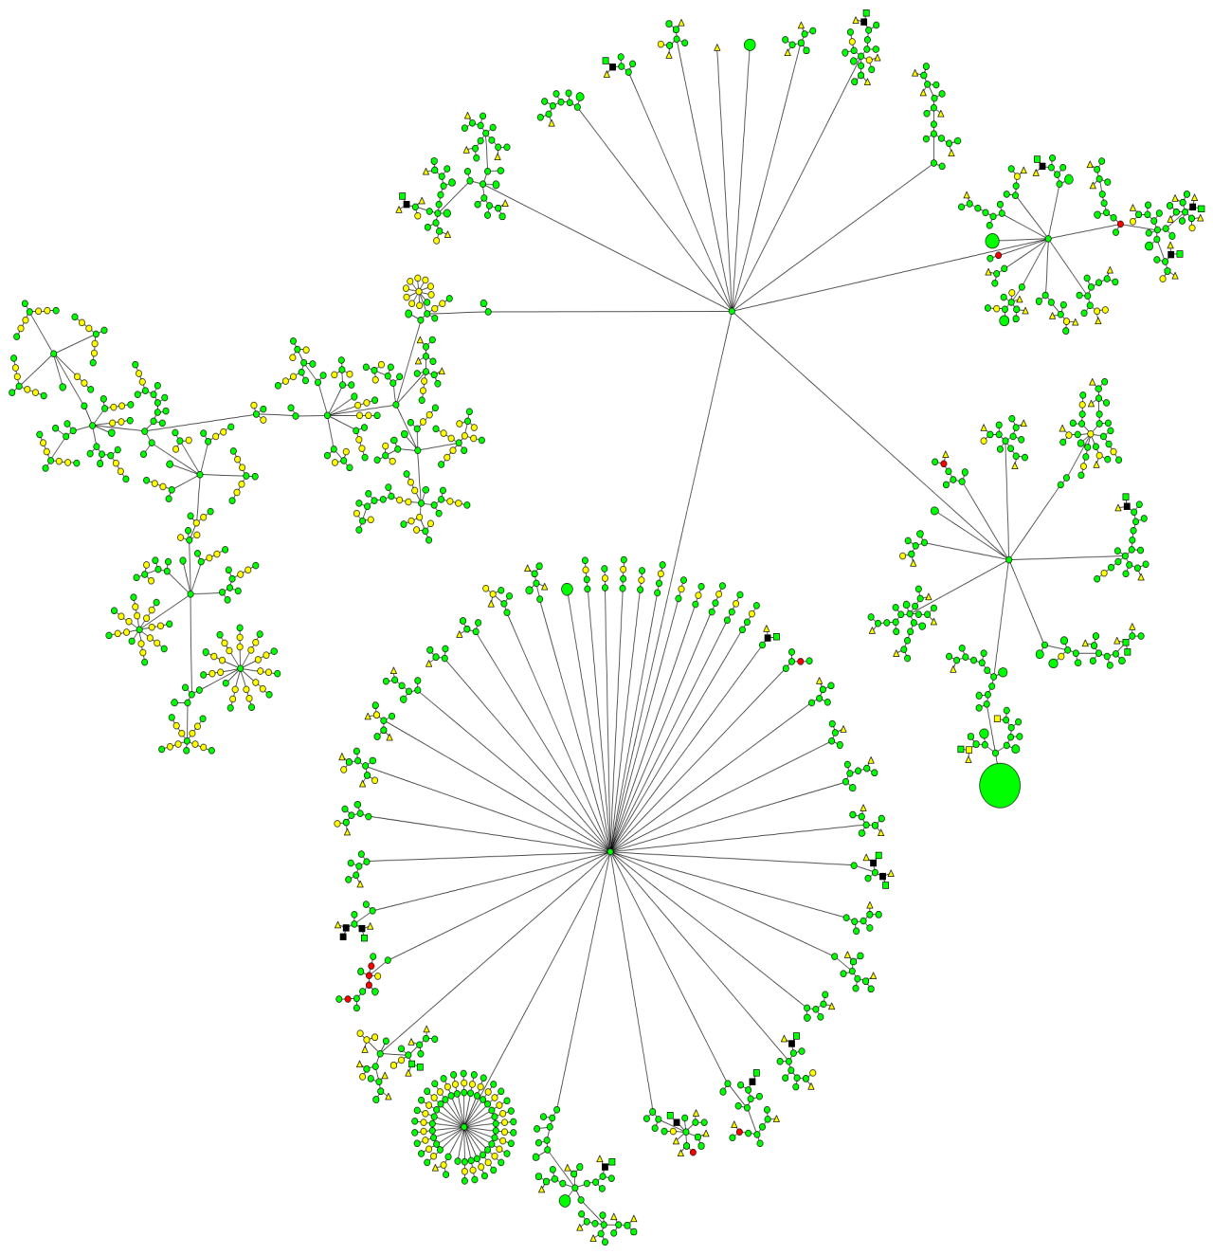
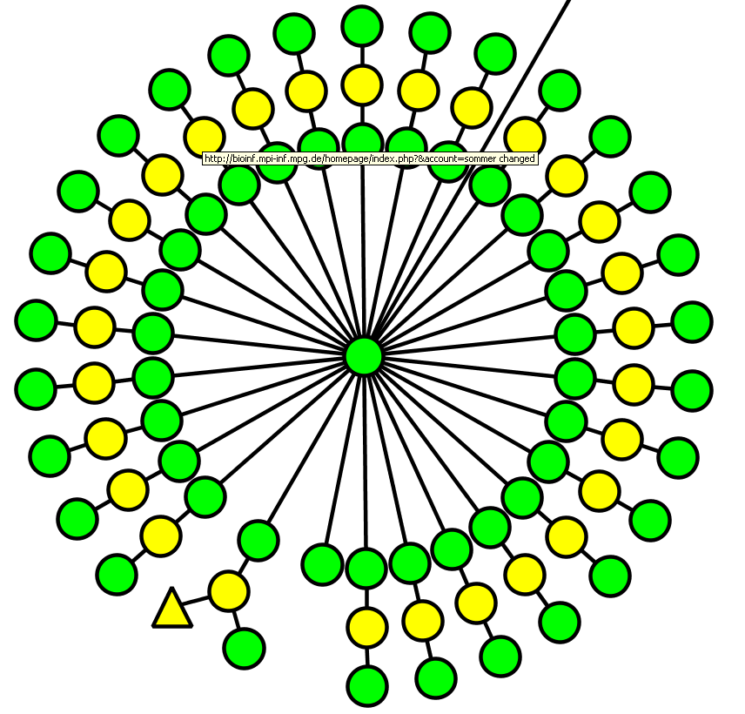
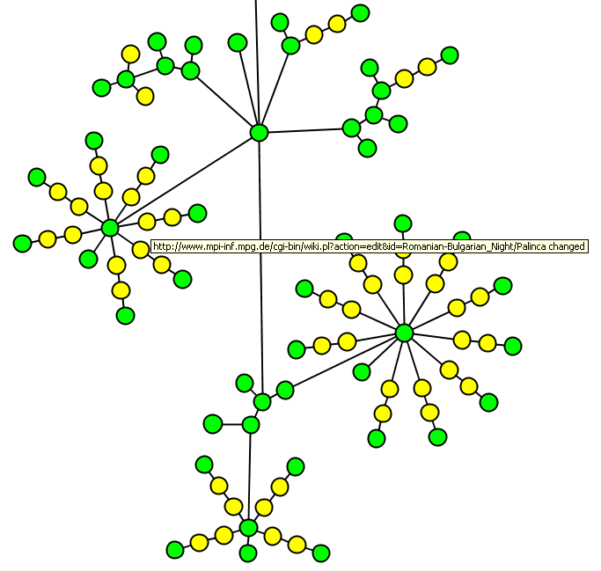
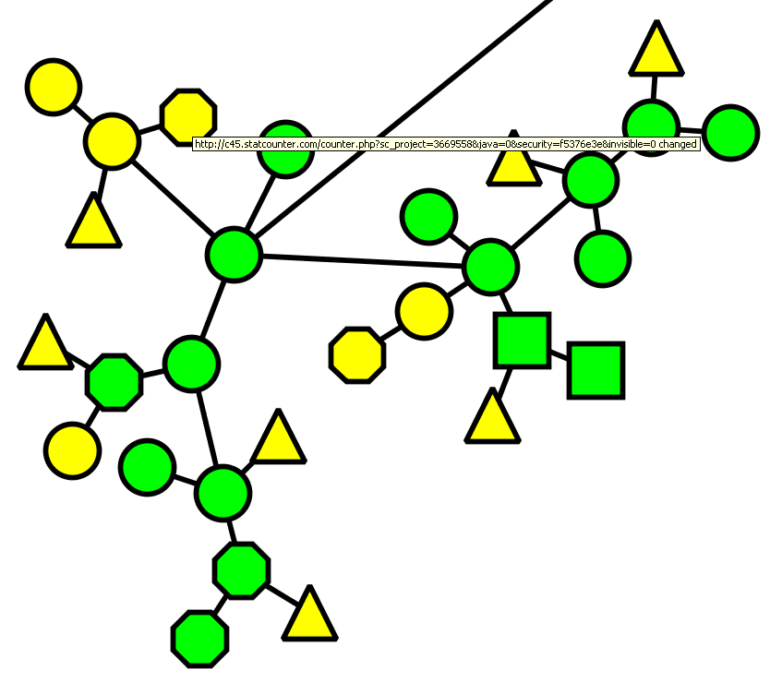
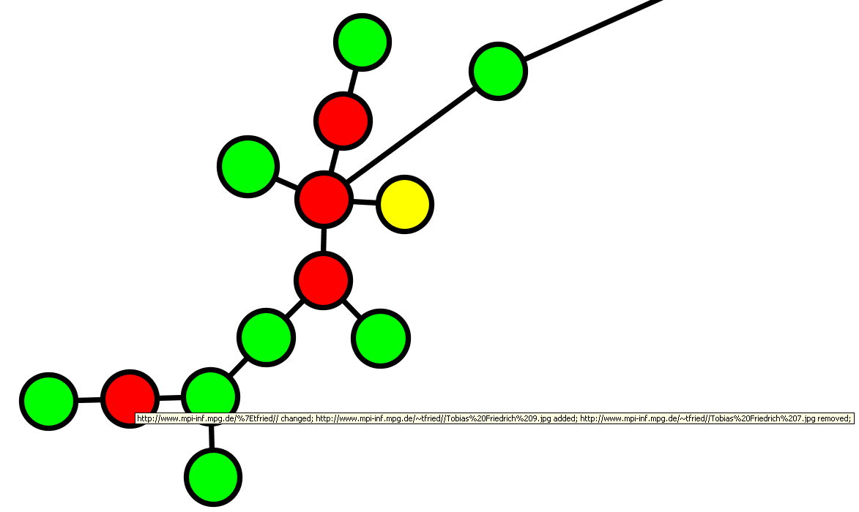
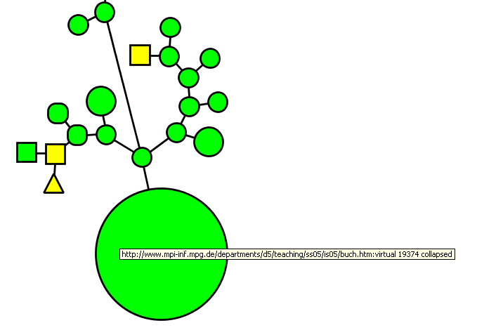
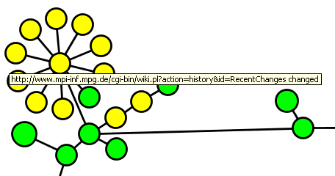
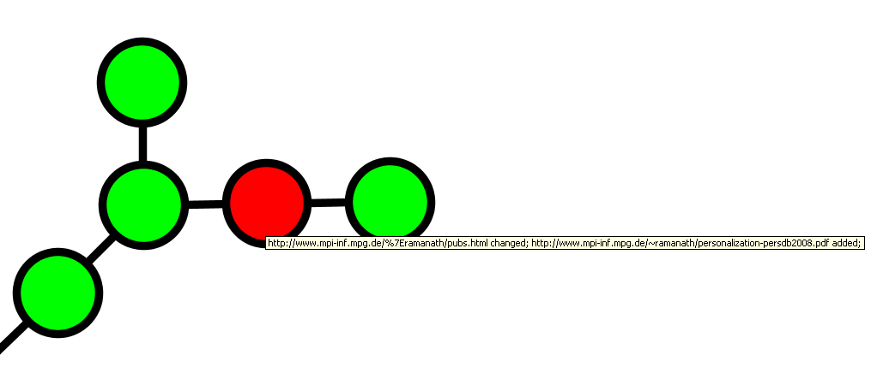
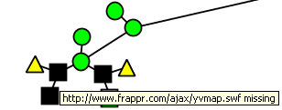
(In-)Coherence Visualization
Notes:
circle :: html hexagon :: image, video, audio triangle :: dns round rectangle :: javascript, flash, css, rdf square :: pdf, zip, ps other binary data (without multimedia)
---------------------------------------- green :: unchanged yellow :: content changed (text only) red :: link structure changed
black :: content missing at time of revisit

Slide 42
Outline
Challenges of temporally coherent Web archiving
Coherence framework
Single access strategies – best-effort coherence
“Double” access strategies – certified coherence
(In-)Coherence visualization
Conclusions
Challenges of temporally coherent Web archiving
Coherence framework
Single access strategies – best-effort coherence
“Double” access strategies – certified coherence
(In-)Coherence visualization
Conclusions

Slide 43
Conclusions
Temporal coherent Web archiving
Quantifies the amount of change occurred
Ensures complete and proper dating of contents
Captures Web sites as “authentic” as possible
Enables the creation of a high quality Web archive
Coherence analysis helps crawl engineers and archivists to
Identify critical (sub-)graphs
Adjust future crawls
Strategy
Frequency
Understand the nature of incoherence
⇒ Making sense of Web archive data

