Slide 1
Entity-level Temporal Web Analytics
–
Making Sense of Web Archive Data
Marc Spaniol
Summerschool “Network Analysis and Applications”
Luchon, France, June 30, 2014

Slide 2
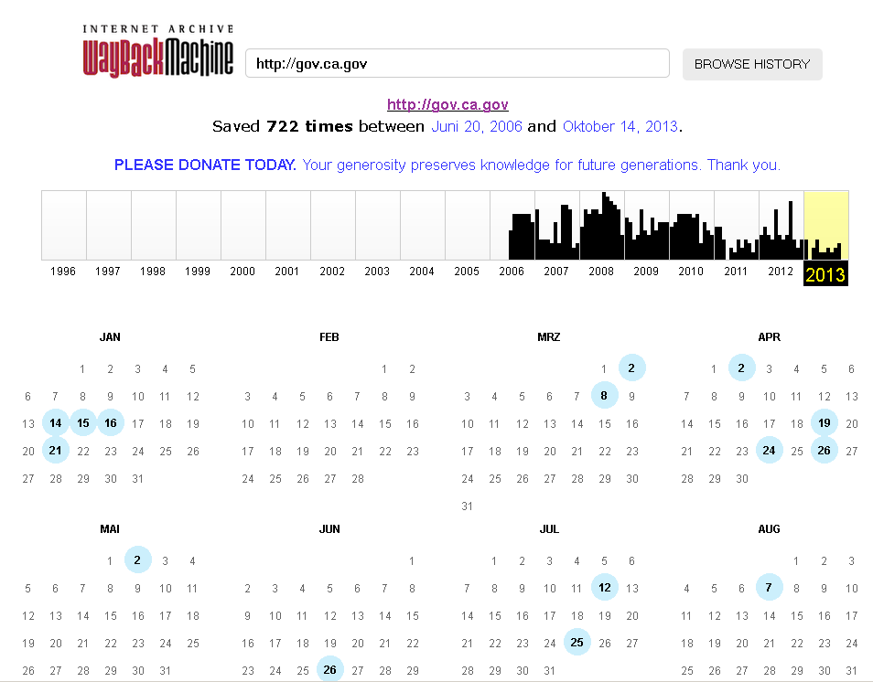
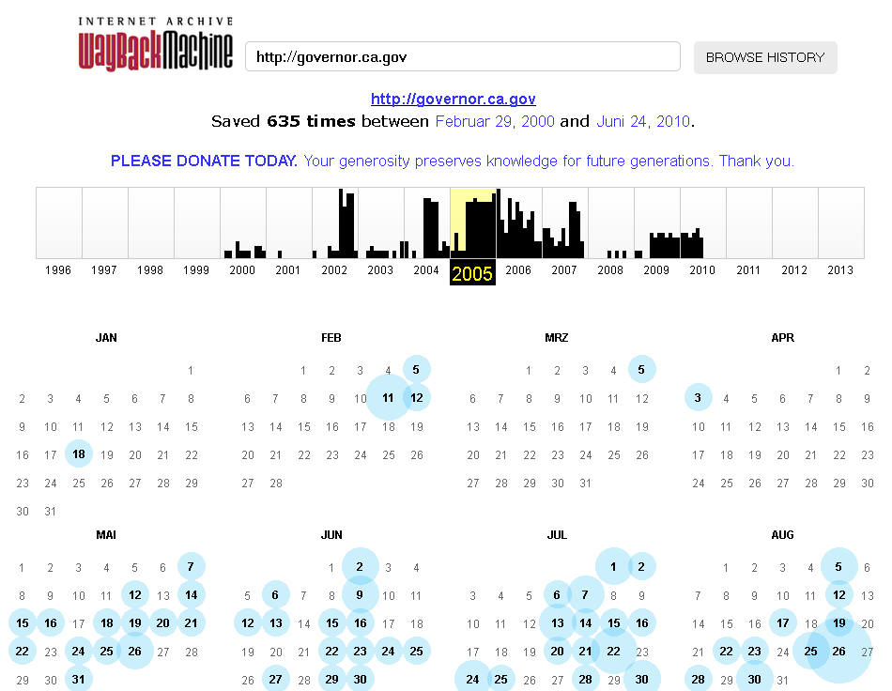
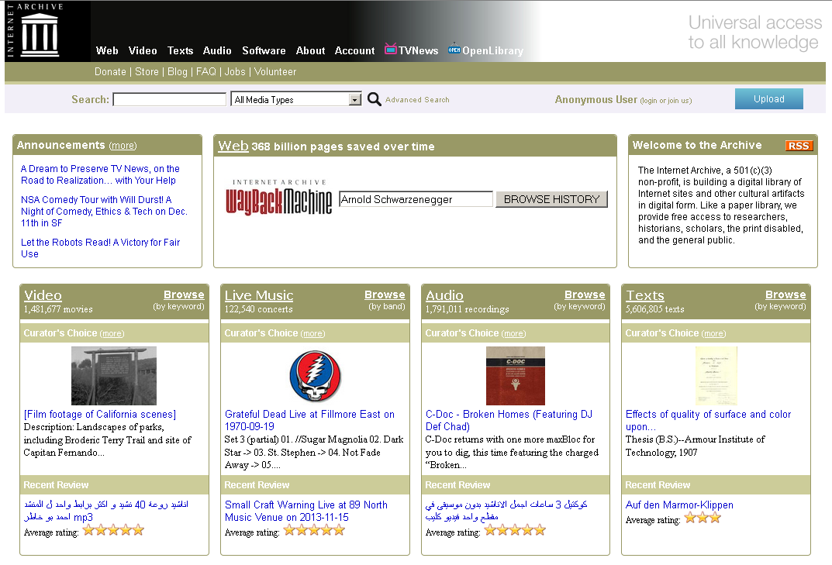
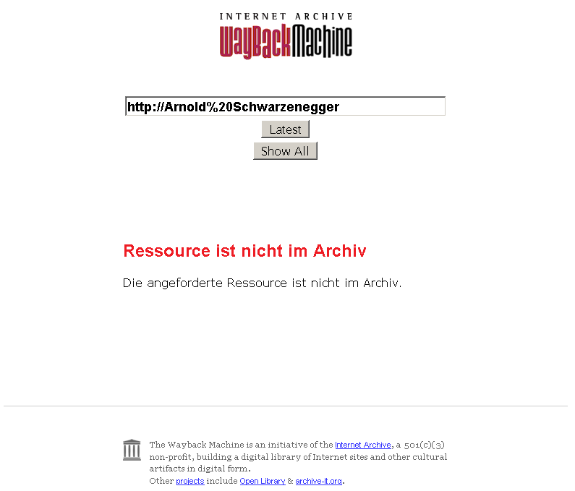

Motivation
governor.ca.gov [2000,2010]
gov.ca.gov [2006,now]

Slide 3

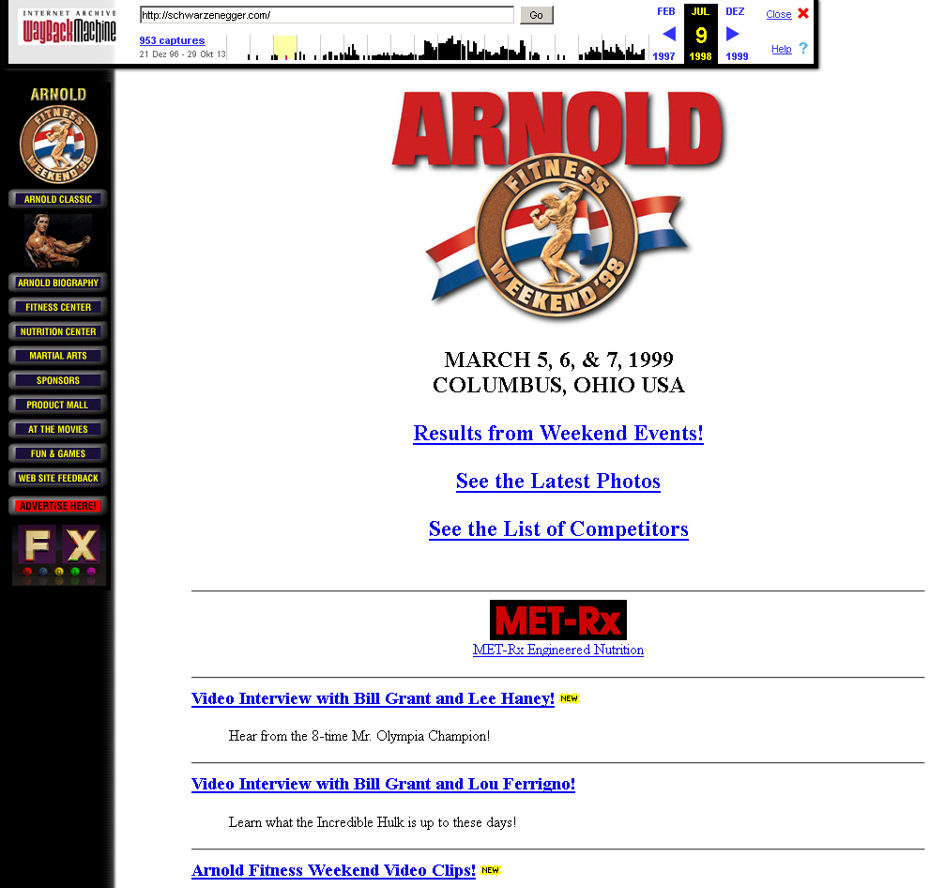
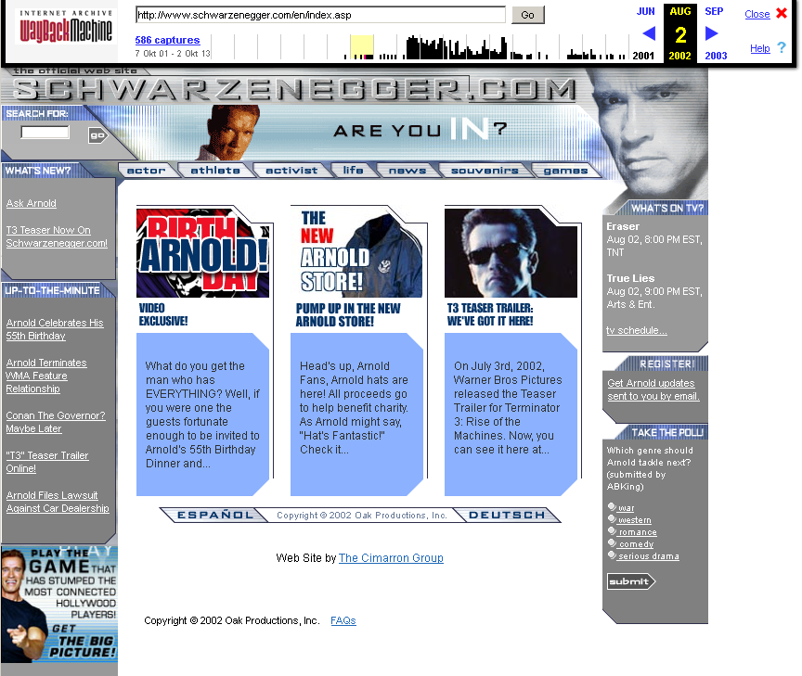
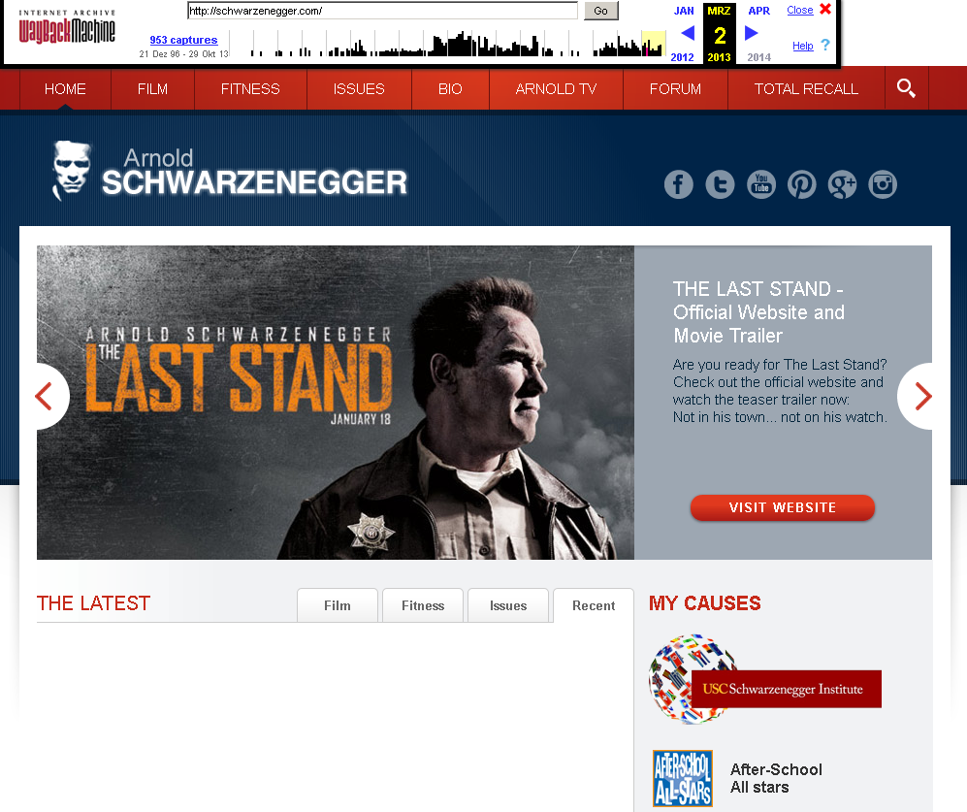

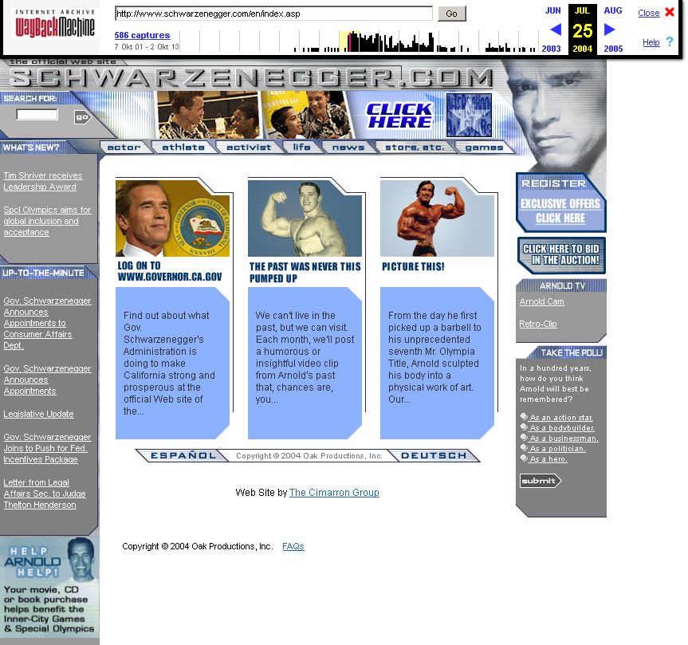

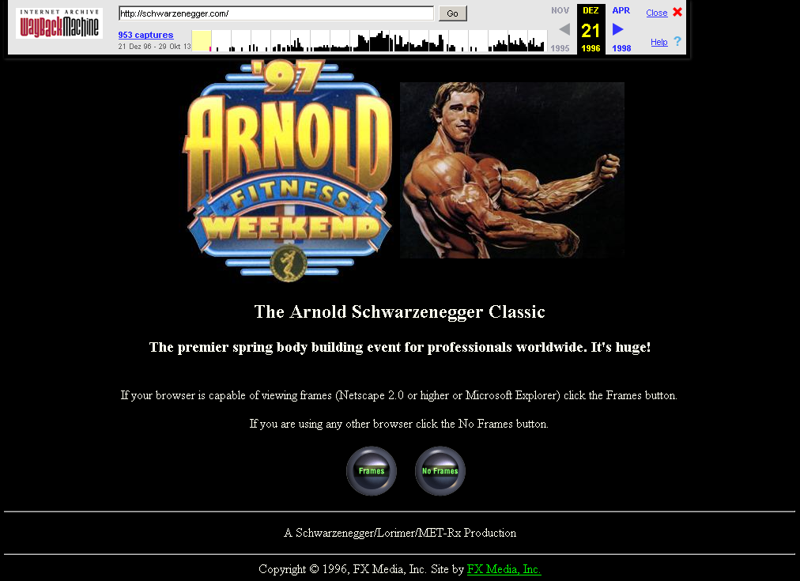

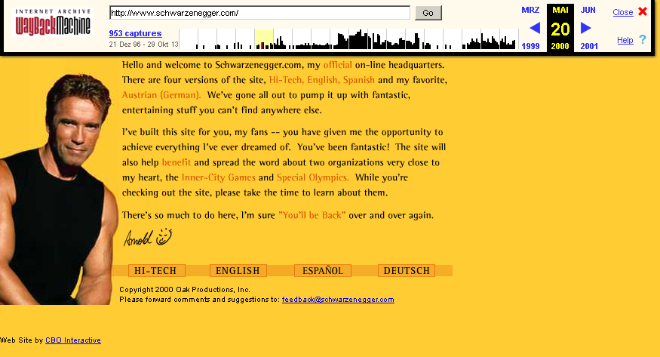
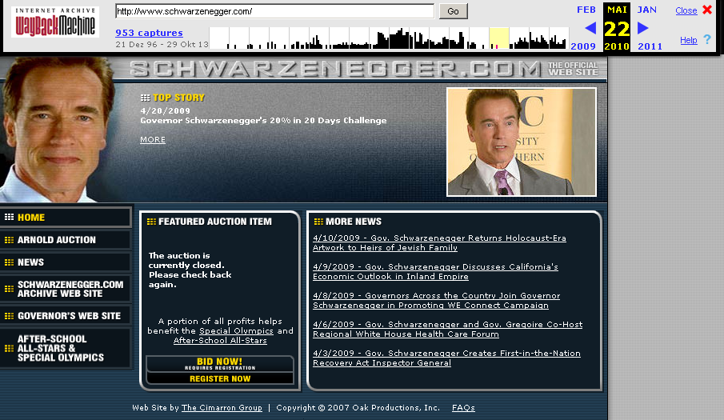
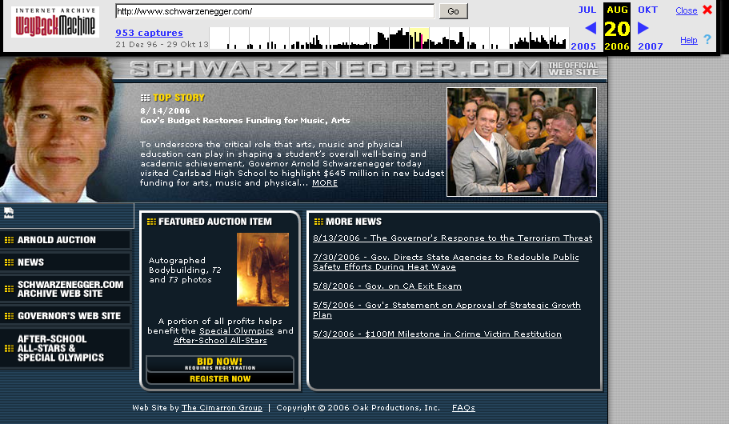
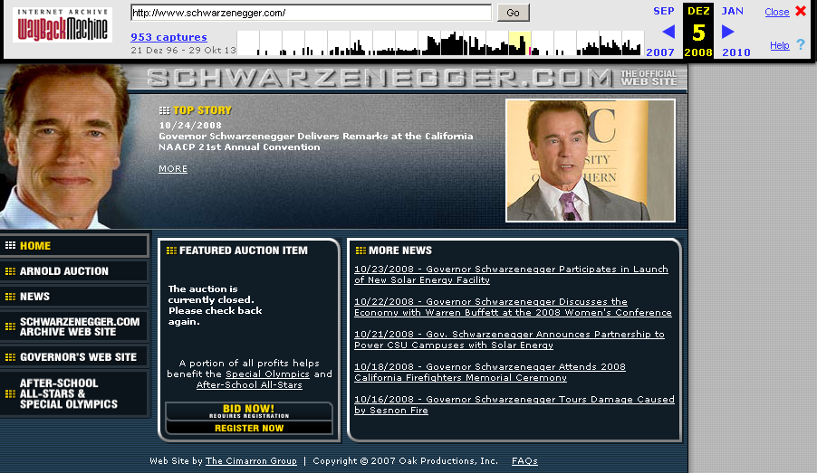
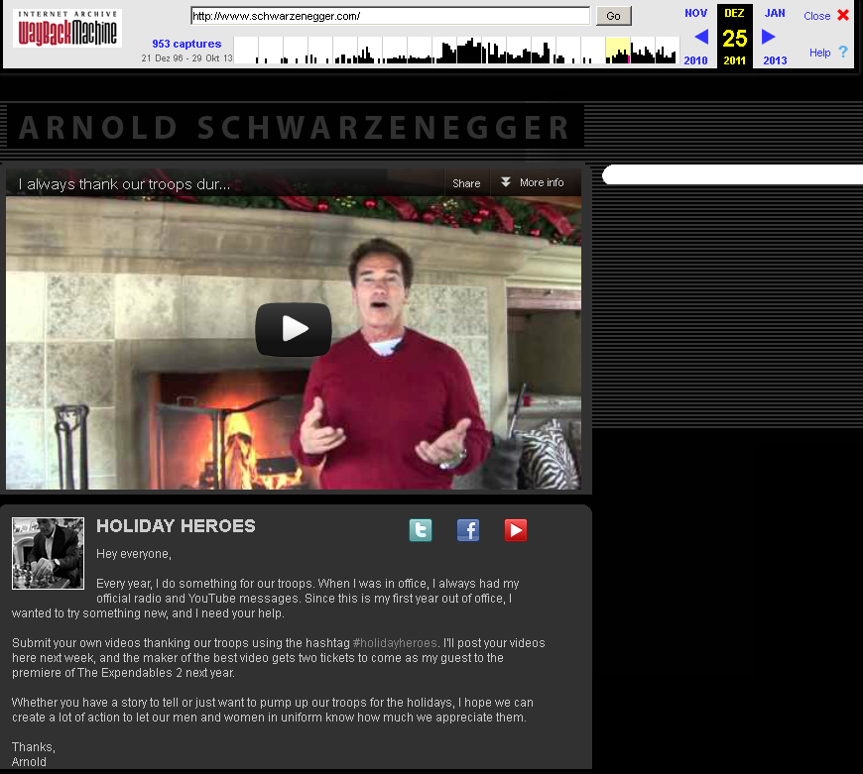
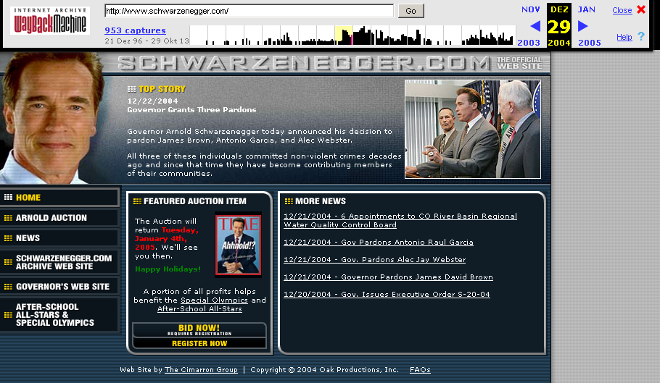
Motivation
h
1996
1998
General design pattern:
Identify entities of interest & their relationships
Position in time & space
Group and aggregate
Find insightful patterns & predict trends
2000
2020
???
2002
2004
2006
2008
now
2010
2011
2012
2013
Notes:
The constantly evolving Web reflects the evolution of the society in the cyberspace. Projects like the Open Directory Project can be understood as a collective memory of society on the Web. It represents the topical knowledge in a structured way in form of taxonomy.
Several types of changes can be performed in the taxonomy (category merge/addition/removing).
New concepts first appear in sources external to any classification systems – blogs, news and other social media.
Picture.
We hypothesize, that any concept emerging in news has first to reach a certain cognition level to become a part of taxonomy.

Slide 4
Outline
Challenges and “state-of-the-art”
Entity-level temporal Web analytics
  Named entity disambiguation
  Temporal fact extraction
  Entity type classification
  Emerging concept identification
  Knowledge linking
  Reference architecture
Conclusions
Challenges and “state-of-the-art”
Entity-level temporal Web analytics
  Named entity disambiguation
  Temporal fact extraction
  Entity type classification
  Emerging concept identification
  Knowledge linking
  Reference architecture
Conclusions

Slide 5

Challenges
Web archive data
Entity analytics over time
Two decades of Web data
Comprehensive coverage
URL-based retrieval
Missing text/entity indexes
No aggregation tools
...
Exemplary task:
“Analyze Android market share”
→ Identify product names
→ Extract types
→ Cluster by product
→ Count and aggregate
...
EU project [2010-2013]
Max-Planck-Institut für Informatik
Internet Memory Foundation
(European sibling of archive.org)
+ 4 other partners

Slide 6
Challenges in Web Archive Data:
Wikipedia vs. Web
 | Wikipedia | Web
Single version | > 4.1 million articles (en) > 1.5 million articles (de) > 14 million (in total) | > 1.3 billion pages (indexed Web only)
Revision history (monthly granularity) | ~ 30 million articles (en) 160 versions (since 2001) | > 350 billion Web pages (since 1996)
Entities | > 3 million (en) | ???
Indexed terms | ~ 500 million | ???
Hbase footprint | few TBs | ???

Slide 7
State-of-the-Art
Big Web archive data
> 10 PB at Internet Archive (archive.org)
~ 250 TB growth per year
> 350 billion Web pages
up to 100 versions per page, per year
> 25*10¹⁵ (500-1000 terms per page)

Slide 8
State-of-the-Art
ARC/WARC Files
  ARC/WARC files (Web ARChive) ~ 500 MB – 1 GB each
  “ZIP files” of content(s) and some metadata
Web Archives Grid
  Many “connected” servers
  WARC files spread among several servers
  Indexing of WARC files for access by URL and date

Slide 9
Outline
Challenges and “state-of-the-art”
Entity-level temporal Web analytics
  Named entity disambiguation
  Temporal fact extraction
  Entity type classification
  Emerging concept identification
  Knowledge linking
  Reference architecture
Conclusions
Challenges and “state-of-the-art”
Entity-level temporal Web analytics
  Named entity disambiguation
  Temporal fact extraction
  Entity type classification
  Emerging concept identification
  Knowledge linking
  Reference architecture
Conclusions
Challenges and “state-of-the-art”
Entity-level temporal Web analytics
  Named entity disambiguation
  Temporal fact extraction
  Entity type classification
  Emerging concept identification
  Knowledge linking
  Reference architecture
Conclusions

Slide 10




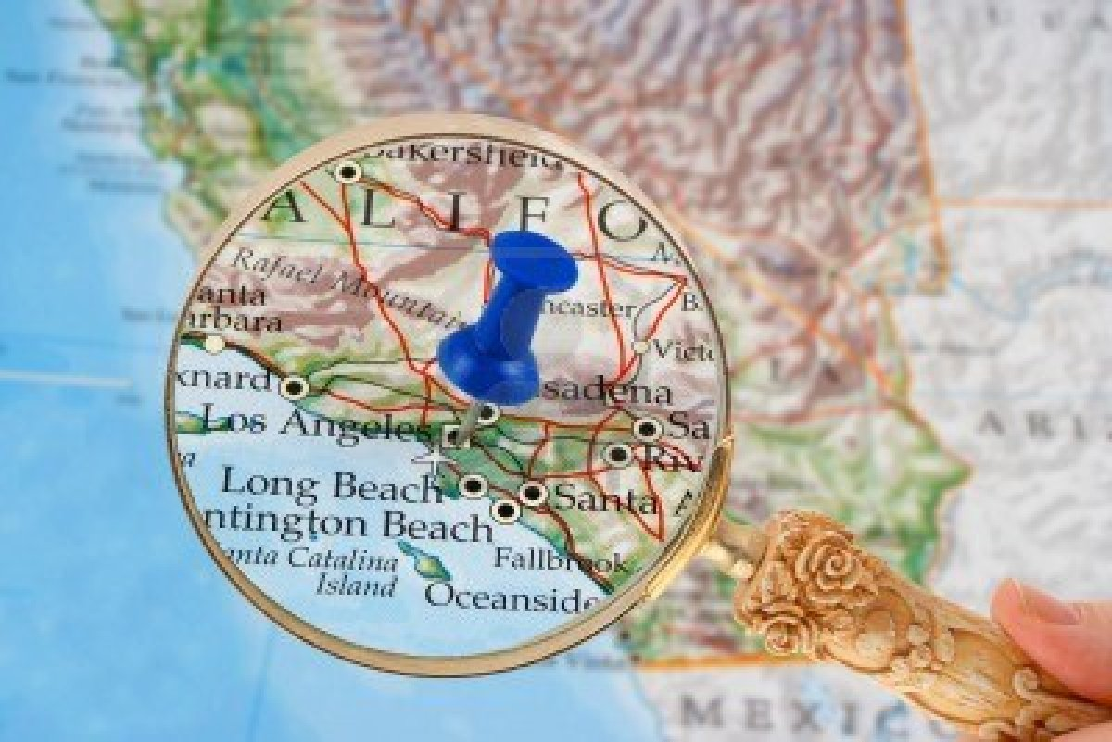
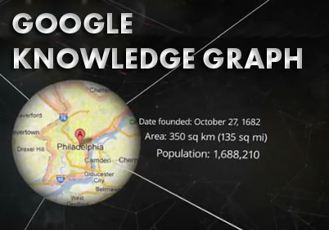


Named Entity Disambiguation
  “Which places did a politician visit during an election campaign?”
Arnold Schwarzenegger
Arnie
The Californian governor
Governator
Action Hero
Former Mister Universe
...
Los Angeles
LA
The city of angels
Hollywood
Walk of fame
Orange county
...
...
Map to knowledge base
Cast into unified representation

Slide 11

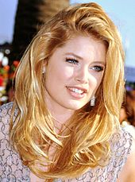
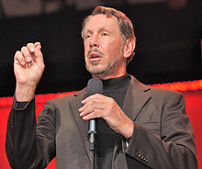




Entity Disambiguation by Example
Neelie
Kroes
Doutzen
Kroes
Larry
Ellison
Jennifer Ellison
Kroes attacked Ellison about the Sun deal threatening open source software and competition.
Hoffart et al. [EMNLP2011]
Yosef et al. [VLDB 2011]
The Sun (UK)
Sun Microsystems
Sun Myung Moon

Slide 12

Features for Disambiguation
Wallace and Gromit
Prior
Similarity
Coherence
The Guardian
The Independent
…
Keyphrases
58%
0.2
Harlan Ellison
Kroes attacked Ellison about the Sun deal threatening open source software and competition.
Larry Ellison
Neelie Kroes
Larry Ellison
14%
7.1
Open Source
Keyphrases
European Union Microsoft
competition case
Computer software
Oracle software
...
How good do entity keyphrases and context tokens overlap?
How often did “Sun” link to this entity in Wikipedia?
Are the disambiguated entities related?

Slide 13

Graph-based Joint Disambiguation
Text with proper nouns
Candidate
Entities
Coherence based
on inlink overlap
Prior
Probability
Keyphrase
based similarity
YAGO
(with additional data)
Notes:
Introduce problem as joint inference
Cast as graph problem

Slide 14
Graph Algorithm
Entity Candidates
Mentions of Entities
Objective: Maximize the minimum weighted degree
Constraint: Keep at least one entity per mention
Notes:
Introduce problem as joint inference
Cast as graph problem

Slide 15
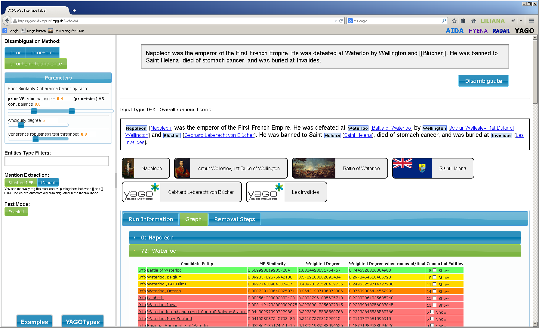
AIDA https://gate.d5.mpi-inf.mpg.de/webaida/

Slide 16
Outline
Challenges and “state-of-the-art”
Entity-level temporal Web analytics
  Named entity disambiguation
  Temporal fact extraction
  Entity type classification
  Emerging concept identification
  Knowledge linking
  Reference architecture
Conclusions
Challenges and “state-of-the-art”
Entity-level temporal Web analytics
  Named entity disambiguation
  Temporal fact extraction
  Entity type classification
  Emerging concept identification
  Knowledge linking
  Reference architecture
Conclusions

Slide 17
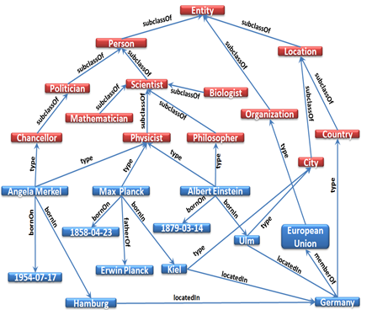
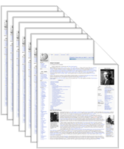
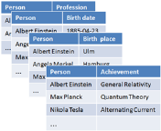
The YAGO Knowledge Base
Knowledge harvesting from Web sources
1.9 Mio. entities, 19 Mio. facts
F. M. Suchanek et al. [WWW 2007]
J. Hoffart et al. [WWW 2011]
Knowledge graph

Slide 18
Temporal Fact Extraction
Corpus +
Relations of Interest
Candidate Gathering
Fact
Candidates
Candidate
Sentences
Pos./Neg.
Seed Facts
Pattern Analysis
Patterns with weights
Graph Construction
Graph
Label Propagation
Wang et al. [WWW 2011]
Wang et al. [CIKM 2011]
Wang et al. [ACL 2012]
Wang et al. [CIKM 2012]
Base & Temporal Facts

Slide 19
Candidate Gathering
David and Victoria were married in Ireland.
…
Beckham planned to join Real in 2002.
Beckham finally moved to Real in 2003.
Ronaldo moved to Real in 2002.
worksForClub(PERSON,CLUB)
YAGO
Victoria_Beckham: person
David_Beckham: person
Real_Madrid_C.F.: club
Ronaldo: person
David Beckham: PERSON
Victoria Beckham: PERSON
Ronaldo: PERSON
Real Madrid C.F.: CLUB
David Beckham planned to join Real Madrid C.F. in 2002.
David Beckham finally moved to Real Madrid C.F. in 2003.
Ronaldo moved to Real Madrid C.F. in 2002.
Candidate sentences
(David_Beckham, Real_Madrid_C.F.)@2003
(Ronaldo, Real_Madrid_C.F.)@2002
(David_Beckham, Real_Madrid_C.F.)@2002
Temporal fact candidates
(David_Beckham, Real_Madrid_C.F.)
(Ronaldo, Real_Madrid_C.F.)
Base fact candidates

Slide 20
Pattern Representation
David Beckham finally moved from Real Madrid C.F. before his recent joining LA Galaxy in 2007
Surface string
TypeE1: PERSON
finally moved from Real Madrid C.F. before his recent joining
TypeE2: CLUB
Keep only verbs, nouns & preposition
Compressed surface string
move from Real Madrid C.F. before join
  Replace entity mentions
  by their types
Compressed lifted surface string
move from CLUB before join
  Trigram as an example
n-gram based compressed lifted
surface string
{“move from CLUB”, “from CLUB before”, “CLUB before join”}
  Fact pattern representation
(TypeE1, TypeE2, n-gram pattern)
PERSON, CLUB, {“move from CLUB”, “from CLUB before”, “CLUB before join”}
{PERSON, CLUB, n-gram pattern}, weight
Notes:
Too many

Slide 21
Graph Based Semi-supervised Learning
David_Beckham’s new contract with Real_Madrid starts from 2003.
David_Beckham finally moved to Real_Madrid in 2003.
David_Beckham finally moved to Spain in 2003.
Ronaldo’s last minute move to Real Madrid is the best transfer in 2002.
(PERSON, CLUB), {contract with}
V_{P1}
0.7
V_{F1}
(David_Beckham, Real_Madrid)@2003
(PERSON, CLUB),
{move to}
0.9
V_{P2}
V_{F2}
(David_Beckham, Spain)@2003
0.3
(PERSON, LOCATION), {move to}
V_{P3}
0.67
V_{F3}
(Ronaldo, Real_Madrid)@2002
0.6
(PERSON, CLUB),
{minute move, move to}
The more frequent the fact node co-occurred with the pattern node, the greater the weight is.
V_{P4}
V_{P2} = {“move to”:1}
V_{P4} = {“minute move”:1, “move to”:2}
Jaccard = {“move to”}/{”minute move”, “move to”}
= 2/3 = 0.67

Slide 22
Iterative Label Propagation by
Minimizing the Objective Function
Seed label loss
Loss across an edge
Regularization
Inclusion constraints between different labels
Loss between base and temporal pattern nodes

Slide 23
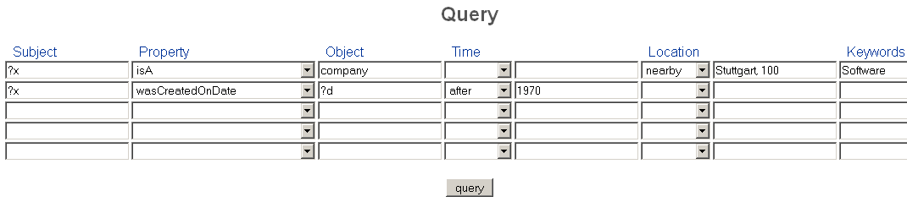
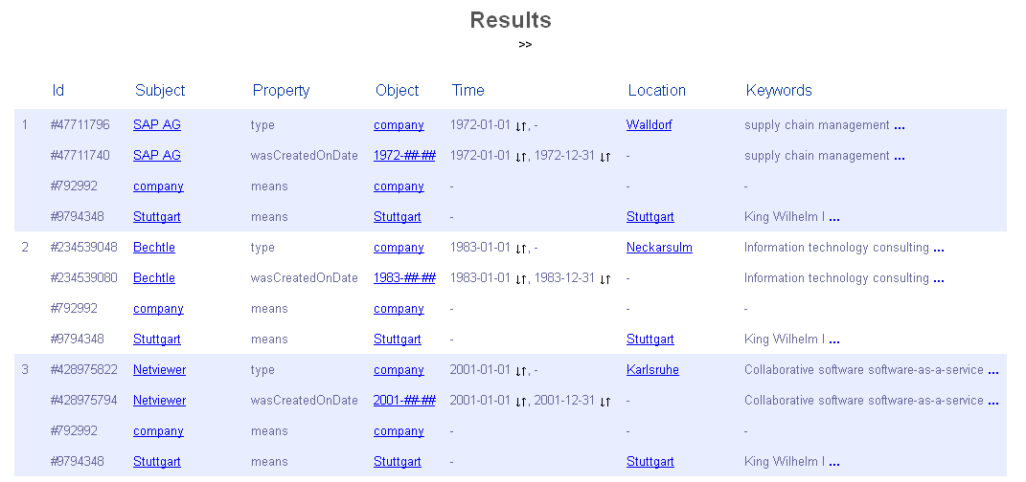
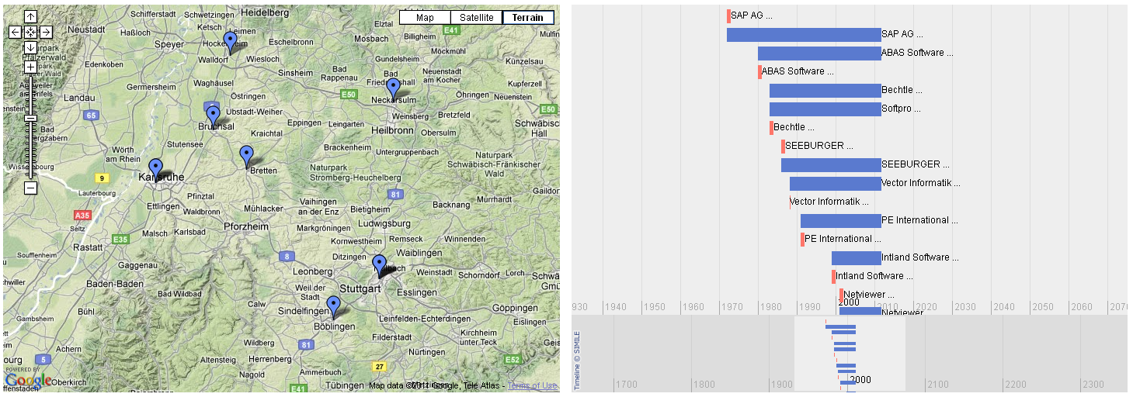
Temporal Entity Analytics by Example

Slide 24
Outline
Challenges and “state-of-the-art”
Entity-level temporal Web analytics
  Named entity disambiguation
  Temporal fact extraction
  Entity type classification
  Emerging concept identification
  Knowledge linking
  Reference architecture
Conclusions
Challenges and “state-of-the-art”
Entity-level temporal Web analytics
  Named entity disambiguation
  Temporal fact extraction
  Entity type classification
  Emerging concept identification
  Knowledge linking
  Reference architecture
Conclusions

Slide 25


HYENA
Hierarchical tYpe classification for Entity NAmes
“Funded with 100,000$, Google was founded by Brin and Page”
“Page played on his first guitar in 1952.”
Business_people
Entrepreneur
Entertainer
Musician
Yosef et al. [Coling 2012]

Slide 26
Basic Idea
Benefits of entity type classification
  Disambiguation support (in the scope of AIDA)
    Enable early pruning in disambiguation [Speed]
    Incorporating types for disambiguation [Precision]
  Classification of “unknown” or “emerging” entities
Conceptual approach
  Detection of entity types for (unknown) entities
  Fine-grained annotations based on the YAGO type hierarchy
  Exploitation of Wikipedia for training
  Meta-classification for subsequent “clean-up”

Slide 27
Hierarchical Type System
Derived from the YAGO knowledge base
5 top-level types + 5*100 prominent subtypes in WordNet
Prominence measured by population size in YAGO
Entity
Person
Location
Organization
Event
Artifact
Scientist
Leader
Entertainer
Creator
Act
Happening
Incident
Trouble
Spiritual leader
Politician
Trainer
Producer
Artist
Musician
Painter
Legislator
Mayor

Slide 28
Multi-Label Hierarchical Meta-Classification
Hierarchical classification
  Type-specific binary classifiers
  Top-down classification
  Training data from Wikipedia + YAGO
  Negative instances are type sibling instances
  “Others” nodes for each non-leaf node
  Only accepted types are propagated to all children classifiers
  SVM liblinear software
Meta-classification
  Trades off recall for improved precision
  Input: per-type scores of classifier for each mention
  Output: per-type choice of #sub-types for the mention

Slide 29
Classification by Example
Train each type against siblings and “OTHER”
Train a meta-classifier for higher precision
Prediction of types from top to down per instance
Select the n highest-ranked sub-types based on the meta-classifier’s output
L2 #2
Inst. 3: 0.827, 0.404, ...
Inst. 2: 0.684, ...
...
L1 #1
Inst.1: 0.621, 0.234, ...
Inst. 3: 0.184, ...
...
L0 #1
Inst. 2: 0.892, 0.772, ...
Inst. 1: 0.043, ...
...

Slide 30
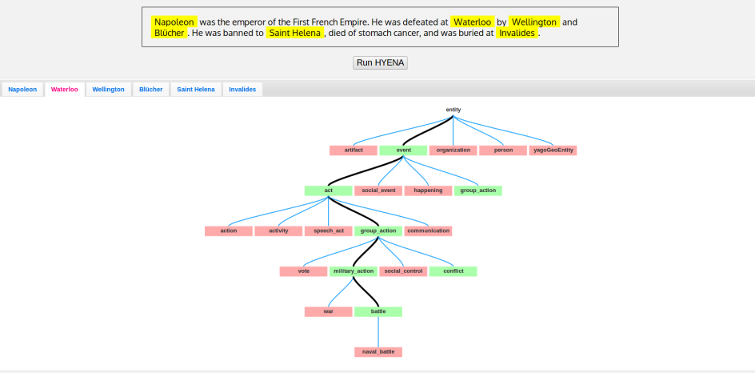
HYENA-live https://d5gate.ag5.mpi-sb.mpg.de/webhyena/
Yosef et al. [ACL 2013]

Slide 31
Outline
Challenges and “state-of-the-art”
Entity-level temporal Web analytics
  Named entity disambiguation
  Temporal fact extraction
  Entity type classification
  Emerging concept identification
  Knowledge linking
  Reference architecture
Conclusions
Challenges and “state-of-the-art”
Entity-level temporal Web analytics
  Named entity disambiguation
  Temporal fact extraction
  Entity type classification
  Emerging concept identification
  Knowledge linking
  Reference architecture
Conclusions

Slide 32
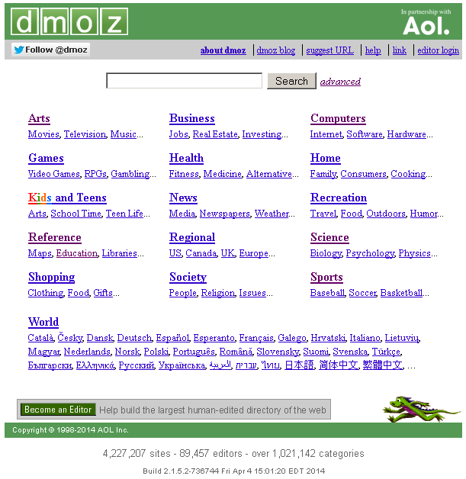
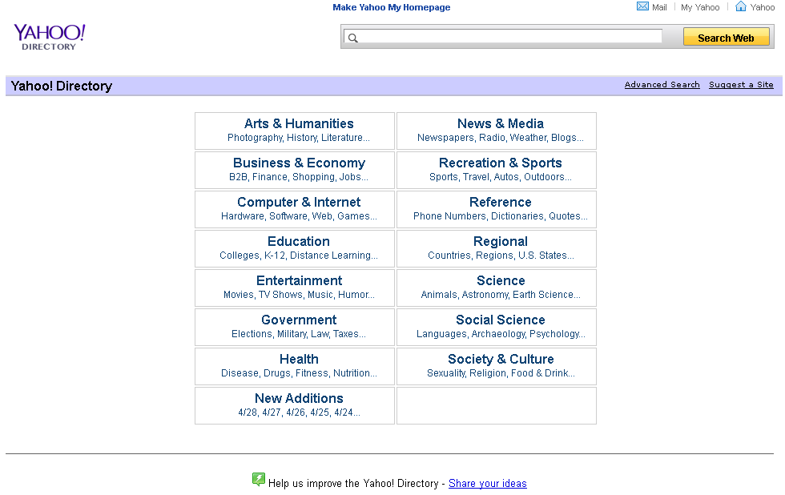
  Emerging Concept Identification
Web catalogues – collective memories of society
Human-edited directories of the Web
Promiment examples
  Yahoo! Directory
  DMOZ (Directory Mozilla)
Prytkova et al. [WebDB 2012]

Slide 33


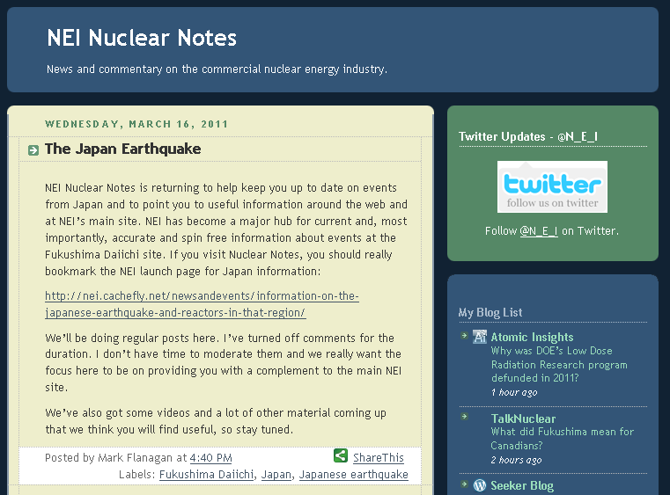


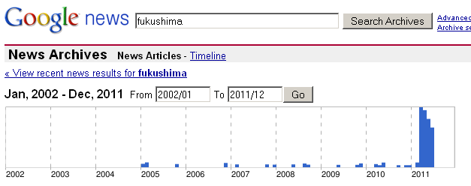
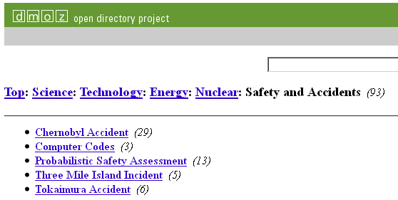

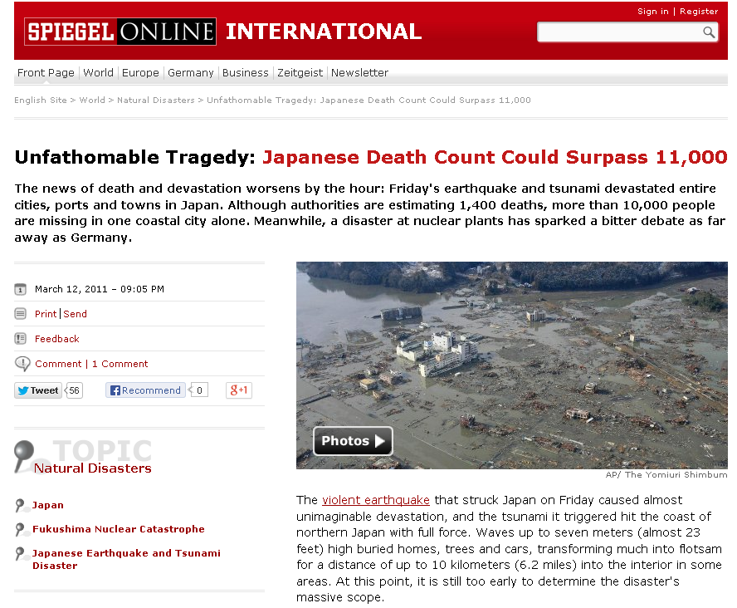
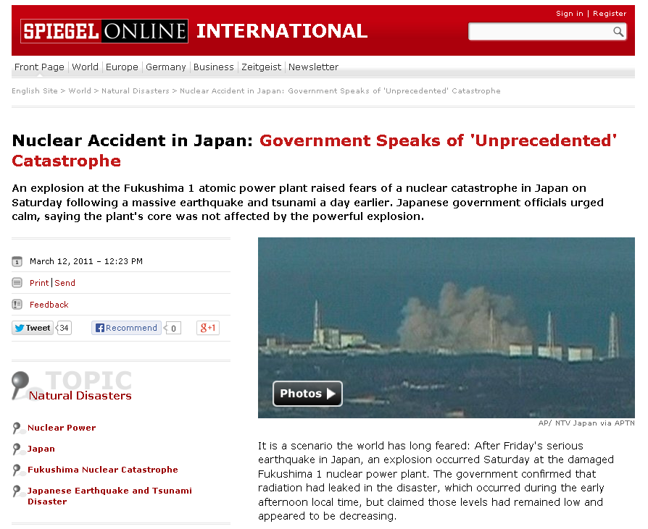
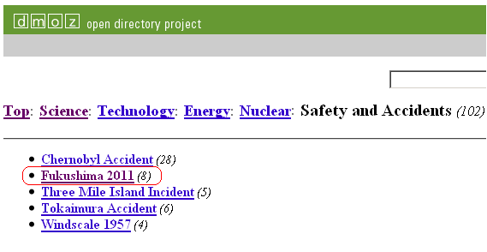
Collective Perception of an Event
Fukushima Tsunami Plant
06.08.2010
27.06.2011
PIWO
(Predicting evolution In
Web catalOgues)

Slide 34
Research Hypothesis
Co-evolution between Web contents and categories
Collective memories on the Web reflect real world discourses
Media coverage precedes the taxonomy evolution
Goal:
Predicting evolution in collective Web catalogues (e.g. Yahoo! or open directory project DMOZ)
Concept mining from news articles
Taxonomy change prediction

Slide 35
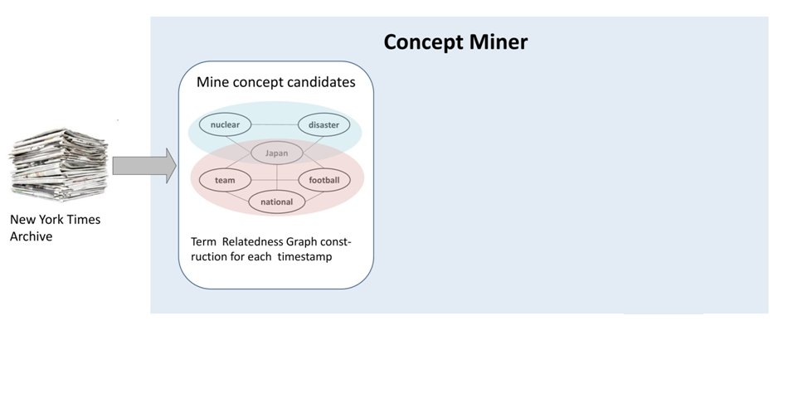
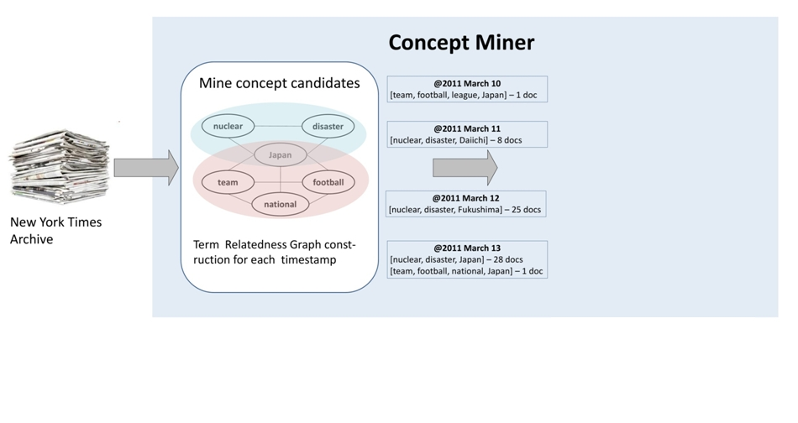
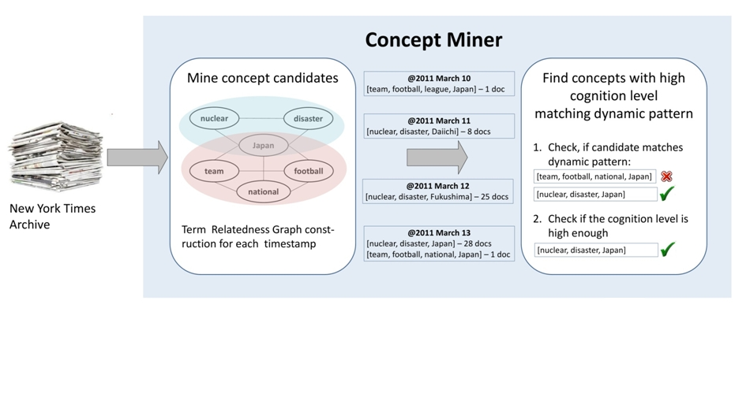
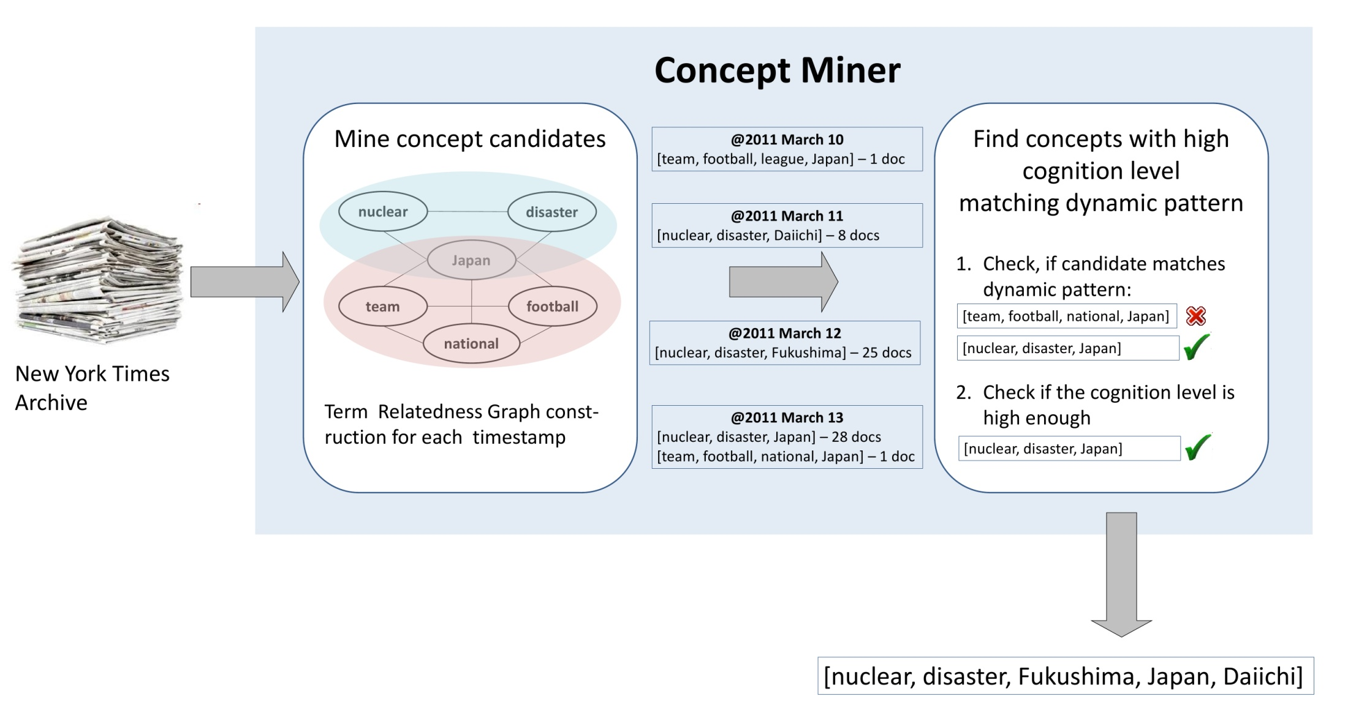
From “Noise” to Categories
Gather concept candidates
Identify “stable” candidates
Evaluate relevance over time
Distributed concept mining

Slide 36
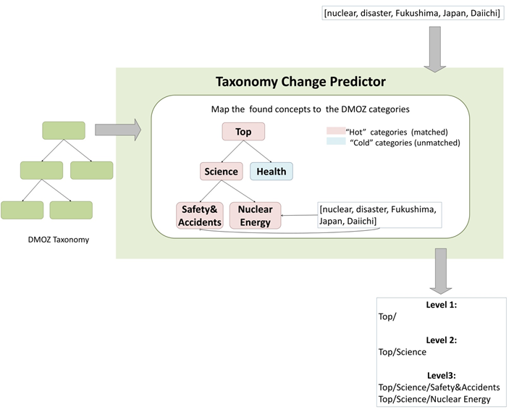
Emerging and Evolving Concepts in Taxonomies
Use-cases
Concept-based prediction
  “Concept identification”
  Concepts mined from news must appear in DMOZ
Topic-based prediction
  “Taxonomy maintenance”
  Identification of “hot” categories that will change

Slide 37
Outline
Challenges and “state-of-the-art”
Entity-level temporal Web analytics
  Named entity disambiguation
  Temporal fact extraction
  Entity type classification
  Emerging concept identification
  Knowledge linking
  Reference architecture
Conclusions
Challenges and “state-of-the-art”
Entity-level temporal Web analytics
  Named entity disambiguation
  Temporal fact extraction
  Entity type classification
  Emerging concept identification
  Knowledge linking
  Reference architecture
Conclusions

Slide 38
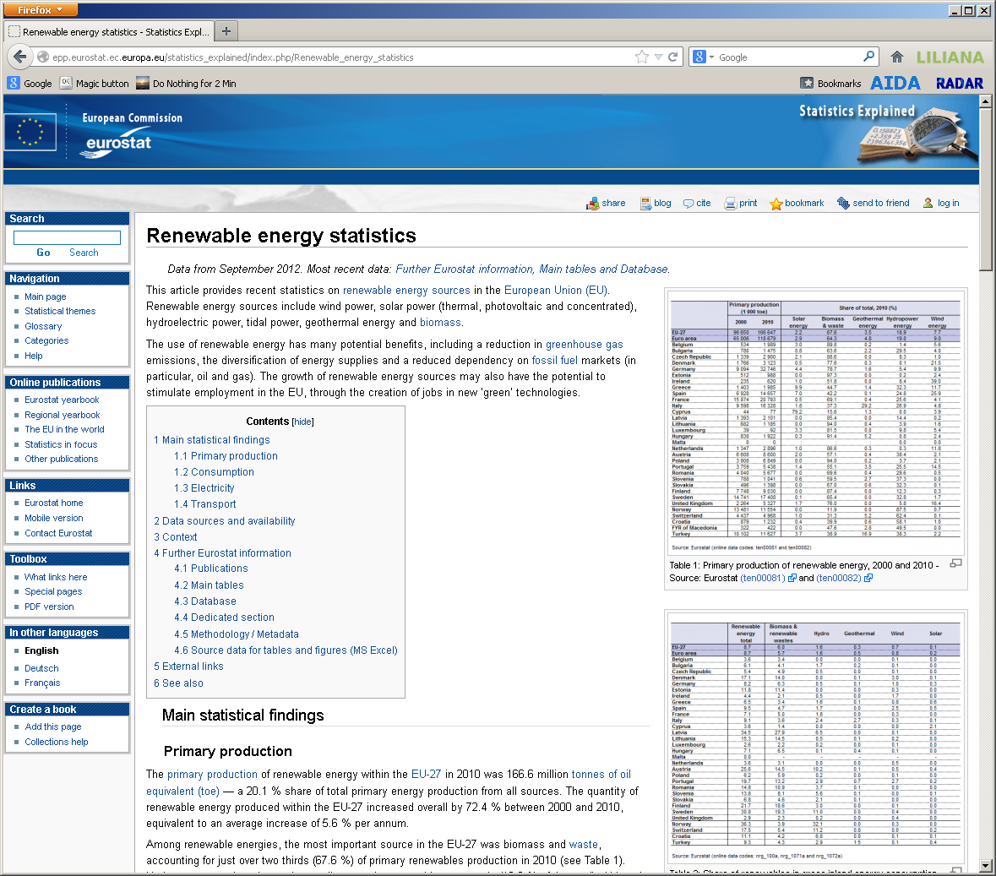

Challenge: Information in Context
Understanding Web data is hard without context
Exploiting Wikis and portals for background information
Linking contents to knowledge
Spaniol et al. [WSC 2013]

Slide 39


Conceptual approach
LILIANA
The recent solar boom means the alternative form of energy now reaches 8 million homes in Germany, a 45 percent increase compared to 2011, the German Solar Industry Association (BSW) said yesterday.
1
Rank
1
2
3
Score
0.9
0.7
0.5
3
2
Knowledge base alignment
Entity disambiguation
Semantic ranking

Slide 40

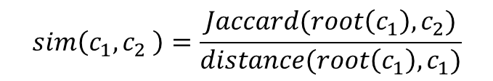
Knowledge Base Alignment
3 million entities
350.000 types
20.000 articles
40 categories
Sim > θ
Mapping from eurostat type onto YAGO sub-hierarchy
Similarity computation for the remaining categories:
⇒ More than 1 million type / category pairs
$$sim\left(c_{1},c_{2} \right)=\frac{Jaccard(root\left(c_{1}\right), c_{2})}{distance(root\left(c_{1}\right), c_{1})}$$

Slide 41
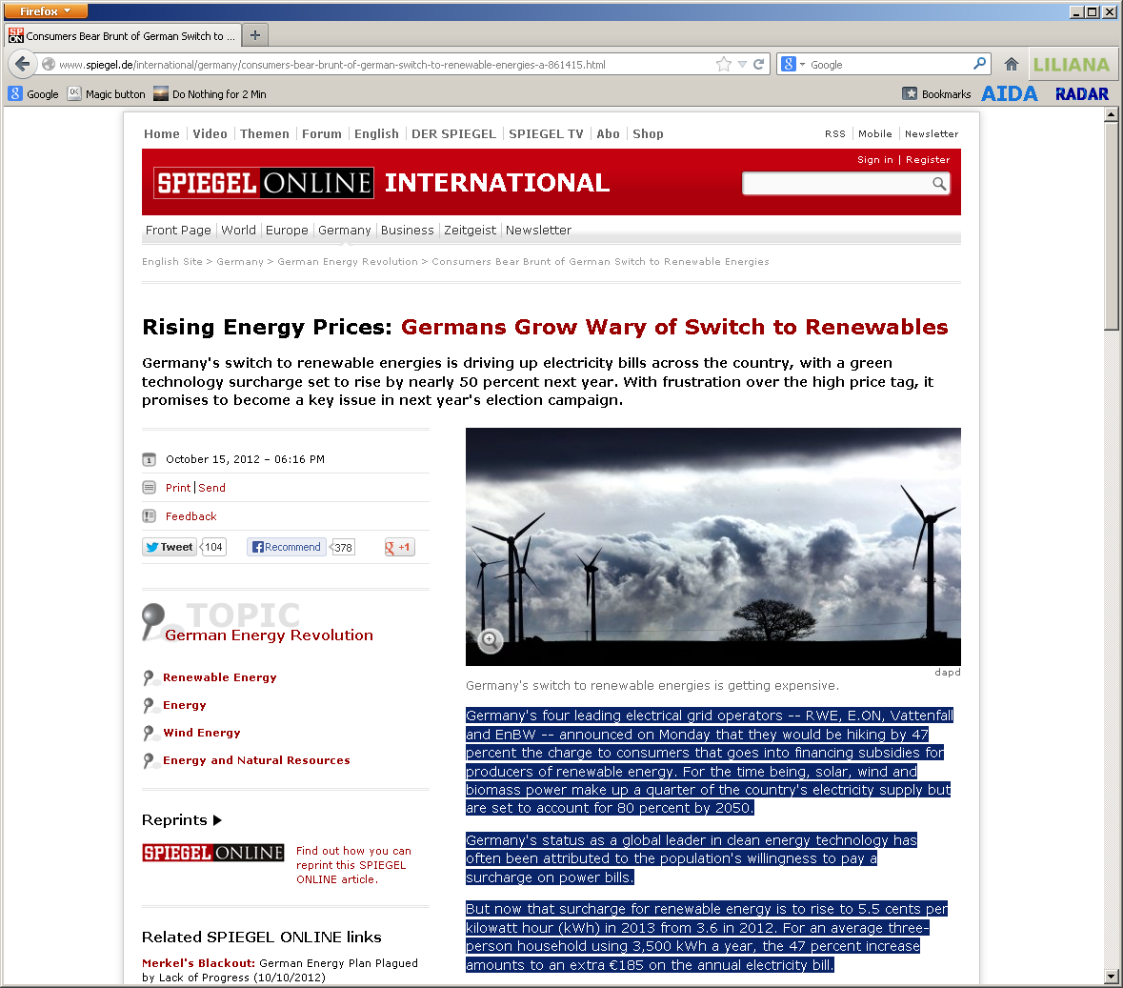
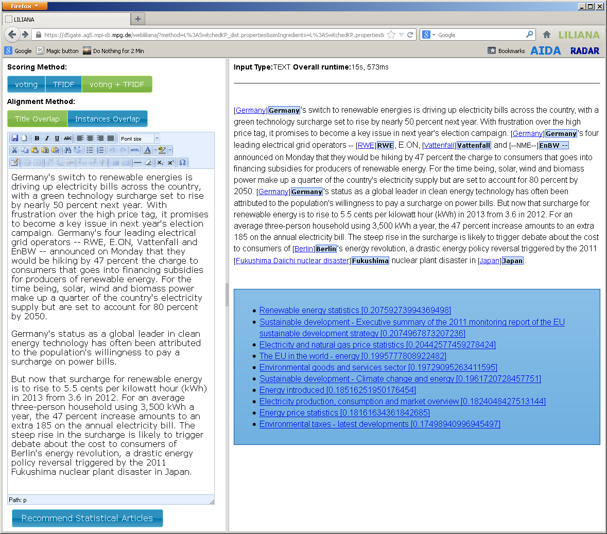

Approach: Knowledge Linking
Dynamic analysis of input text
Relevance assessment based on
  Textual similarity
  Entity-level similarity
Provision of encyclopedic background information

Slide 42
Outline
Challenges and “state-of-the-art”
Entity-level temporal Web analytics
  Named entity disambiguation
  Temporal fact extraction
  Entity type classification
  Emerging concept identification
  Knowledge linking
  Reference architecture
Conclusions
Challenges and “state-of-the-art”
Entity-level temporal Web analytics
  Named entity disambiguation
  Temporal fact extraction
  Entity type classification
  Emerging concept identification
  Knowledge linking
  Reference architecture
Conclusions

Slide 43
Architecture for Temporal Web Analytics
Application Layer
Analytics Layer
Visualization
Named Entity
Analytics
User Interfaces
Classification
Knowledge Linking
Graph Analysis
ETA Layer
Rich Annotation
Transformation
Data Extraction
Web-Scale Crawler
Query Processing
Capturing Social
Streams & Media
Indexing
Raw Web Contents (WARC’s)
Distributed Storage
Weikum et al. [CIDR 2011]
Spaniol et al. [WWW 2012]
Capture Layer
Management Layer

Slide 44
Data Management
Scale-out distributed platform (HBase)
Keypath data is a multidimensional map
<row_id, column_family, column_qualifier, timestamp>
Row Key | Content
Page Id (URI & Timestamp)
 | e.g. Mime type, length, etc. | Web document | Mentions and entities | Plain article, templates, etc.
Meta
Content
NED
Boilerpipe

Slide 45
Indexing
Lucene-based indexing via ElasticSearch
Map-reduce jobs for index construction
Indexes capture
  Page title
  MIME type
  Page full text
  Entities in page
  Time

Slide 46
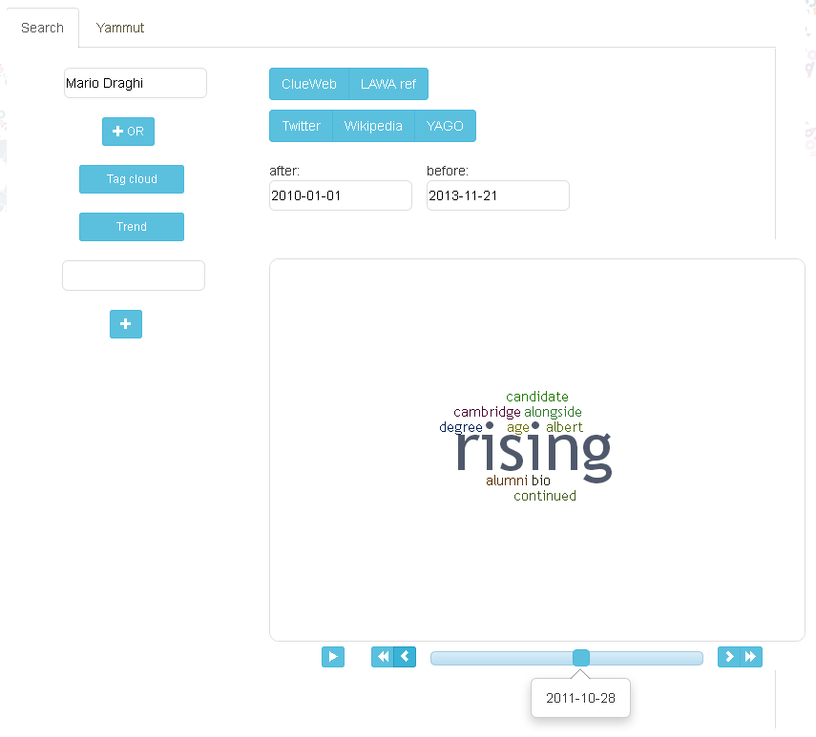
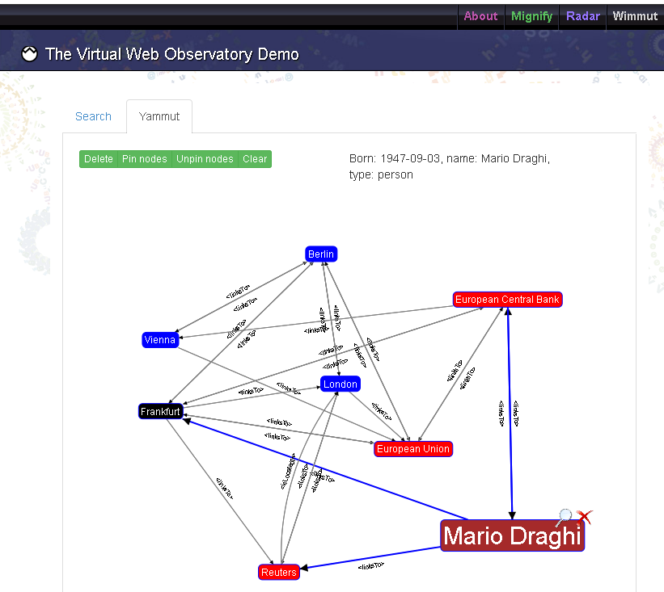
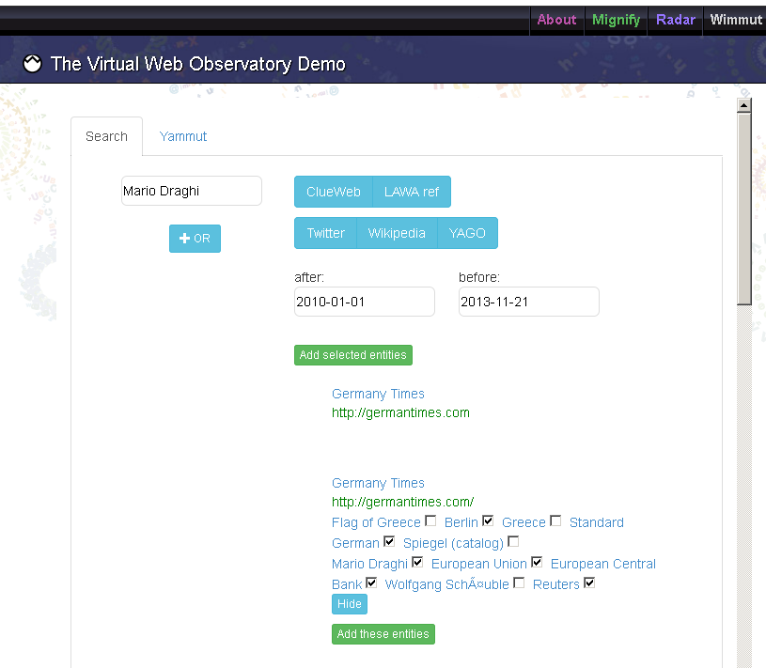
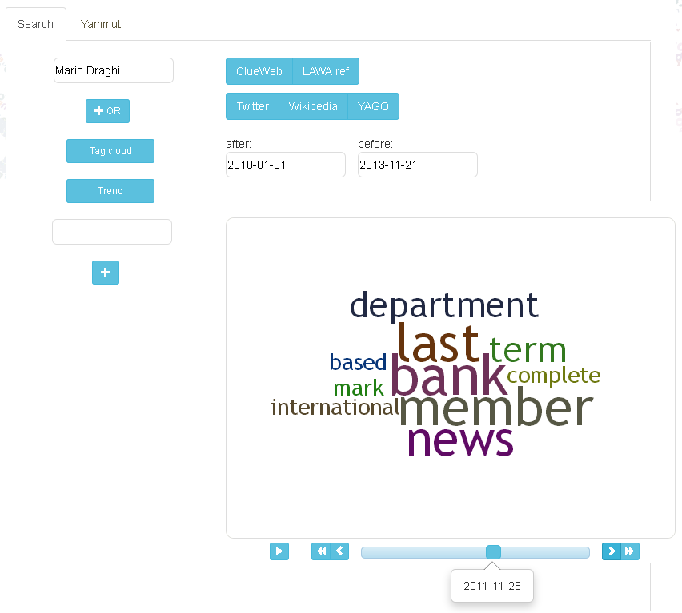
Interfaces to Big Web Archive Data
Entity Querying
Entity Visualization
Temporal Trends

Slide 47
Outline
Challenges and “state-of-the-art”
Entity-level temporal Web analytics
  Named entity disambiguation
  Temporal fact extraction
  Entity type classification
  Emerging concept identification
  Knowledge linking
  Reference architecture
Conclusions
Challenges and “state-of-the-art”
Entity-level temporal Web analytics
  Named entity disambiguation
  Temporal fact extraction
  Entity type classification
  Emerging concept identification
  Knowledge linking
  Reference architecture
Conclusions

Slide 48
Conclusions
The Web of the Past is as important as the Web of the Future
Big Web archive data
  Learn from the past and anticipate the future
  Reveals the cultural and political zeitgeist
  Huge potential for analysts
Entity-level temporal Web analytics
  Groups and aggregates from text to entities
  Supports entity-level (semantic) knowledge linking
  Makes sense of (noisy) Web archive data
The Web of the Past is as important as the Web of the Future
Big Web archive data
  Learn from the past and anticipate the future
  Reveals the cultural and political zeitgeist
  Huge potential for analysts
Entity-level temporal Web analytics
  Groups and aggregates from text to entities
  Supports entity-level (semantic) knowledge linking
  Makes sense of (noisy) Web archive data
The Web of the Past is as important as the Web of the Future
Big Web archive data
  Learn from the past and anticipate the future
  Reveals the cultural and political zeitgeist
  Huge potential for analysts
Entity-level temporal Web analytics
  Groups and aggregates from text to entities
  Supports entity-level (semantic) knowledge linking
  Makes sense of (noisy) Web archive data
The Web of the Past is as important as the Web of the Future
Big Web archive data
  Learn from the past and anticipate the future
  Reveals the cultural and political zeitgeist
  Huge potential for analysts
Entity-level temporal Web analytics
  Groups and aggregates from text to entities
  Supports entity-level (semantic) knowledge linking
  Makes sense of (noisy) Web archive data

