Slide 1
Popularity and quality in social media
Luca Maria Aiello
School for advanced sciences of Luchon, Summer 2015

Slide 2
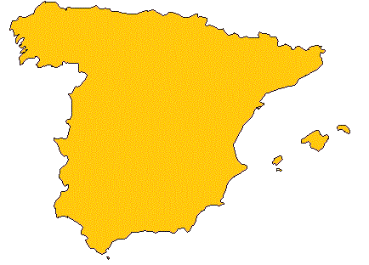
Who’s this guy?

Slide 3
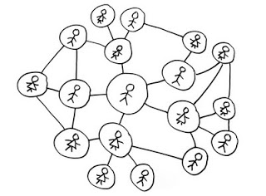
Social media

Slide 4
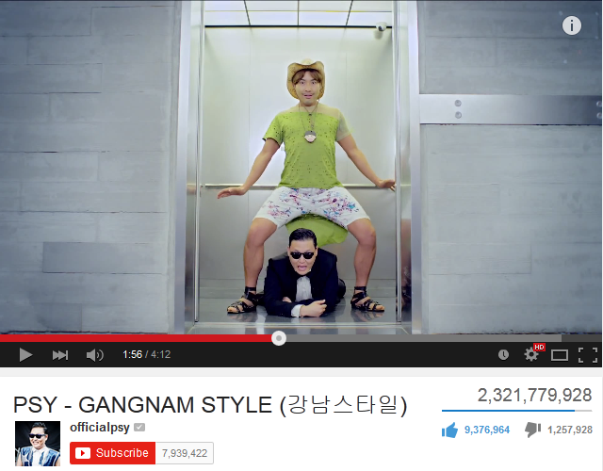
Popularity in social media
$$$
$$$

Slide 5
Popularity ≠ Quality
Exploitation of social norms
Bias of active local communities
Human biases in perception
Limited exposure

Slide 6
Popularity by social norm exploitation
or:
how to leverage social communication to gain power

Slide 7
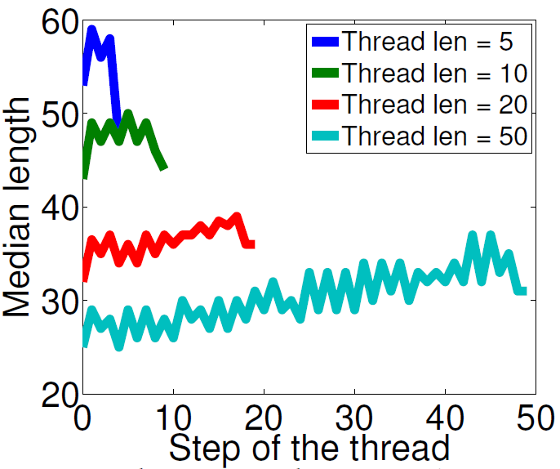
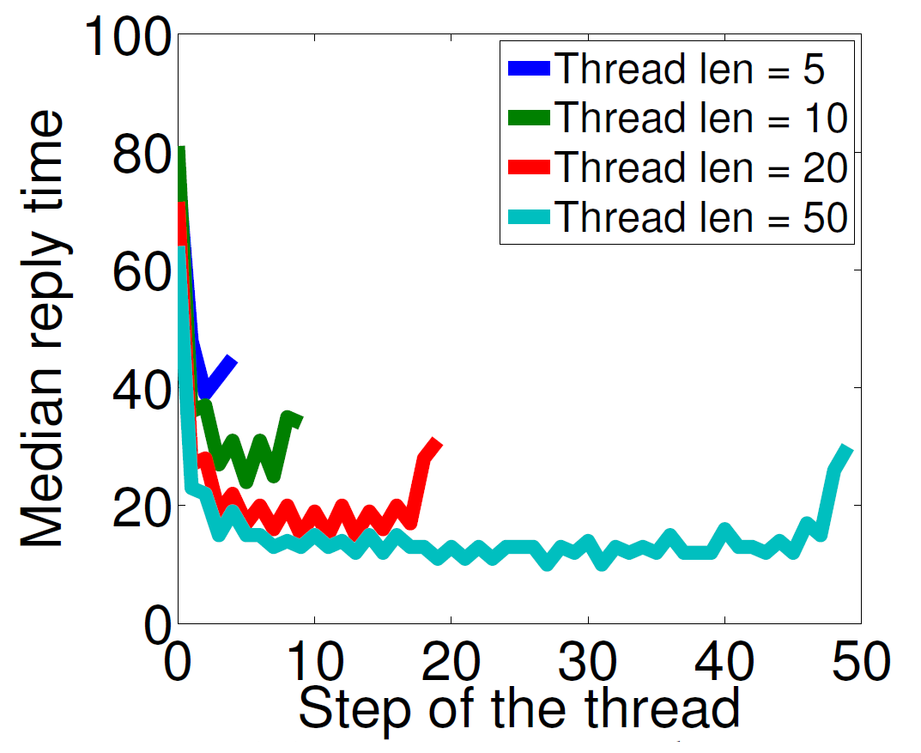
Social norms
We follow norms in our everyday social interaction (more than we imagine)
Yahoo Email
Kooti et al. “Evolution of Conversations in the Age of Email Overload”, WWW 2015

Slide 8
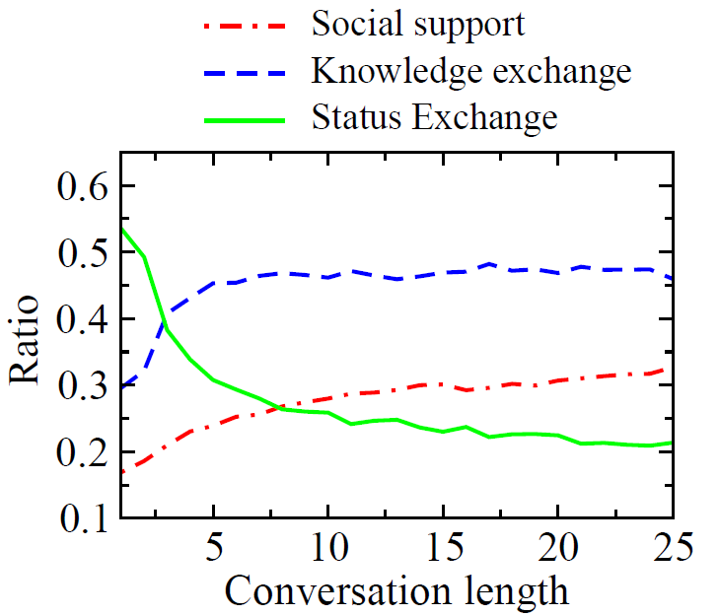
Social norms
We follow norms in our everyday social interaction (more than we imagine)
Aiello et al. “Reading the Source Code of Social Ties”, WebSci 2014

Slide 9
If you want to be popular,
know the social norm

Slide 10
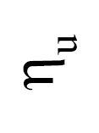
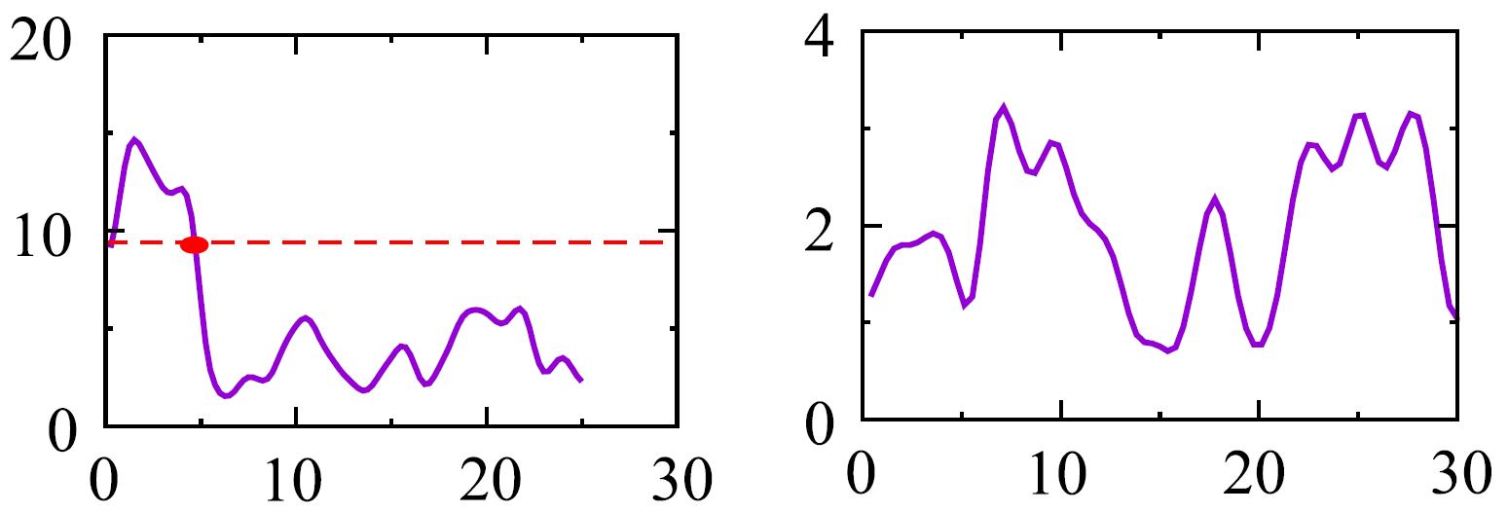
Interaction norms to gain popularity
Peak
Increasing
Decreasing
Stable
Time
Time
Efficiency (likes per post) in time, for different classes of Yahoo Meme users

Slide 11
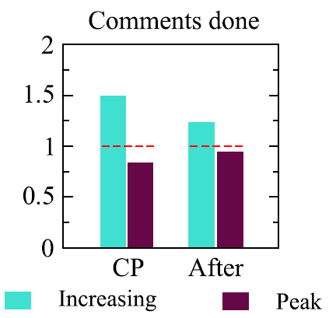
What sustains popularity?
Change Point (CP)
Before
After
Increasing
[CP|After] / Before
Peaky
Activity(After) /Activity(Before)
Activity(CP) / Activity(Before)
Vaca et al. “Modeling dynamics of attention in social media with user efficiency”, EPJ’14

Slide 12
If you want to be popular,
know the social norm
defy

Slide 13
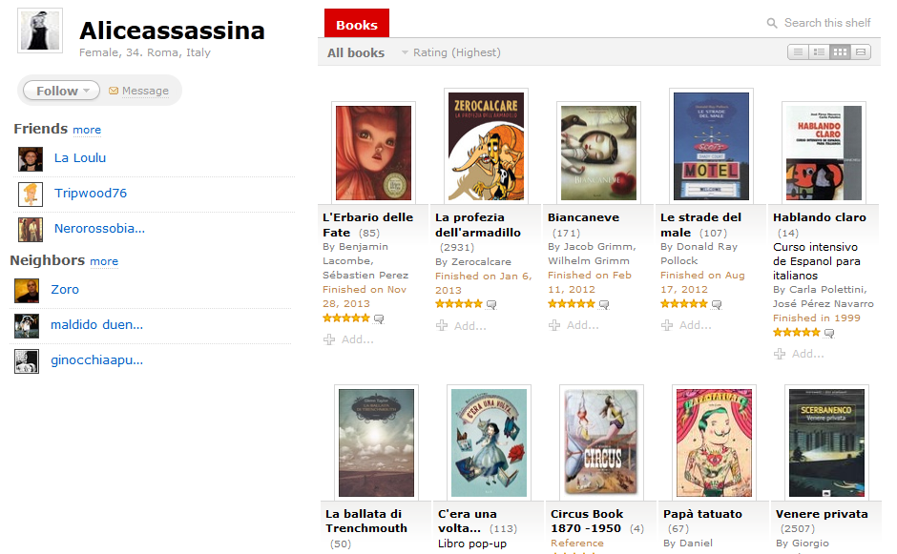
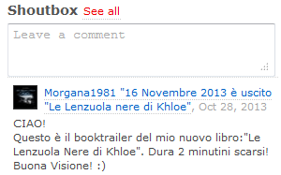
aNobii.com

Slide 14
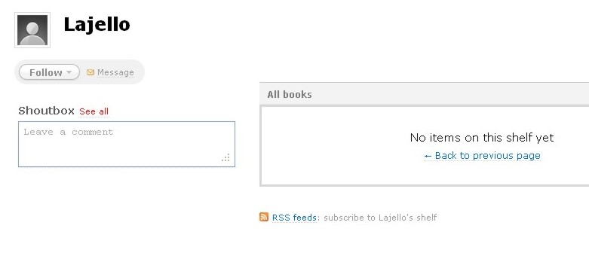
Crawling with lajello bot

Slide 15
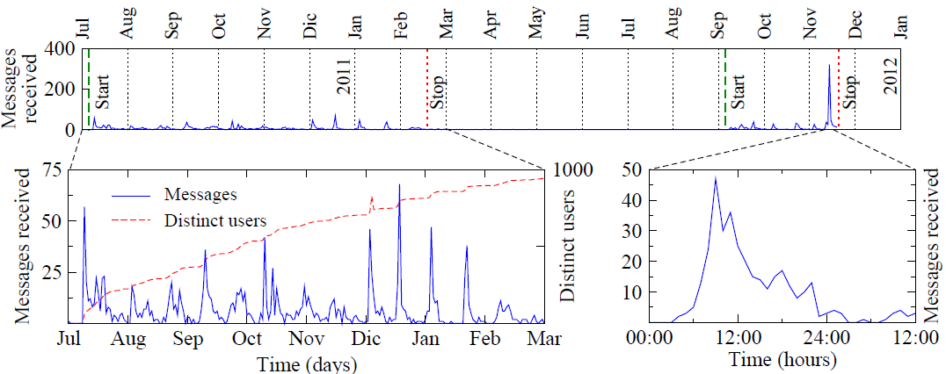
Gain of popularity
Social bot (“lajello”) acquiring popularity by “probing”
Activity → popularity

Slide 16
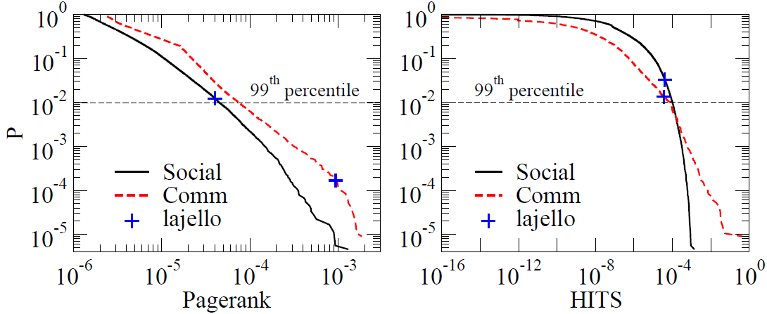
Gain of popularity
2,435 public messages
1,263 different users
>200 private messages
>66,000 profile visits
211 incoming connections

Slide 17
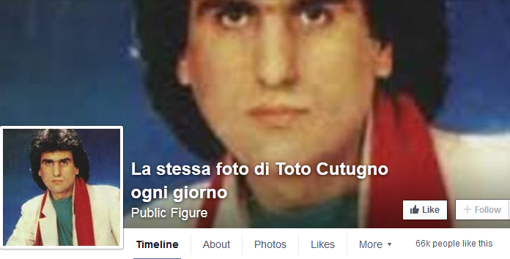
Toto Cutugno on Facebook
Bessi et al. “Everyday the Same Picture: Popularity and Content Diversity”. ArXiv, 2015

Slide 18
Reputation and influence
Left a personalized comment in the shoutbox of 2000 users
52% followed the “who to follow” recommendation
Only 10% among the non-followers

Slide 19
Emotional reaction

Slide 20
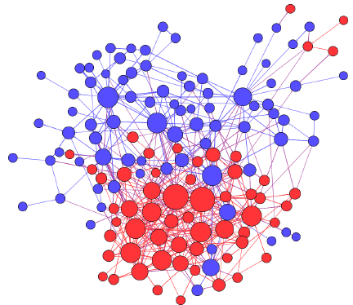
Polarization
Visualization of nodes subscribed to groups “hands-off lajello” and “the (non-requested) suggestions of lajello”

Slide 21
Popularity by LOCAL acclaim
or:
popular locally, popular everywhere (if your community is loud enough)

Slide 22
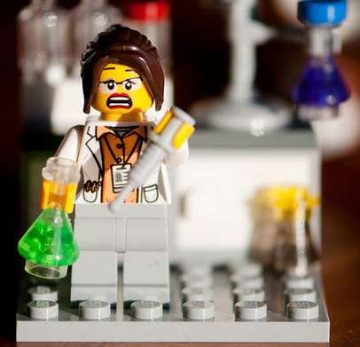
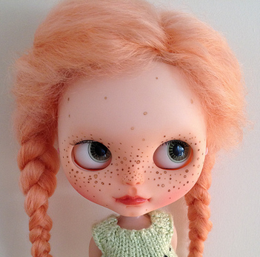
Most viewed Flickr photos in 2012

Slide 23
Browse Graph
Nodes are pages
Edges are aggregated browsing transitions
Centrality is a “good” indicator of content interestingness
External layers add useful information
“Scary house”
community

Slide 24
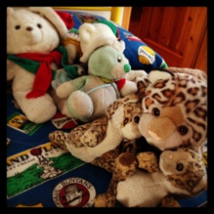
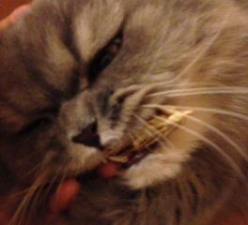
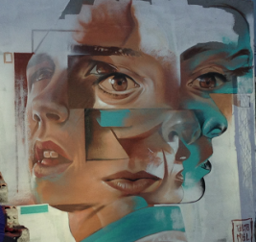
Flickr browsegraph
Flickr browsing data
2 months, 10M users, 50M nodes, 300M pageviews
Comparison with PageRank (no external nodes), Favorites, Clicks, View time
High quality
Higher topical variety
Surfaces photos related to real world events or interesting but not popular
Trevisiol et al. “Image Ranking Based on User Browsing Behaviour” SIGIR 2012

Slide 25
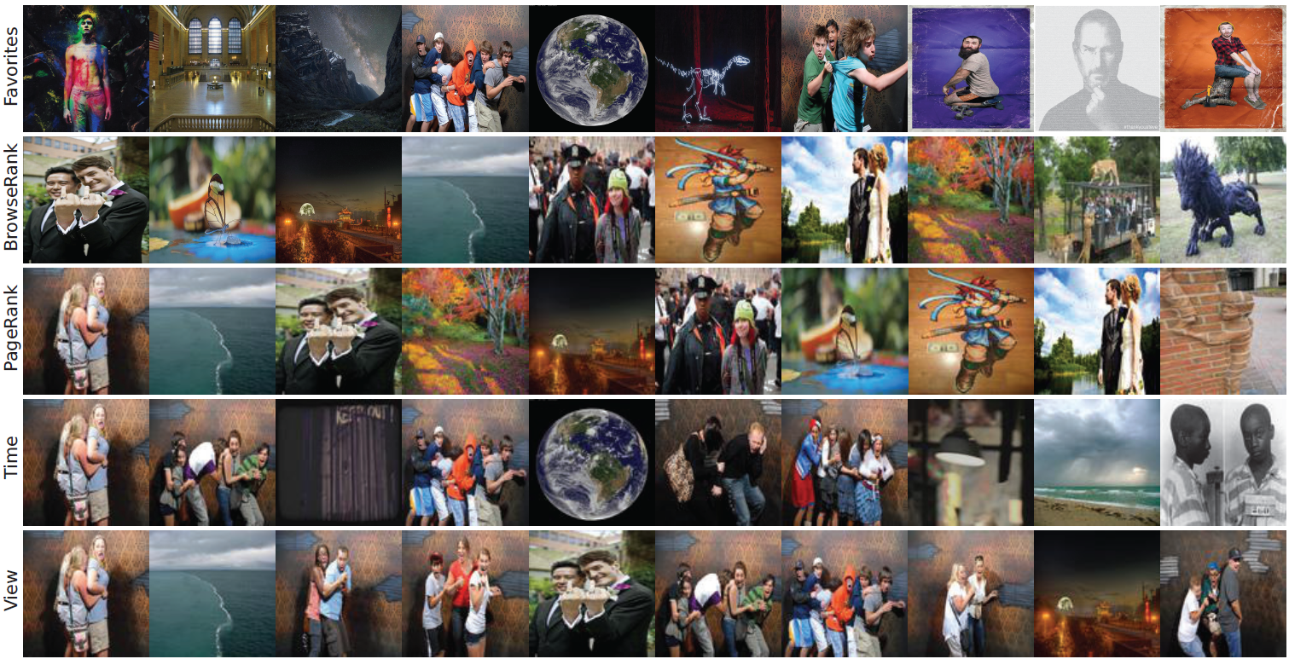
Top 10 photos
Art
Niche
Events
Odd

Slide 26
Bias in quality assessment
or:
your perception of quality changes based on your prior experience

Slide 27
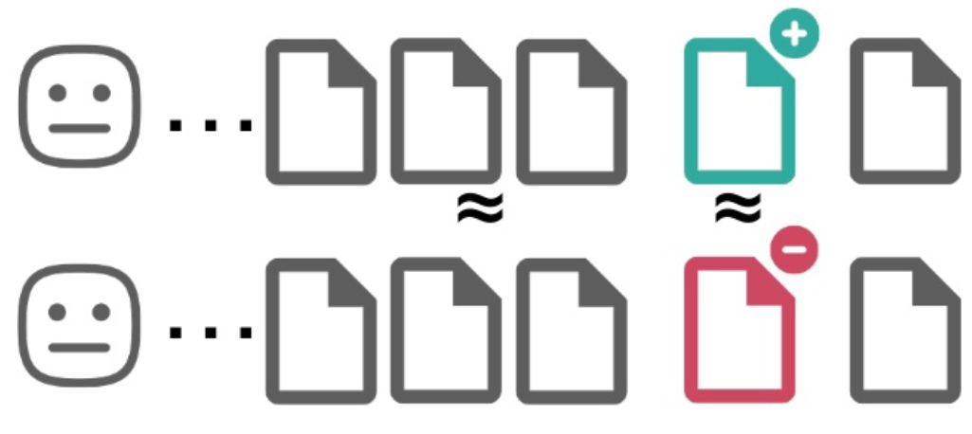
Bias in quality assessment
No bias
User assessment
-
Post Quality
Community bias
Negative bias
Cheng et al. “How Community Feedback Shapes User Behavior”, ICWSM 2014

Slide 28
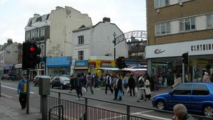
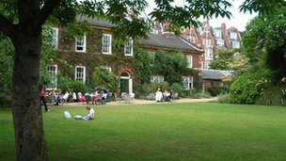
Image quality assessment
A
B
Quercia et al. “The shortest path to happiness: Recommending beautiful, quiet, and happy routes in the city”, HT 2014

Slide 29
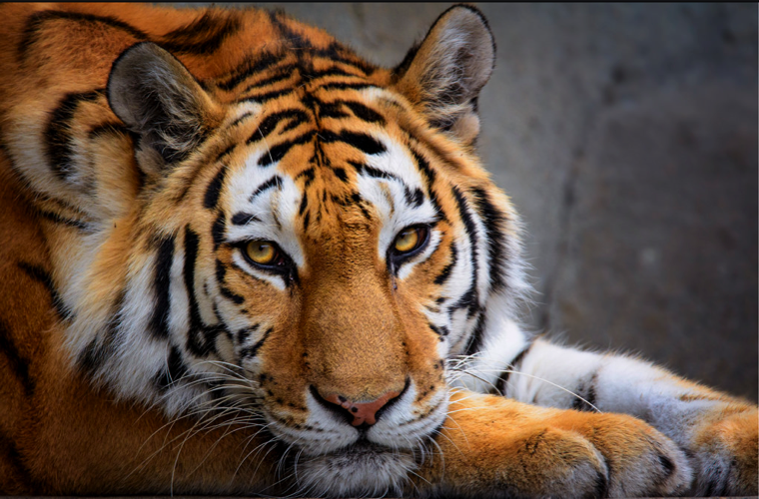
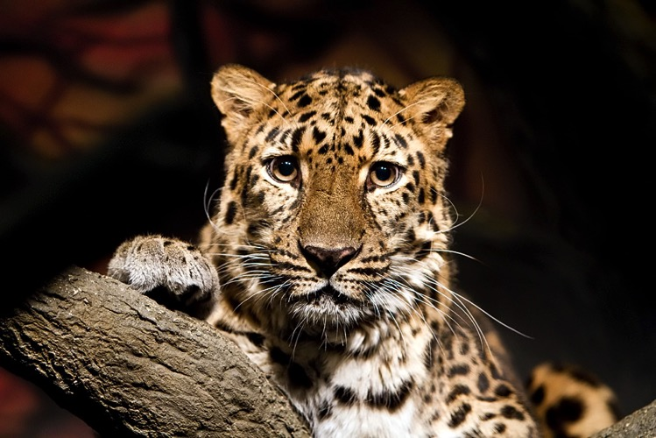
A
B
favorites
comments
views
686
45
18,475
favorites
comments
views
3
1
190

Slide 30
Limited exposure
or:
No matter how good your content is, it won’t attract attention if it is not advertised

Slide 31
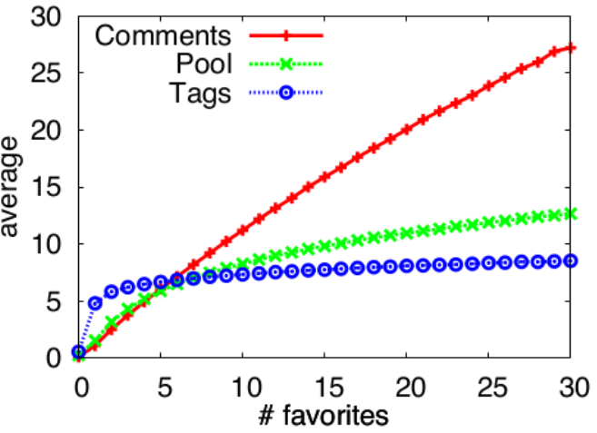
Unpopular items are difficult to index
Flickr 100M

Slide 32
2%
≥ 6
98%
≤5
Flickr 100M
Notes:
Analyzing a larger set of photos, in our case the 100M creative commons Flickr dataset, we found that only 2% of the pictures have more than 5 favorites while the remaining 98% have five or less (more than a half of the pictures have at most 1 favorite). As expected, the vast majority of the content shared lies below the surface of attention.

Slide 33
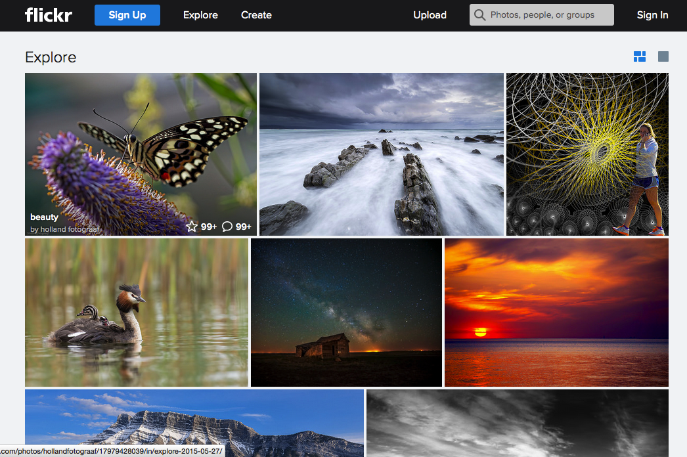
99+
favorites
Notes:
While exploratory interfaces like the Flickr Explorer page tend to promote very appealing photos that turned out to be very popular, in fact the top ones have more than 100 favorites

Slide 34
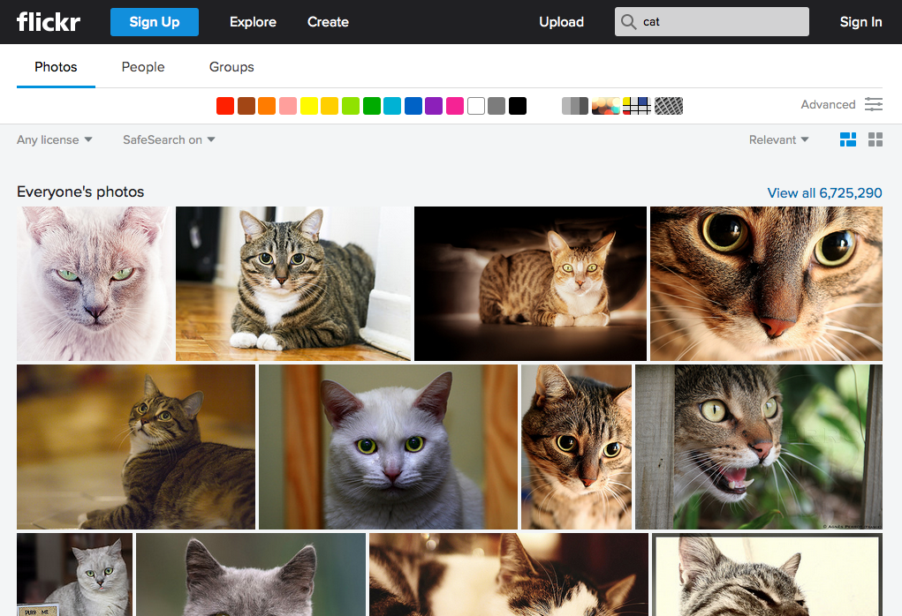

Slide 35
Flickr 100M
Notes:
what happens to the unpopular content? Is it possible that all those 98M pictures do not deserve attention?

Slide 36
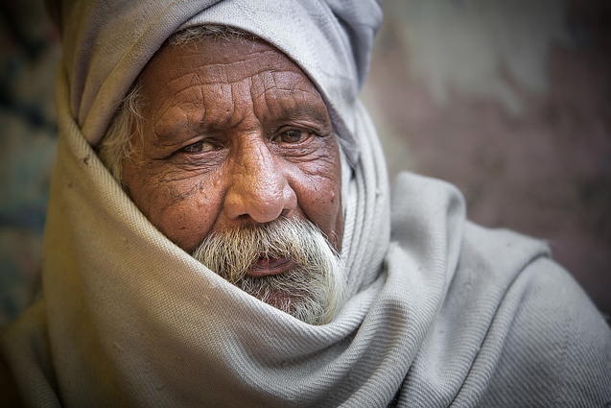
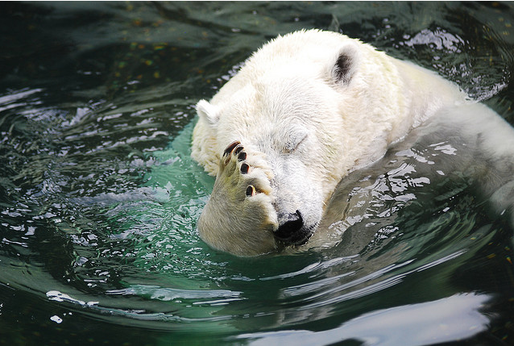
10K photos
Full popularity range
Notes:
We sampled 10K images within 4 topical categories (nature, urban, people and animals). In order to automatically classify images in the four categories we used Flickr machine tags, that are tags assigned by a computer vision classifier trained to recognize the type of subject depicted in a photo (e.g., a bird or a tree). We manually group the most frequent machine tags in those topically-coherent macro-groups. We introduced categories in order to reduce the bias in comparing aesthetics of pictures with completely different subjects, for example a spider and a church.
Because we want to see how quality varies with popularity within each category we randomly sample popular, average popular and unpopular pictures.

Slide 37
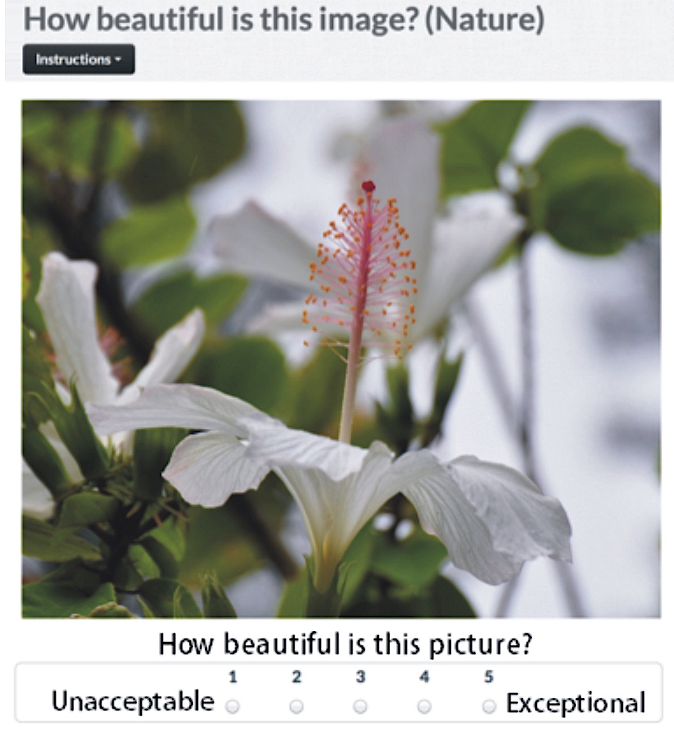
Crowdsourcing image aesthetics judgments
Schifanella et al. “An Image is Worth More than a Thousand Favorites: Surfacing the Hidden Beauty of Flickr Pictures”, ICWSM 2015
Notes:
We design a crowdsourcing task where a user has to evaluate how beautiful is an image on a 5-grade scale. We ask at least 5 independent judgments per image.

Slide 38
Instructions
Examples for each score
Evaluate the beauty of the picture, NOT the beauty of the subject
Notes:
We provide to the workers detailed instructions and concrete examples for each score. Moreover, we asked to judge the beauty of the picture and not the beauty of the subject. In fact, there can be terrible pictures of a cute puppy and great pictures of a carcass of an animal.

Slide 39
Good inter-rater agreement
Notes:
We calculated different inter-rater agreement metrics and we found that consistently the agreement is good despite the difficulty and subjectivity of the task. In fact assessing if a picture is beautiful or not (binary task) is way simpler that guessing an exact score.

Slide 40
Large ground truth of aesthetic scores made by non-expert
http://di.unito.it/beautyicwsm15
10K photos
60K
scores
Notes:
The result of this process is the collection of a large ground truth of aesthetic scores made by non-expert. There are other image aesthetics ground truths out there but they are either small scale or they contains images from photo contest web site like dpchallenge where the quality of the average pictures is higher than online photosharing collections, however for our task we need also examples of low quality pictures that are judged by ordinary user.
The dataset is public under this link.

Slide 41
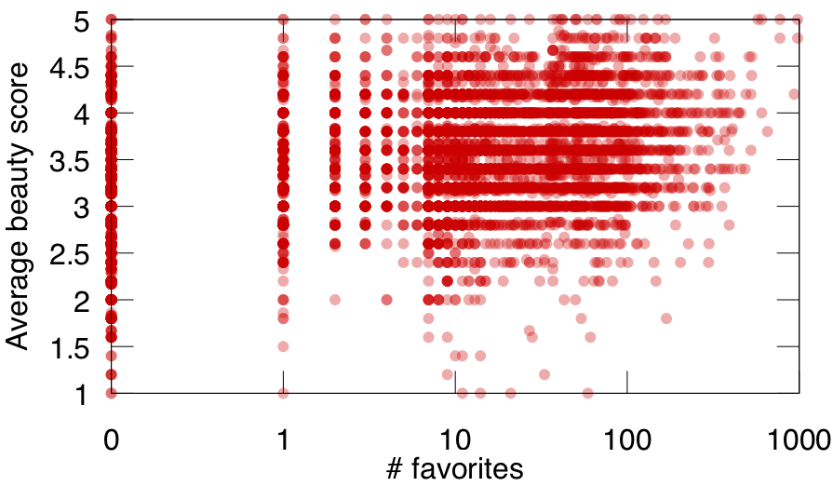
Beauty is all around
popularity ~ beauty (0.43)
Notes:
We plot the number of favorites against the average beauty score and even if there is a positive correlation between popularity and beauty (that means on average popular pictures are perceived as appealing)

Slide 42
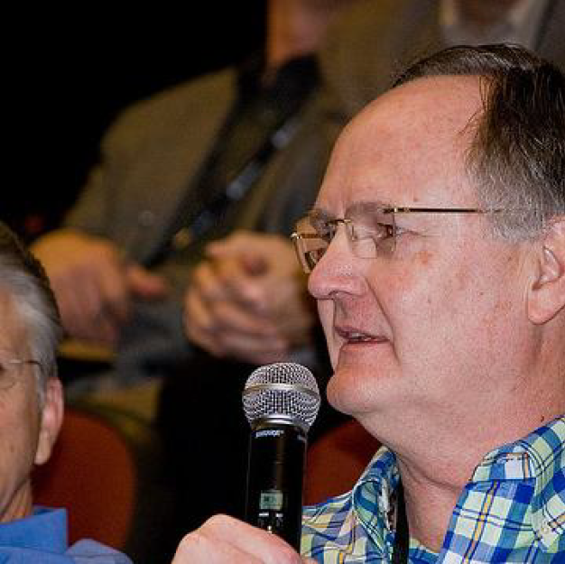
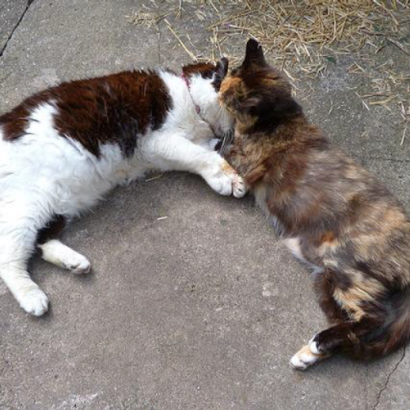
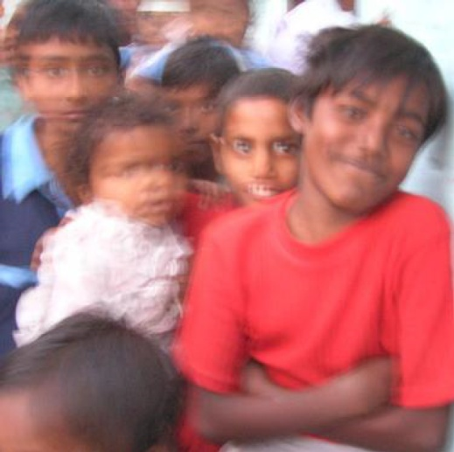
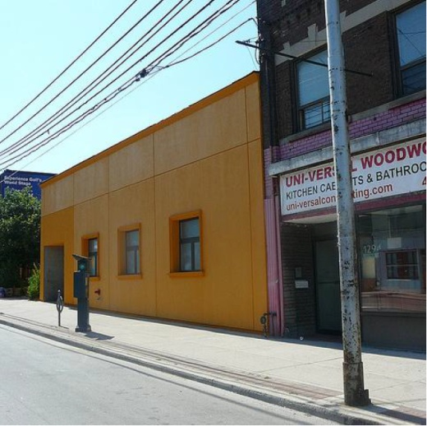
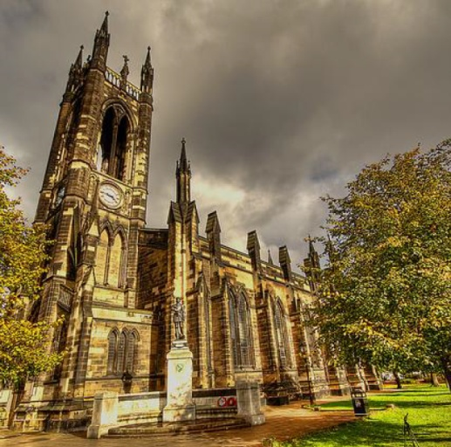
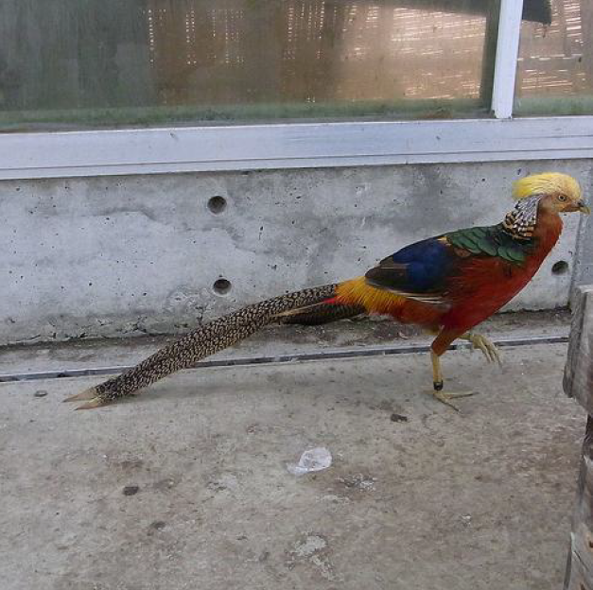
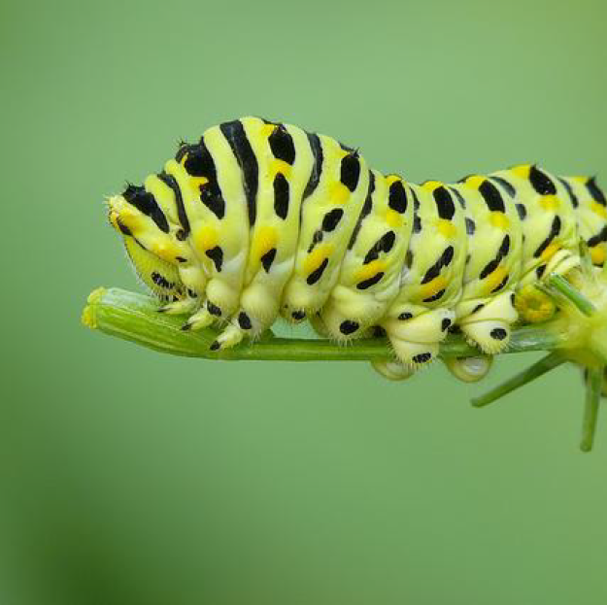
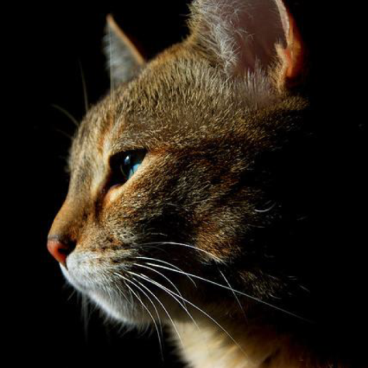
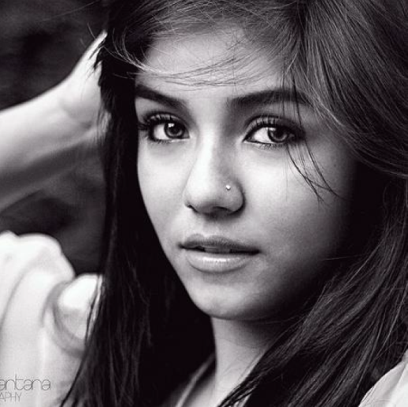

Slide 43
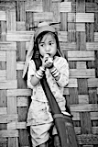
Crowd Beauty
Photographic Rules
COMPOSITIONAL VISUAL FEATURES
CROWDSOURCED DATASET
PARTIAL LEAST SQUARES REGRESSION
Schifanella et al. “An Image is Worth More than a Thousand Favorites: Surfacing the Hidden Beauty of Flickr Pictures”, ICWSM 2015
Notes:
A possible solution is to look at the pixels. To surface the high-quality content we use the crowdsourced dataset to learn a computational aesthetic framework based on compositional visual features that model photographic rules used by photographers to shoot beautiful pictures. Examples of features are related to color (contrast, hue, saturation, brightness, …), spatial arrangement (symmetry, rule of thirds, …), or the texture of an image. Such framework is able to automatically score images according to their aesthetic value. We called it CrowdBeauty

Slide 44
Evaluation on 9M Flickr pictures
Average beauty score
Notes:
The results show that consistently across categories, the perceived beauty of the surfaced images is comparable to the most popular photos (look at the blue and the green bars). In two cases (nature, animals) we also outperformed the popular ones. The random sample of the unpopular pictures (red bars) always performed worse as expected.

Slide 45
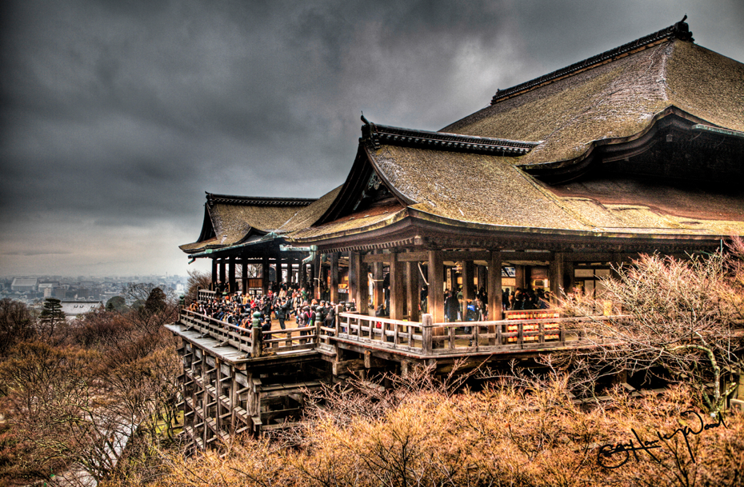
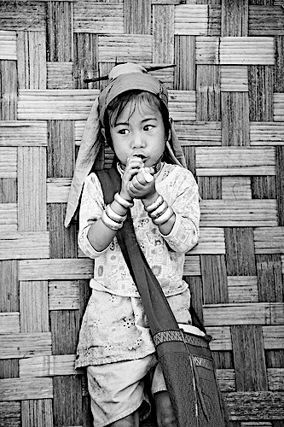
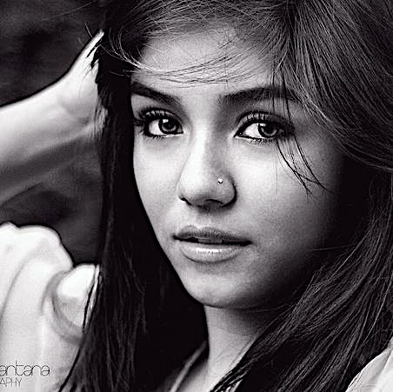
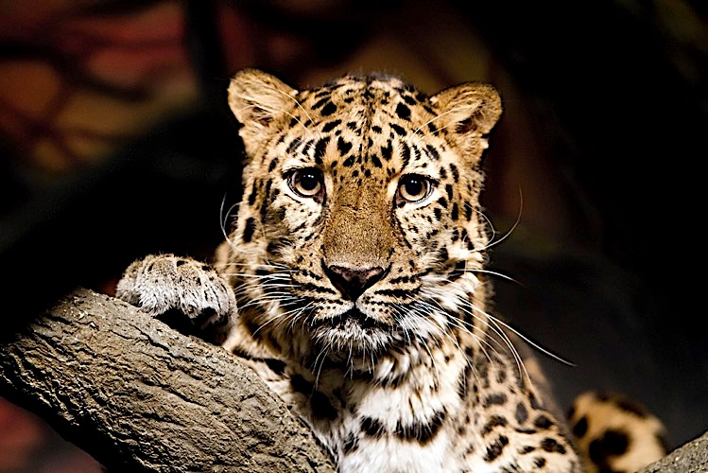
Notes:
This is a sample of pictures we surfaced with our CrowdBeauty algorithm. Look at them, they would probably remain unseen without it.
Unfortunately we cannot do anything for your papers, but if you are a talented photographer, we can help you to get the attention you deserve.
Thank you!

Slide 46
summary
Exploitation of social norms
Bias of active local communities
Human biases in perception
Limited exposure

Slide 47
Reading list
Aiello et al. “People are Strange when you're a Stranger: Impact and Influence of Bots on Social Networks”, ICWSM 2012
Trevisiol et al. “Image Ranking Based on User Browsing Behavior”, SIGIR 2012
Vaca-Ruiz et al. “Modeling dynamics of attention in social media with user efficiency”, EPJ Data Science 2014
Cheng et al. “How Community Feedback Shapes User Behavior”, ICWSM 2014
Aiello et al. “Reading the Source Code of Social Ties”, WebSci 2014
Quercia et al. “The shortest path to happiness: Recommending beautiful, quiet, and happy routes in the city”, HT 2014
Schifanella et al. “An Image is Worth More than a Thousand Favorites: Surfacing the Hidden Beauty of Flickr Pictures”, ICWSM 2015
Bessi et al. “Everyday the Same Picture: Popularity and Content Diversity”, arXiv 2015
Kooti et al. “Evolution of Conversations in the Age of Email Overload”, WWW 2015

Slide 48
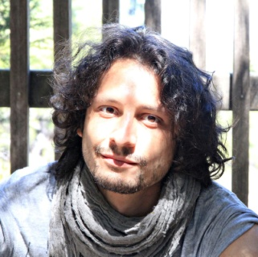
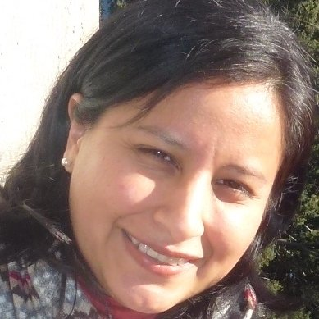
Collaborators
Michele
Trevisiol
Luca
Chiarandini
Carmen
Vaca
Farshad
Kooti
Kristina
Lerman
Bogdan
State
Rossano
Schifanella
Miriam
Redi
Giancarlo
Ruffo
Mihajlo
Grbovic
Amin
Mantrach
Daniele
Quercia

Slide 49
Thank you!
@lajello
www.lajello.com
alucca@yahoo-inc.com

Slide 50
Reasons why popularity != quality
User many biases in quality perception (jure)
Popularity is gained by tapping social norms (lajello story + meme)
Popularity is boosted by small communities (flickr browsegraph)
Limited attention. High quality content has sometimes no way to become popular (pixelbeauty)

Slide 51
Research on popularity
Diffusion models
Factors of popularity/virality (prediction)
Study the history of popular items
Attention to unpopular items too
What is the relation between popularity and quality?
Can we leverage social dynamics to boost content popularity?
How do we promote high-quality content?

