Slide 1
Metabolic networks analysis Application to Food Toxicology
Clément Frainay
PhD Student
Supervisors : Dr Daniel Zalko, Dr Fabien Jourdan
INRA Toxalim (French National Institute of Agronomic Research)

Slide 2
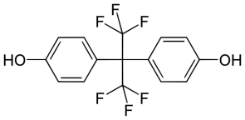
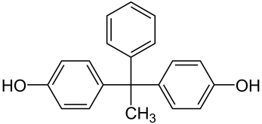
Context Food Toxicology
Toxicology : Study of the adverse effects of chemicals on living systems
Toxicant : toxic substances that are produced by or that are a by-product of human-made activities
Toxic effects are usually due to long time exposure to low dose of toxic substance -> hard to detect
Example : Bisphenol A (BPA), food contaminant with adverse effect on human health^{1,2}
Forbidden in France for use in contact with food since 2015³
… new BPA substitues are coming on the market
Toxic
Toxic ?
Toxic ?
Toxic ?
Toxic ?
BPA
BPS
BPF
BPAF
BPAP
¹ Evaluation des risques du bisphénol A pour la santé humaine. Agence Nationale de Sécurité Sanitaire (report ofthe French food safety agency )
² Cabaton et al. (2013) Effects of low doses of bisphenol A on the metabolome of perinatally exposed CD-1 mice. Environ Health Perspect, 121, 586-93.
³ Law n°2014-1442 du 24/12/12, JORF n°0300 of the 26/12/12 p.20395 text n°2
Notes:
Agences nationales et europ se pose des questions sur l’inocuité des produits de substitutions étant donnée la durée considérable qui à été nécessaire avant d’interdire l’utilisation du BPA

Slide 3
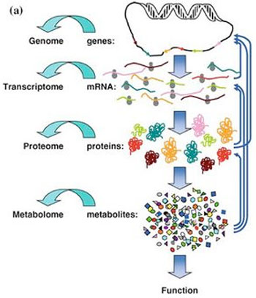
Context Effect of Toxicant on metabolism
Metabolism is the overall process through which living systems acquire and utilize the free energy they need to carry out various functions
Adverse effects of food contaminants can come from perturbations of the metabolism
How to analyze such perturbations?
How to predict adverse effect on human health?

Slide 4
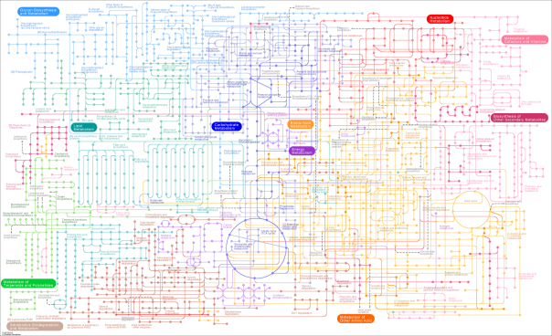
Context Effect of Toxicant on metabolism
Metabolic Network
Nodes : metabolites
Edges : existence of a biochemical reaction consuming the source node and producing the target node
Human global metabolism¹
5064 nodes – 53479 edges
¹ Thiele et al. (2013) A community-driven global reconstruction of human metabolism. Nature Biotechnology, 31(5), 419-25

Slide 5
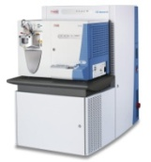
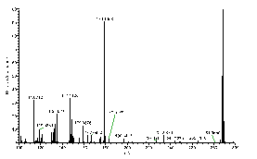
Data
Human Liver Cells
Métabolomic
Control
Biomarker list
BPA
Statistical Analysis
BPS/BPF/BPAP/…
Statistical Analysis
Metabolites identification + Quantification (LC-MS)
Notes:
données disponibles issues du projet anr newplast,
basée sur model vitro de cellules hépatiques humaines exposées au bpa et plusieurs de ses substituants potentiels

Slide 6
Metabolic Network Analysis
Biomarkers list
…
How Biomarkers are connected?
Which biochemical reaction could be affected by the toxicant exposure?
Metabolic network
?
Notes:
confronter les résultats de métabo aux connaissances du métabolisme humain
info synthétisée sous forme de réseaux (représentation simplifiée)
qui représente l’ensemble des interconnexion entre toutes les réactions pouvant s’opérer dans l’organisme (ex cycle krebs, uree…)
localisation des bm ds le réseau
Problématique: comment relier nos bm? -> nbx possibilités, certaines plus vraissemblable que d’autre
nécessité d’une approche de bioinfo pour pouvoir interpréter ce réseau

Slide 7
Metabolic Network Analysis JAVA library
Main implemented Methods :
Dijsktra Shortest Paths
Yen K-Shortest
A*
Steiner Tree
Random Walk betweenness
Personalized PageRank
…
Several modifications needed to guarantee biochemical relevance of the results

Slide 8
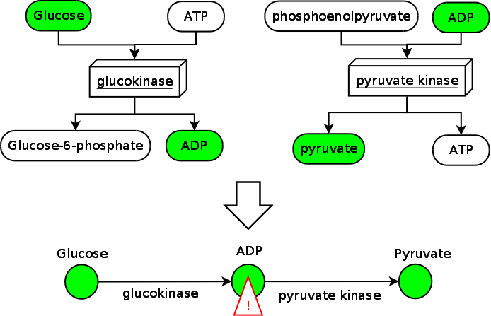
Metabolic network’s specific issues
Side compounds

Slide 9
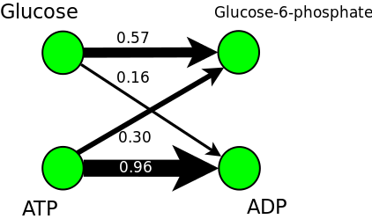
Metabolic network’s specific issues
Side compounds
Using chemical similarity or atom mapping to avoid side compounds

Slide 10
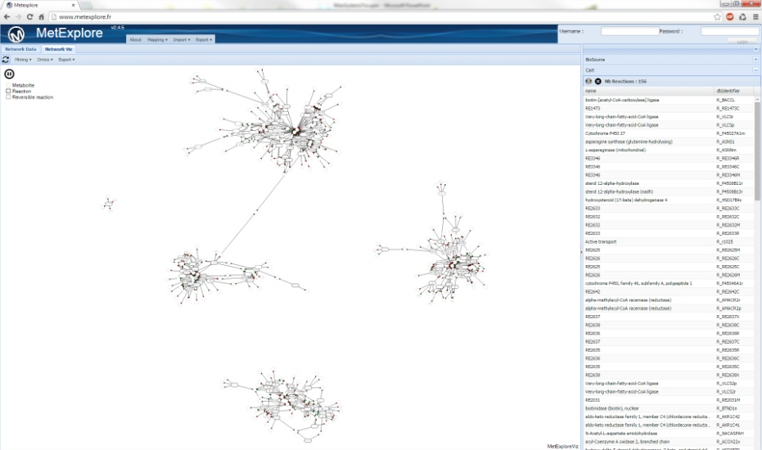
Metabolic Network Analysis Metexplore Web Server
www.metexplore.fr
A web server for the analysis of omics data in the context of metabolic networks
Multi-Omics inputs
Open Access
Genome scale network reconstruction and annotation
Visualization facilities

Slide 12
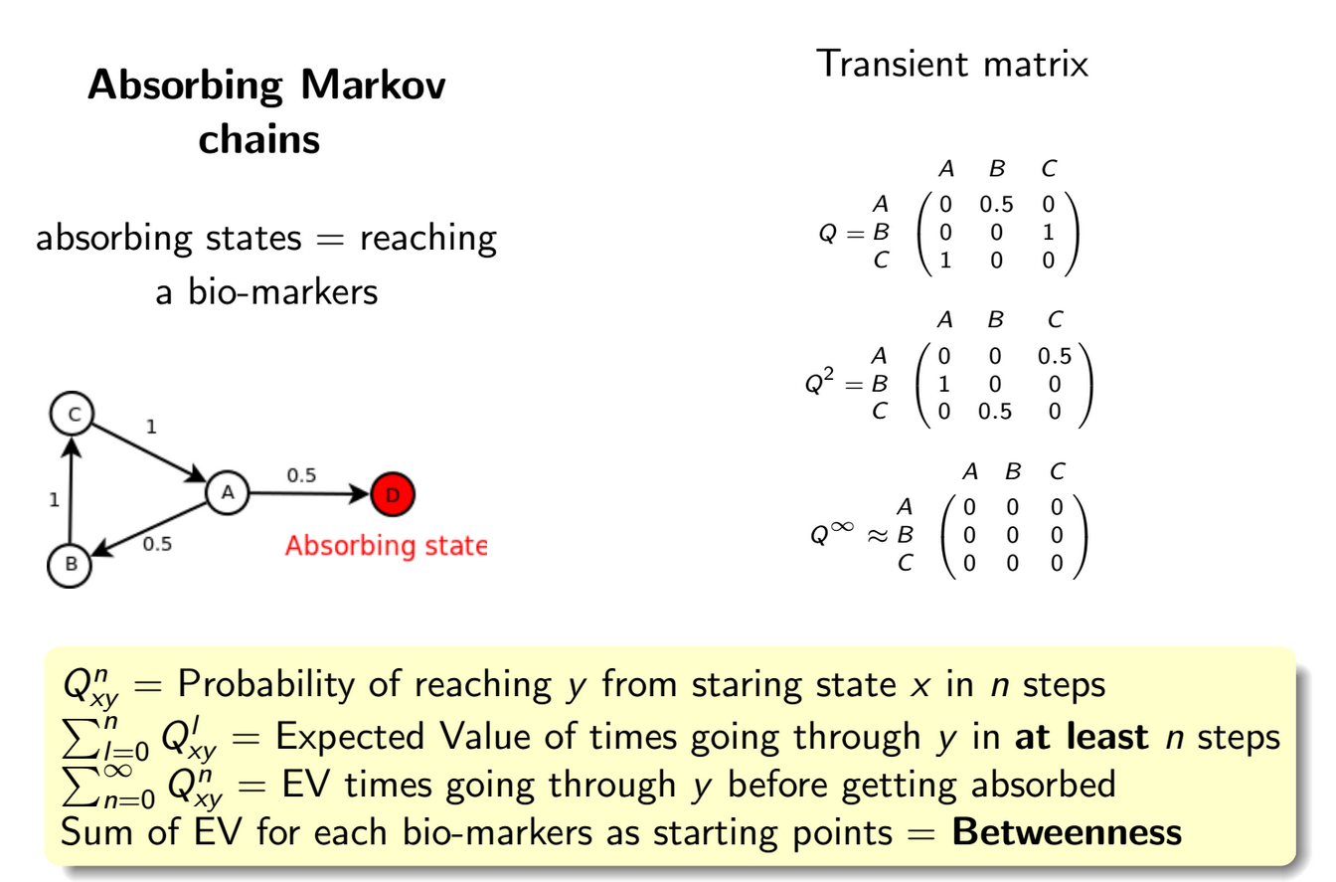
Relevant sub-network extraction
Random walk betweenness centrality

Slide 13
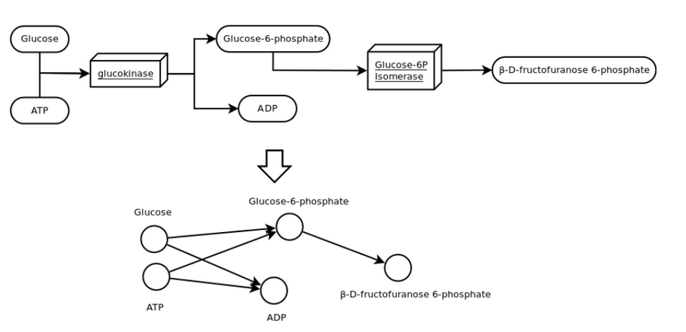
Compound graph

